Slide 1
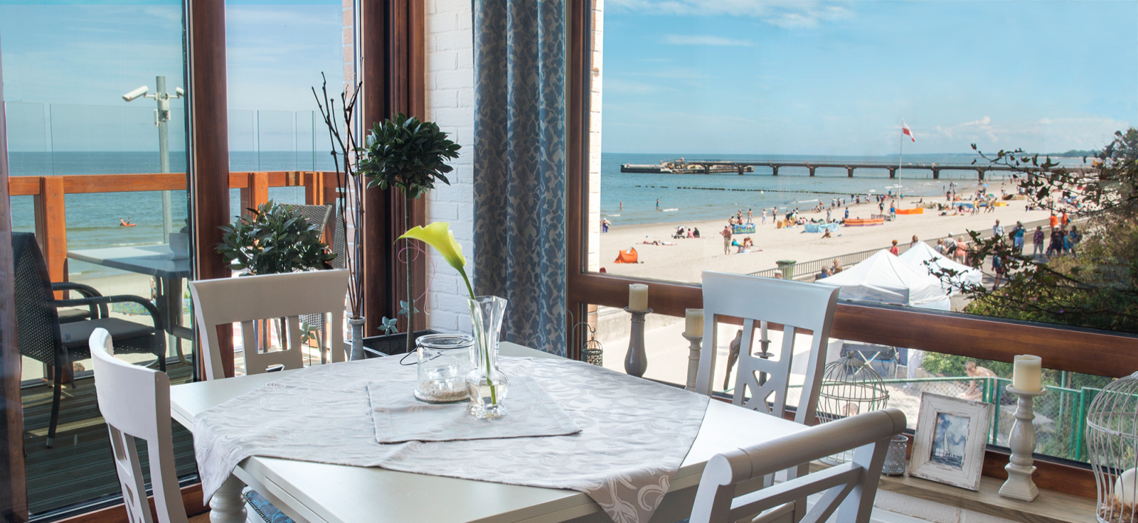
Delasea Restaurant
Alicja Bednarczyk
Notes:
Prezentacja zawiera lokowanie produktu

Slide 2
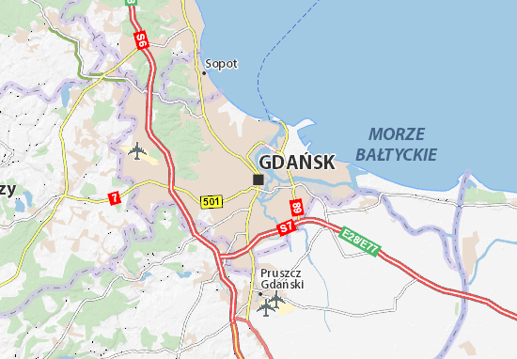
Location of Gdańsk
Gdańsk is situated in Pomerania region
It’s a city in the north of Poland, situated at the Baltic Sea at the Motlava River, at Gdańsk Bay
Gdańsk is famous for its tourists attractions

Slide 3
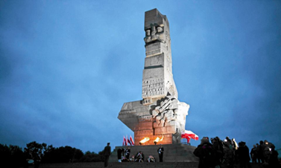
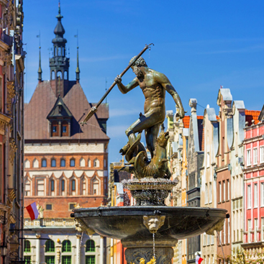
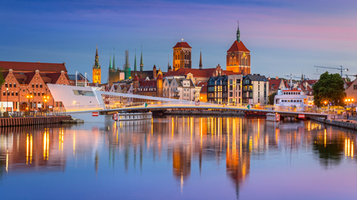
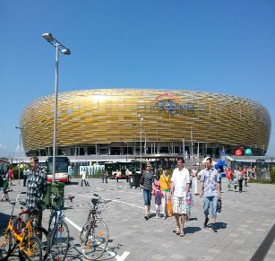
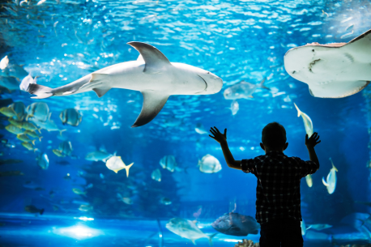
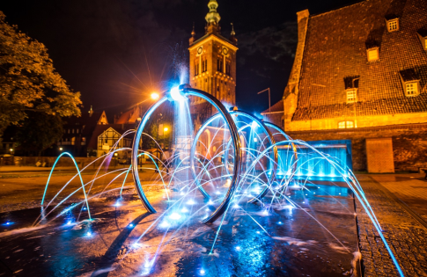
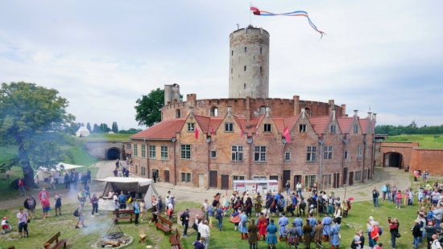
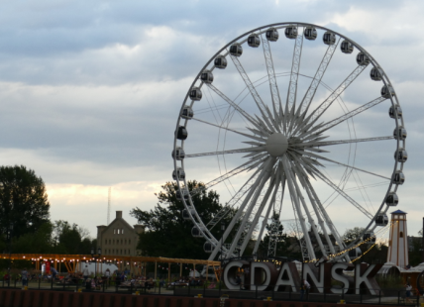
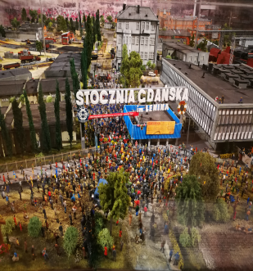
Westerplatte monument
Neptune Monument
Old Town and Motlava River
PGE Arena
Hevelius fountain
Wisłoujście

Slide 4
Delasea

Slide 5
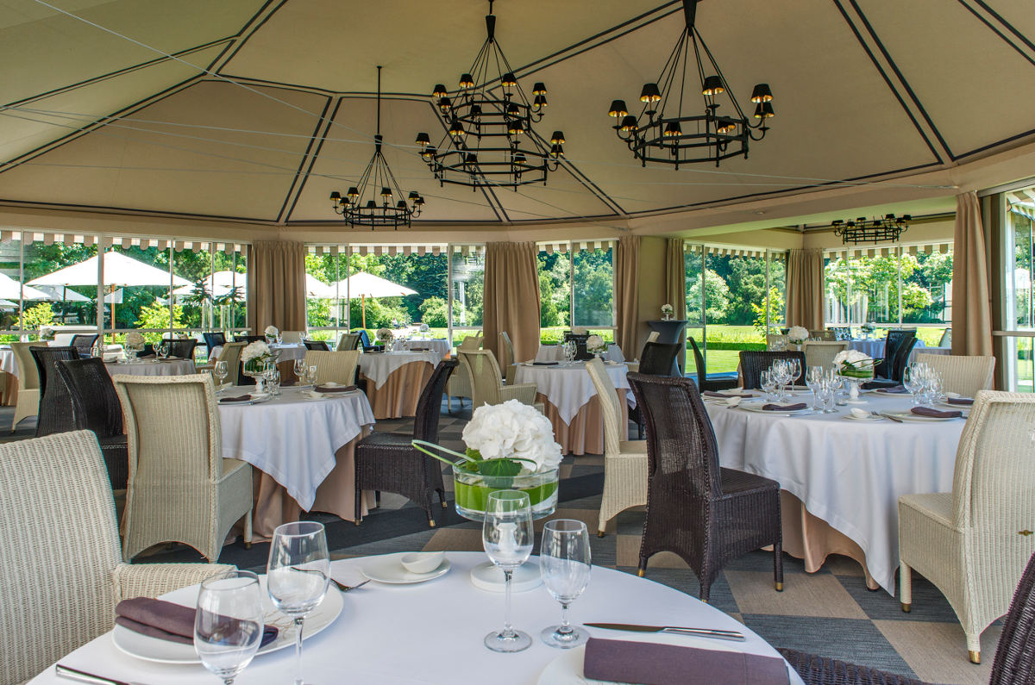
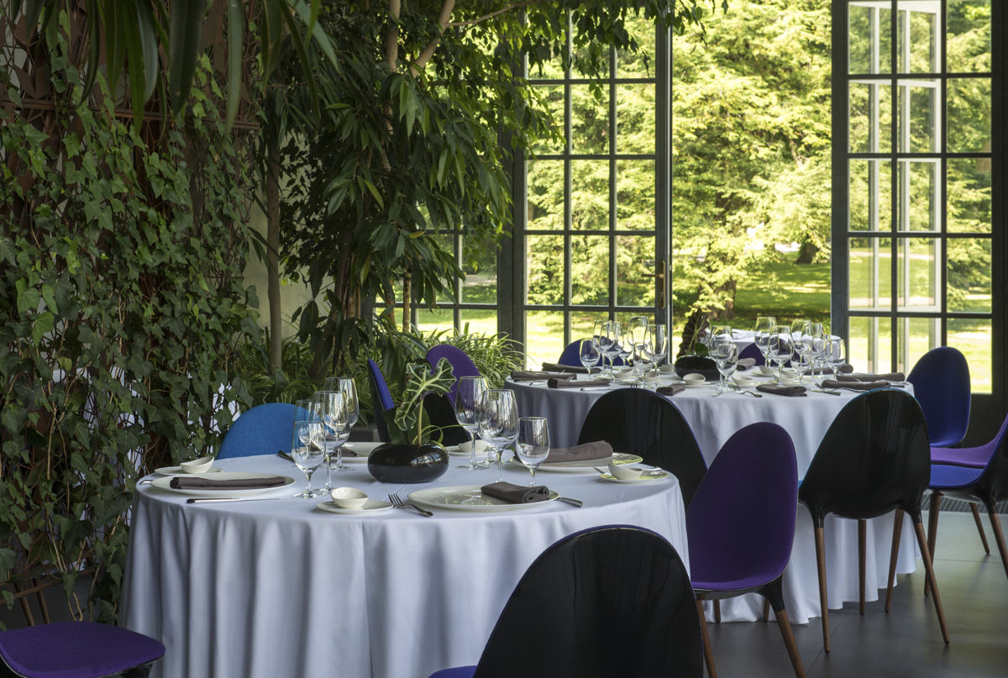
Decor
of the place

Slide 6
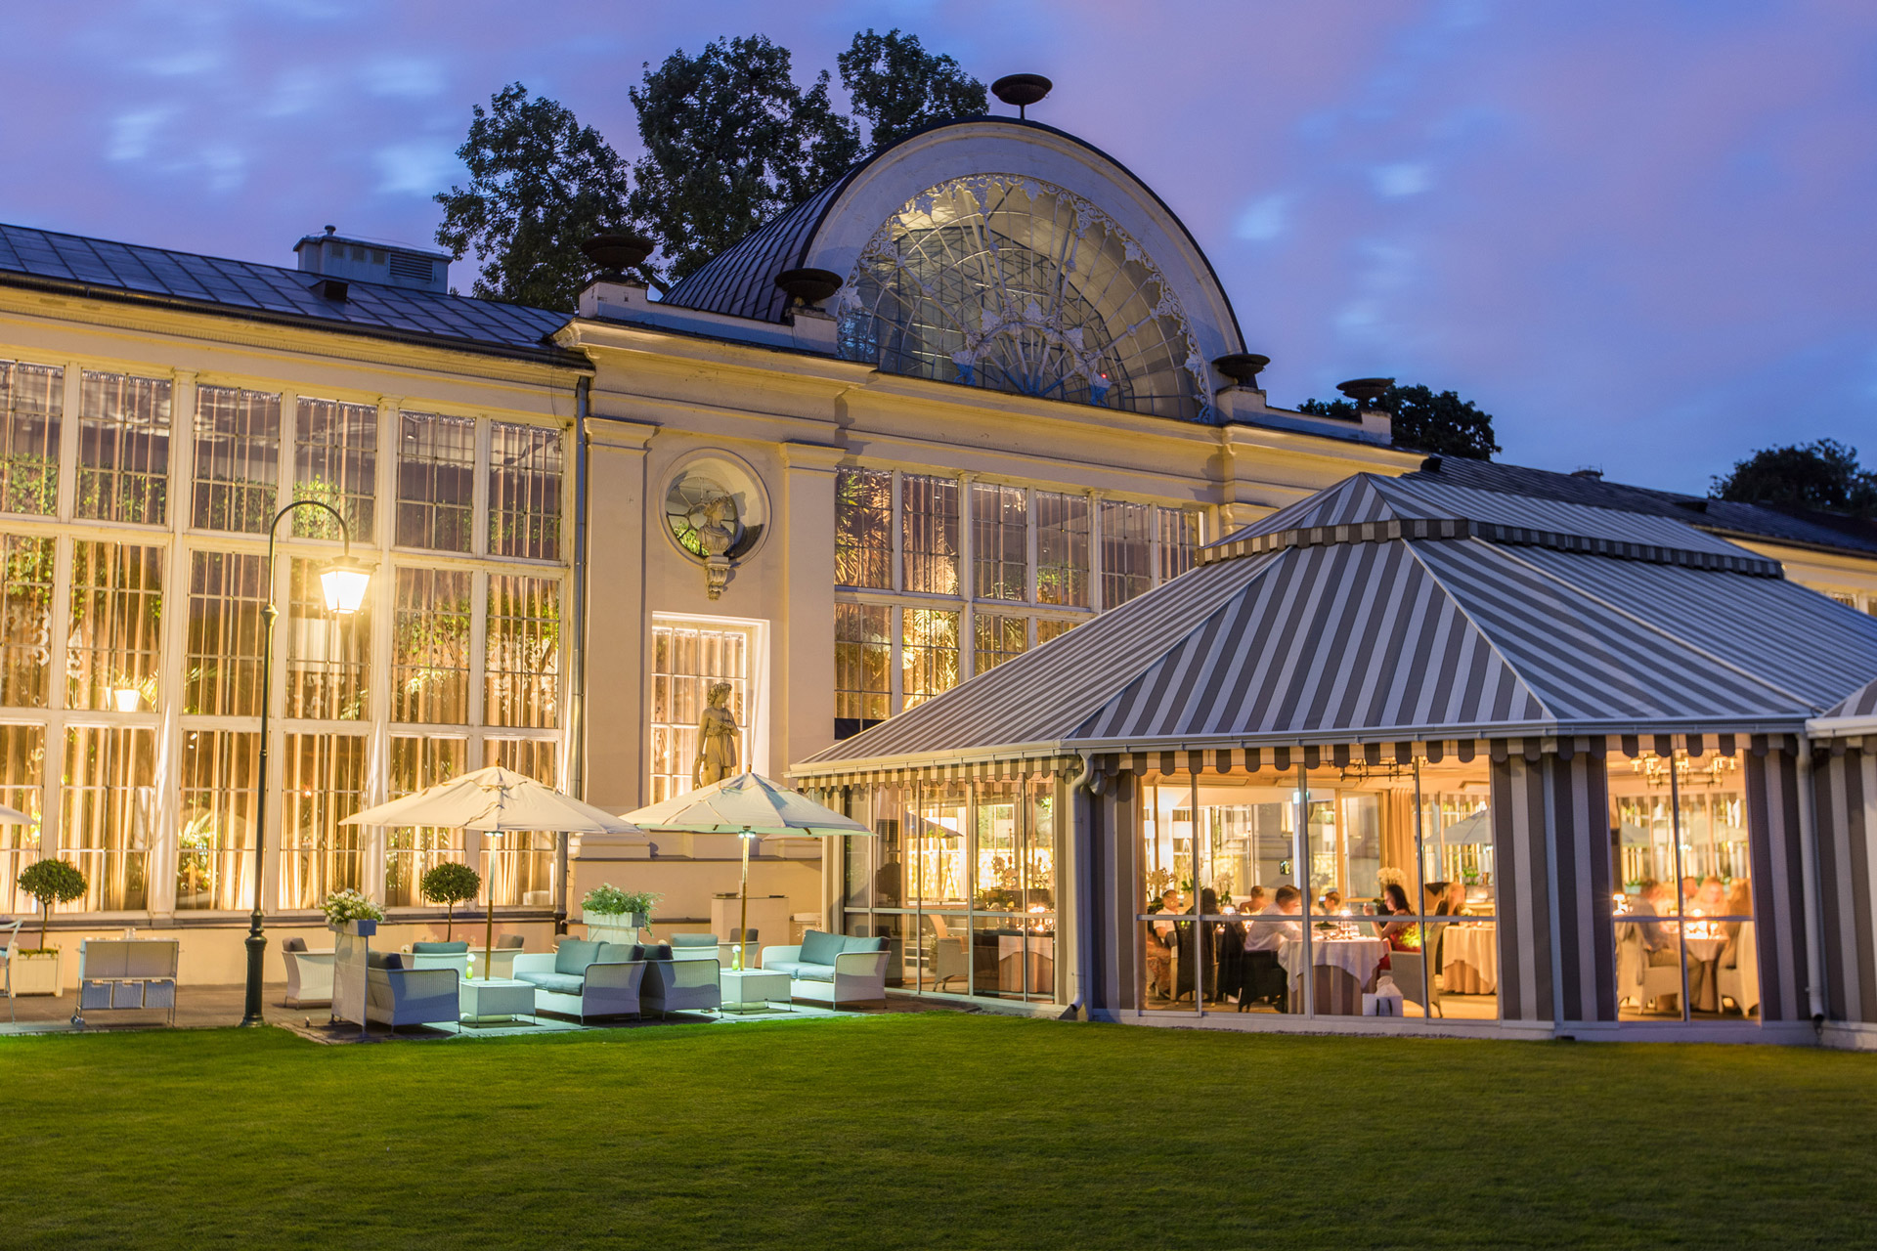
Luxurious and sophisticated

Slide 7
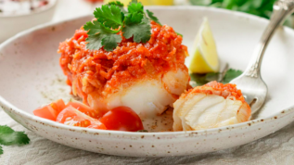
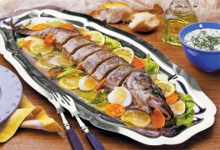
MENU
Starter:
Greek fish ☺ 2.67zł ☺ 0.63 €
Pike in jelly ☺ 2.00 zł ☺ 0.47 €
Soup:
Kidney bean soup ☺ 16.00 zł ☺ 3.77 €
Polewka Gdańska soup with dried mushrooms
☺ 14.00zł. ☺ 3.30 €

Slide 8
MENU
Drinks: ☺ 1.00zł ☺0.24 € Fanta, Koktajl truskawkowy , Coca Cola, Mirinda, Sprite
Main course:
Turkish-Polish mezze ☺ 10.00zł. ☺ 2.36€
Shish kebab ☺ 16.00zł. ☺ 3.77€

Slide 9
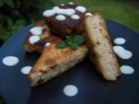
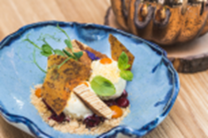
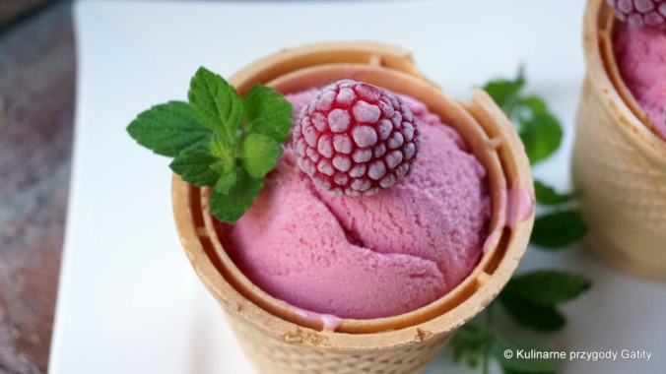
MENU
Desserts:
Rice delicacy ☺10.30zł.☺2.43€
Correze ☺ 10.24 zł.☺ 2.42 €
Raspberry ice-cream ☺ 1.50 zł. ☺ 0.35€

Slide 10
I’m looking forward for you to be my guests!
The manager of the restaurant: Alicja Bednarczyk class Vb

