Slide 1
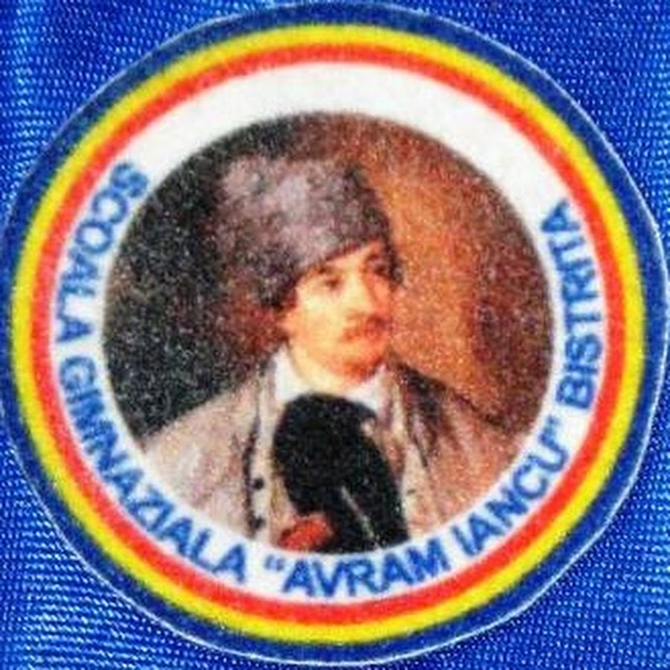
MY SCHOOL
School ,, Avram Iancu’’ Romania, Bistrita

Slide 2
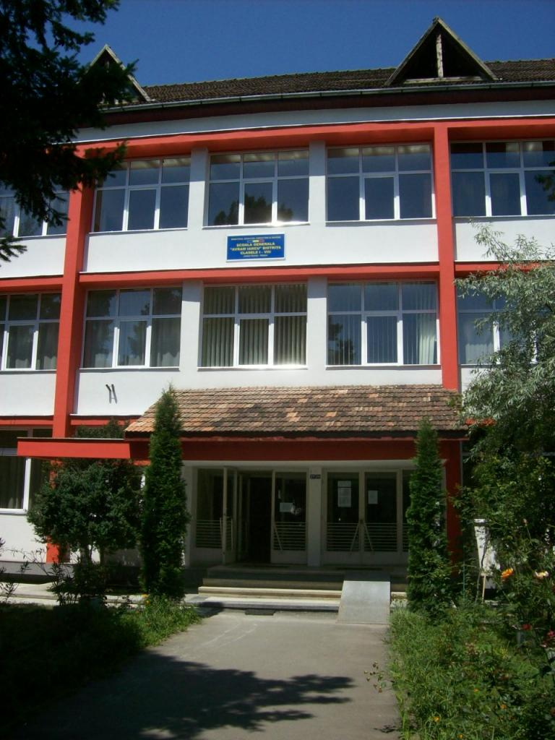
LAYOUT
Our school is in Central Europe, Romania, in Bistrita-Nasaud County, Bistrita, 1 Decembrie street.

Slide 3
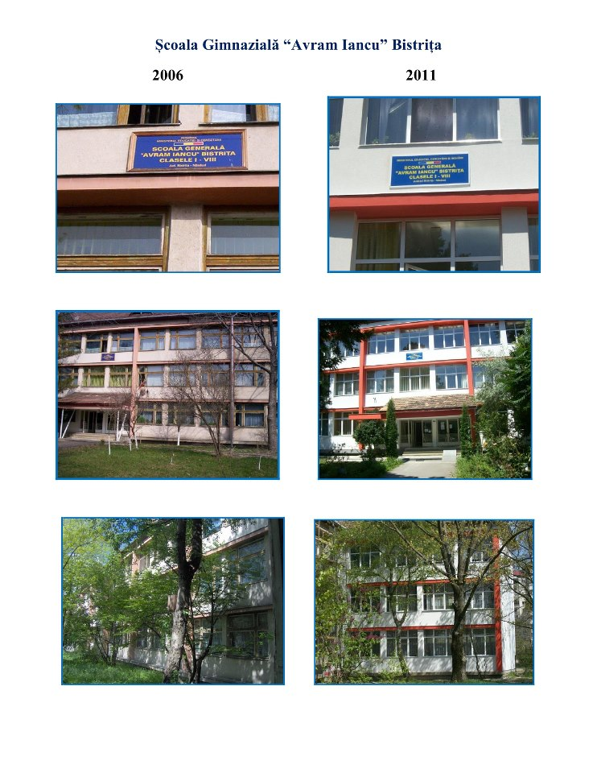
Evolution

Slide 4
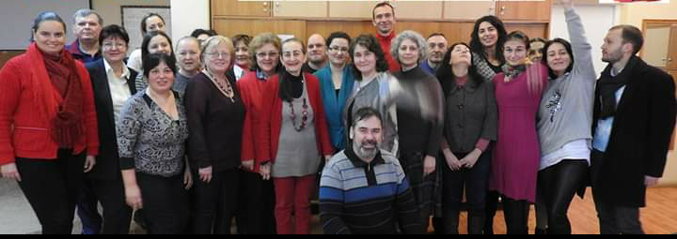
Teachers
We have 50 teachers for classes 0-8 (they are just a part)

Slide 5
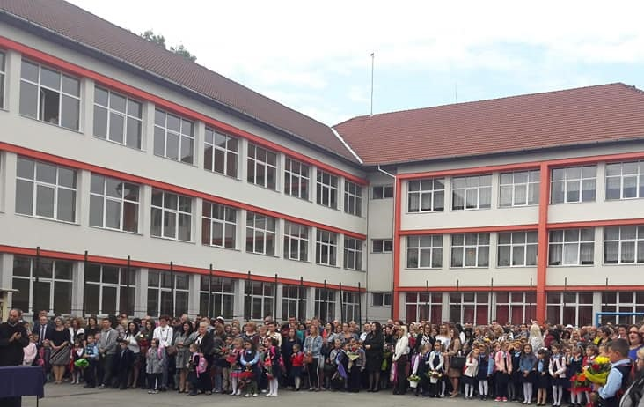
Pupils
There are about 1,000 students

Slide 6
Features
Each classroom is equipped with a video projector
Children's food is provided with the school canteen and a shop
Children's health is provided, a dental office and general assistance
A library and a reading room are also available for students' documentation
But for the emotional problems a school psychologist is available
Physical education is provided with a sports hall equipped with heating and modern equipment

Slide 7
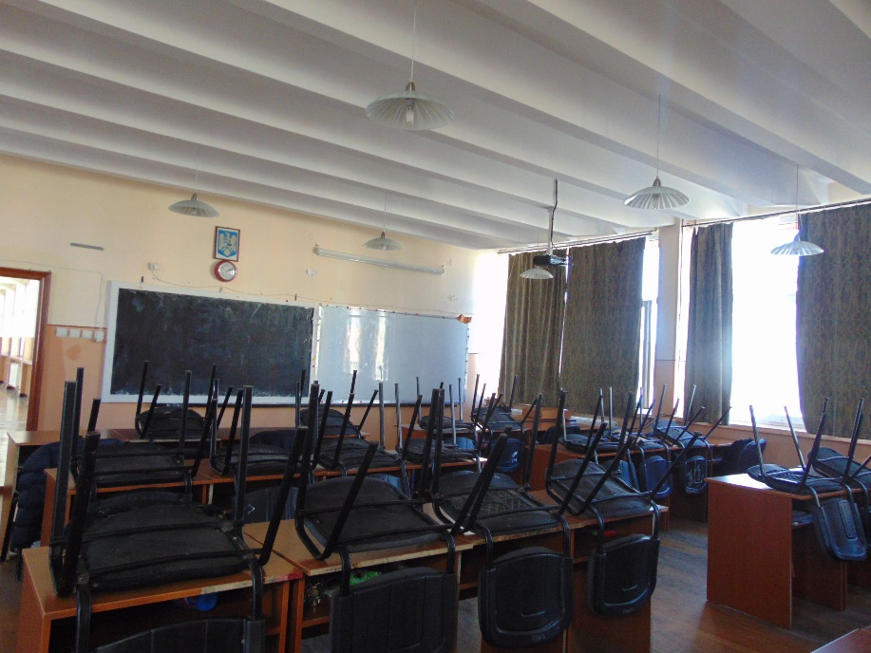
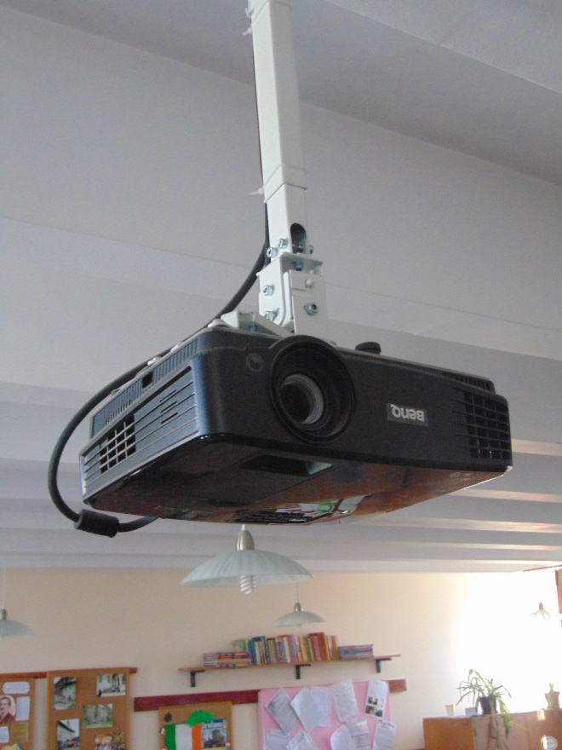
Organization of halls
Each room is equipped with a video projector
A bench and a chair for each student

Slide 8
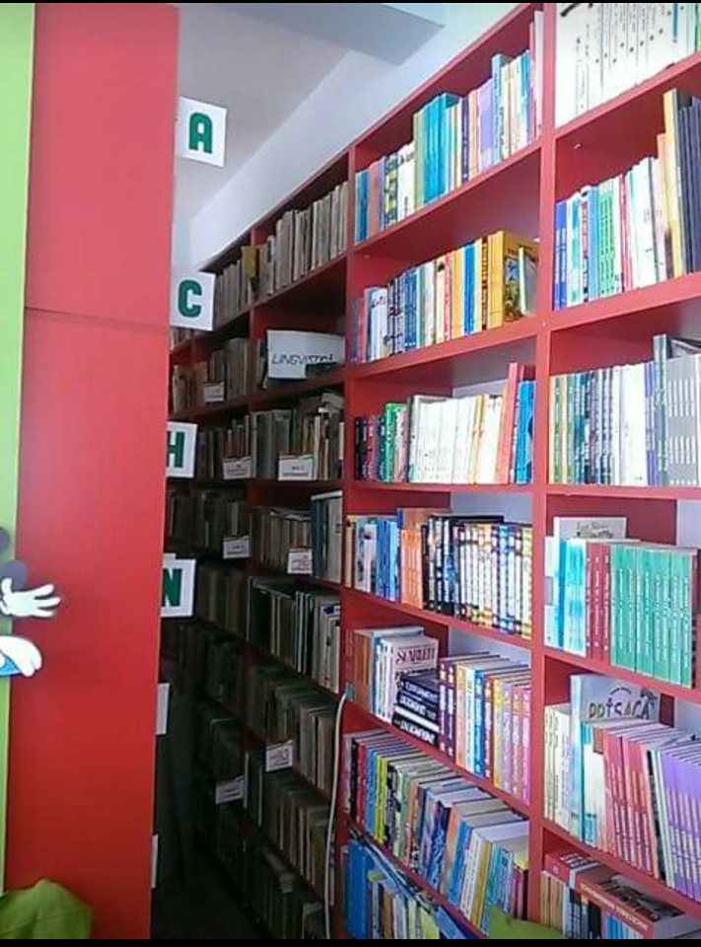
Library
- There are 12810 volumes in the library

Slide 9
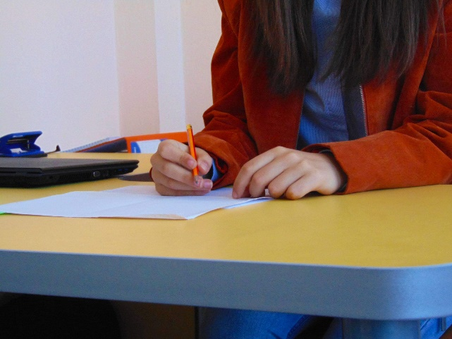
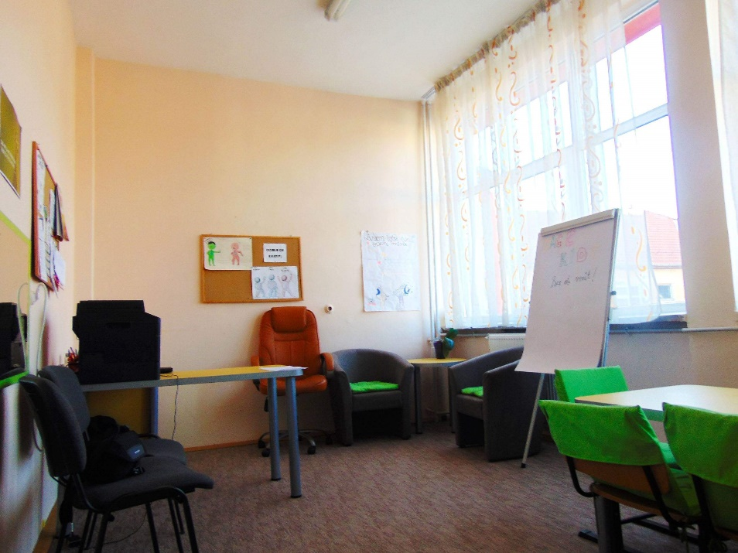
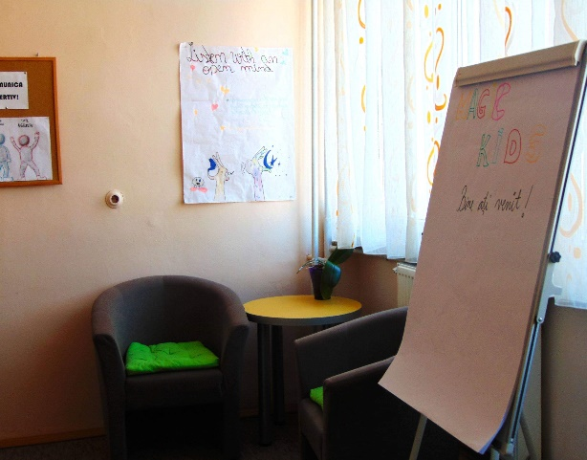
Psychology cabinet
- There is a responsible (psychologist) available at any time

Slide 10
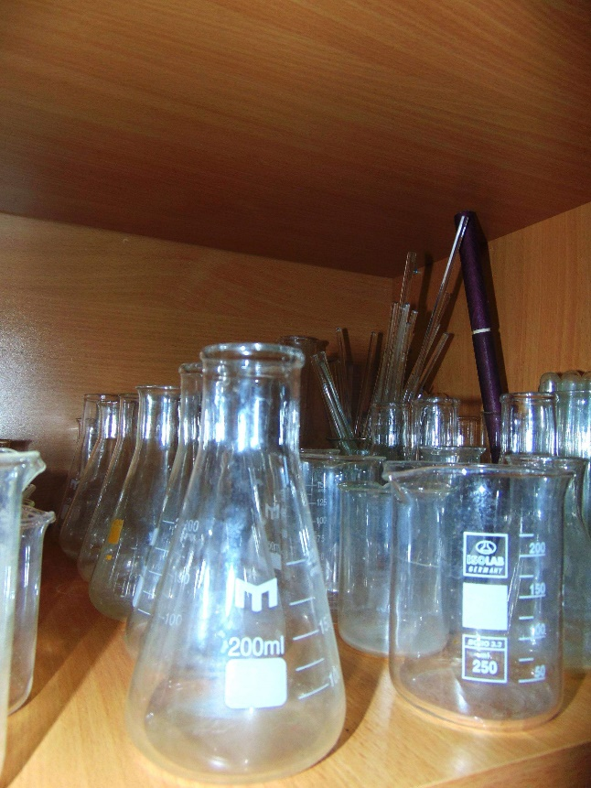
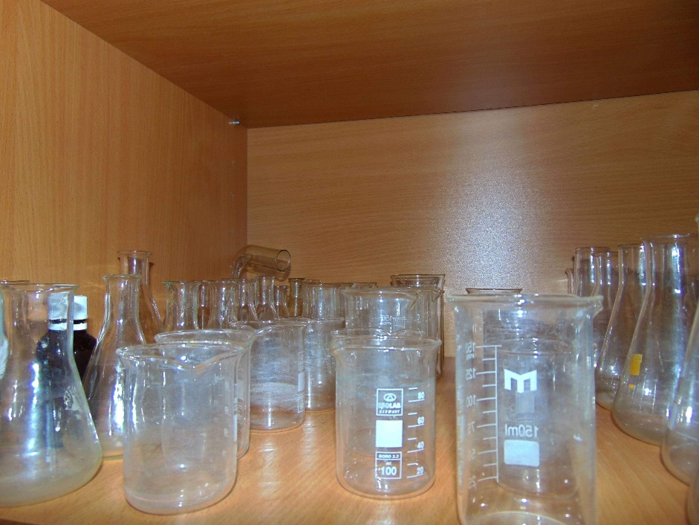
Chemistry cabinet
There are solutions, test tubes of all sizes, glasses of all sizes and educational plans.
There is a disinfection site for the experiments.

Slide 11
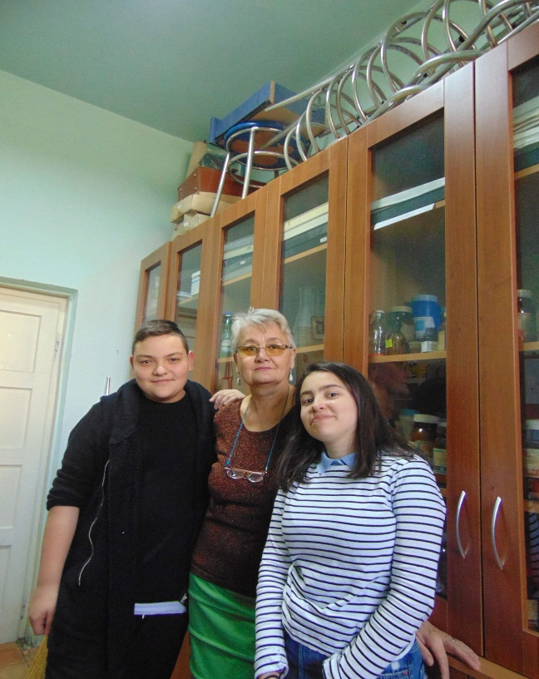
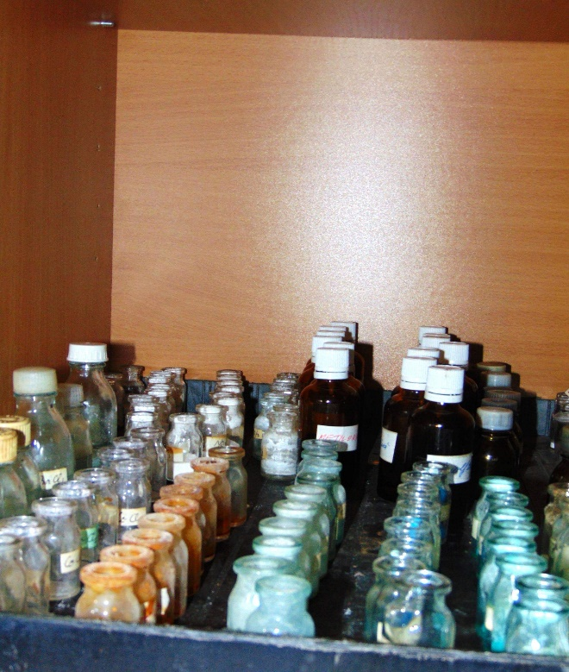
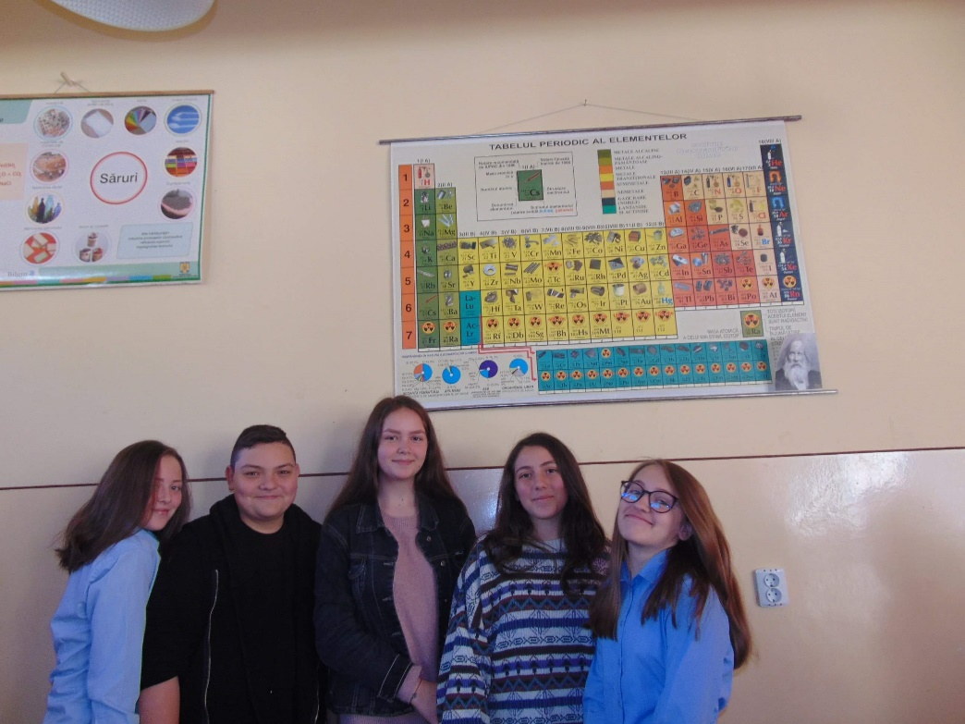

Slide 12
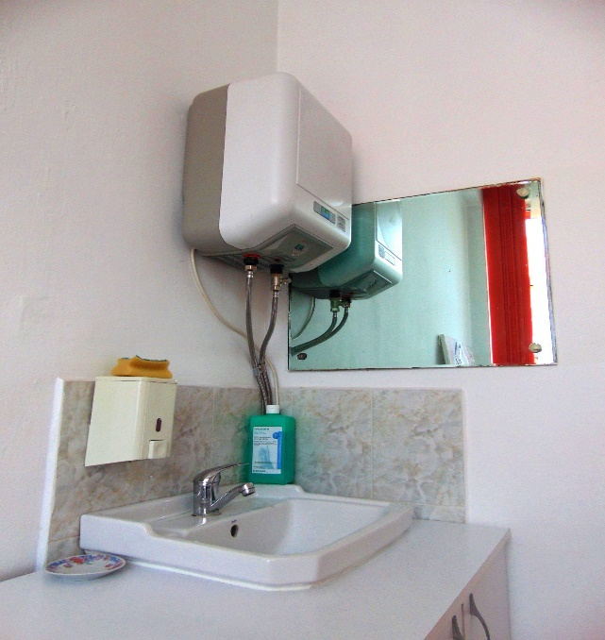
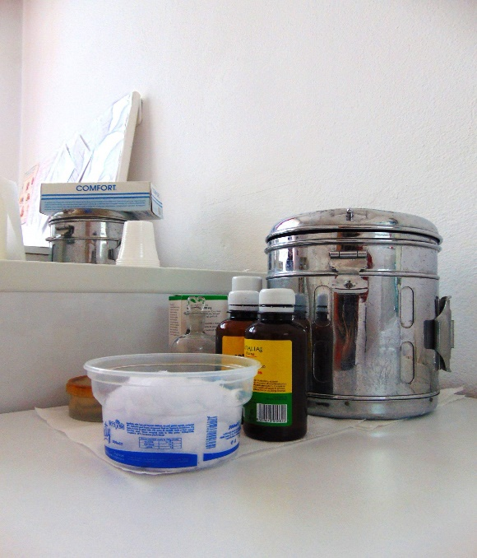
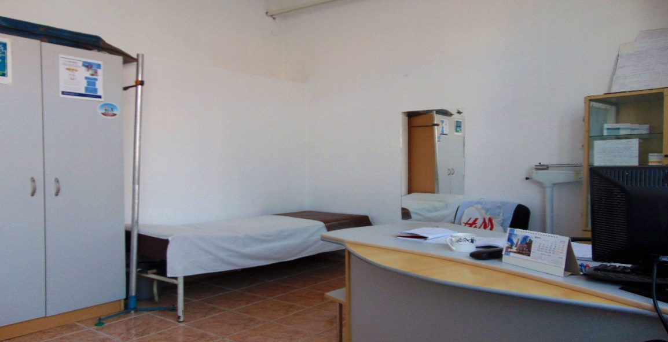
Medical cabinet

Slide 13
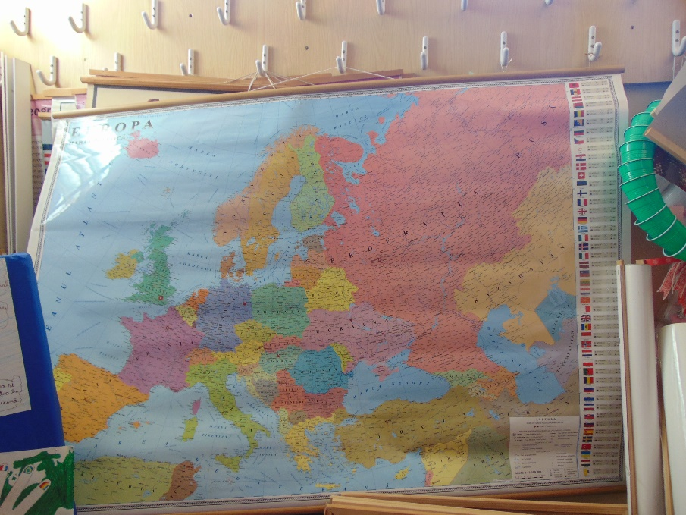
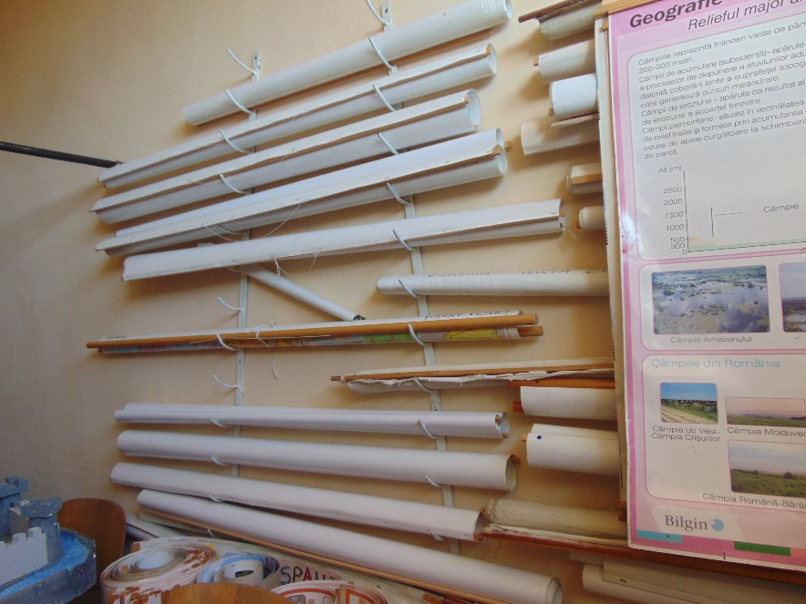
The Geography Cabinet
There are all types of maps for grades V-VIII + projects made by students and educational plans.

Slide 14
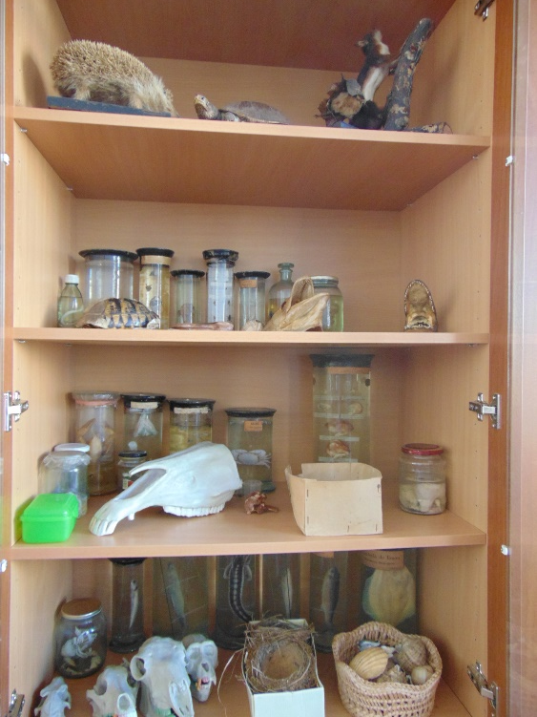
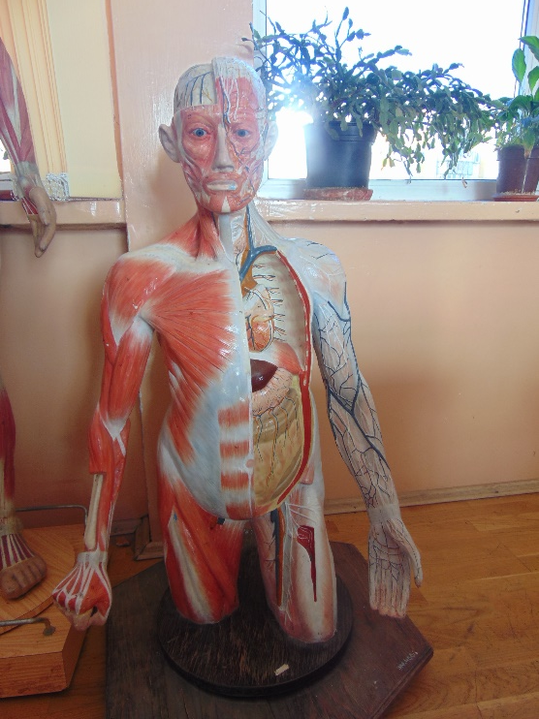
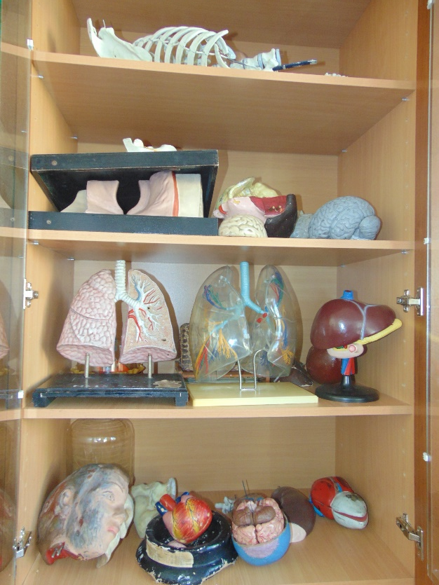
Biology cabinet
There are the skeleton of the human body (made of plastic), maps for different lessons, the parts of the body (plastic) and detailed books related to the structure of the V-VIII classes
Three microscopes of the latest generation are available

Slide 15
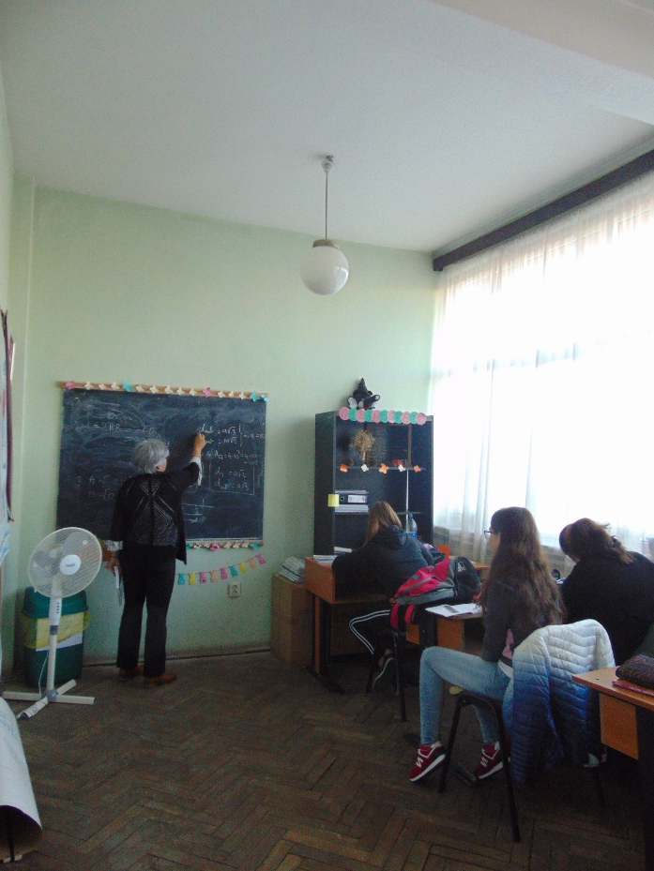
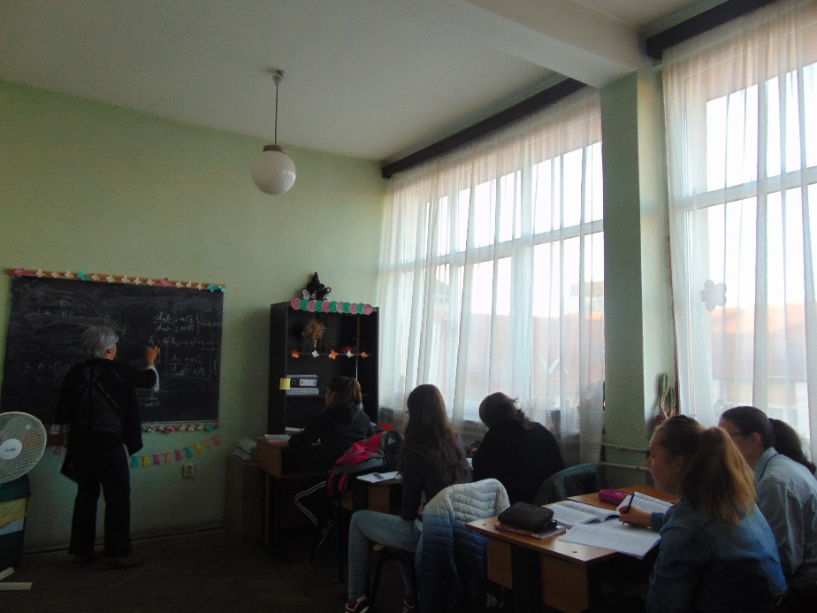
The Mathematics Cabinet
- Educational plans are provided for the V-VIII class structure

Slide 16
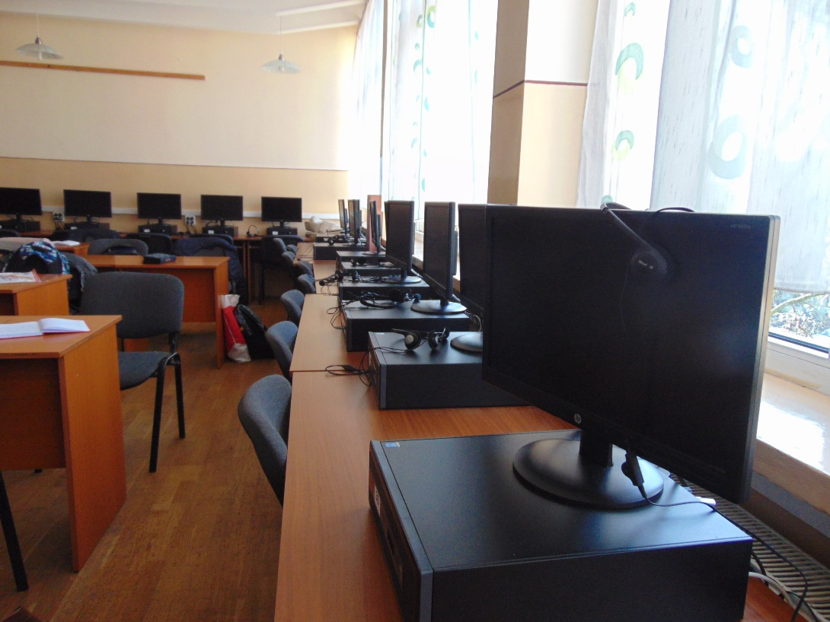
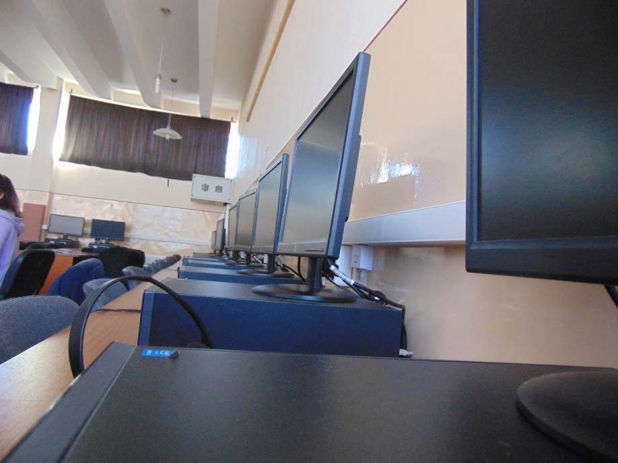
Office of Computer Science

Slide 17
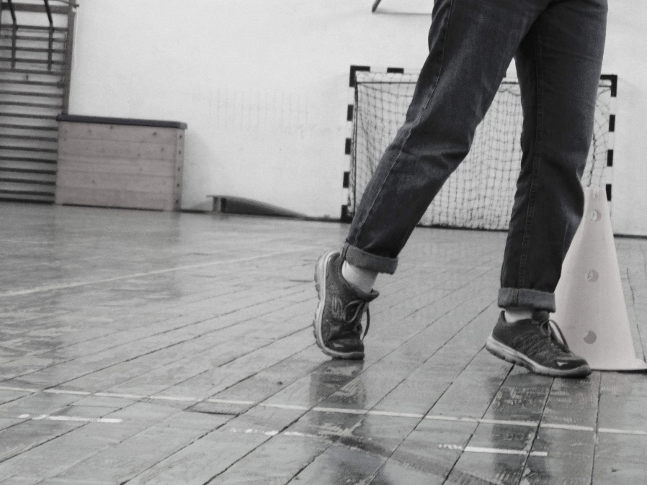
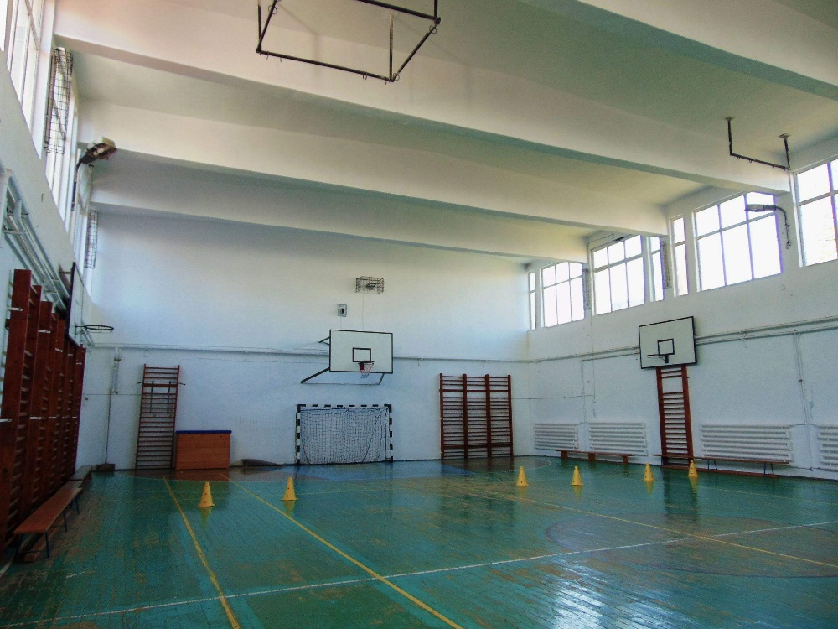
Gym
- They were upgraded in 2017 with new equipment and state-of-the-art ventilation systems

Slide 18
Olympics and contests
We managed to get to :
the county stage of history
the county biology stage
the county stage of mathematics
the national French stage
the local ecology stage
the county stage of the first aid
the national IT phase
the first place in the drawing contest, the national stage
Etc.

Slide 19
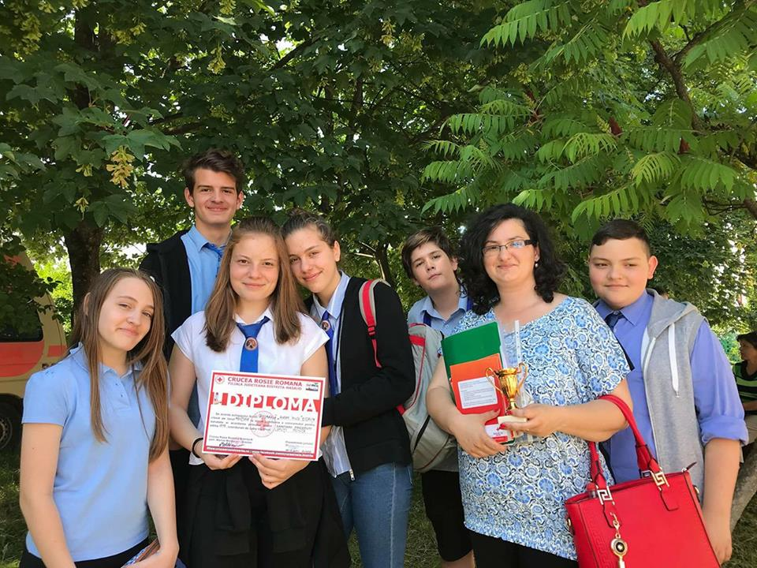
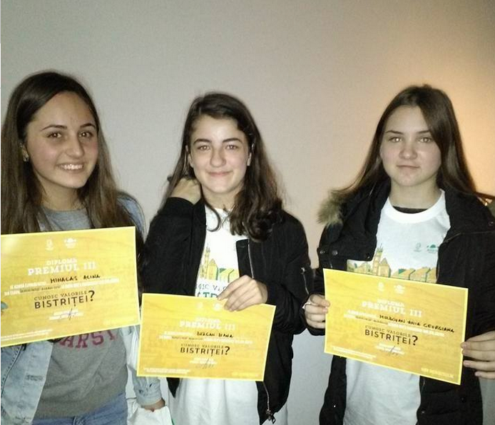
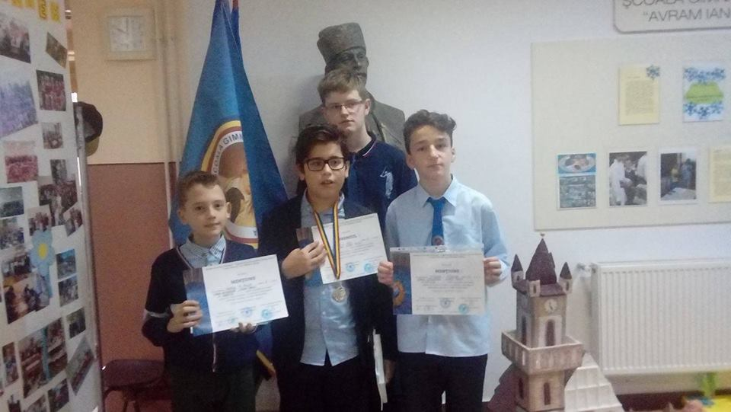
Part of the Olympic

Slide 20
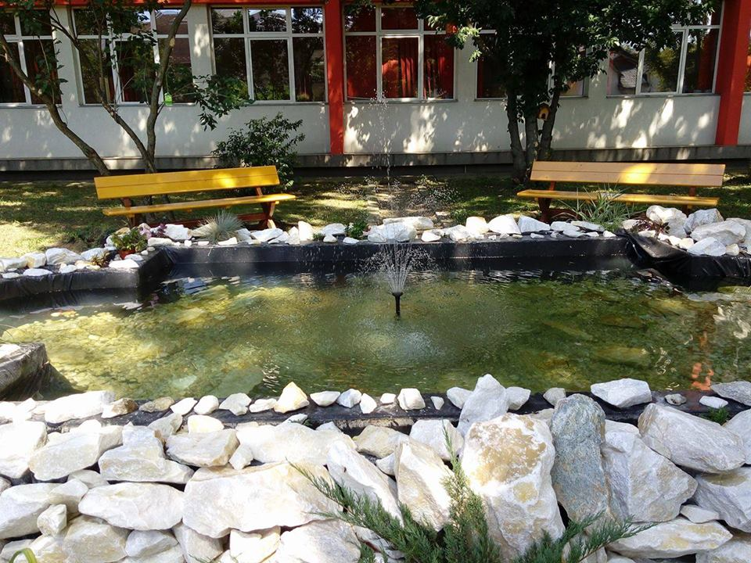
Renovation of the green space in front of the institution
Before
After

Slide 21
Separate cupboards for grades I-IV (2017) have been made available to ease the weight of the satchel

Slide 22
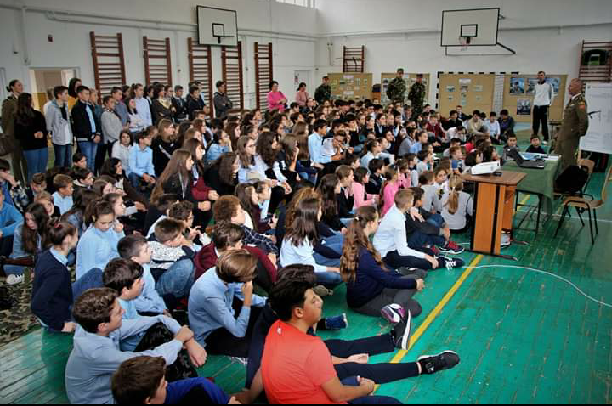
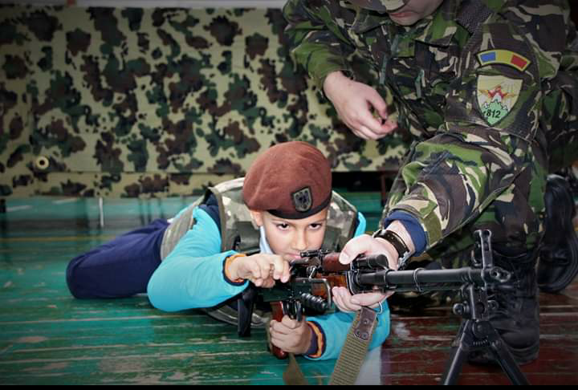
Extracurricular activities
1. On the day of the army, the soldiers came and presented us life on the front (equipment, weapons, etc.)

Slide 23
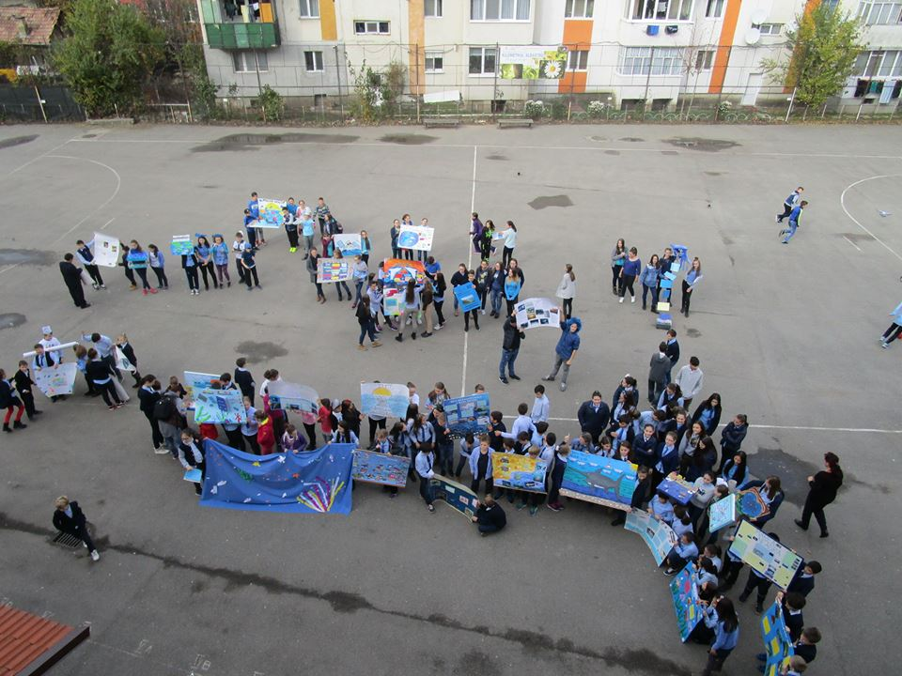
2. On Black Sea Day, students organized projects

Slide 24
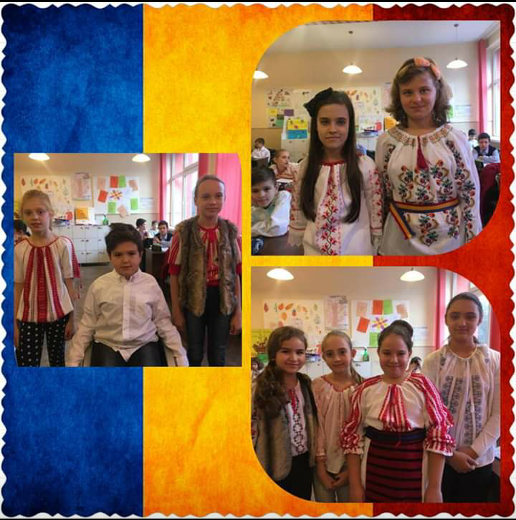
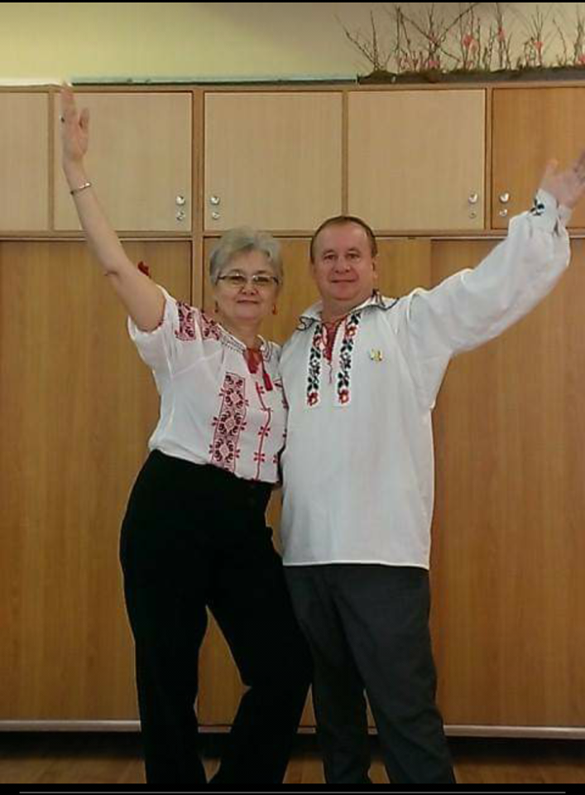
3. On the day of Romania pupils were dressed in folk costumes (our ancestors' clothing, handmade)

Slide 25
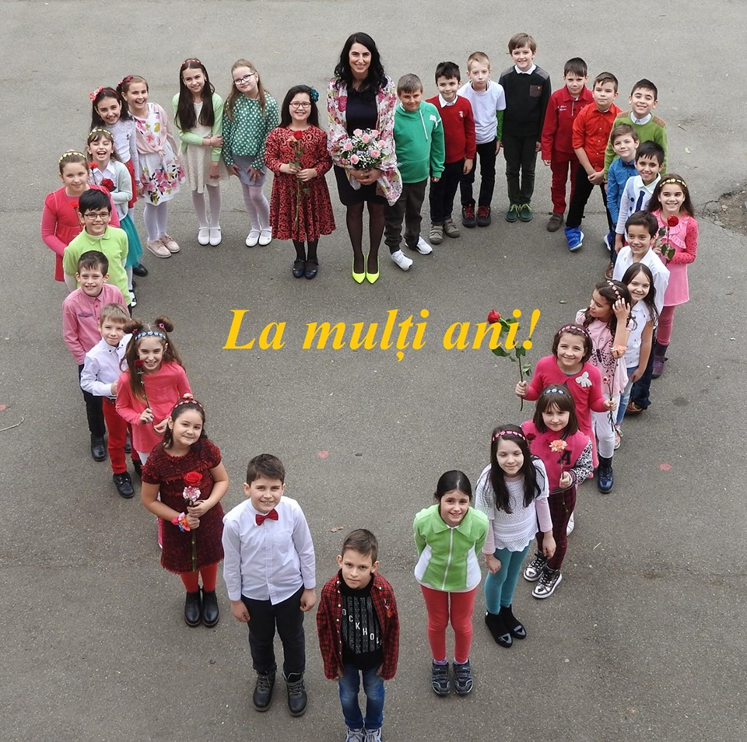
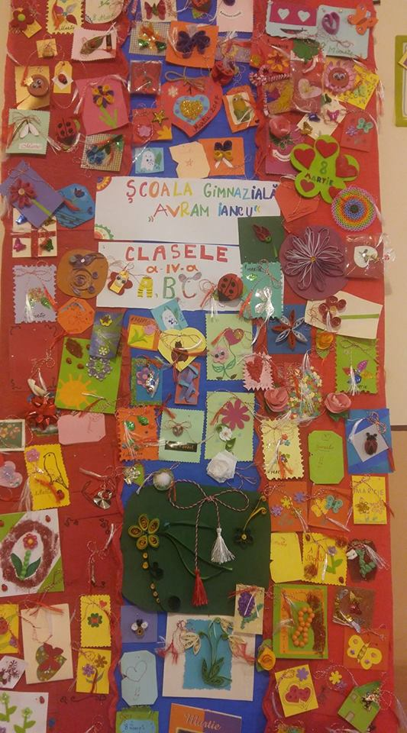
4. On 8 March (Mother's Day) the children congratulated and enjoyed each other

Slide 26
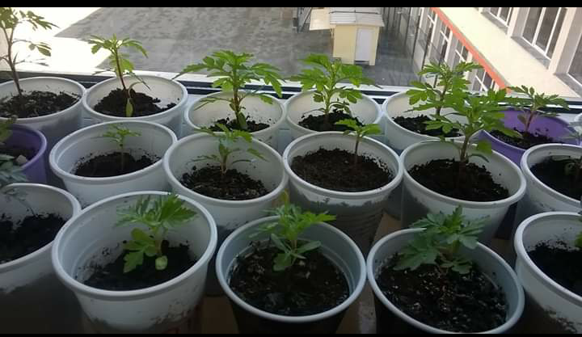
5. On planting day planting of different plant species was organized

Slide 27
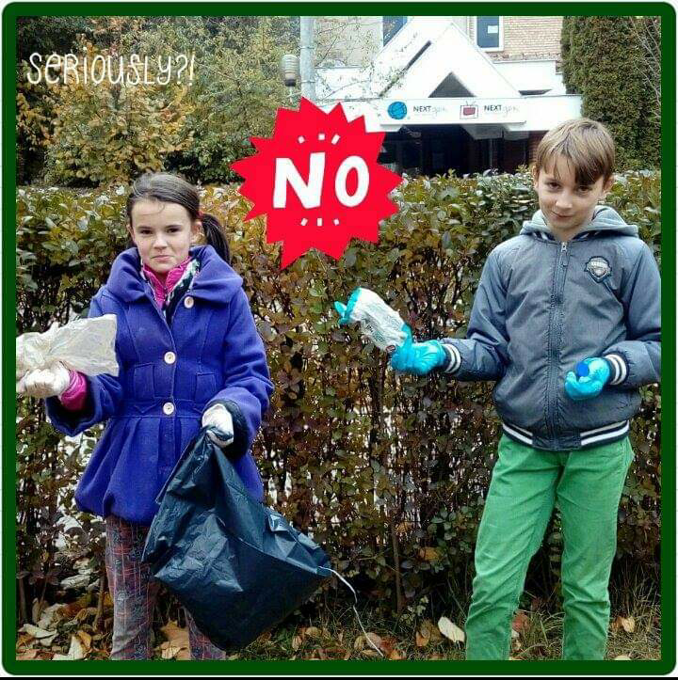
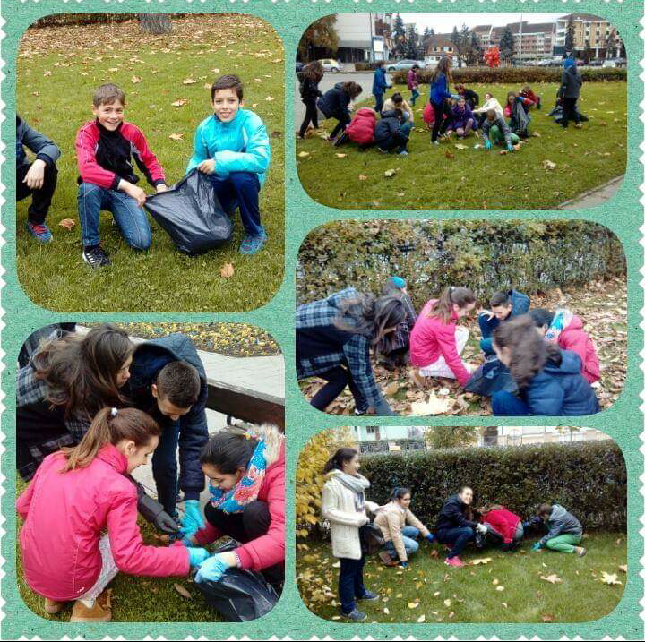
6. On the ecology day there were gunaoies from a park near the school

Slide 28
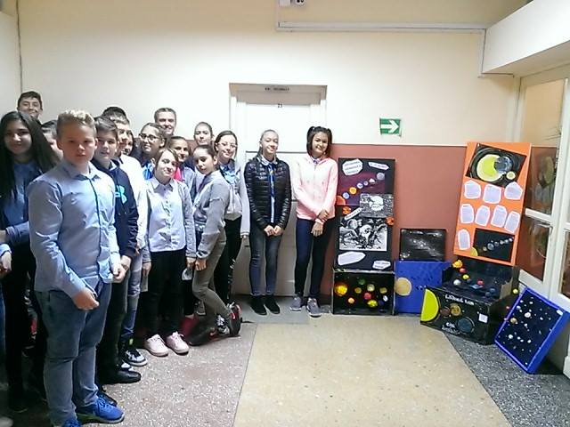
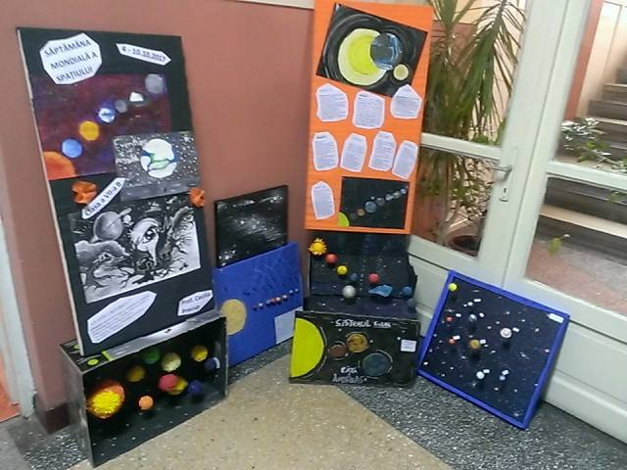
7. Day, World of Cosmic Space

Slide 29
The end
I hope you liked this project made by the students of the gymnasium school "Avram Iancu" – Bistrita :
- Antohi Bianca-Andreea
- Florea Jessica
Class: a-VIII-a C
Coordinator : Monica Luputi
In this project we presented to you the beauty of our school, extracurricular activities and our facilities, we are very proud to have been able to take part in such a project.

