Slide 1
Persönlichkeiten & Helden in Deutschland -------------------------------- Important people & heroes in Germany

Slide 2
Erich Kästner - primary school in Leipzig

Slide 3
Our school was built in 2013

Slide 5
Erich Kästner (1899–1974)
Our school is named after
Erich Kästner.
He is a famous author.

Slide 6
Children‘s books by Erich Kästner

Slide 7
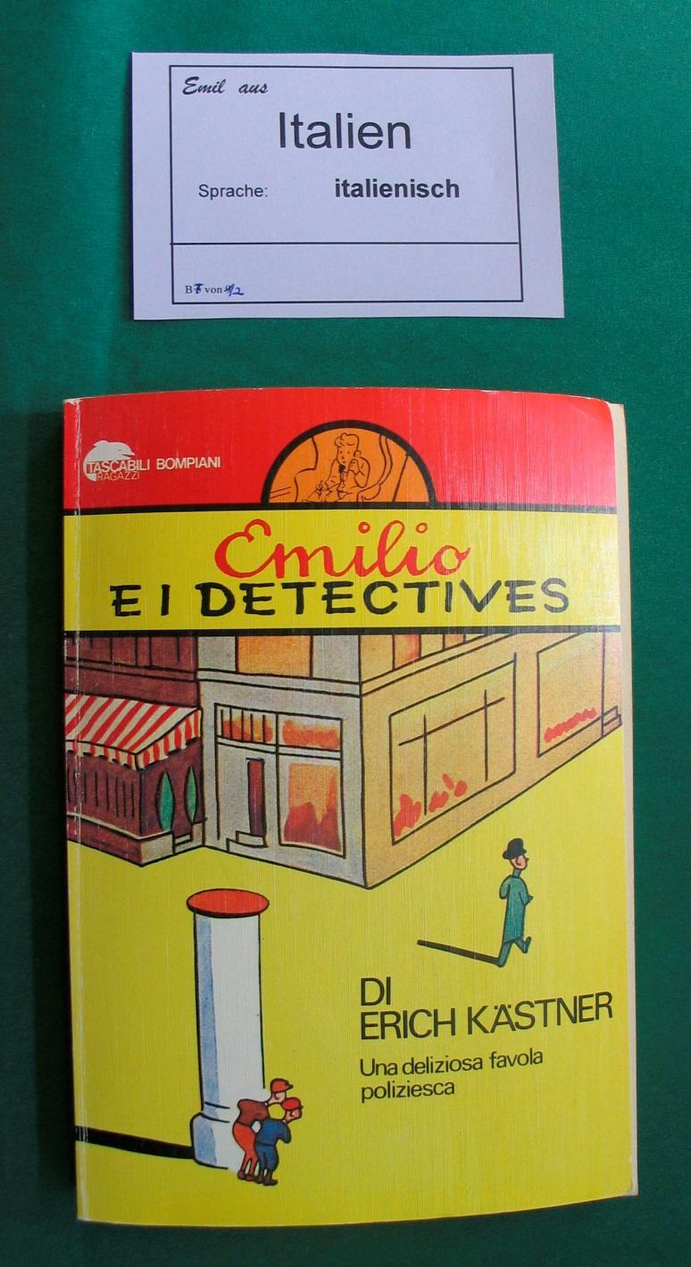
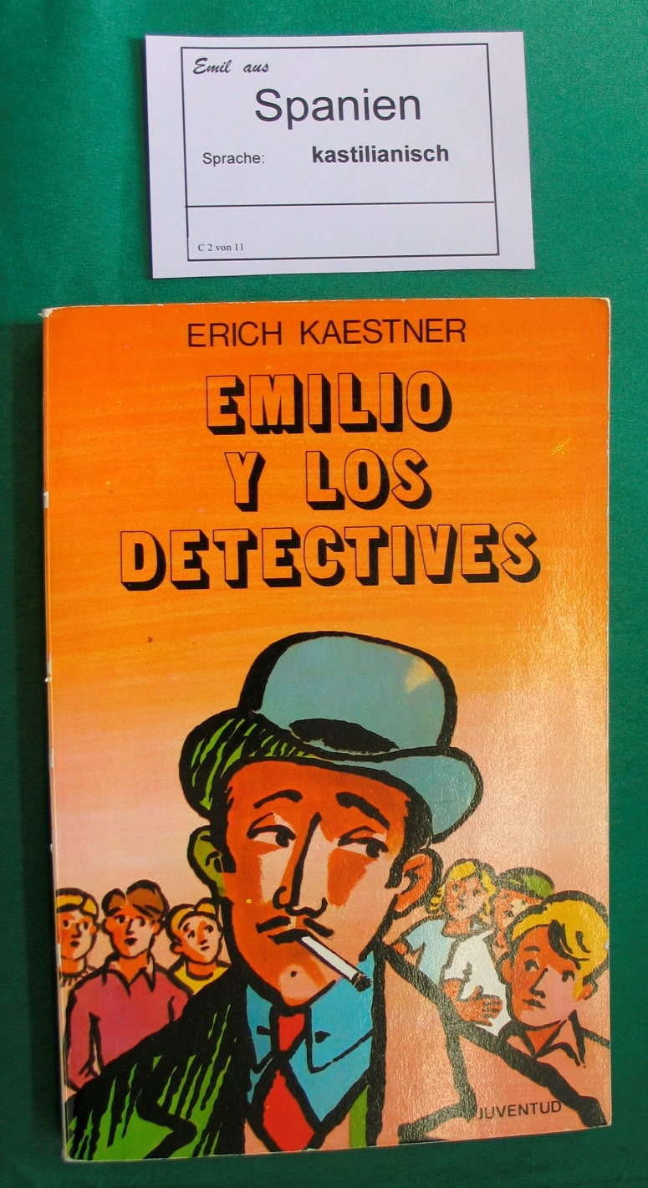
His books were translated into 150 languages.

Slide 8
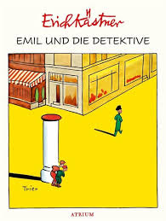

Slide 9
We also have famous comic characters:
The „Digedags“

Slide 10
Fix and Foxi

Slide 11
Max and Moritz

Slide 12
Characters by Loriot
(for adults)

Slide 13
Sigmund Jähn (1937–2019)
He was the first German astronaut in space.

Slide 14
Together with his friend Sigmund Jähn circled the earth 125 times in 8 days.
Jähn and Bykowski

Slide 15
His mascot is „Sandman“.

Slide 16
„Sandman“
„Sandman“ is a hero for young children in Germany.
Since 1959 a daily show is on TV.

Slide 17
Children are sent to sleep by the „Sandman“ with “sleeping sand“.

Slide 18
Conrad Röntgen (1845–1923)
He discovered the X-rays.

Slide 19
The first X-ray picture is the hand of Röntgen`s wife.
You can see the bones and the wedding ring.

Slide 20
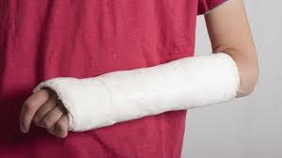

Slide 21
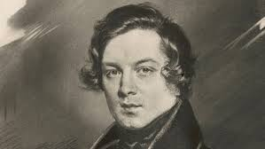
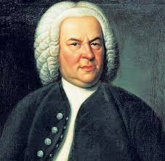
Famous musicians
Schuhmann
Beethoven
Bach

Slide 22
Johann Sebastian Bach (1685 - 1750)
Bach lived and worked in Leipzig

Slide 23
Bach was a choirmaster.
Only boys sing in this choir.
The choir still sings today in Leipzig.

Slide 24
Robert und Clara Schumann
She started playing the piano when she was 5 years old.
Clara was born in Leipzig.

Slide 25
Felix Mendelssohn Bartholdy
He was the director of music in the Gewandhaus (music/opera house in Leipzig).
The Gewandhaus orchestra is still famous.
1809 in Hamburg – 1847 in Leipzig

Slide 26
Johann Wolfgang von Goethe
He was a famous author and scientist.

Slide 27
Albert Einstein
He was a physicist.

Slide 28
Martin Luther
He was a monk.
He caused the reformation of the chruch.

Slide 29
Johannes Gutenberg
He is the inventor of letterpress printing.
ca. 1400 – 1468

Slide 30
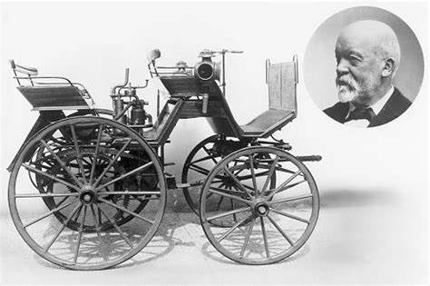
Gottlieb Daimler (1834–1900)
Daimler was a German engineer.
He developed the first petrol engine.

Slide 31
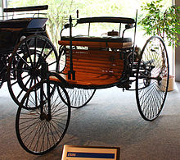
Carl Benz (1844–1929)
Daimler and Benz developed the first motor vehicle.

