Slide 1
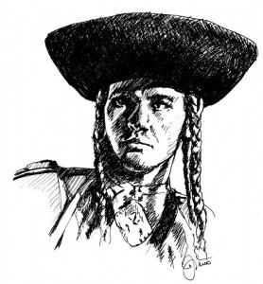
Juraj Jánošík
National hero from Slovakia

Slide 2
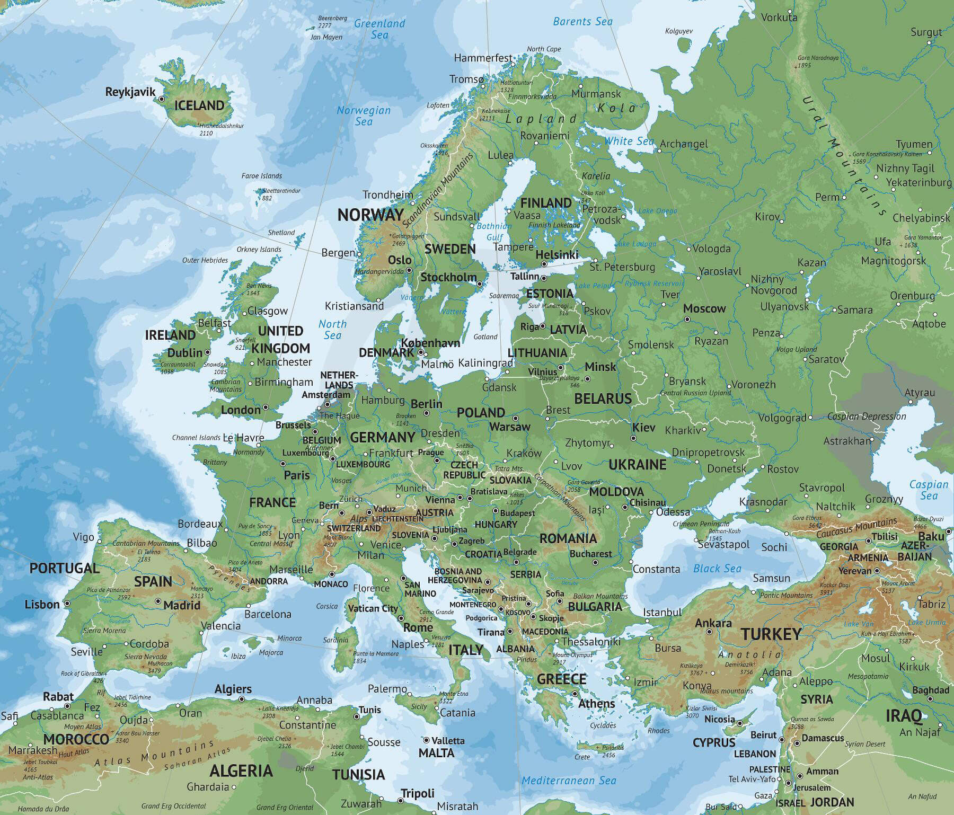

Slide 3
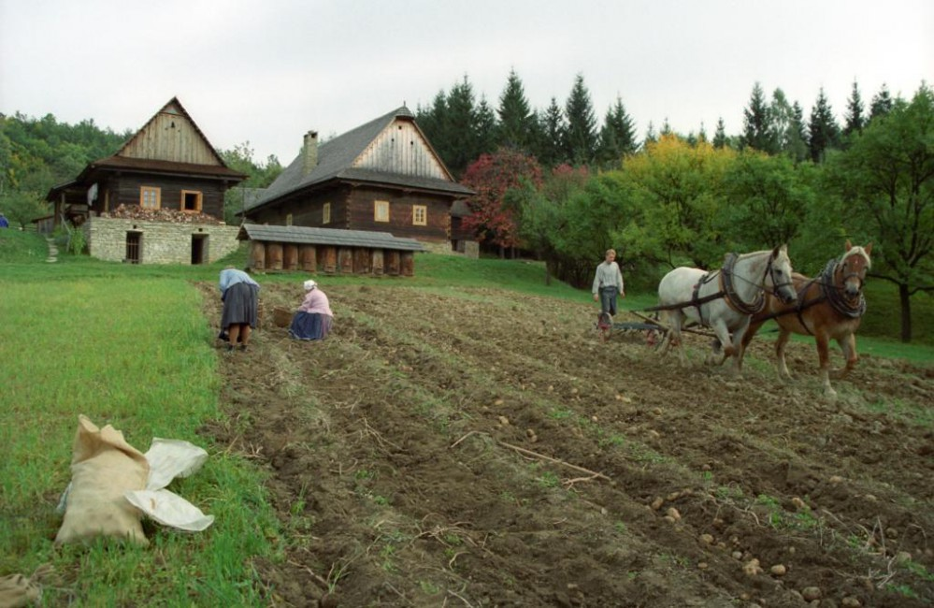
Slovakia in the past

Slide 4
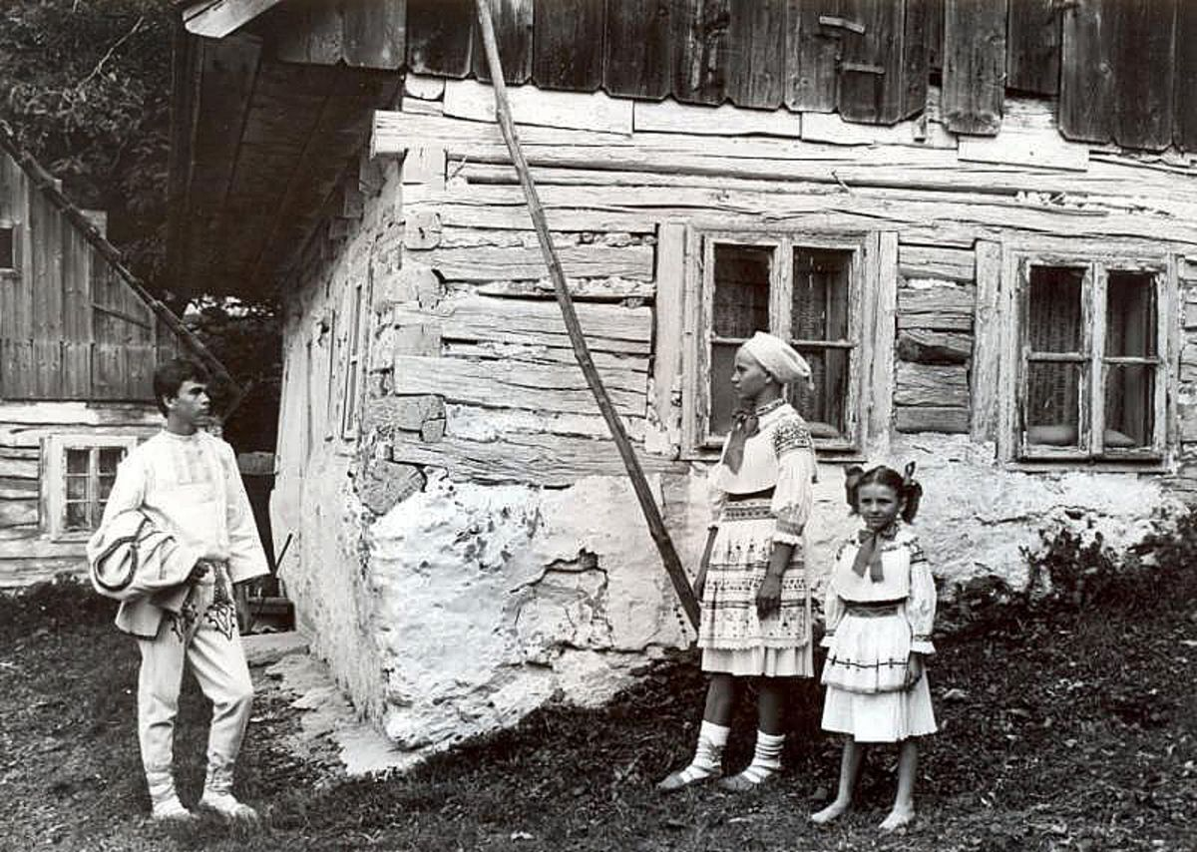
People worked hard, but they were poor.
They didn´t have enough money

Slide 5
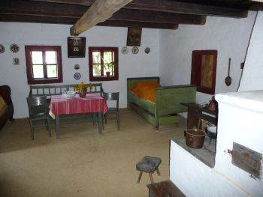
People in the past used to live in similar houses.
https://www.youtube.com/watch?v=HkOFnQm2LEI

Slide 6
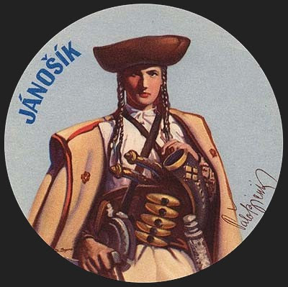
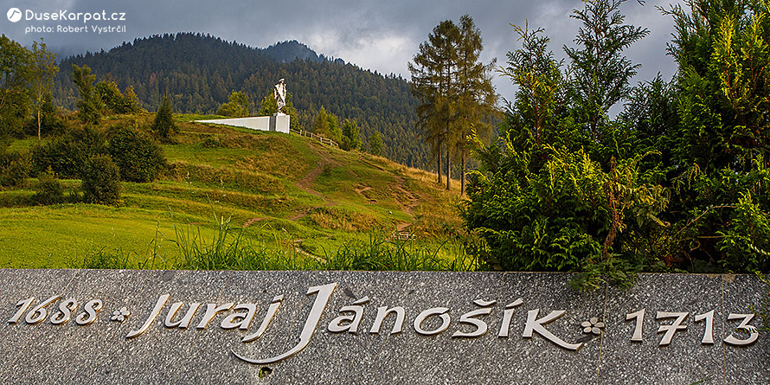
Juraj Jánošík
He was like Robin Hood from Slovakia

Slide 7
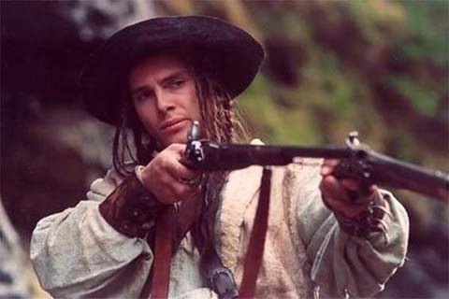
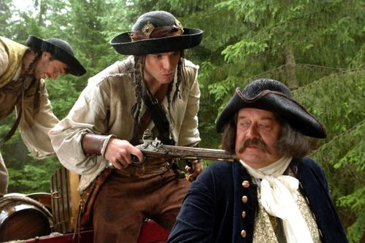
Why was he famous?
He wanted to help poor people around him. So he robbed nobles and gave the money to the poor. He did not kill any of the robbed victims.

Slide 8
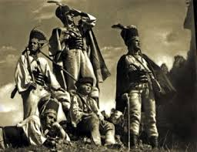
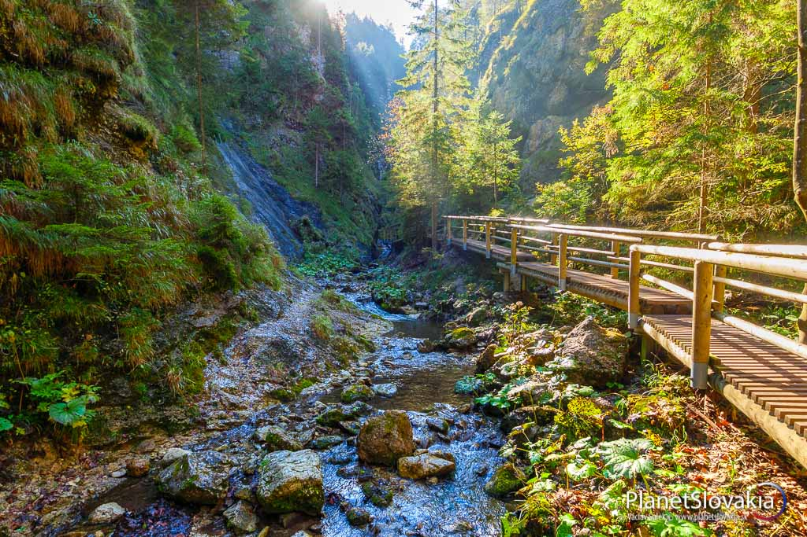
He lived with his group in the forest

Slide 9
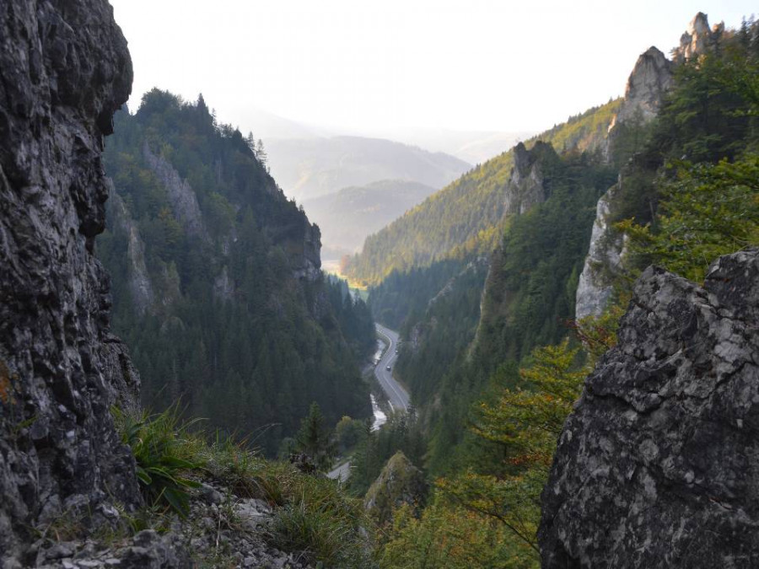

Slide 10
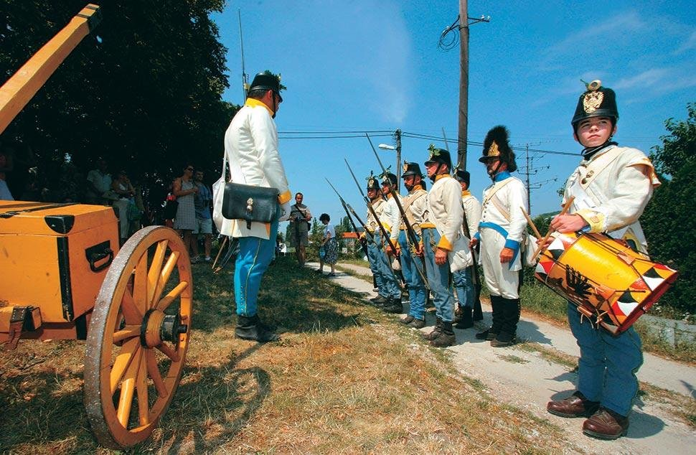
Army wanted to catch Jánošík, but he was very fast and hid in the mountains.

Slide 11
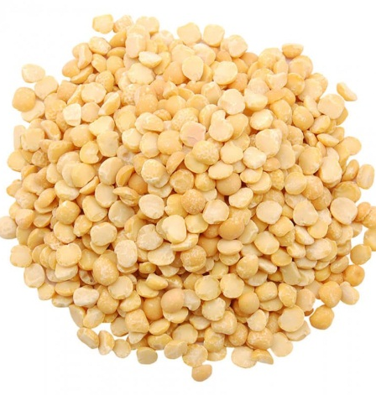
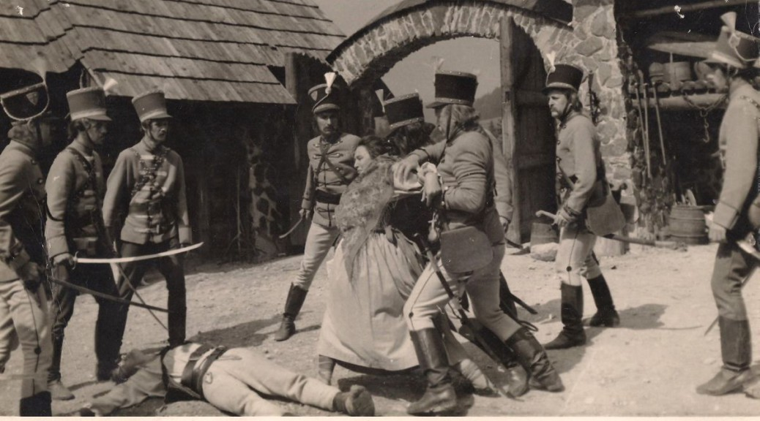
Jánošík and the pea

Slide 12
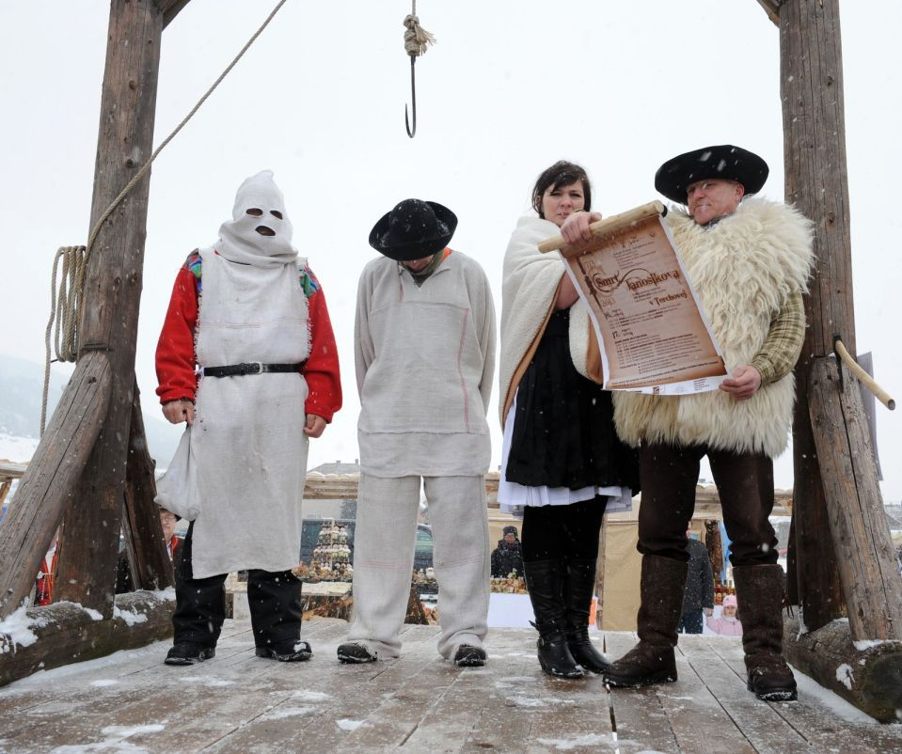
At the end they caught him and killed him

Slide 13
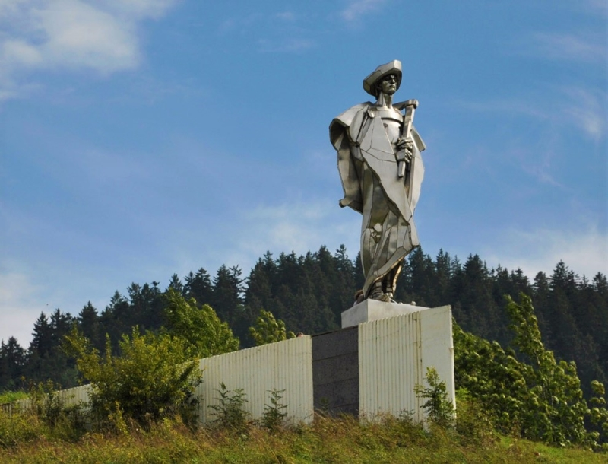
There are lots of stories,poems,films and TV series about him.

Slide 14
Thanks for your attetion !
Thank you for your attention ☺

