Slide 1
Theseus A Greek Hero
3rd Primary School of Voula

Slide 2
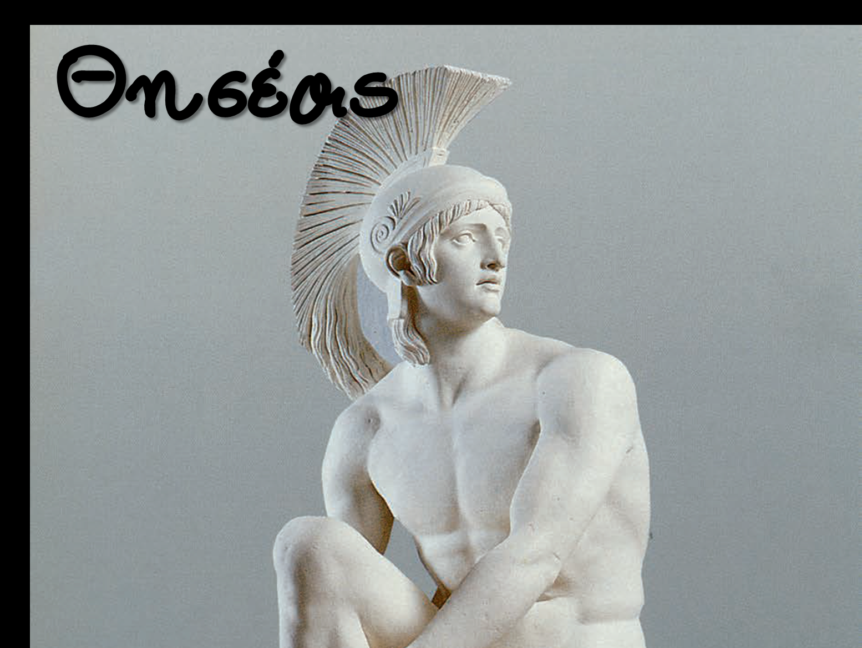
Theseus was a hero in Greek mythology and a legendary king of Athens.
He was not only brave and strong, but also clever and wise.

Slide 3
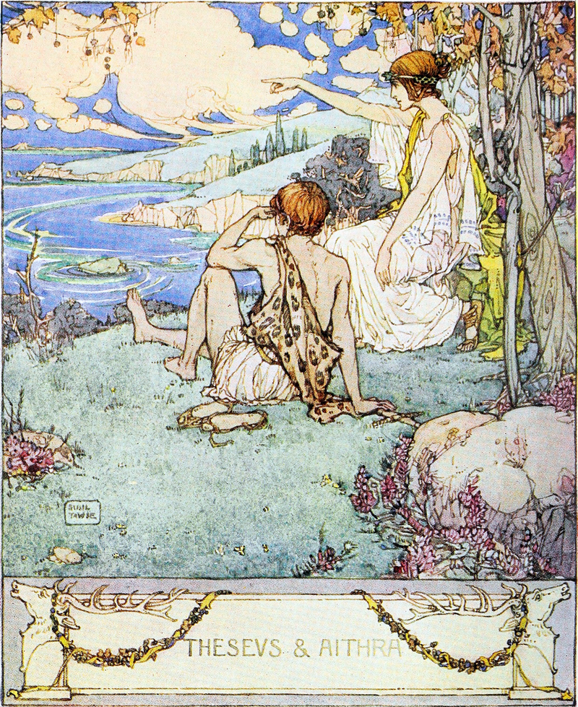
Ηis mother was Aethra.

Slide 4
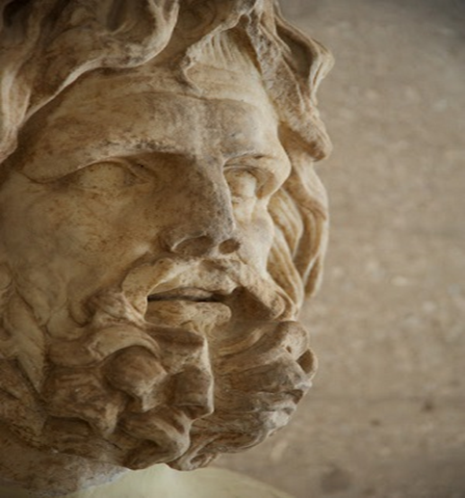
Theseus had two fathers.
One father was Aegeus,
King of Athens.

Slide 5
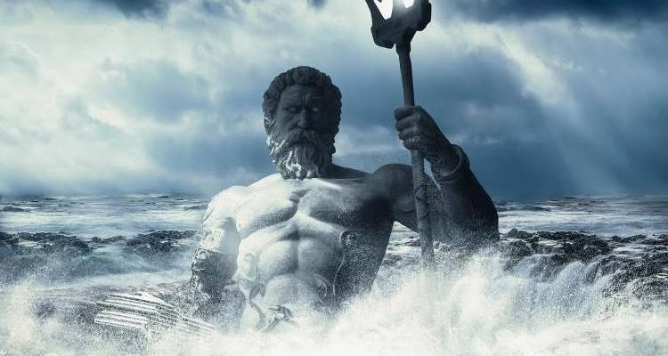
Ηis other father was Poseidon, the god of the sea.

Slide 6
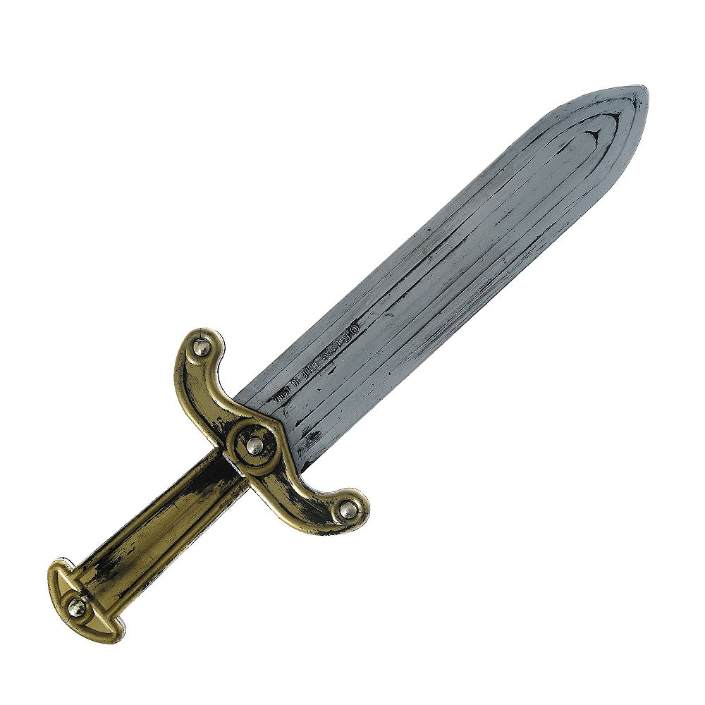
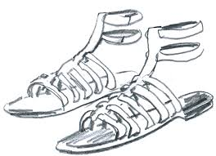
Aegeus left Aethra and his new-born son, and went to Athens. But before leaving, he left his sword and sandals under a huge rock. He told Aethra to send Theseus to Athens when he was able to retrieve these items from under the rock.

Slide 7
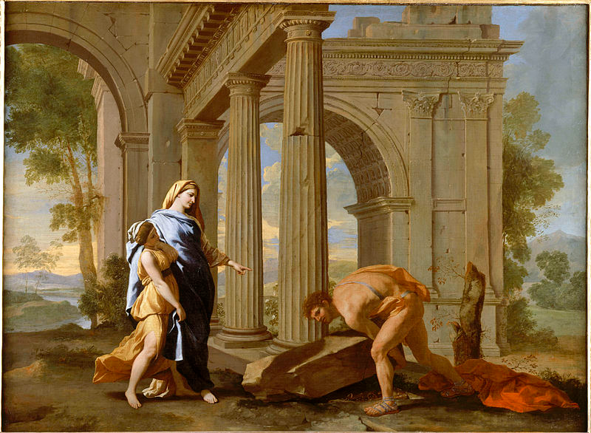
Theseus easily picked up the large rock and found his father’s items so he started his journey to Athens.

Slide 8
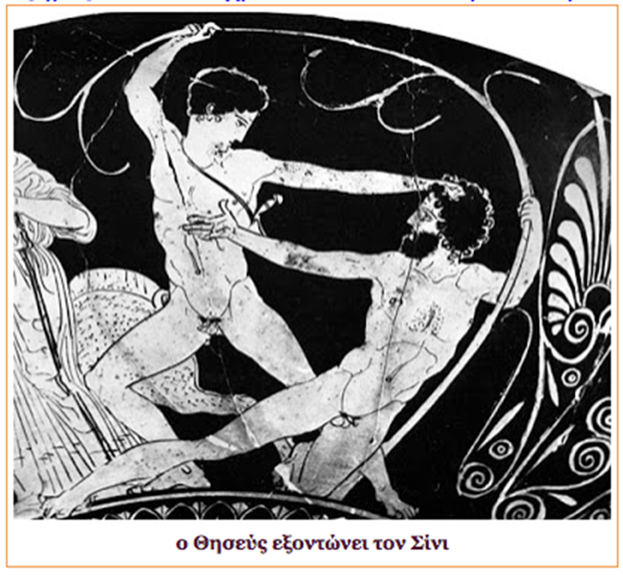
Along the road he had to fight six battles.
He defeated four
dangerous thieves…..

Slide 9
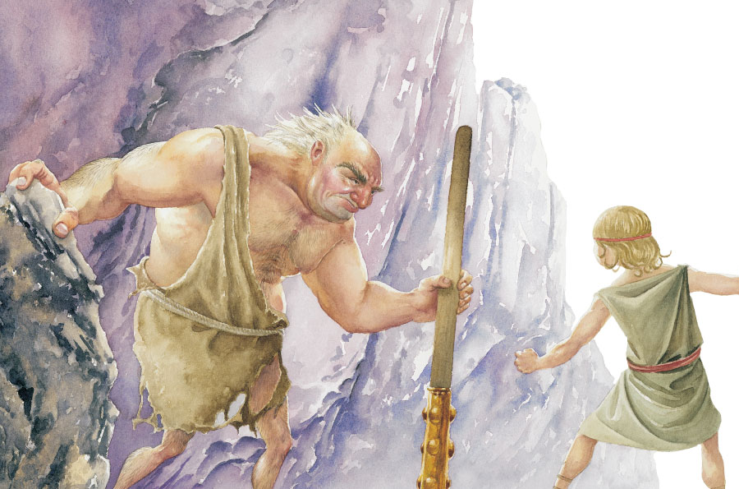
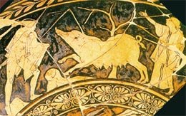
one monster pig …
…and one giant

Slide 10
Sometime later came Theseus’ greatest challenge.
Battle with the Minotaur

Slide 11
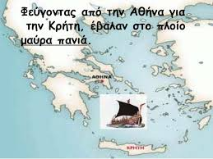
Every seven years King Minos of Crete forced Athens to send seven young men and seven young women to sacrifice to the Minotaur.
These young Athenians went to Crete in a ship that had black sails.

Slide 12
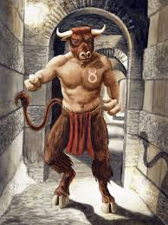
Minotaur was a half-man, half-bull creature…

Slide 13
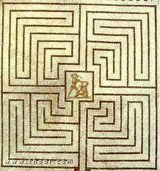
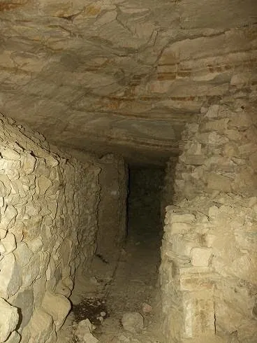
…that lived in a complicated maze, the labyrinth, under Minos’ castle.

Slide 14
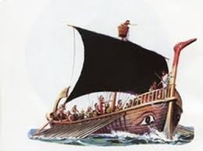
Theseus volunteered to be one of the 7 men, promising to kill the Minotaur and end this tradition.
Aegeus, his father made him promise to change the ship’s sails from black to white before he returned to show that he had succeeded.

Slide 15
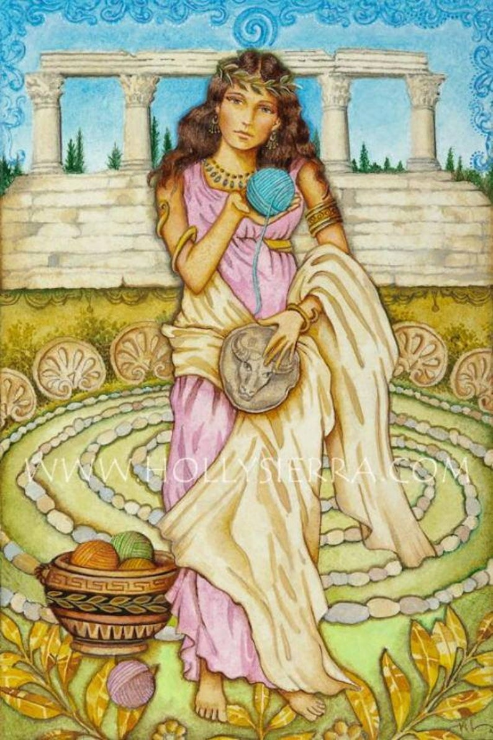
When Theseus arrived in Crete, King Minos’ daughter Ariadne fell in love with him and decided to help him escape the labyrinth.
So she gave him a ball of silk thread and a sword.

Slide 16
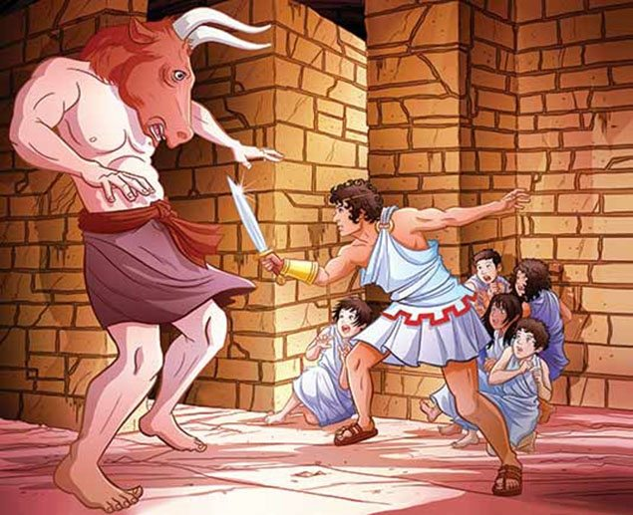
Theseus and the Athenians entered the maze and tied the end of the thread near the door, letting out the string as they walked. They continued until they found the sleeping Minotaur in the center. Theseus attacked and there was a terrible battle until the Minotaur was killed.

Slide 17
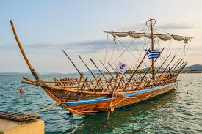
They then followed the thread back to the door and were able to board the ship with the waiting Ariadne before King Minos knew what had happened.

Slide 18
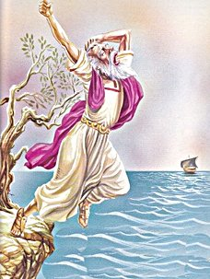
But Theseus forgot to change the ship’s sails from black to white.
His father, seeing the black sails on the approaching ship, assumed Theseus was dead. Aegeus threw himself off the cliffs and into the sea to his death. That’s why this sea is called Aegean Sea.

Slide 19
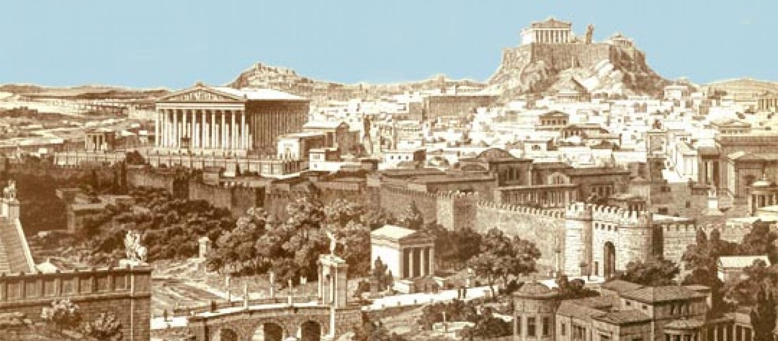
Theseus became King of Athens after his father’s death. He led the people well and united the people around Athens. He is credited as a creator of democracy.

Slide 20
Thank you!!!

