Slide 1
The biggest Czech hero

Slide 2
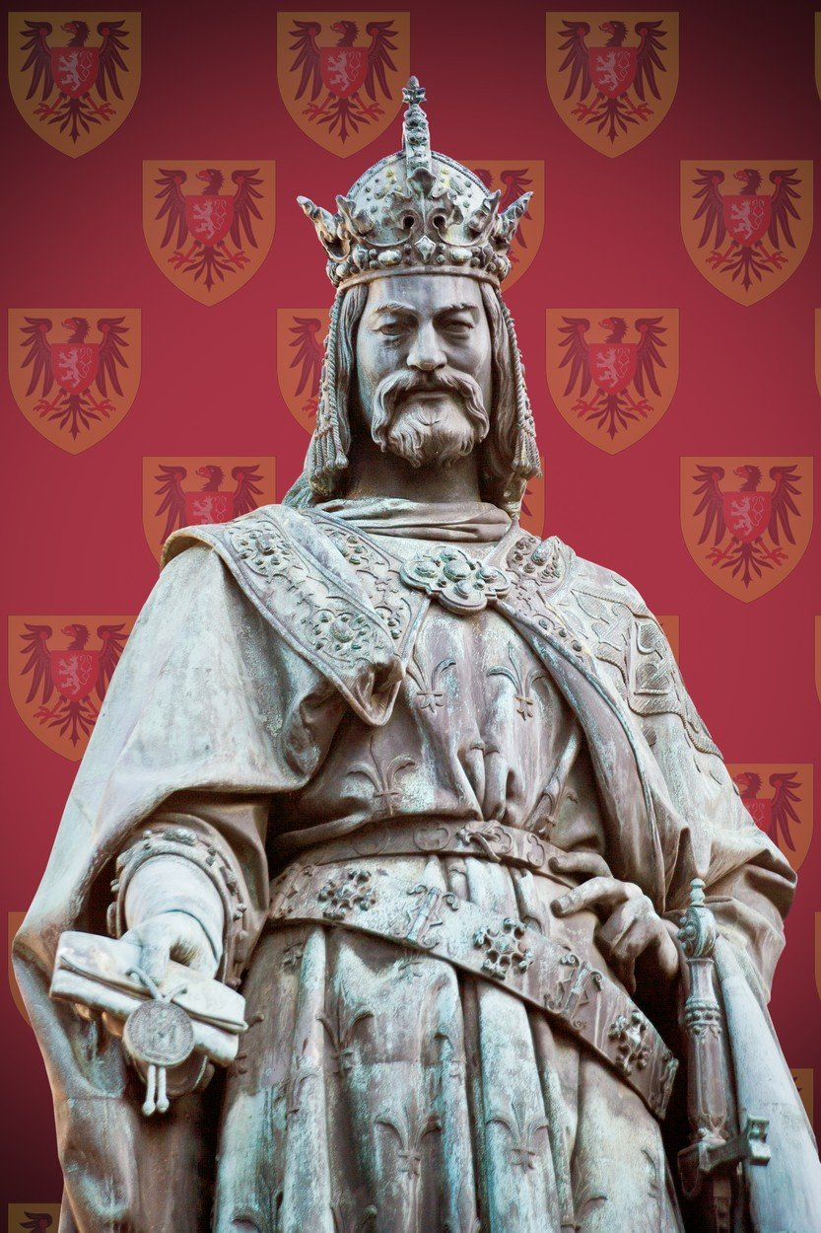
The Czech king and the emperor of the Holy Roman empire Karel IV.

Slide 3
Karel IV.
the Czech king
the emperor of the Holy Roman empire
the biggest Czech (the winner of the competiton)
was born 700 years ago

Slide 4
His name is often in the names of:
towns, cities
streets
schools
buildings

Slide 5
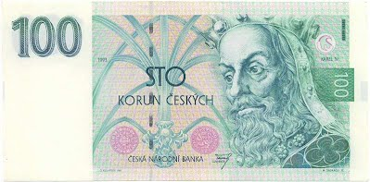
His image is on/in many:
statues
pictures
coins and bills

Slide 6
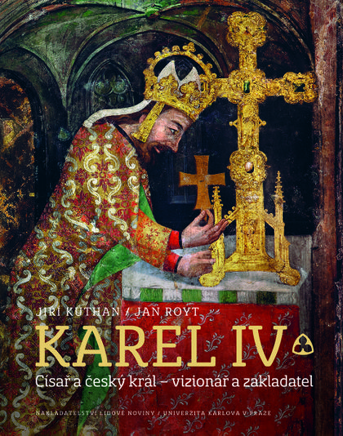
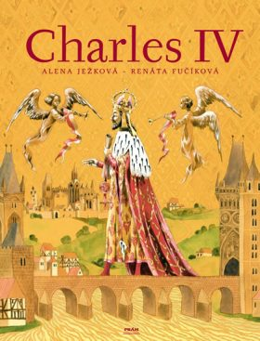
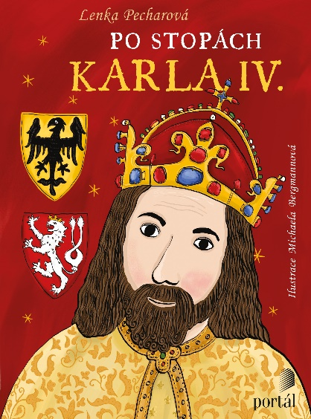
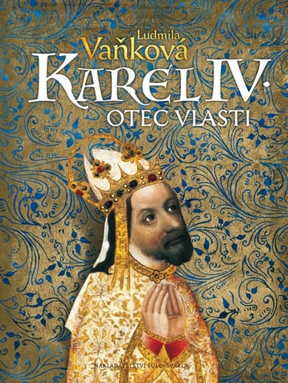
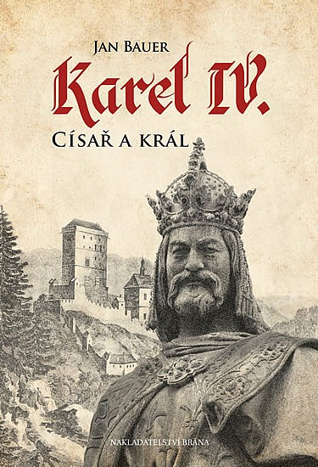
You can see him or hear about him in:
museums
poems
songs
films
musicals

Slide 7
How was the king Karel IV.?
educated and clever
He wrote his biography.
He could speak 5 languages : Latin, French, German, Italian and Czech
(1. kůň, 2. pferd, 3. άλογο, 4. cavallo, 5. kôň, 6. caballo)
English | horse
German
Slovak
Italy
Greek
Czech
Spain

Slide 8
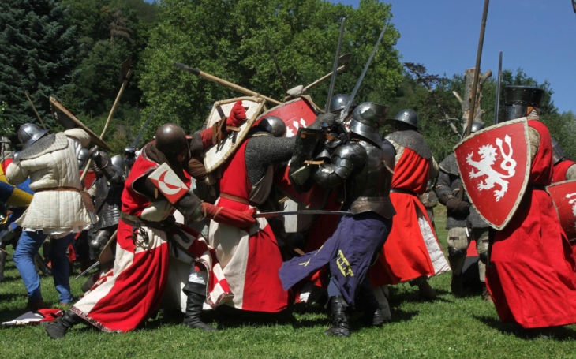
brave
He was a good soldier,but he preferred solving the problems in a diplomatic way an keeping the peace.

Slide 9
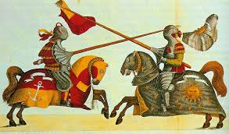
strong
He was an excellent knight.

Slide 12
hard working He built many churches, castles and other famous buildings in the Czech as well as other European countries. Some of them are named after him: Karel = Charles :
Charles University
Charles Bridge
Karlštejn Castle
Montecarlo (Italy)
Karlovy Vary

Slide 13
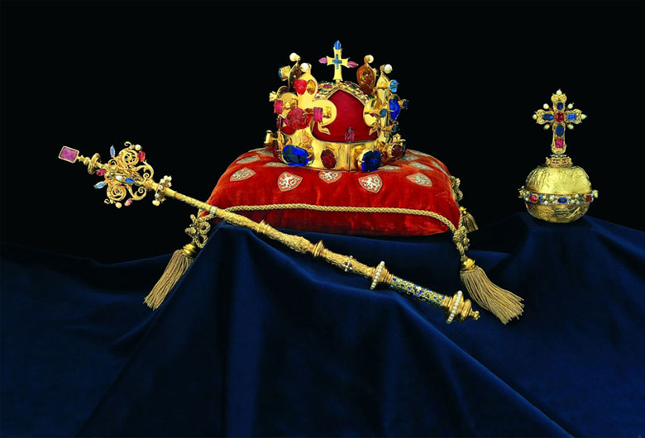
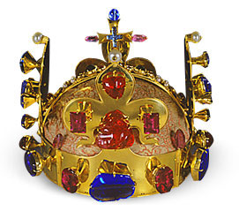
wise
He designed the crown jeewels

Slide 14
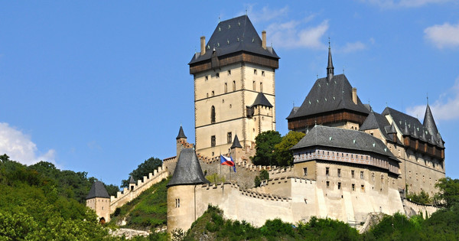
Karlštejn Castle

Slide 15
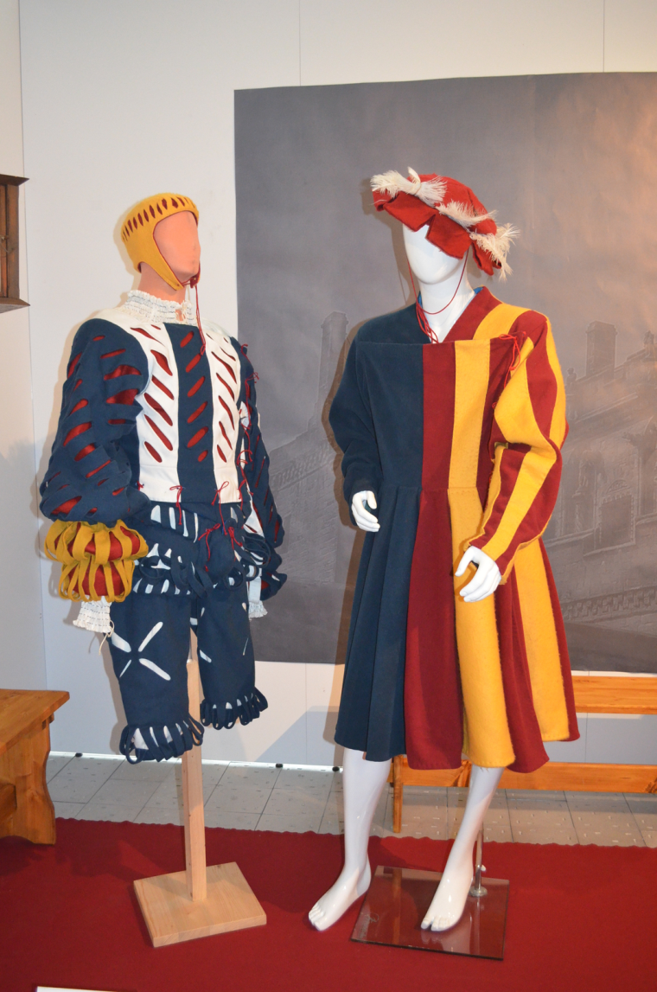
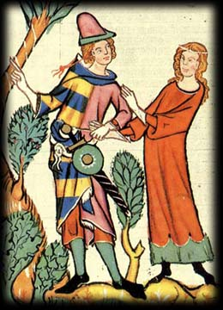
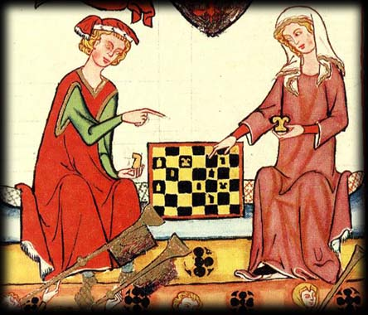
witty
He went to see ordinary people in different costumes .

Slide 16
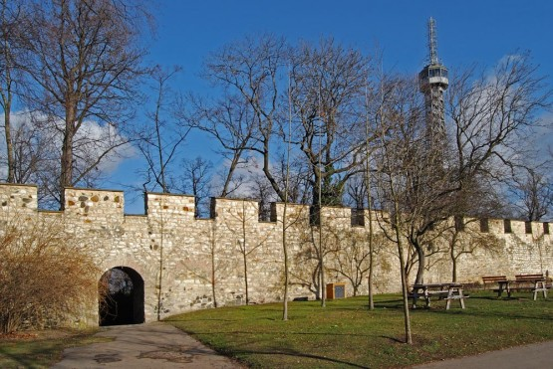
friendly and kind
He gave the work to poor hungry people to earn some money . Then they could buy some food.
The wall they built is called the Hungry Wall.

Slide 17
And now you know our the Czech hero
Charles IV.

