Slide 1
SPANISH BARCELONA My Erasmus+ KA2 Stay
Tamara Šughová, ZŠ Nábrežná, Kys.Nové Mesto, Slovakia

Slide 2
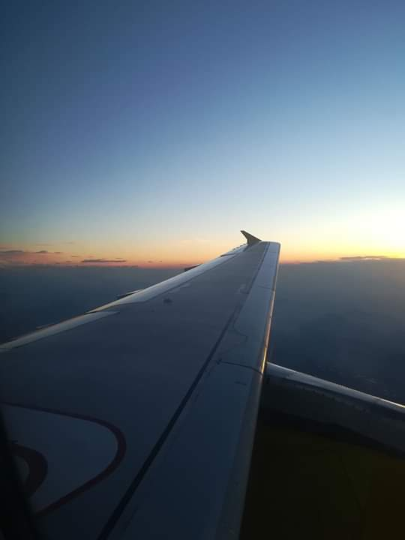
INTRODUCTION
I would like to say that everything is not always as we imagine it.
If you don't have your
own experience you can't know what it is like.
Even at school
you can find new foreign friends and experience something new.

Slide 3
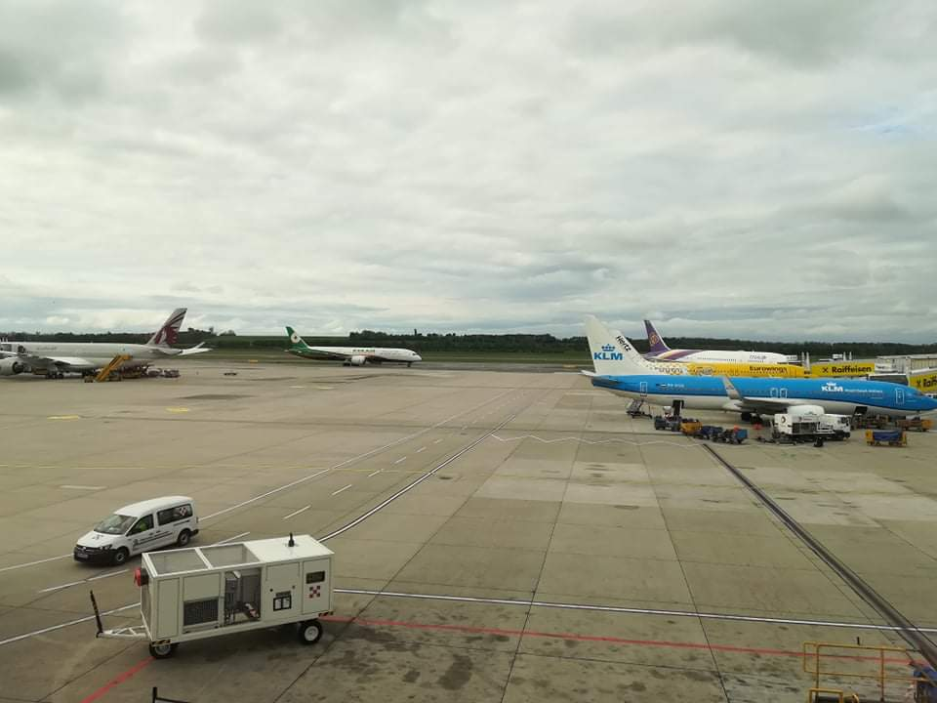
The beginning...
12.5.2019 we went to Spain. The journey took about 4 hours until we finally arrived at Vienna Airport. About 2 hours we waited in a beautiful airport building. Time ran really fast. I boarded the plane
with great enthusiasm.
It was something
unbelievable and
indescribable.

Slide 4
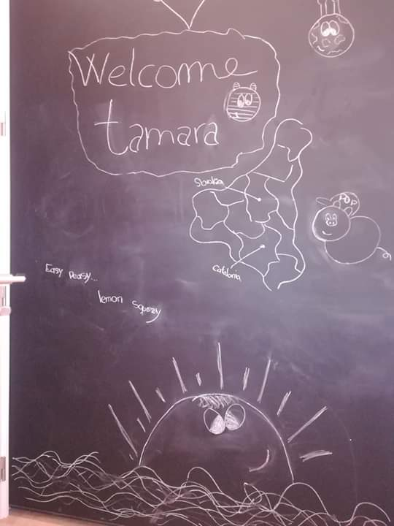
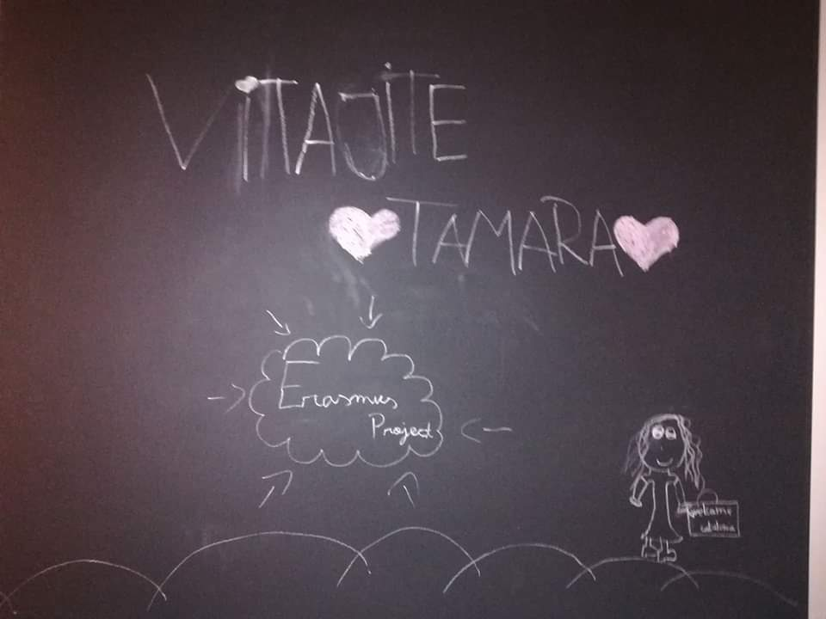
After 2 hours we landed down at Spanish airport, from where we went by bus to the train station. By train we travelled for about 1 hour until we finally arrived in Mollet del Valles. Here we met
our families for the first time. They welcomed us and took us
to their homes. I had a really wonderful „family“ . They welcomed me with the cake and the girls drew this for me...

Slide 5
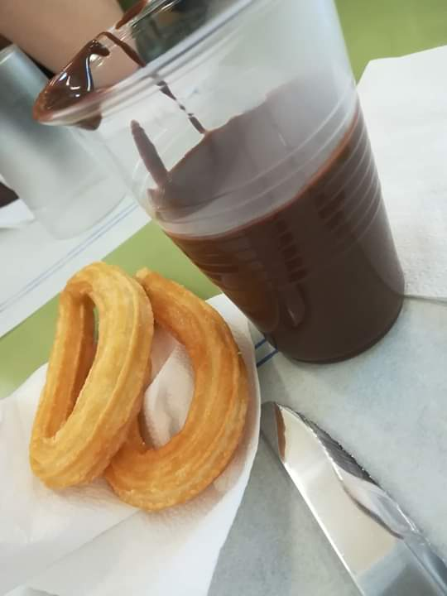
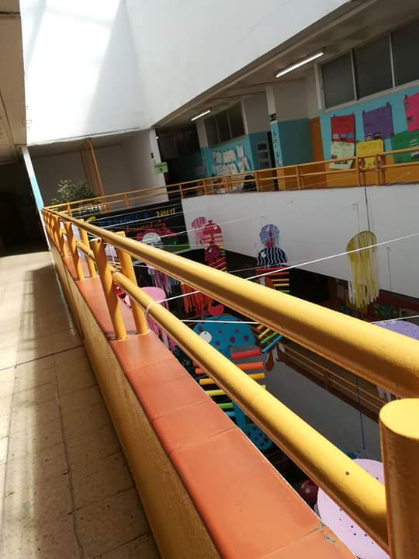
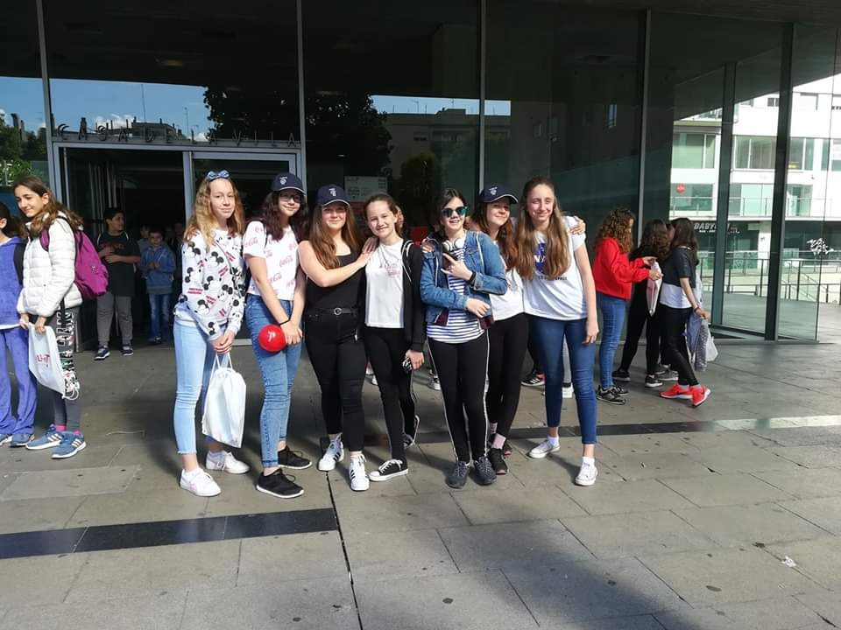
MONDAY
On Monday we visited the Spanish school which was really beautiful. We even tasted churros in other words it means the Spanish donuts. We were to visit the town hall where we were all present.

Slide 6
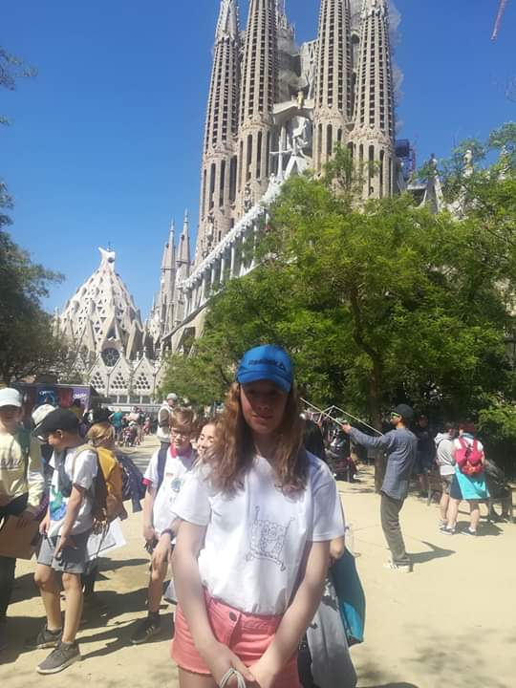
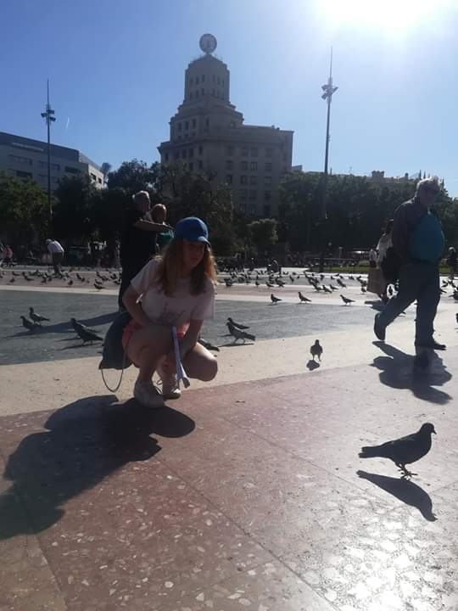
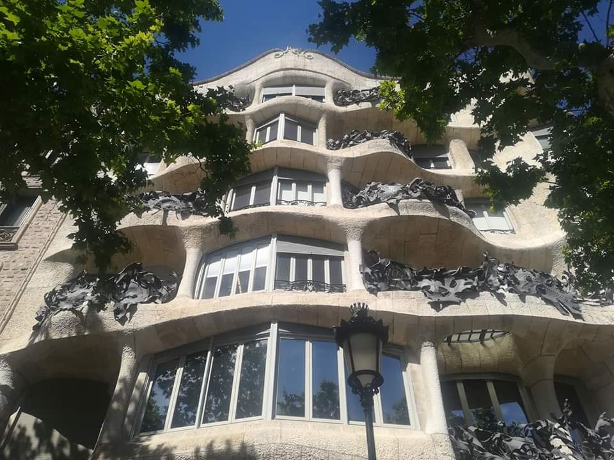
TUESDAY
On Tuesday we went to Barcelona and Sagrada Família. Really,
it was amazing and remarkable.
From Sagrada Família
we went up to the square and La Rambla.
We have seen a variety of interesting buildings and structures.

Slide 7
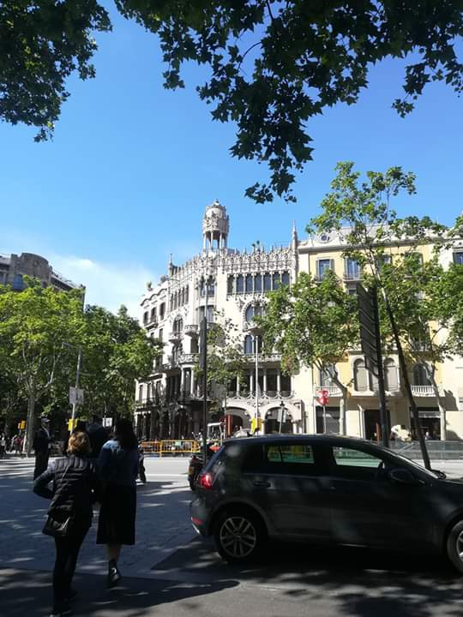
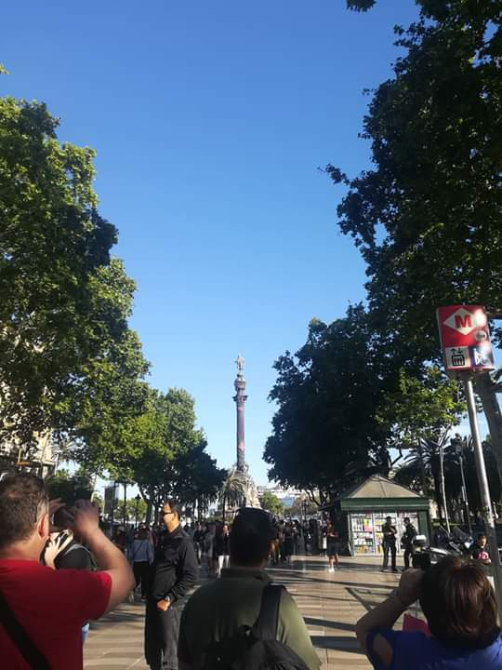
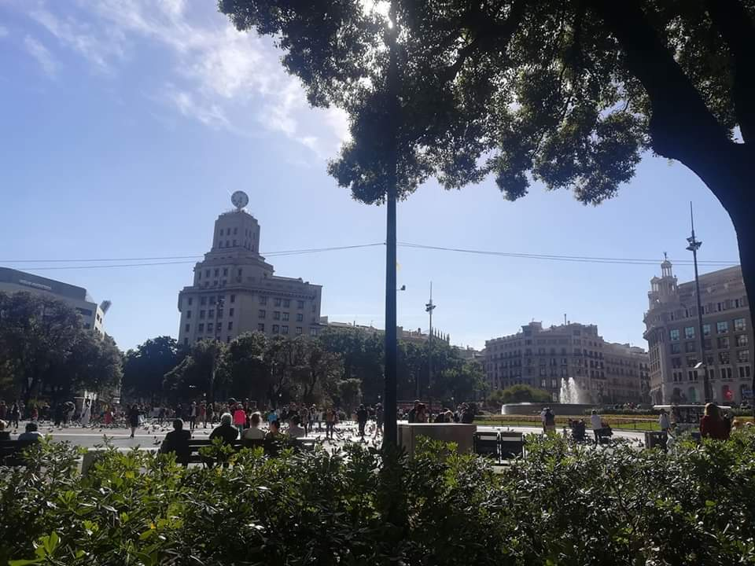

Slide 8
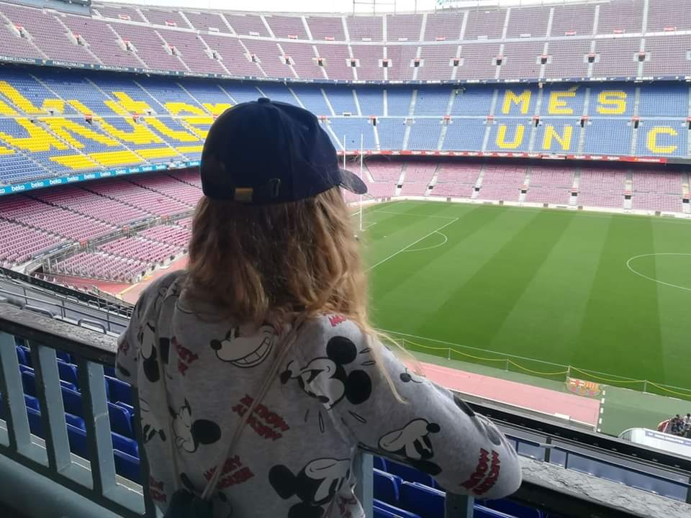
WEDNESDAY
On Wednesday we went to
the stadium of FCB.
It was really a huge stadium.
We were even lucky that
we had a guide and we could see the bathroom as well as the cups that they have won so far and many more things.
But, at the end, we went
to the shops.

Slide 9
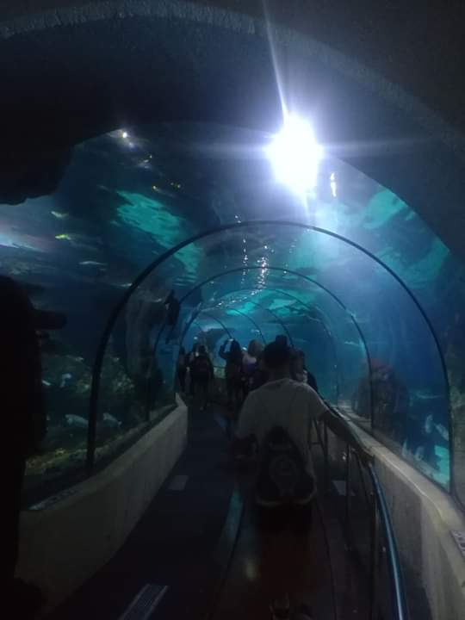
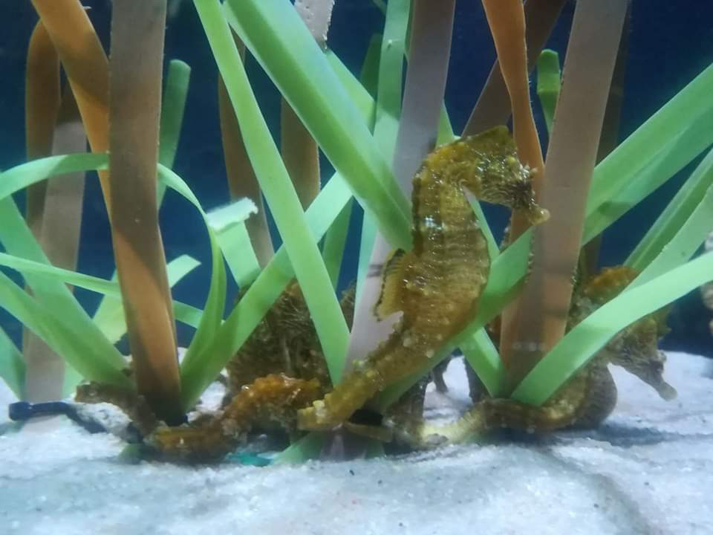
THURSDAY
Thursday was also amazing we went to have a look into the famous Aquarium. It was really fascinating, just incredible. We went under the sea, and we saw a variety of aquatic animals. Oh and of course I can't forget also an amazing break by the sea and the Magnum ice cream for 3 €. ☺

Slide 10
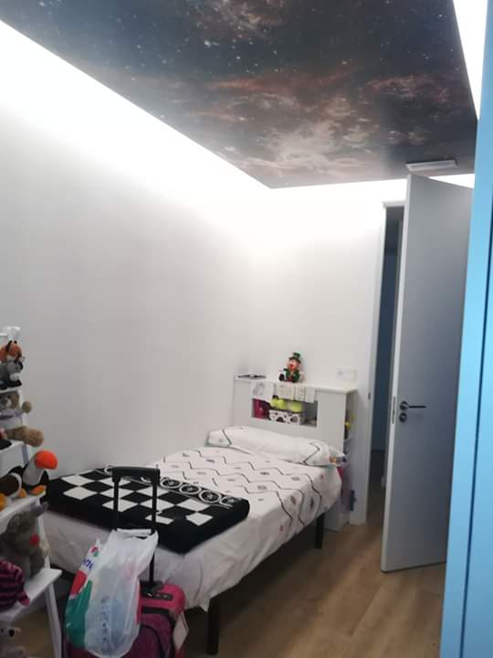
FRIDAY
On Friday, our last day of school,
the olympics were held.
It was really very exciting.
After we went to eat and to farewell, they played us
songs and they made a dance show. On that day, my „family“ took me into a typical Catalan restaurant where they gave me two magnets and a book about Barcelona as a souvenir.
Thank you!

Slide 11
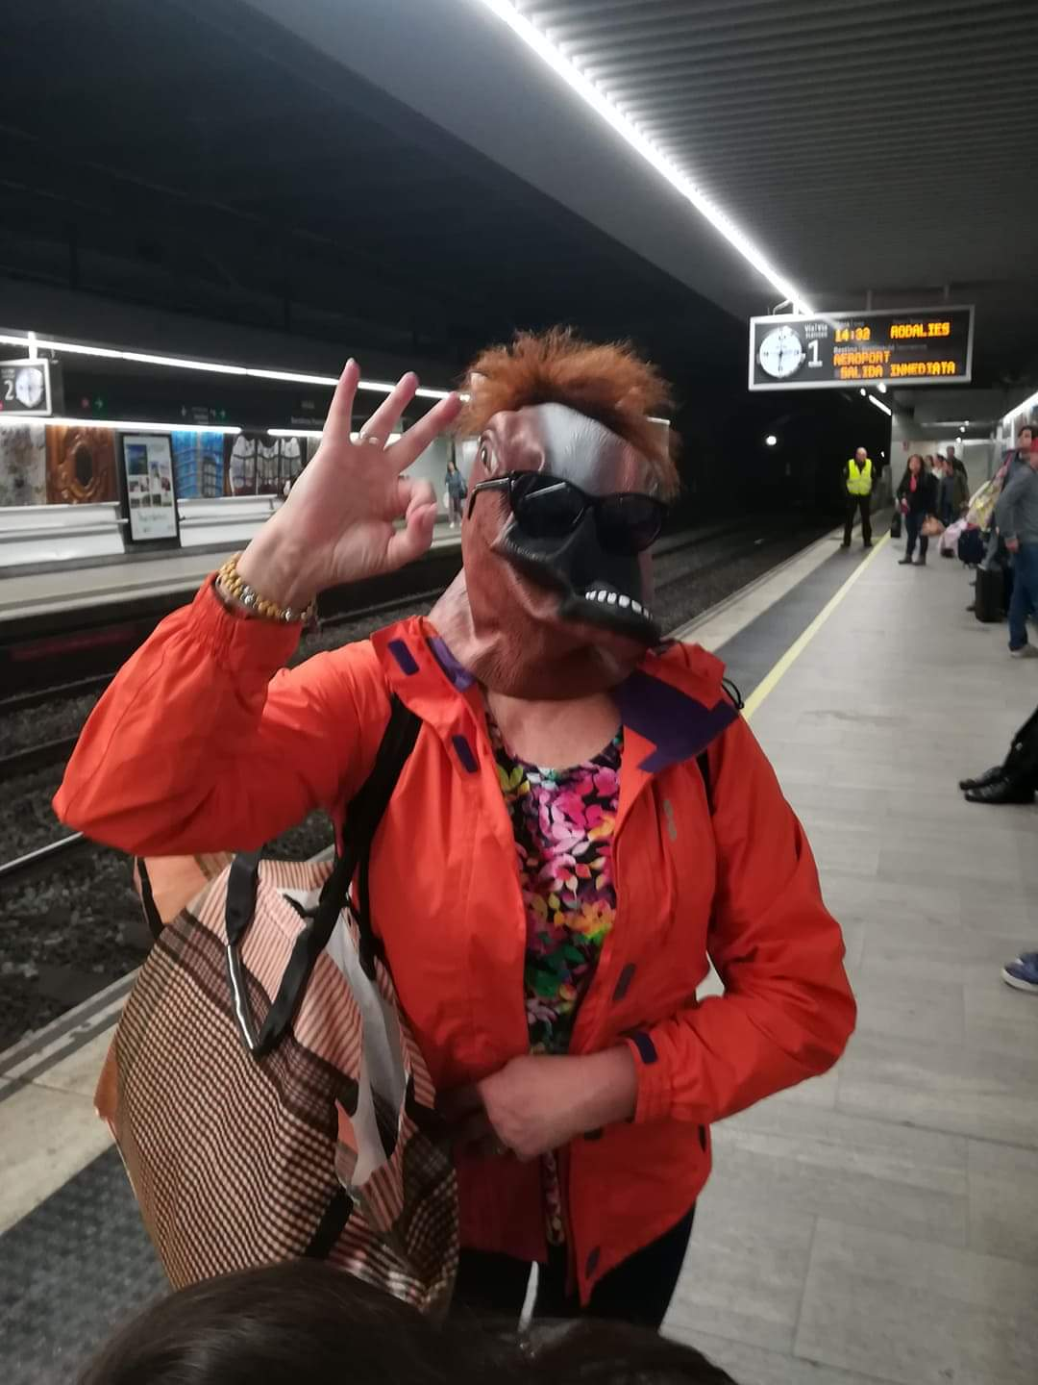
SATURDAY
Saturday was our last day in Spain. We said good bye and we went by train. From train to bus, from bus to plane, from plane to car straight home. During the way, we have experienced a really funny moments such as...
Meet Lučenzo, a horse head. ☺

Slide 12
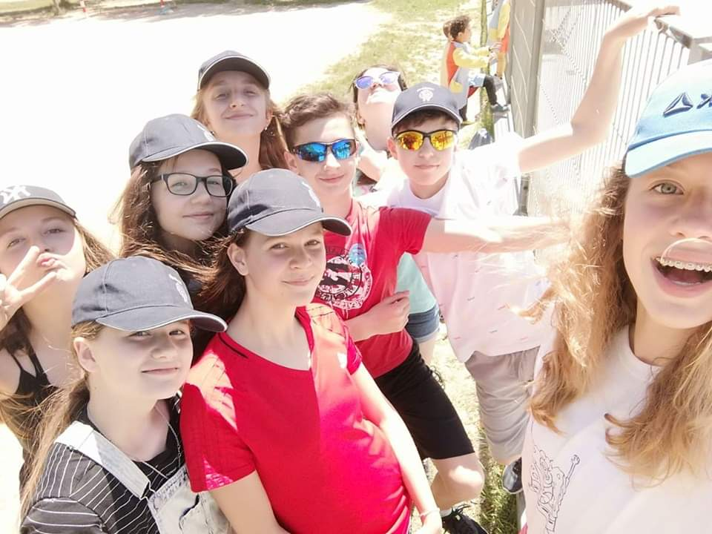
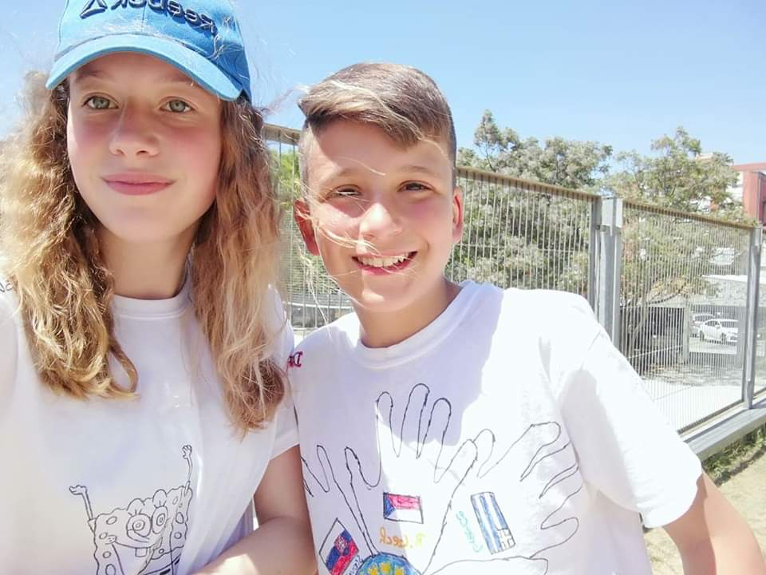
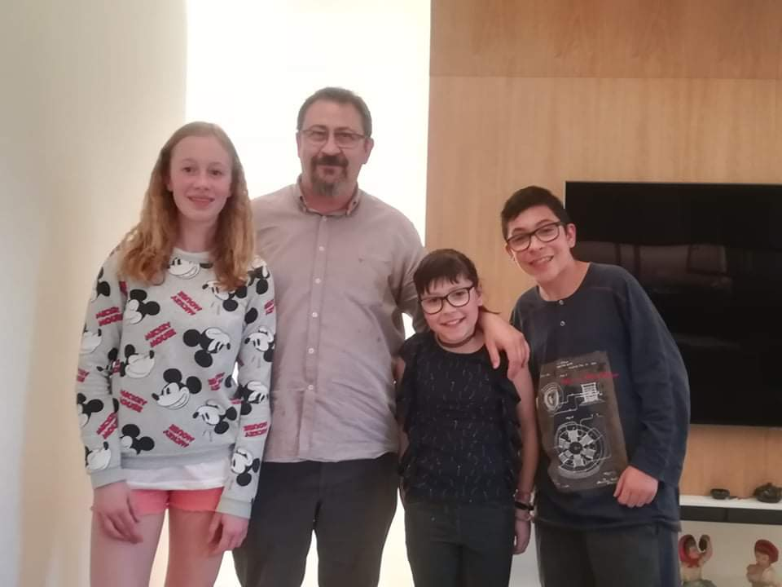

Slide 13
CONCLUSION
In conclusion, I want to say that I had prejudices towards this place. I was afraid of that
I would be alone in the family
and I wouldn ´t be able to speak English,
but believe it or not, when you are with them, you think about how good your English is.
You must have your own experience
and the memories like me ☺.

Slide 14
THANKS
I want to thank our teachers and a director
that they know us to understand and
they know us to encourage.
We really enjoy it.
It was like a dream for me and
I was glad to be there with you.
It was really amazing.
Thank you so much for everything ☺.

Slide 15
THANK YOU FOR YOUR ATTENTION !

