Slide 1
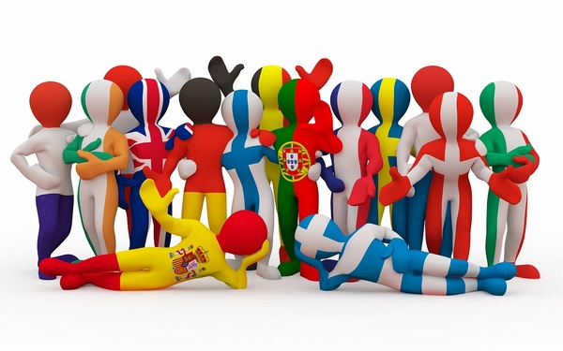
EU AND CITIZENS

Slide 2
What does it mean to be a European citizen?
All citizens of an EU country are automatically citizens of the EU. Being an EU citizen gives you some important extra rights and responsibilities.
If you are an European citizen you can work, travel and study in other country of the European Union.

Slide 3
Fundamental rights
The fundamental rights are:
the right to strike;
the right of workers to be informed and consulted;
the right to reconcile family life and professional life;
the right to healthcare, social security and social assistance throughout the European Union.

Slide 4
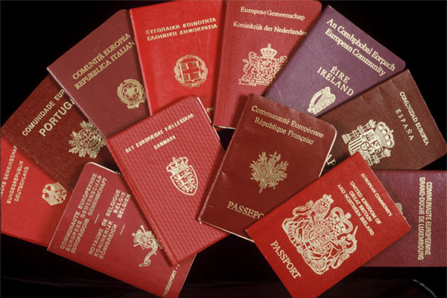
The right to travel in all European countries

Slide 5
For all EU citizens, citizenship implies:
the right to vote and to stand as a candidate in elections to the European Parliament and in municipal elections in the Member State in which they reside, under the same conditions as nationals of that State
the right to access European Parliament, Council and Commission documents, subject to certain conditions

Slide 6
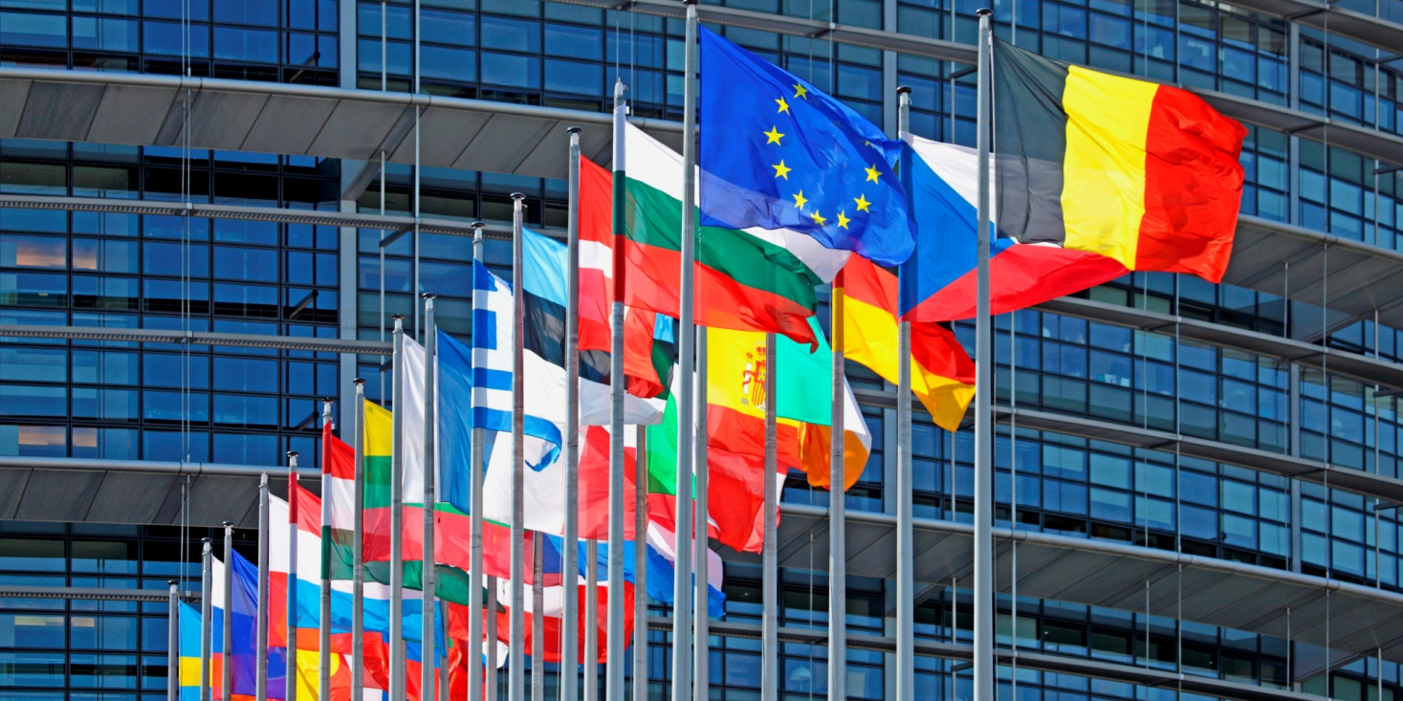

Slide 7
REALIZZATO DA DI MIRA FRANCESCA DI NINNO GIOVANNA D’EMMA FRANCESCA

