Slide 1
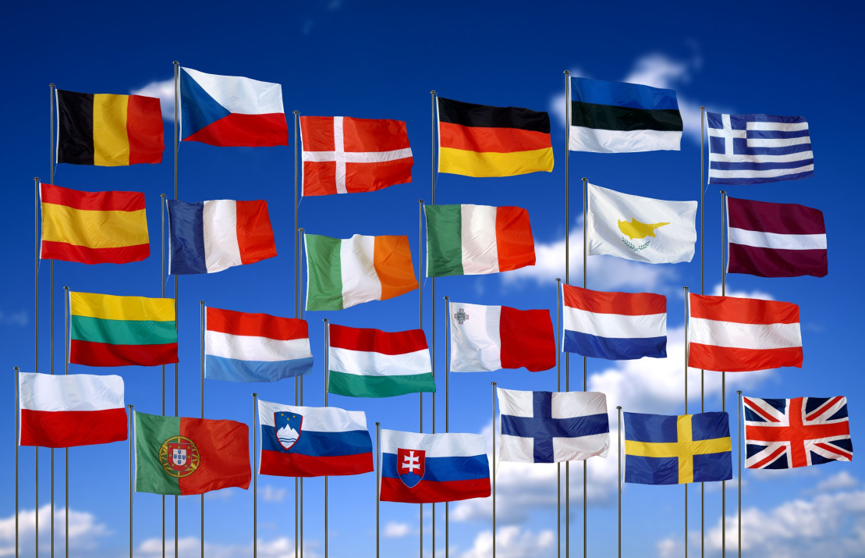
What is the European Union?
How many countries in the EU can you name?
Why aren’t all European countries in the EU?

Slide 2
What is the European Union?
28 European countries in an economic and political alliance

Slide 3
How does the European Union Work?
Watch the video and then match up each institution to its definition and role.
S&C
Why do you think the EU was formed?
Do you think the EU is still relevant today?
http://youtu.be/b2-4gpRIkUE
Notes:
What is the EU? – Mr Miller Productions

Slide 4
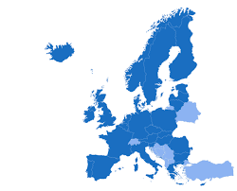
Find out:
What is the European Economic Area (EEA)?
Who is a member of the EEA?
How does the EEA differ to the EU?

Slide 5
Should the UK be a member of the EU?
Positives | Negatives
Draw the table in your book
Write the statements under the correct heading

