Slide 1
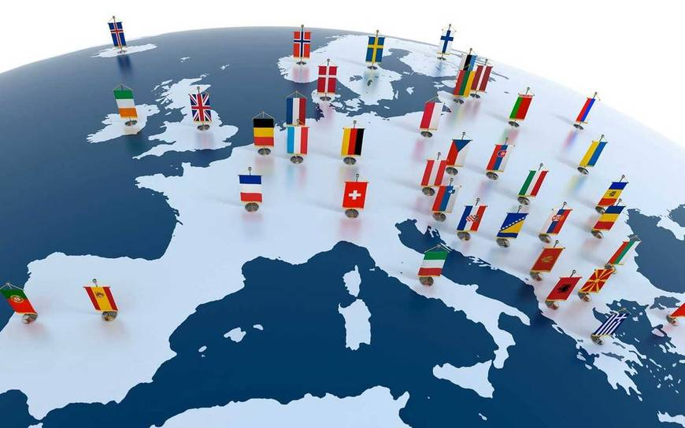
THE EUROPEAN UNION
&
HUMAN RIGHTS

Slide 2
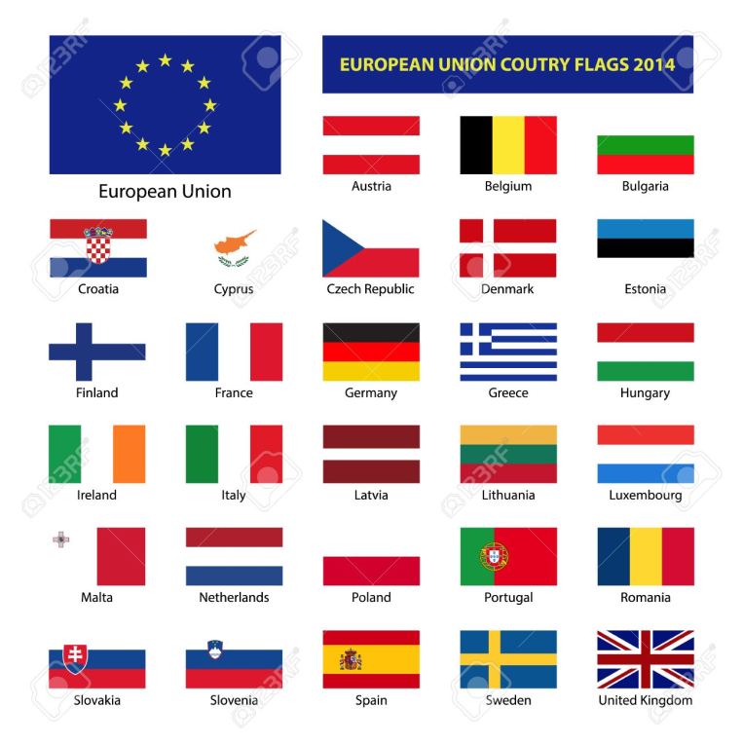
THE EUROPEAN UNION
The EU was not always as big as it is today. When European countries started to cooperate economically in 1951, only Belgium, Germany, France, Italy, Luxembourg and the Netherlands participated.
The euro (€) is the official currency of 19 out of 28 EU member countries. These countries are collectively known as the Eurozone.

Slide 3
Human rights
The European Union is based on a strong commitment to promoting and protecting human rights, democracy and the rule of law worldwide. Human rights are at the very heart of EU relations with other countries and regions. Promoting human rights work can help to prevent and resolve conflicts and, ultimately, to alleviate poverty.
EU policy includes:
working to promote the rights of women, children, minorities and displaced persons
opposing the death penalty, torture, human trafficking and discrimination
defending civil, political, economic, social and cultural rights
defending the universal and indivisible nature of human rights through full and active partnership with partner countries, international and regional organizations, and groups and associations at all levels of society.

Slide 4
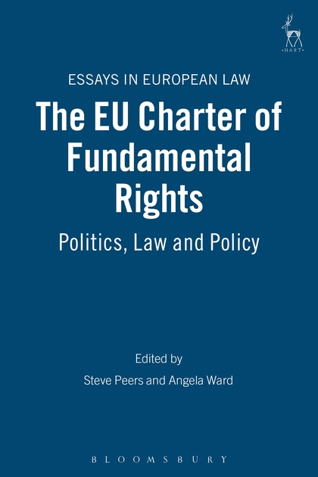
EU Charter of Fundamental Rights
The Charter of Fundamental Rights of the EU brings together in a single document the fundamental rights protected in the EU. The Charter contains rights and freedoms under six titles: Dignity, Freedoms, Equality, Solidarity, Citizens' Rights, and Justice. Proclaimed in 2000, the Charter has become legally binding on the EU with the entry into force of the Treaty of Lisbon, in December 2009.
The provisions of the Charter are addressed to:
- the institutions and bodies of the EU with due regard - for the principle of subsidiarity;
- the national authorities only when they are implementing EU law.
For example, the Charter applies when EU countries adopt or apply a national law implementing an EU directive or when their authorities apply an EU regulation directly.
In cases where the Charter does not apply, the protection of fundamental rights is guaranteed under the constitutions or constitutional traditions of EU countries and international conventions they have ratified.

Slide 5
Power Point creato da:
IAFFALDANO Antonella
MARINELLI Gabriele
MELOSCIA Carlotta

