Slide 1
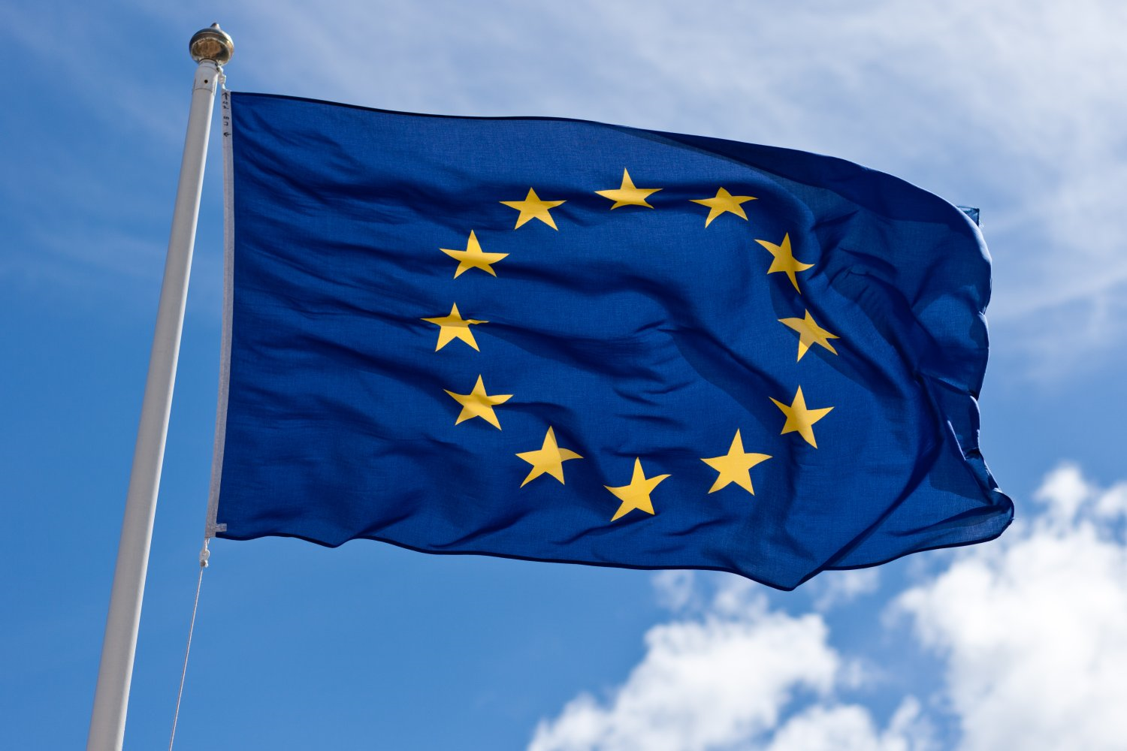
THE EU

Slide 2
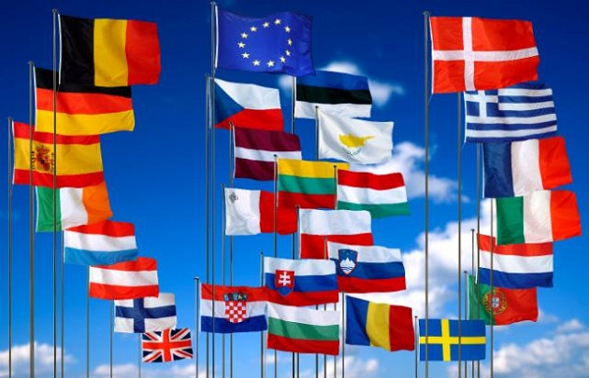
The economic association of over two dozen European countries which seek to create a unified, barrier-free market for products and services throughout the continent, as well as a common currency with a unified authority over that currency.

Slide 3
The European Union has brought peace and stability to Europe. In 2012, the Union was even awarded the Noble Peace Prize.
As a Union citizen, we enjoy four importants right, that are very symbolic :
You can travel freely and stay in any EU member state. You can find work in another EU member state.
You can vote in the European Parliament elections in the member state in which you live permanently.
If you travel outside Europe and need help, the Finnish foreign mission will assist you.
If you have been treated unfairly by any EU official, you can appeal to or ask for help from the European Ombudsman.

