Slide 1
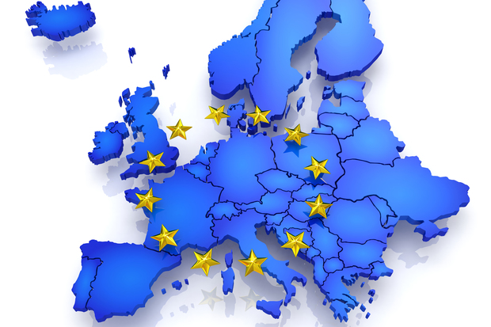
THE HISTORY OF THE EUROPEAN UNION

Slide 2
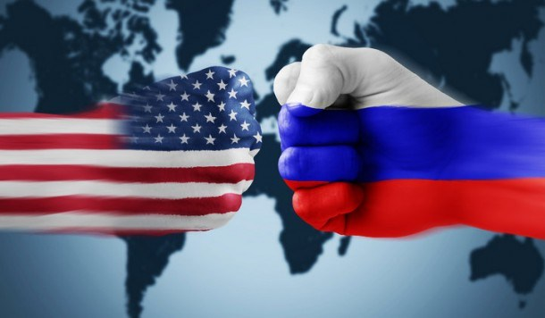
A peaceful Europe – the beginnings of cooperation
The European Union is set up with the aim of ending the frequent and bloody wars between neighbours, which culminated in the Second World War. As of 1950, the European Coal and Steel Community begins to unite European countries economically and politically in order to secure lasting peace. The six founding countries are Belgium, France, Germany, Italy, Luxembourg and the Netherlands. The 1950s are dominated by a cold war between east and west. Protests in Hungary against the Communist regime are put down by Soviet tanks in 1956.

Slide 3
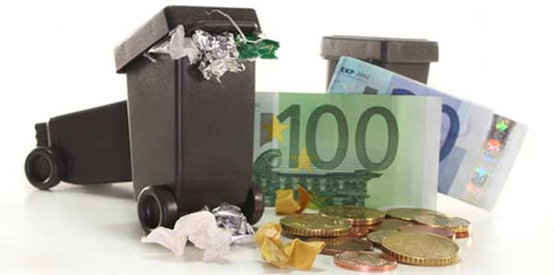
2. A growing Community – the first enlargement
Denmark, Ireland and the United Kingdom join the European Union on 1 January 1973, raising the number of Member States to nine. The short, yet brutal, Arab-Israeli war of October 1973 results in an energy crisis and economic problems in Europe. The European Parliament increases its influence in EU affairs and in 1979 all citizens can, for the first time, elect their members directly. The fight against pollution intensifies in the 1970s. The EU adopts laws to protect the environment, introducing the notion of ‘the polluter pays’ for the first time.

Slide 4
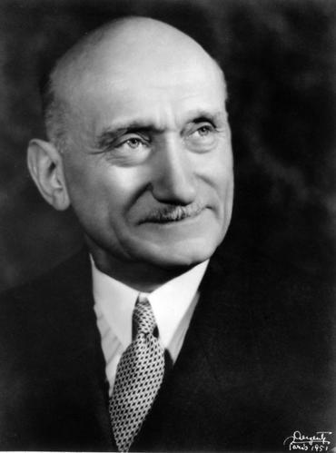
The first step in the process of foundation of the European Community was given by the French Foreign Minister, Robert Schuman. In a speech inspired by Jean Monnet, Schuman proposed that France and Germany and any other European country wishing to join them pool their coal and steel resources. This plan of economic integration looked for developing the approach between France and Germany, moving definitively away the haunt of war in Europe. The foreign ministers of the Six, presided over by the Belgian Paul Henri Spaak, met in a Conference in Messina (Italy) in 1955. The agreements they reached there meant a definitive step in the European construction: the 25th March 1957, the Six signed the Treaties of Rome, establishing the European Economic Community (EEC) and the European Atomic Energy Community (Euratom).

Slide 5
Created by Chiara Adelaide Giulia

