Slide 1
The European Commission's priorities

Slide 2
The European Commission is the executive of the European Union and promotes its general interest.

Slide 3
Jobs, growth and investment
Digital single market
Energy union and climate
Internal market
A deeper and fairer economic and monetary union
A balanced and progressive trade policy to harness globalisation
Justice and fundamental rights
Migration
A stronger global actor
Democratic change

Slide 4
Jogrowth and investmentbs,
Digital single market

Slide 5
Energy union and climate
Internal market

Slide 6
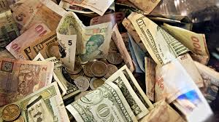
A deeper and fairer economic and monetary union
A balanced and progressive trade policy to harness globalisation

Slide 7
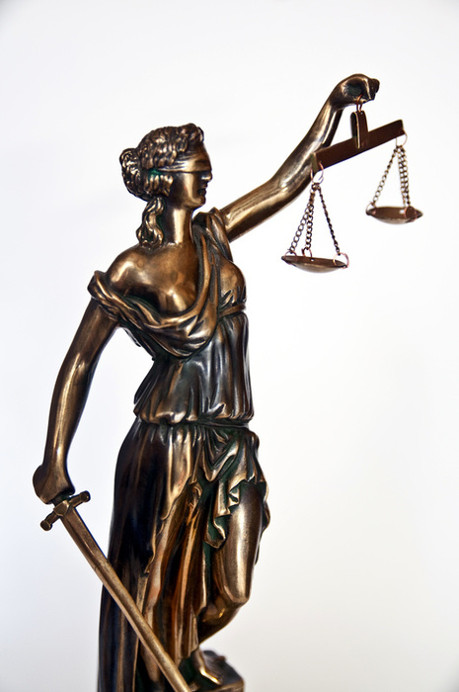
Justice and fundamental rights
Migration

Slide 8
A stronger global actor
Democratic change

