Slide 1
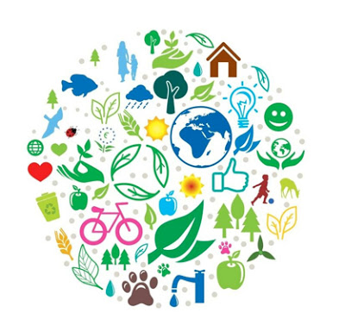
The EU and the environment
The EU has some of the world's highest environmental standards. Environment policy helps green the EU economy, protect nature, and safeguard the health and quality of life of people living in the EU.

Slide 2
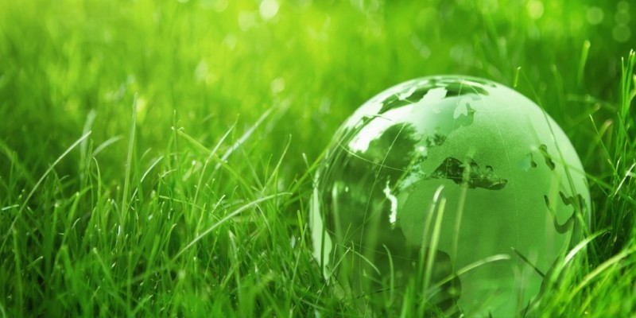
Green growth
'Green growth' entails developing integrated policies that promote a sustainable environmental framework. Environmental innovations can be implemented and exported, making Europe more competitive and improving people's quality of life. Fairness is paramount in all this.

Slide 3
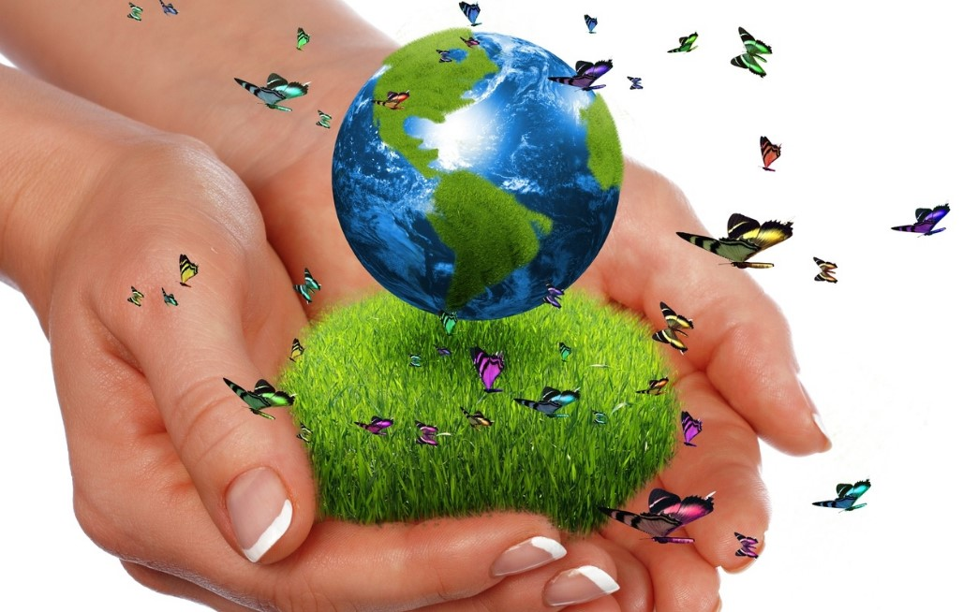
Protecting nature
Nature is our life support system, so we need to look after it. Europe is working to safeguard these natural resources and halt the decline of endangered species and habitats. Natura 2000 is a network of 26,000 protected natural areas, covering almost 20% of the EU's land mass, where sustainable human activities can coexist with rare and vulnerable species and habitats.

Slide 4
Safeguarding the health and wellbeing of people living in the EU
Water, air pollution and chemicals are among people's top environmental concerns. To safeguard people from environment-related pressures and risks to health and wellbeing, EU policy aims to:
guarantee safe drinking and bathing water
improve air quality and reduce noise
reduce or eliminate the effects of harmful chemicals.

Slide 5
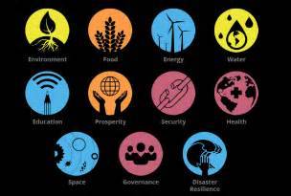
Global challenges
Global environmental challenges become more pressing. More action is needed to ensure that
air, oceans and other water resources are kept clean
land and ecosystems are used sustainably
climate change is kept to manageable levels.
As a global actor, the EU plays a key role in international efforts to promote sustainable development globally.

Slide 6
Lamanda Lorenza
Fedele Denise
Panzini Maria Pia
Maione Castillo Viannaci

