Slide 1
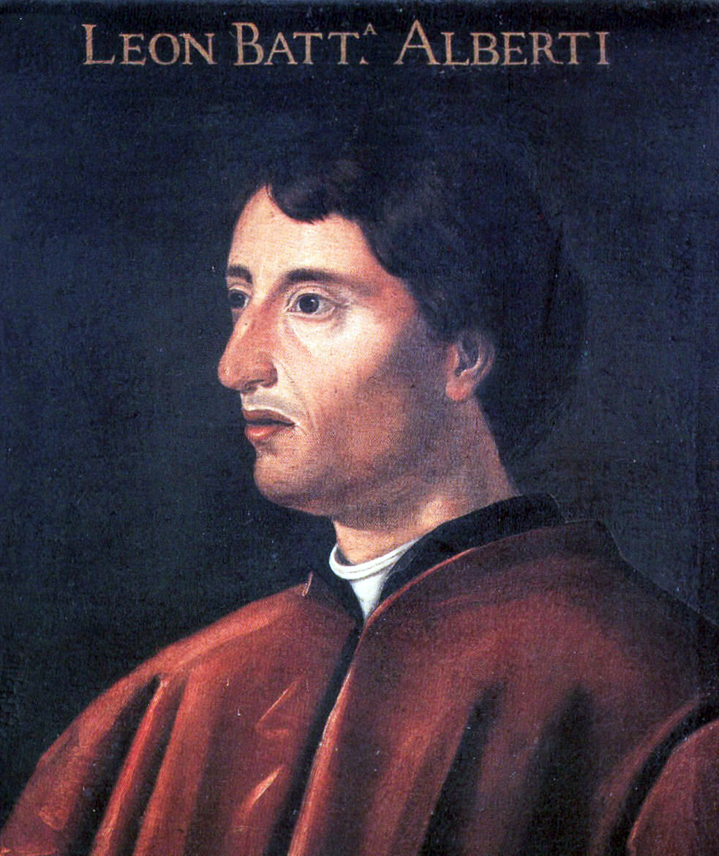
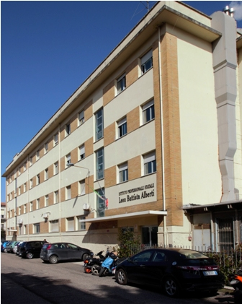
IPSIA Leon Battista Alberti
Our School owes its name to the architect Leon Battista Alberti (1404 – 1472), author of the project of the city's cathedral

Slide 2
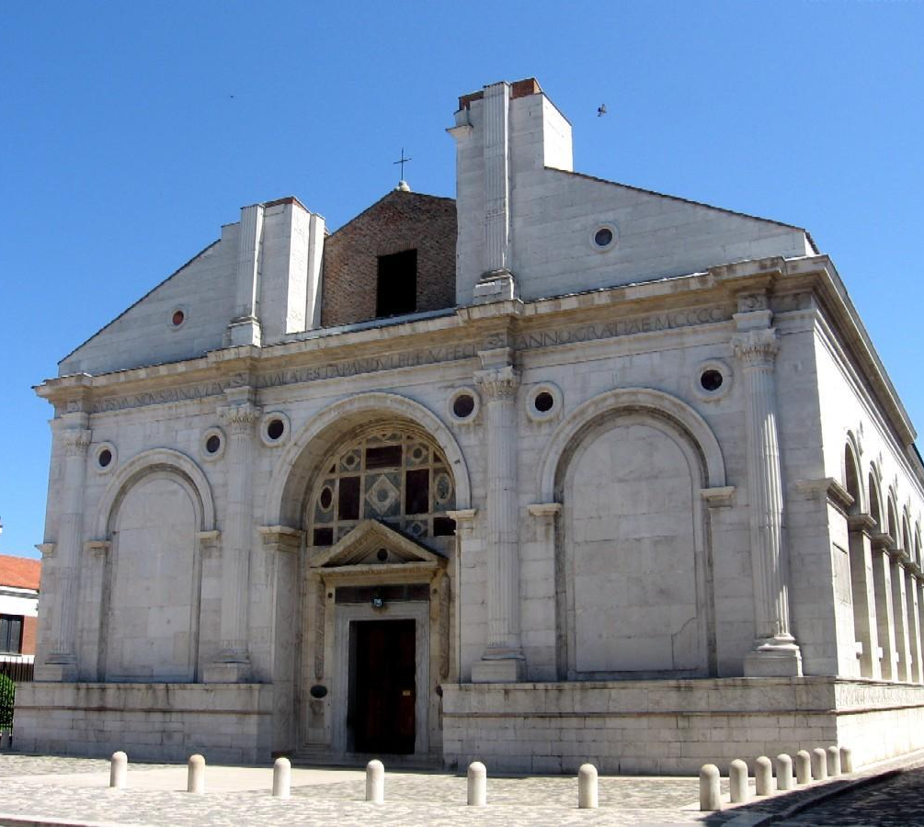
Both the institute's logos recall his work: the ‘Tempio Malatestiano’ in Rimini

Slide 3
It is the oldest school in Rimini, in fact it was founded in 1882 as an evening school of Arts and Crafts.
Later in 1919 the evening school becomes daytime with full schedule and qualification of Working-Class School (Scuola Popolare Operaia).
During Fascism he was reorganized in the Royal Industrial School of Traineeship "Alessandro Mussolini" (father of Benito and whose work was a blacksmith).
After WW2 he was able to reopen only in 1949 with all his courses. Lastly, in 1956 it became a Professional Institute for Industry and Crafts "L.B. Alberti.

Slide 4
The Institute's specializations have always been linked to the needs of the territory
Initially Adjusters, Turners, Blacksmiths,Carpenters-Ebanists and then Masons, Mechanics for Aviation and for Agricultural Tractors or even Radiotelegraphists, Marconists and Repairers of Radio and TV
Now technicians are trained with both, mechanical and electrotechnical/electronic (Mechatronics) skills for the automotive repair or for civil and industrial plants.

Slide 5
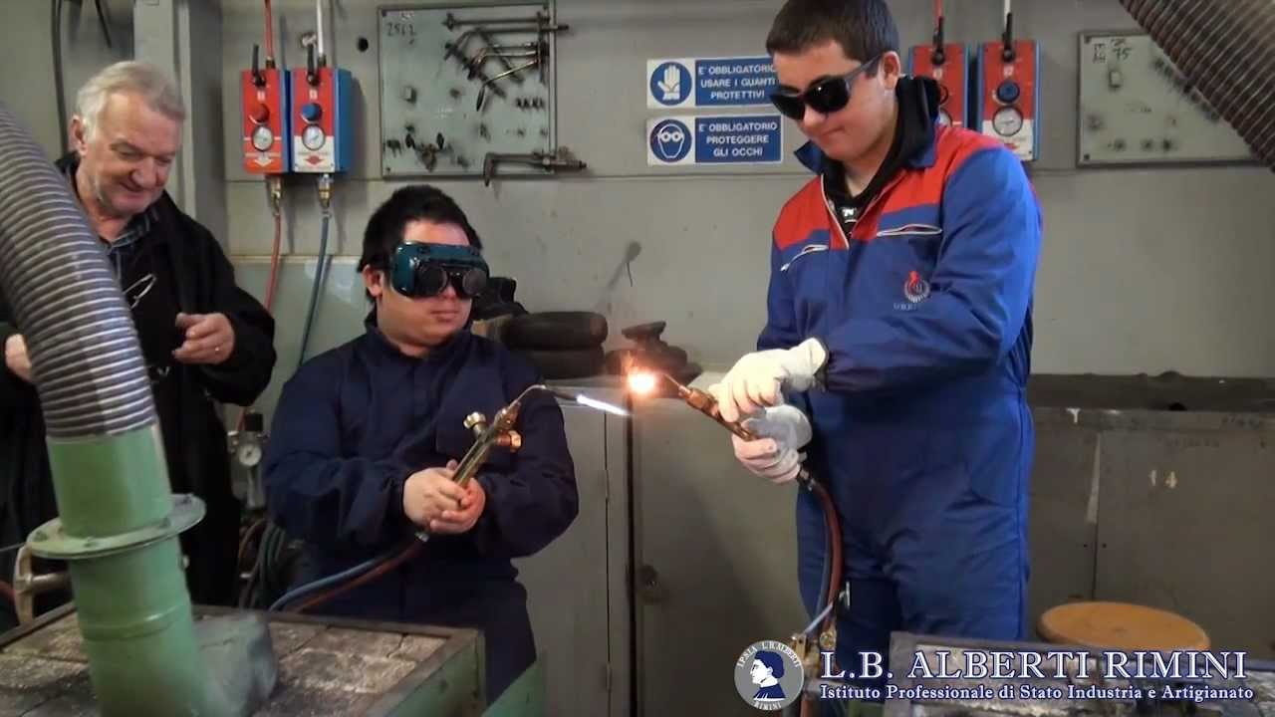
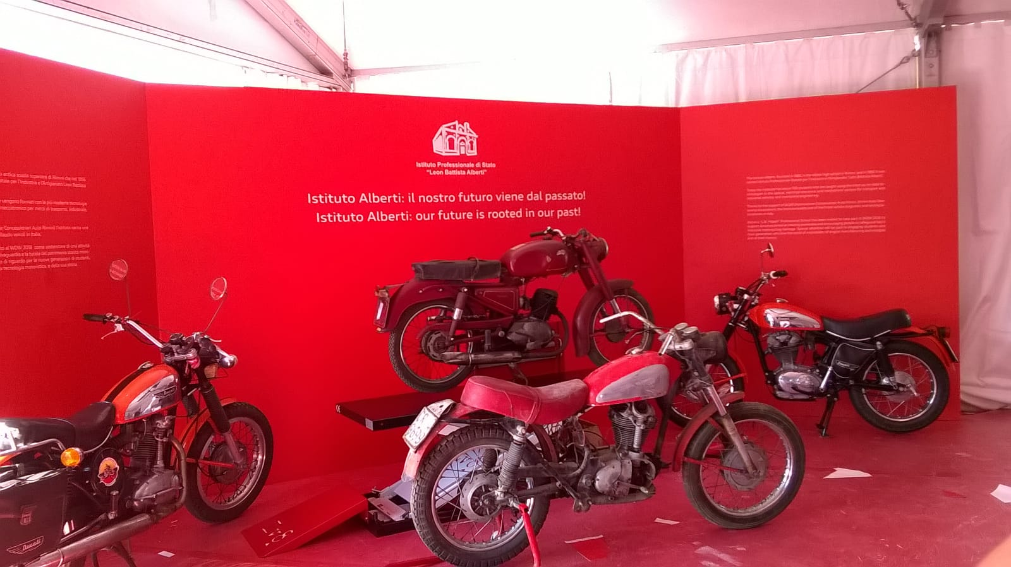
WELDING LABORATORY EXERCISES
RESTORATION OF HISTORICAL MOTORCYCLES

Slide 6
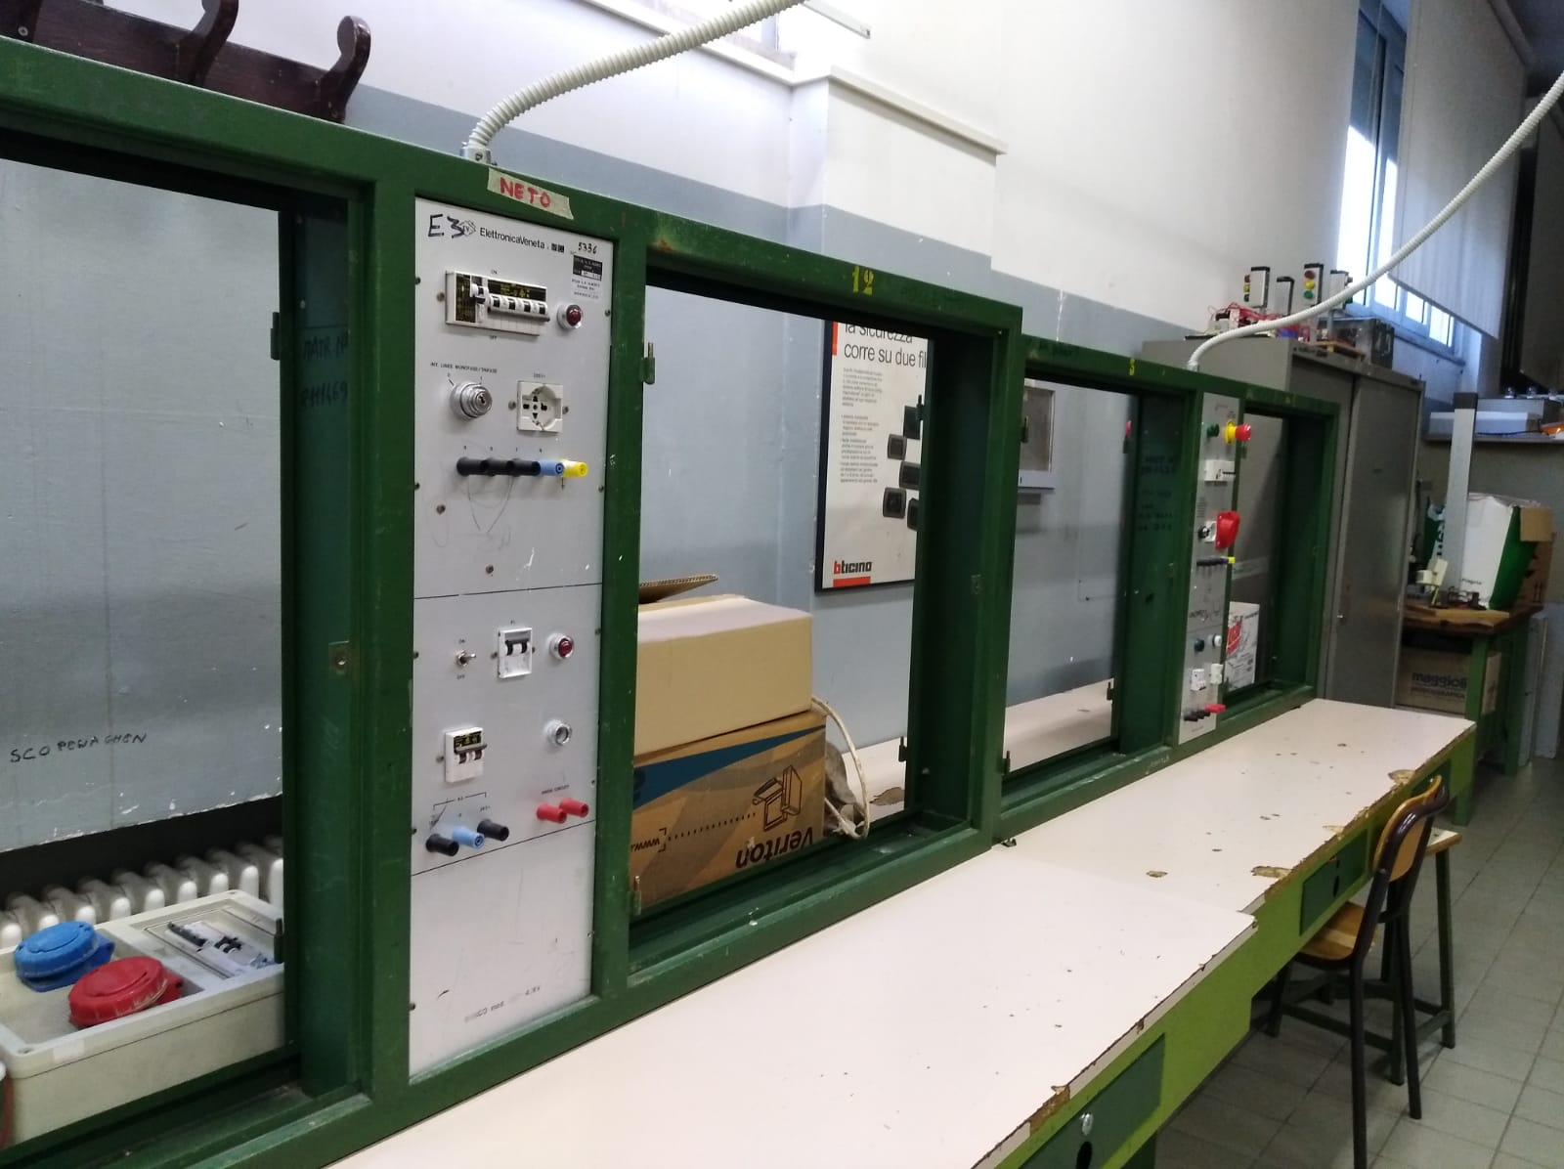
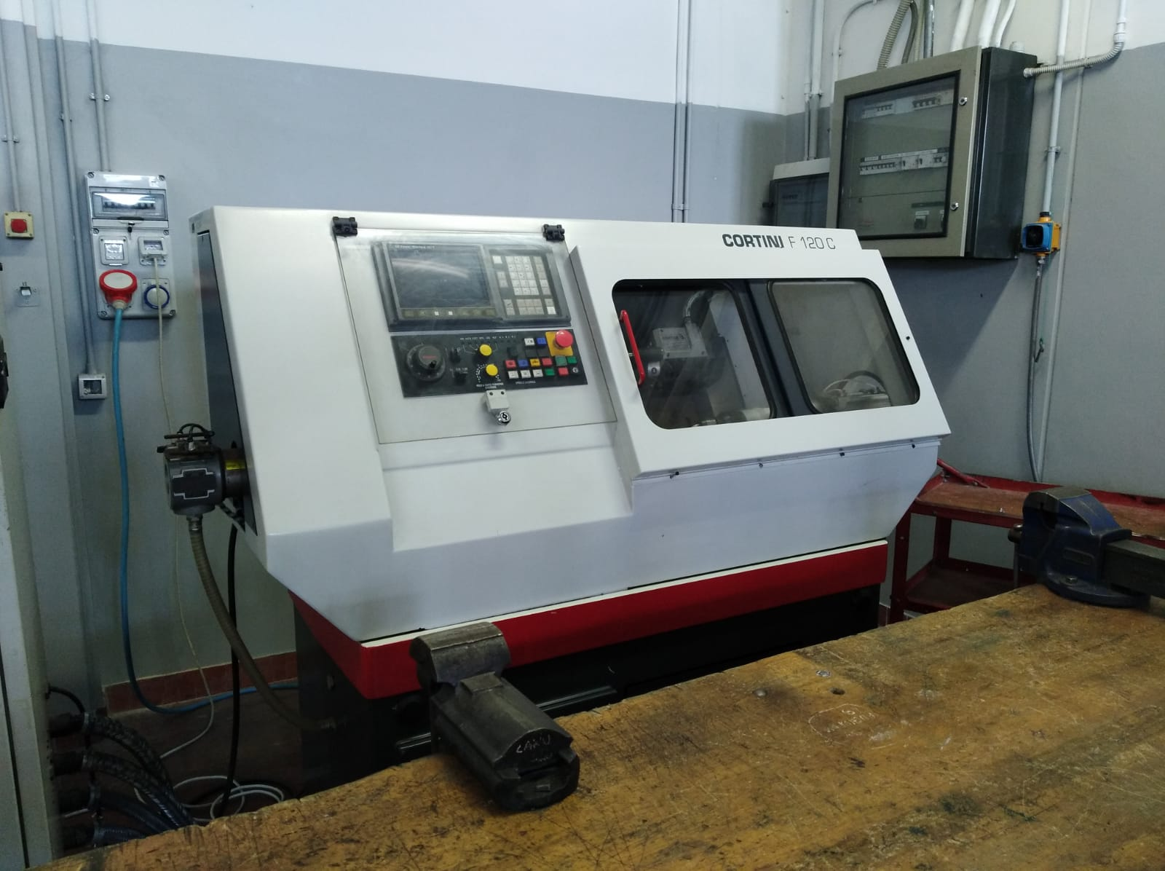
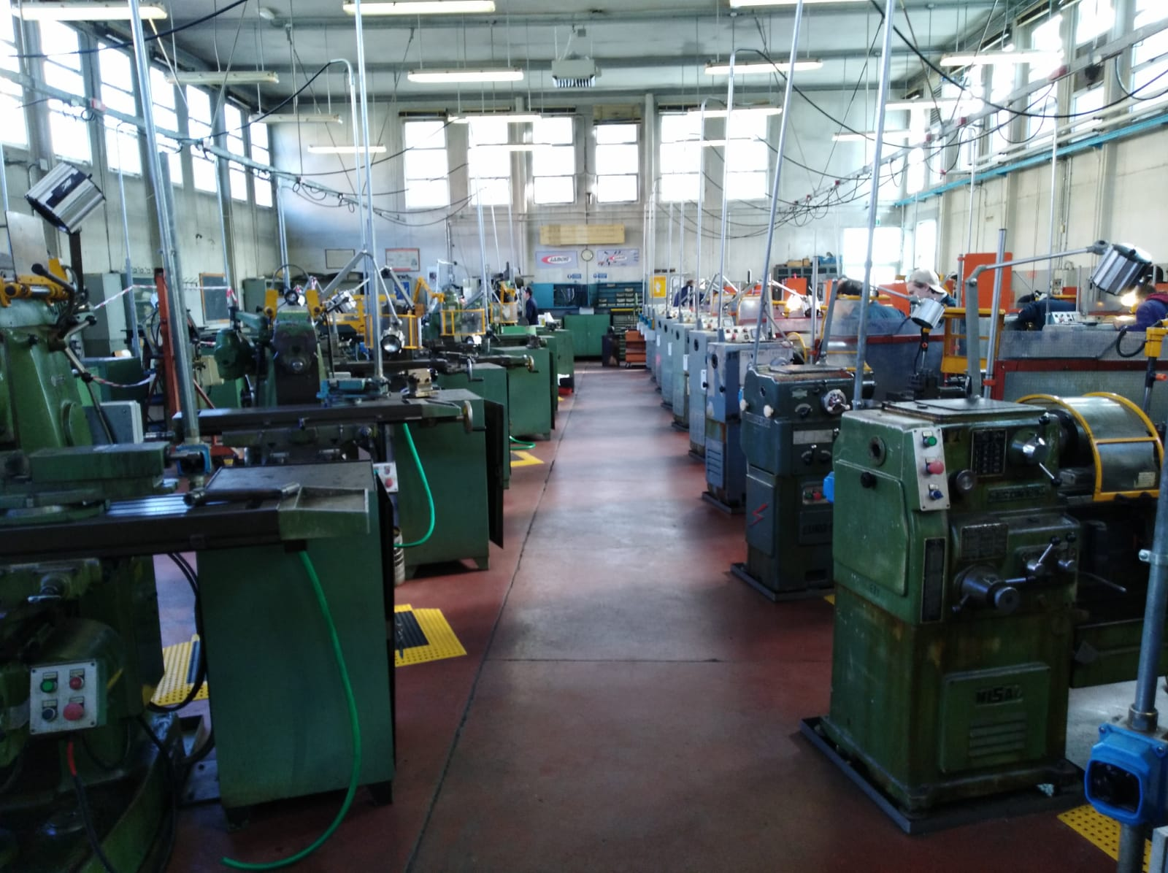
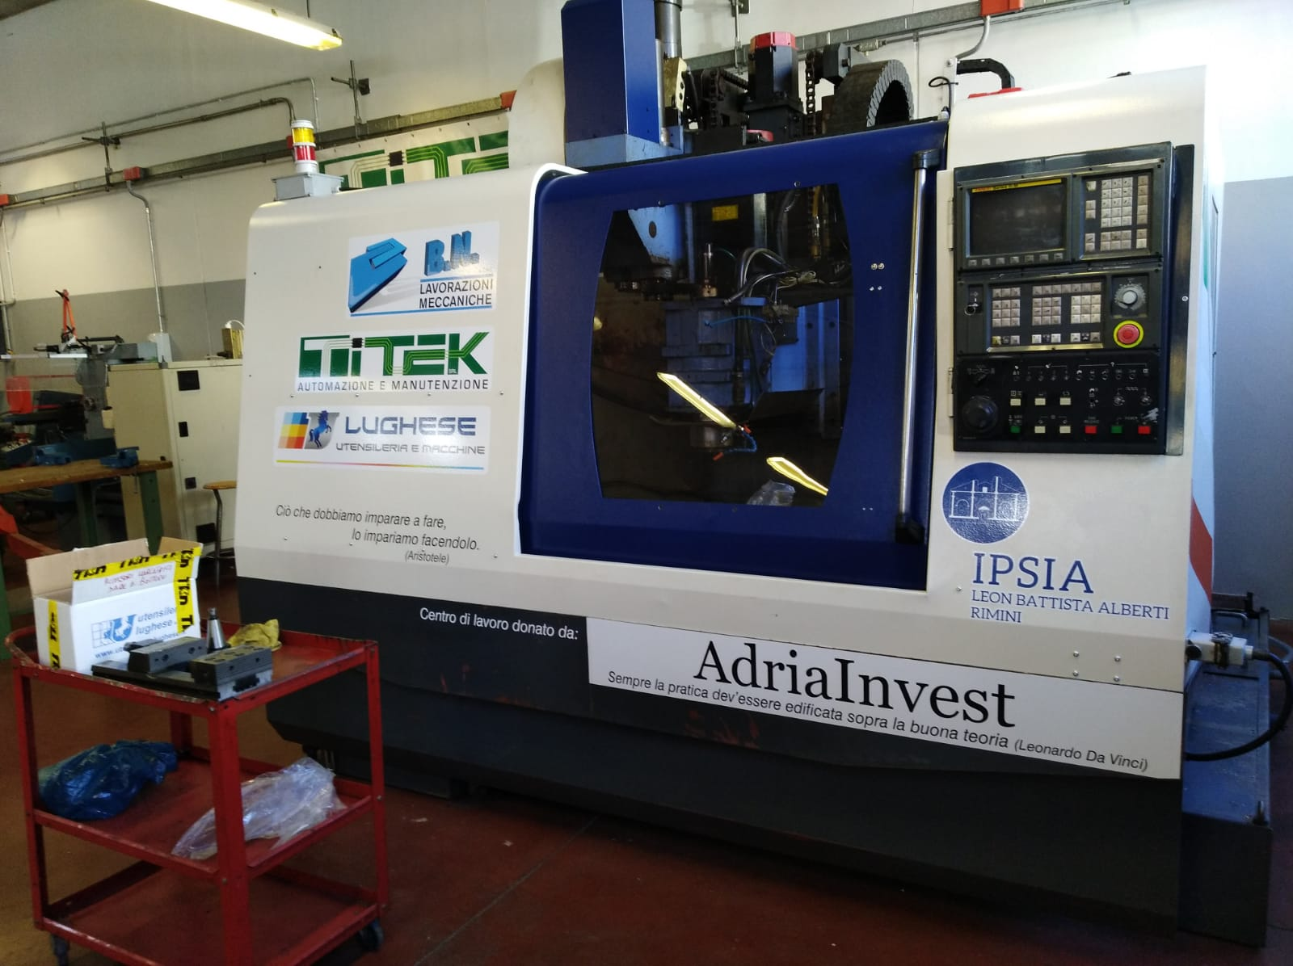
panels for practicing on electrical systems
Laboratories with traditional and numerical control machine tools

Slide 7
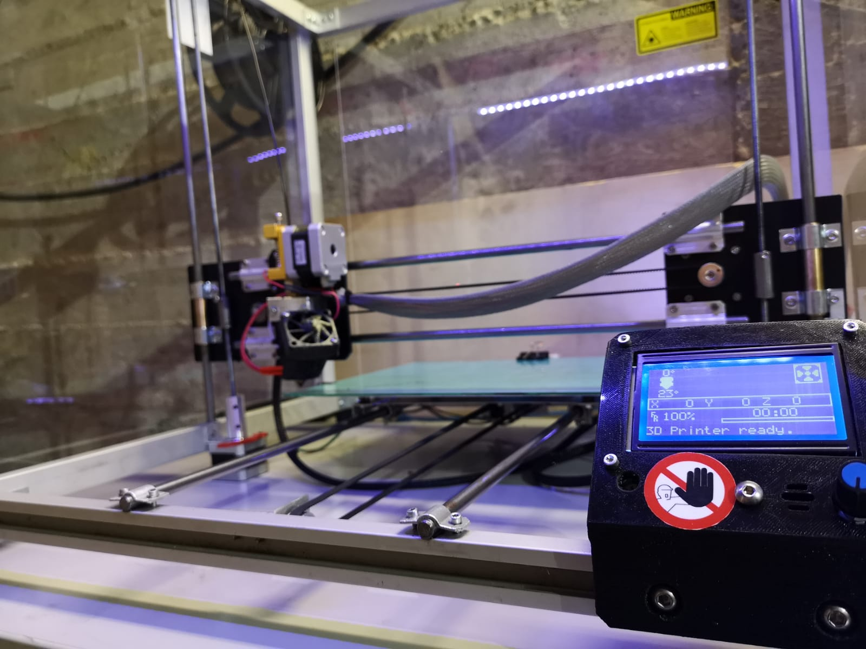
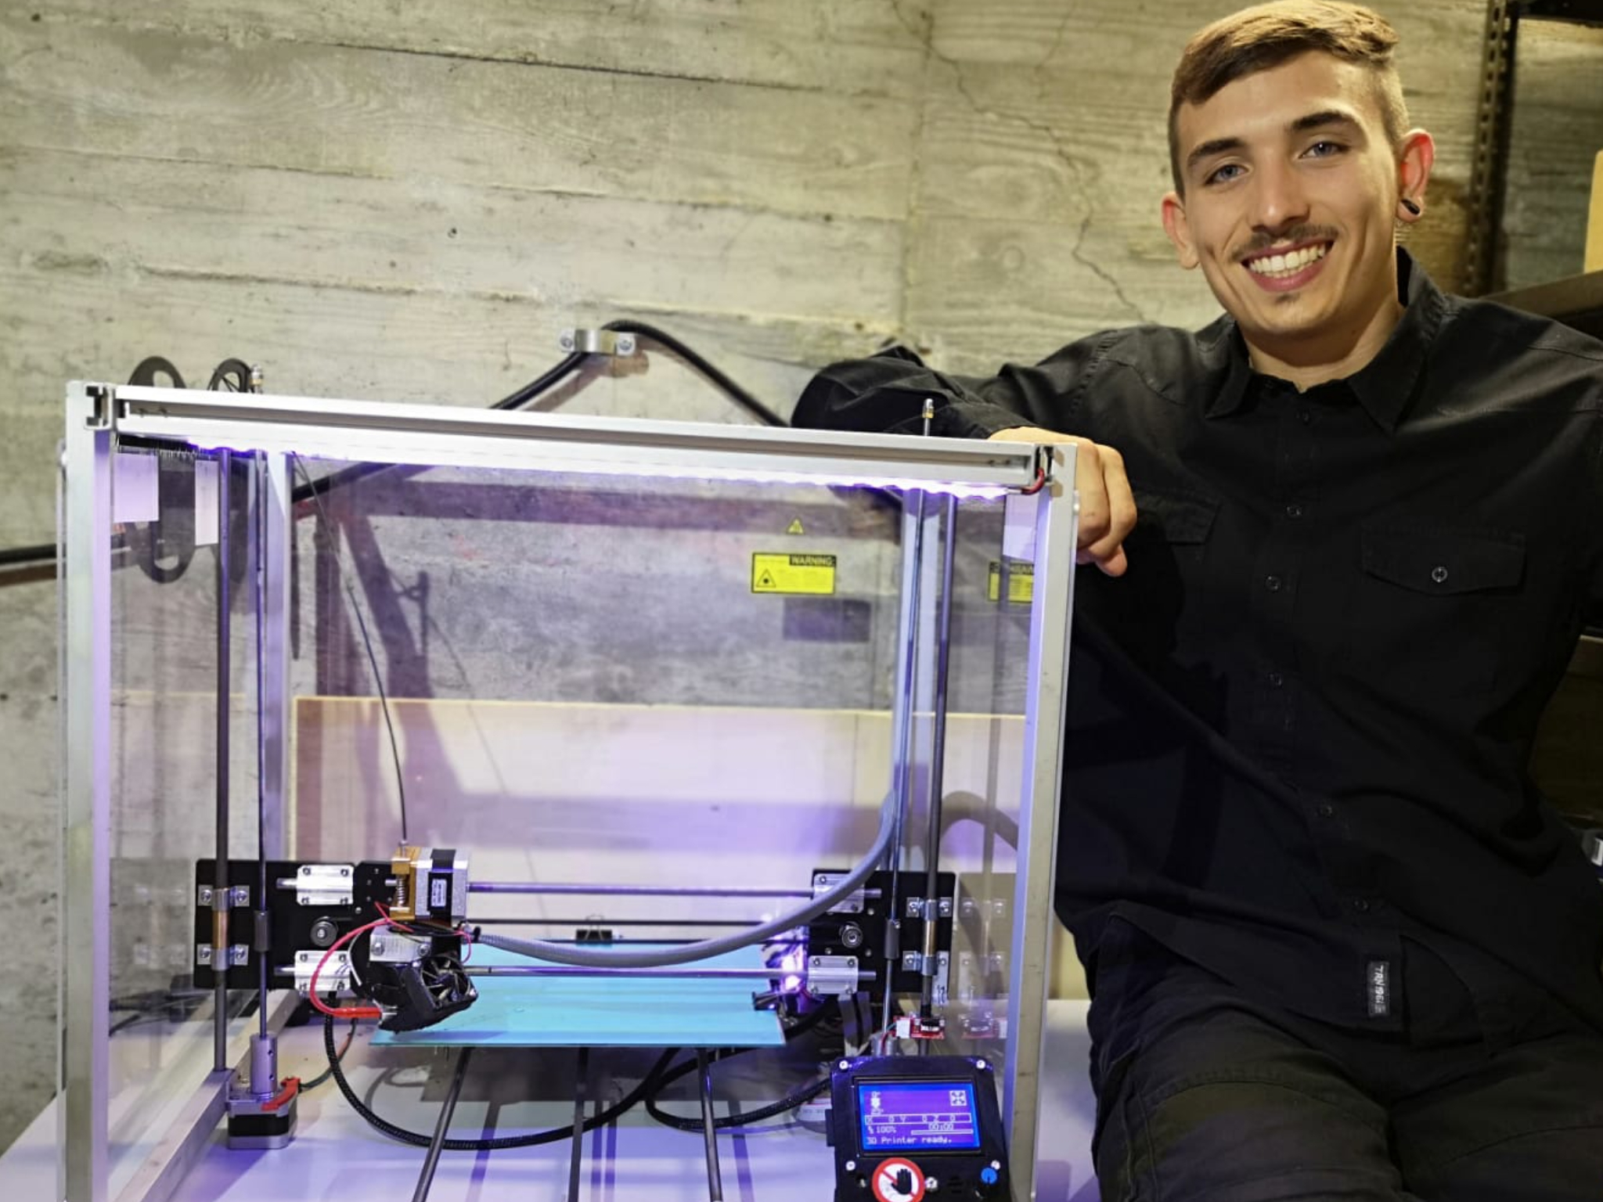
A 3D printer entirely made by a student for the State Exam in year 2018/19

Slide 8
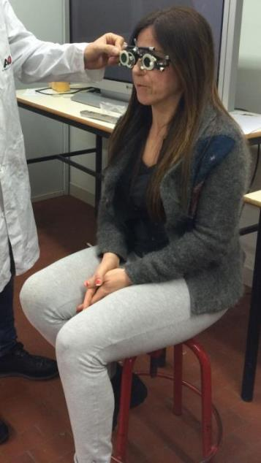
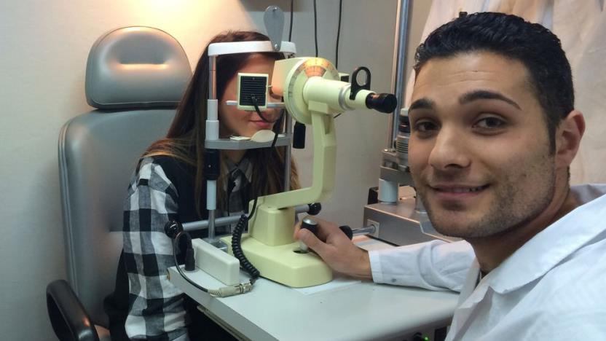
Since 2005, the institute has activated the course for Technician of socio-sanitary systems OPTICIANS
From year 2020-21the institute is going to active the course for Technician of socio-sanitary system (OSS: social worker in public health service)

Slide 9
Evening classes for adults
In our institute there are also evening courses. They have been recently renewed by the legislator in line with the 2006 EU recommendations.
Over the years, the user has changed profoundly.before there were almost exclusively young people who had prematurely stopped their studies.
Now also many adults who wish to improve their training for advancement from a professional point of view or to improve employment prospects
The institute has also been active for years in the course for distance opticians (e-learning) aimed at the students of the evening course with real difficulties to follow all the lessons, facilitating their path without giving up the professional activity.

Slide 10
THANKS FOR YOUR ATTENTION For more information: - address: Via Tambroni 24, 47923 Rimini (RN), Italia - phone number: +39 0541393827 - web address: www.albertirimini.edu.it - e-mail: RNRI010007@istruzione.it

