Slide 1
WE ARE ALL HUMANS

Slide 2
ETWINNING AT OUR SCHOOL
Students of classes 4-8 participated in the project about the life of people with disabilities entitled "We Are All Humans".
Activities includes the social dimension of civic education with the outcome of solidarity and giving assistance to people with disabilities.

Slide 3
ETWINNING IN OUR SCHOOL
The project was initiated by teacher Branka Lamza and teacher Ioannis Prodromou from Greece. The main objective of the project was raising the awareness of the importance of integration of persons with disabilities in everyday life.

Slide 4
Our Activities
Participants of our Web team, led by teacher Iva Naranđa, did a research on the approaches for persons with disabilities at our school premises, and showed the results using Web 2.0 tool Prezi and PowerPoint presentations.

Slide 5
OUR activities
The students of class 7 Melita Sandrin and Antonija Vukelić created an Emaze presentation with 3D effects.
Students of class 4 Idora Filo, Lara Šafarić, Fran Žganec, Ivan Belović, Ivan Hižman, Niko Vurušić, Lovro Carin, Nika Capan, Ela Ambrošić and Doris Bel presented their drawings through a Kizoa slideshow and created voice animations using Web 2.0 tool Voki.

Slide 6
Skype meeting croatia - greece

Slide 7
Activities of 6b
Within classes of Information Technology students of class 6b made videos thematically related to the eTwinning project We Are All Humans.

Slide 8
Activities of CLASS 5
Students of class 5 made Word documents, completed a survey and held a discussion via Edmodo.

Slide 9
Activities of CLASS 8a
As a part of the activities on the eTwinning project We Are All Humans students of class 8a made presentations using the Web 2.0 tool Prezi.
Topics: Computers and technology in the lives of persons with special needs and How technology can improve the lives of people with special needs?

Slide 10
Activities of cLASS 8b
Students of class 8b created comic books thematically related to the eTwinning project We Are All Humans using the Web 2.0 tool Pixton.

Slide 11
Activities of CLASS 8b
As a part of the activities of the eTwinning project We Are All Humans, within classes of Information Technology, students of class 8b tackled the topic using Blendspace.

Slide 12
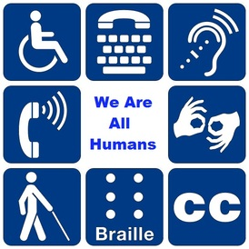
Thanks for your attention!
Created by: Marko Mihoci 6.b, Čakovec, Croatia

