Slide 1
WE ARE ALL HUMANS

Slide 2
Students of classes 4 to 8 of our school, under the guidance of teachers Branka Lamza and Iva Naranđa, participated in the project about the life and rights of people with disabilities entitled "We Are All Humans".

Slide 3
The project was initiated by teacher Branka Lamza and teacher Ioannis Prodromou from Greece (High School of Campos, Chios). The main objective of the project was raising the awareness of the importance of the integration of persons with disabilities in everyday life.

Slide 4
Activities included the social dimension of civic education with the outcome of solidarity and giving assistance to students and other persons with disabilities.

Slide 5
For a start, the participants of our Web team, led by teacher Iva Naranđa investigated the equipment of our school building, including approaches for people with mobility problems, and displayed the results by using Web 2.0 tools Prezi and PowerPoint presentations.

Slide 6
Many of us are not familiar with the rules of dealing with people with disabilities – how to help without hurting their dignity. Participants of the group English Workshop, led by teacher Branka Lamza explored the rules on how to behave accompanied by people with disabilities.

Slide 7
Students
The students of class 7 Melita Sandrin and Antonija Vukelić created an Emaze presentation with 3D effects. The students of class 4 Idora Filo, Lara Šafarić, Fran Žganec, Ivan Belović, Ivan Hižman, Niko Vurušić, Lovro Carin, Nika Capan, Ela Ambrošić and Doris Bel created drawings which they presented through Kizoa slideshow and voice animations using Web 2.0 tool Voki.

Slide 8
Voki

Slide 9
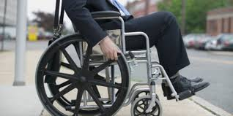
Activities of class 6b
We made final presentations and videos. Watch them and learn about the needs of people with disabilities.

Slide 10
Activities of class 8a
As part of the activities of the eTwinning project We Are All Humans, students of class 8a made presentations using the tool Prezi. Thanks to teacher Branka Lamza for help with texts in English.
Topic: Computers and technology in the lives of persons with special needs - How technology can improve the lives of people with special needs?

Slide 11
Activities of 8.b
As a part of activities in the eTwinning project We Are All Humans, students of 8b class created educational materials using Blendspace which was accessed via Edmodo. This was done as a part of Information Technology classes.

Slide 12
Activities of class 8b
Students of class 8b did comic books thematically related to the eTwinning project We Are All Humans. Pixton was accessed via Edmodo platform.

Slide 13
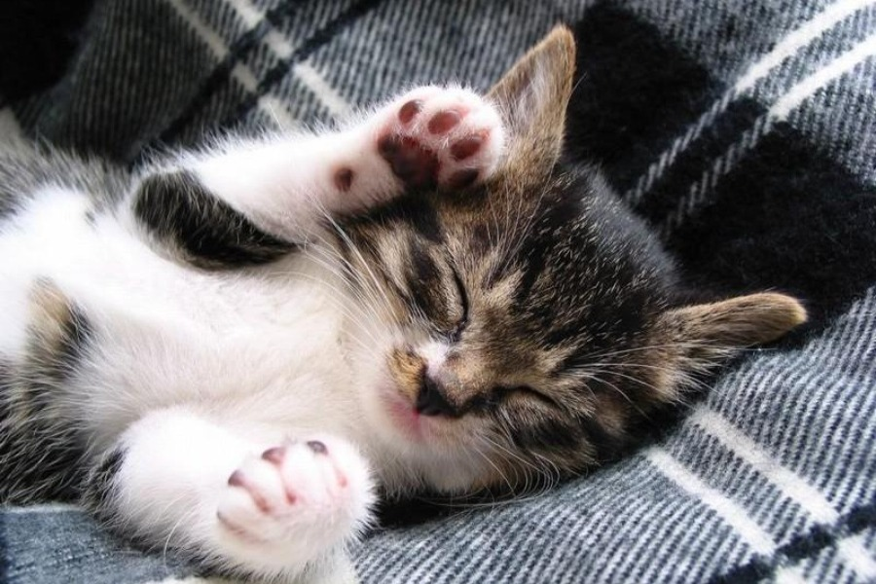
Thanks for your attention!
created by: Noa Ladislav Balog
II. osnovna škola Čakovec, Croatia

