Slide 1
eTwinning project

Slide 2
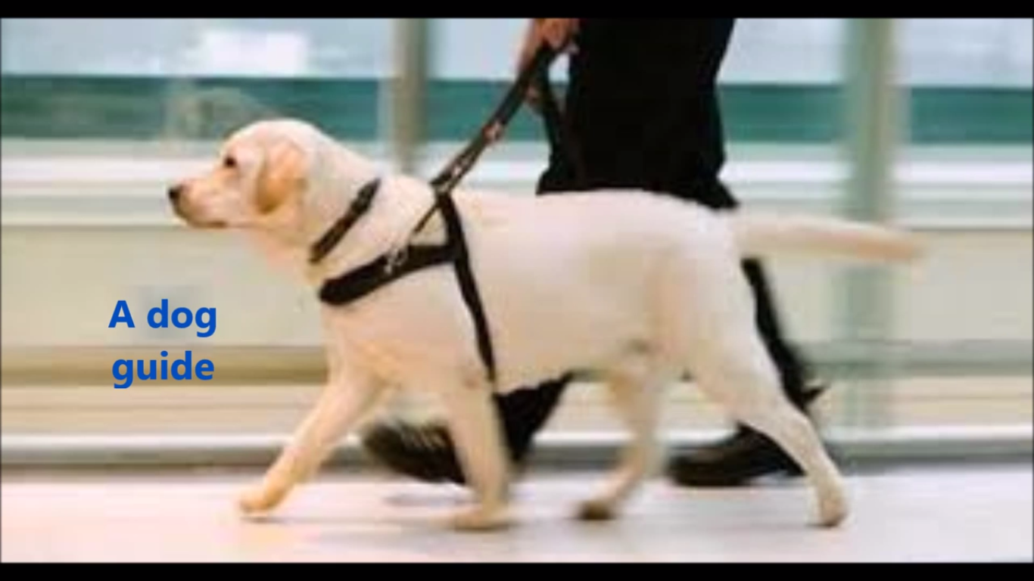
WHAT WE HAVE DONE
We made films…

Slide 3
WHAT WE HAVE DONE
… Vokies…

Slide 4
WHAT WE HAVE DONE
… in Prezi…

Slide 5
WHAT WE HAVE DONE
… in Emaze…

Slide 6
WHAT WE HAVE DONE
… presentations…

Slide 7
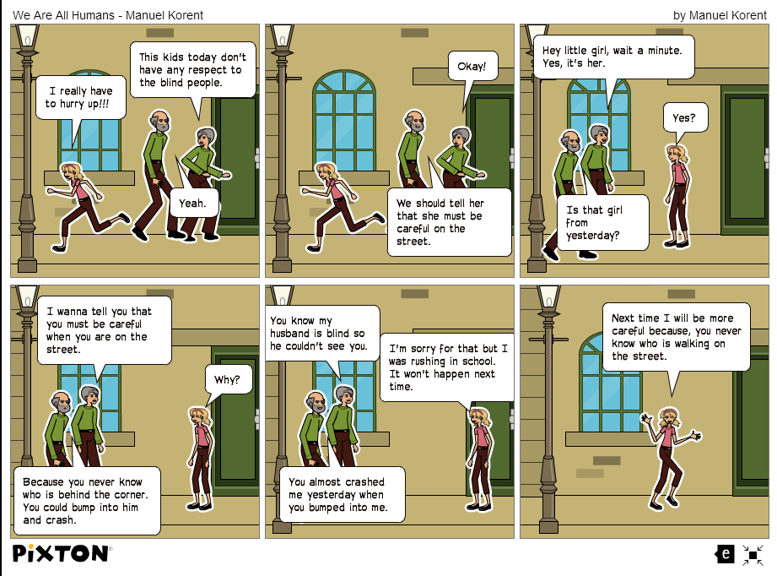
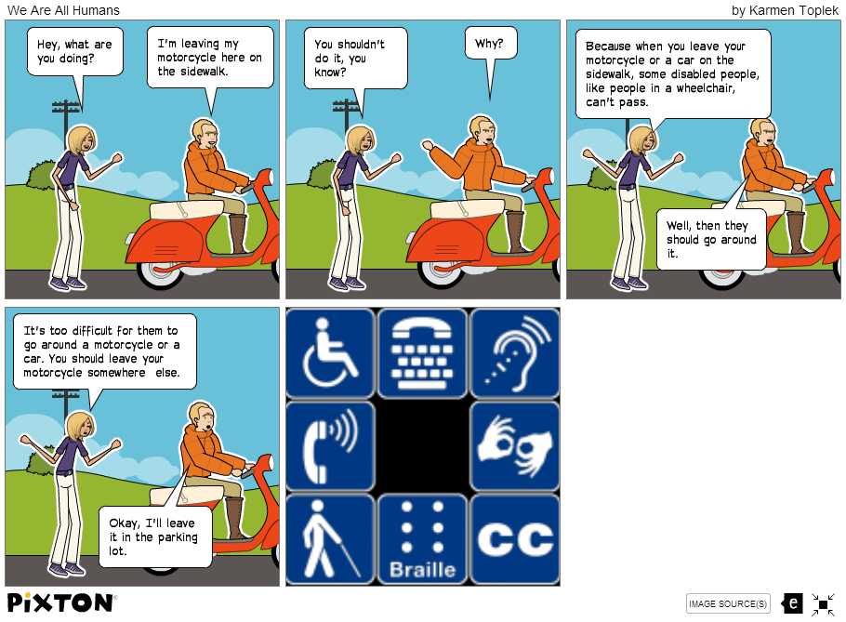
WHAT WE HAVE DONE
… and comics.

Slide 8
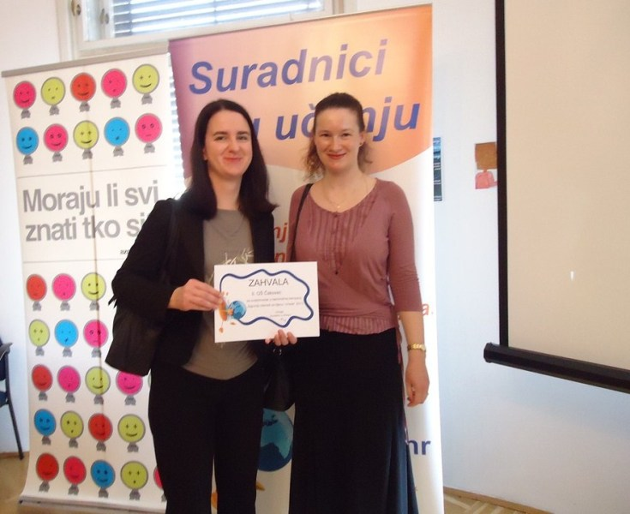
WHAT WE HAVE DONE
Under the guidance of Branka Lamza and Iva Naranđa.

Slide 9
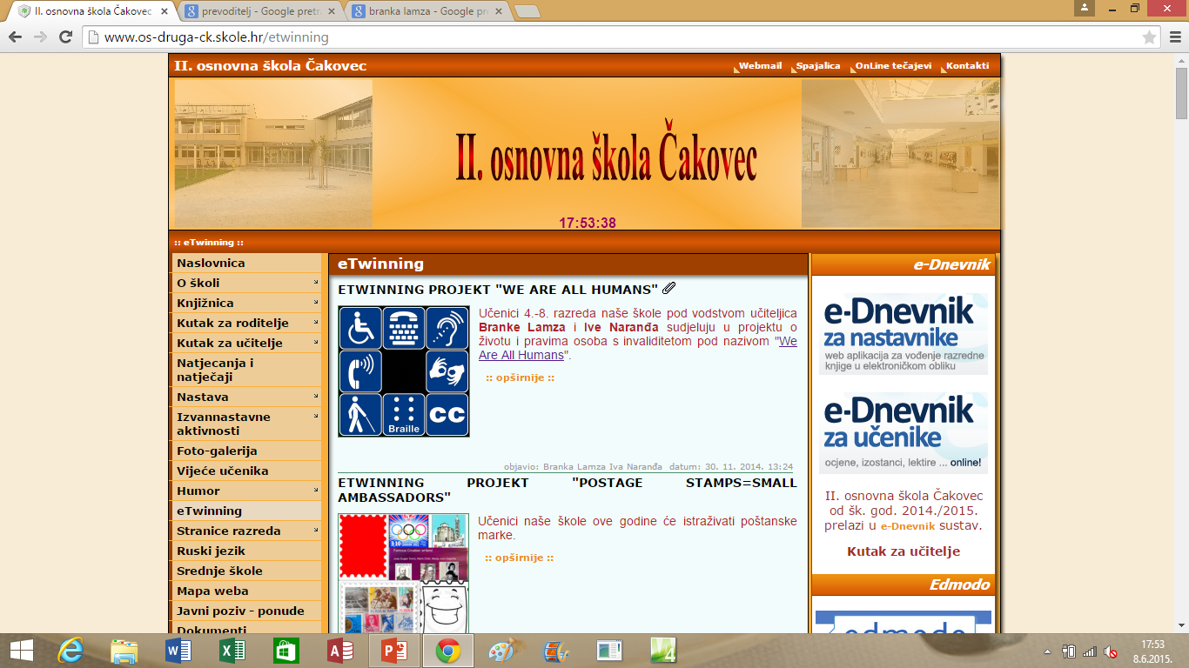
WHAT WE HAVE DONE
All the educational materials we created are published on the school website.

Slide 10
Thanks for your attention!
Made by: Lana maček 6.b II. primary school čakovec

