Slide 1
eTwinning project:
We Are All Humans
Teacher: Iva Naranđa
By: Borna Birač 6.b

Slide 2
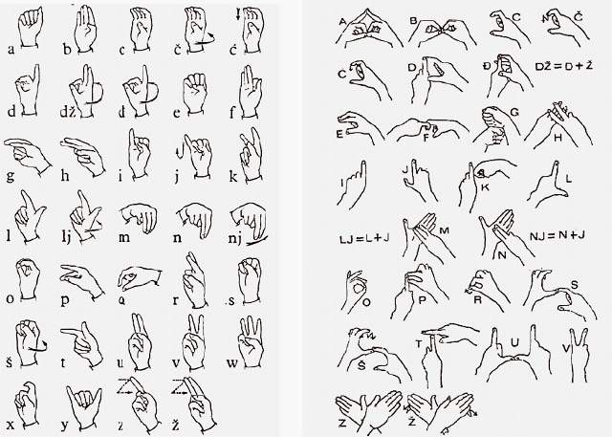
People with hearing impairment
There is a language invented for these people to communicate and it´s called sign language.
Sign laungage

Slide 3
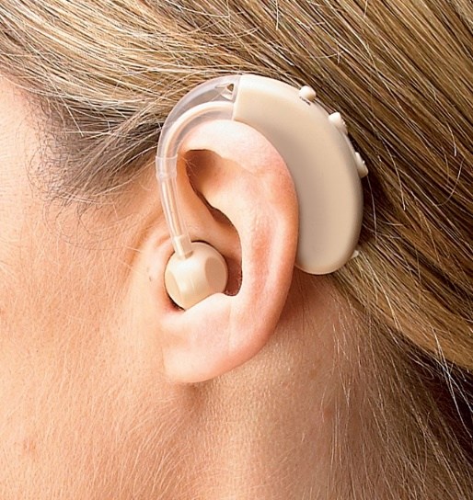
Some people use hearing aids which help them hear you at least partly.
When we talk to people with hearing impairment we need to speak slowly and clearly so they could understand us better.
Hearing aid

Slide 4
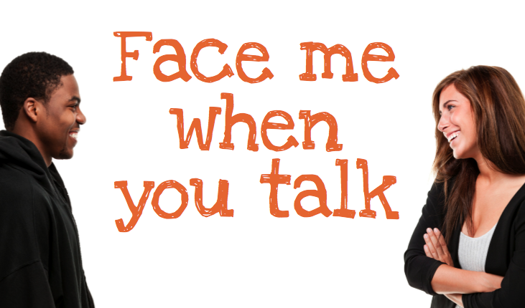
Some of them know how to read from lips.
When we are talking to a deaf person we need to look them in the eyes so they can read from our lips better.

Slide 5
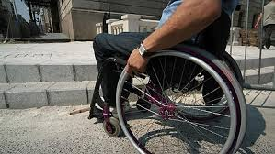
Disabled people
Disabled people are people who either don’t have some limbs or can’t use them.
We mustn’t laugh at disabled people. We need to help them.

Slide 6
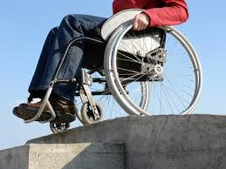
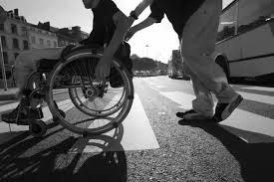
If you see a disabled person in need, approach them and ask if they need help. Be polite.
Most of disabled people use wheelchairs.

Slide 7
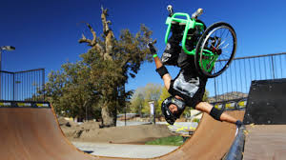
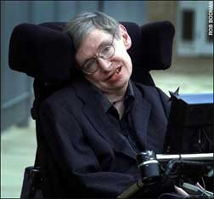
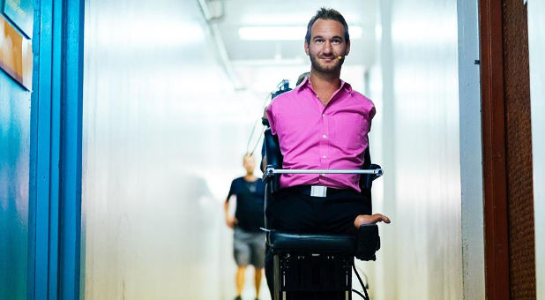
Disabled people who succeeded in life
Here are some suggestions:
1. „Wheelz”
2. Stephen Hawking
3. Nick Vujicic
- and many more…
Aaron Fotheringham „Wheelz” - https://www.youtube.com/watch?v=AUUVfPy0UgI
Nick Vujicic - https://www.youtube.com/watch?v=6kxSrPD__BA

Slide 8
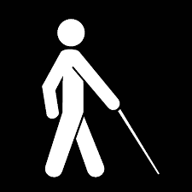
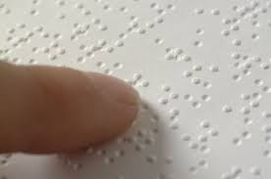
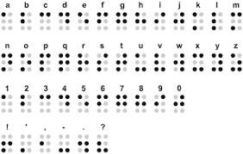
People with visual impairment
There is a special letter made for blind people called Braille´s letter.
Braille´s letter is a letter made out of 3D dots on the paper that blind people read with their fingers.

Slide 9
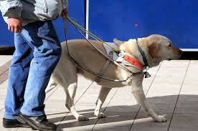
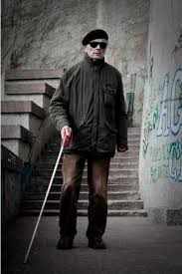
Blind people use special sticks to navigate where they are walking.
Some use trained dogs too.
Sometimes at a red light stop there are beeping sounds so blind people know when it’s red or green.

Slide 10
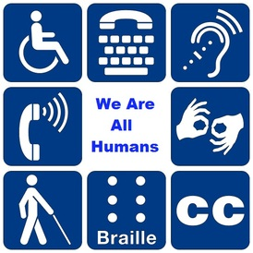
THANKS FOR WATCHING !
By: Borna Birač 6.b
II. osnovna škola Čakovec, Croatia

