Slide 1
Polish writers and their works.
C

Slide 2
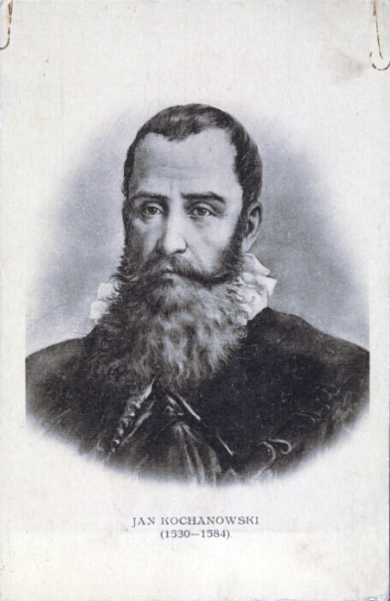
JAN KOCHANOWSKI
He was born in 1530 in Sycyna and died in 1584 in Lublin. He was the greatest poet of the Polish Renaissance.
In 1575 he married Dorota Podlodowska, with whom he had six daughters, and a son, born after Jan's death.
Many of his works commemorate his beloved daughter Ursula, who died in 1578.

Slide 3
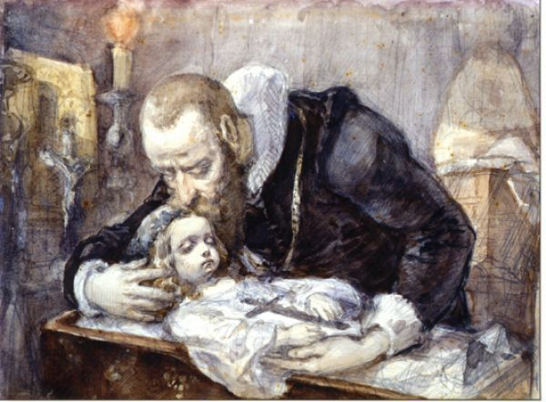
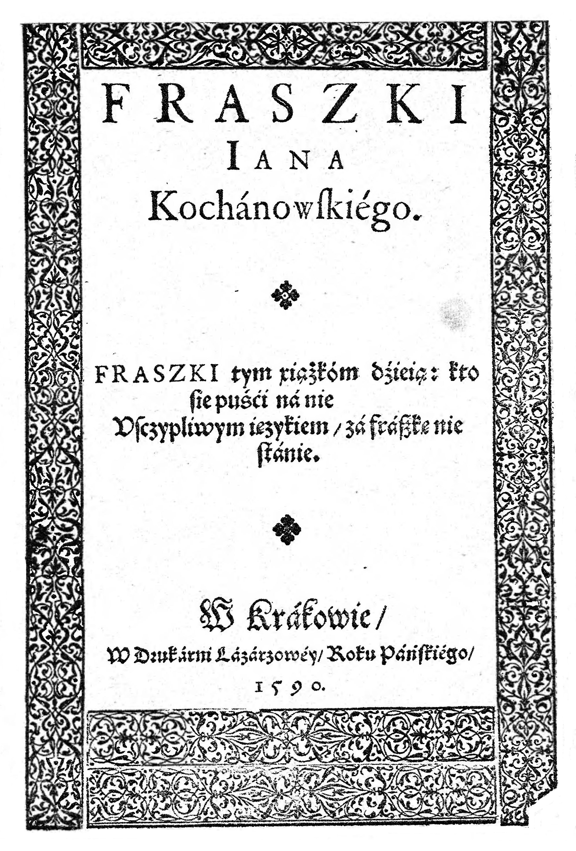
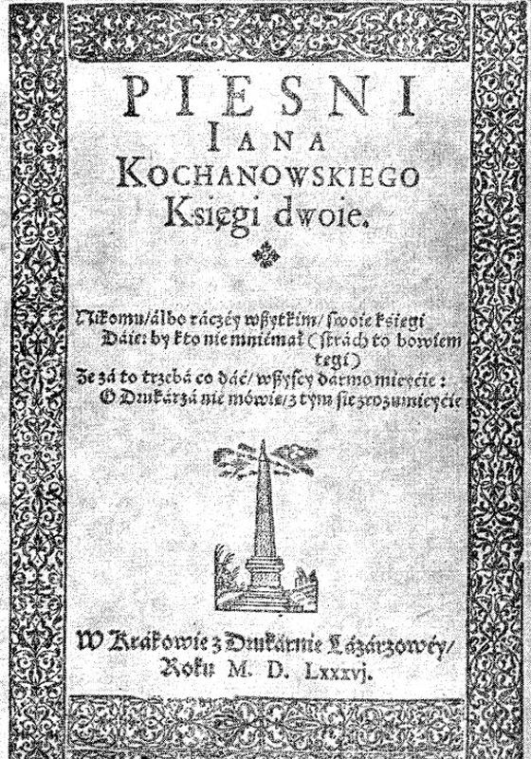
The most famous works
- "Threny" ("Treny")
- "Epigrams" ("Fraszki")
- "Songs" ("Pieśni")
- "The Dismissal of the Grecian Envoys" (" Odprawa Posłów Greckich")
Fun fact:
Nobody knows exactly when Jan Kochanowski was born.

Slide 4
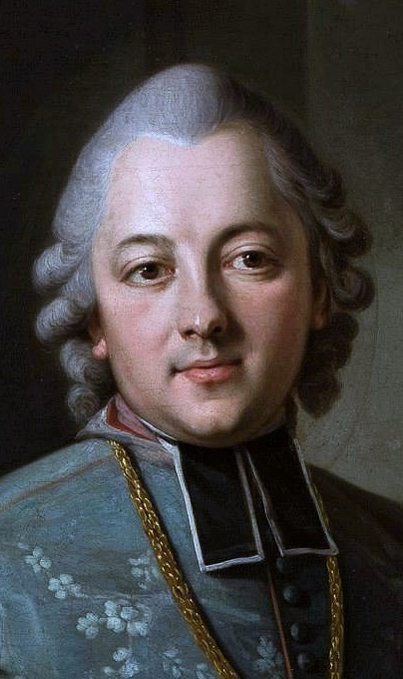
IGNACY KRASICKI
He was born in 1735 in Dubiecko and died in 1801 in Berlin.
He was a bishop as well one of the greatest poets of the Polish Enlightenment.
He created a new literary genre in Poland

Slide 5
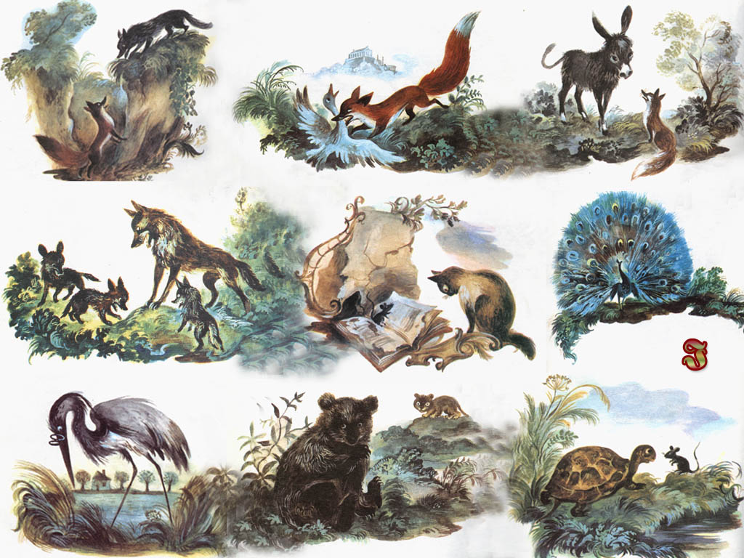
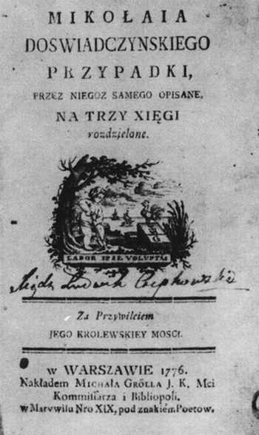
The most famous works
" Mouseiad" ("Myszeida")
"The Adventures of Nicholas Experience"
("Mikołaja Doświadczyńskiego Przypadki")
" Fables and Parables" ("Bajki i przypowieści")
"Satires" ("Satyry")
Fun fact:
20 years after his death, his coffin was moved from Berlin to the Gniezno Cathedral.

Slide 6
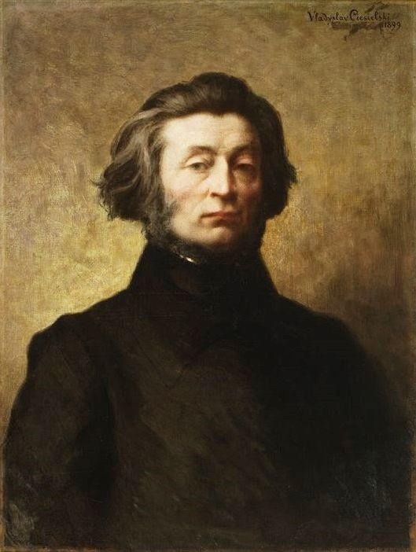
ADAM MICKIEWICZ
He was born in 1798 in Navahrudak, Lithuania, and died in 1855.
He specialized in romanticism.
He considered Lithuania as his homeland, which he wrote in his epic "Pan Tadeusz".
He was a poet and political activist.

Slide 7
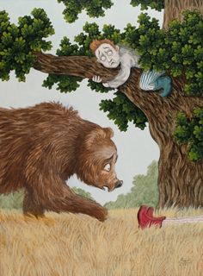
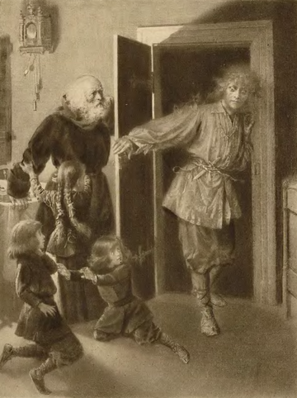
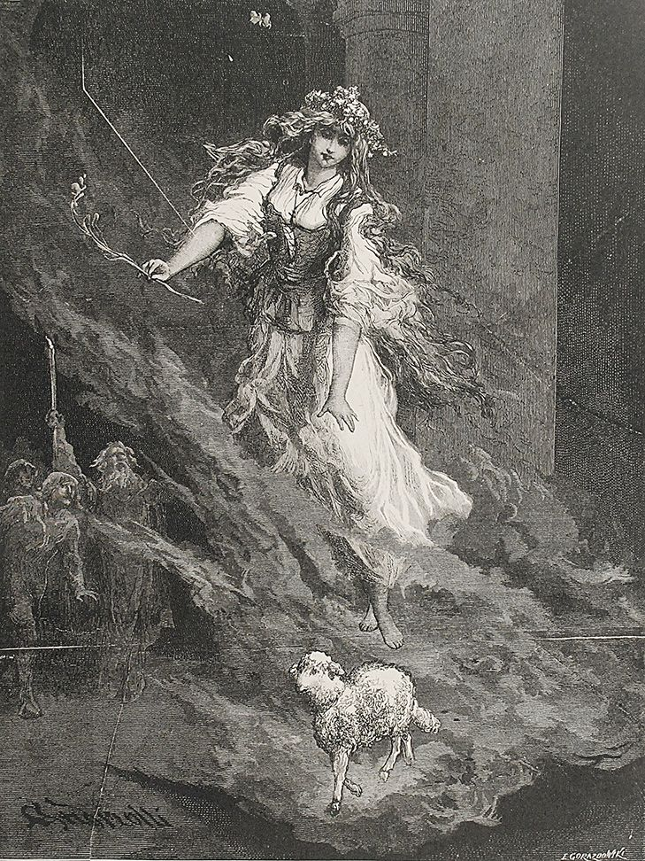
The most famous works
- "Pan Tadeusz"
- "Konrad Wallenrod"
- "Forefather's Eve" ("Dziady")
- "Friendns" ("Przyjaciele")
- "Romance" ("Romance")
- "Sonets" ("Sonety")
Fun fact:
Adam Mickiewicz never visited Krakow or Warsaw.

Slide 8
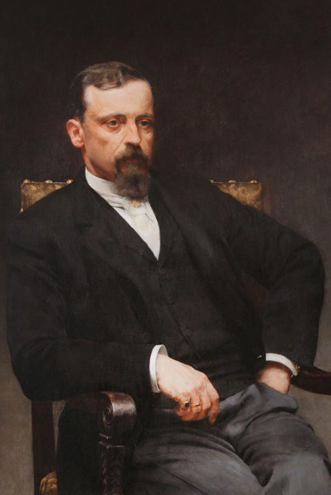
HENRYK SIENKIEWICZ
He was born in 1846 in Wola Okrzejska and died in 1916 in Switzerland.
He was a journalist, publicist,
and a novelist.
He was also the first Polish laureate of the Nobel Prize in Literature, which he received in 1905.

Slide 9
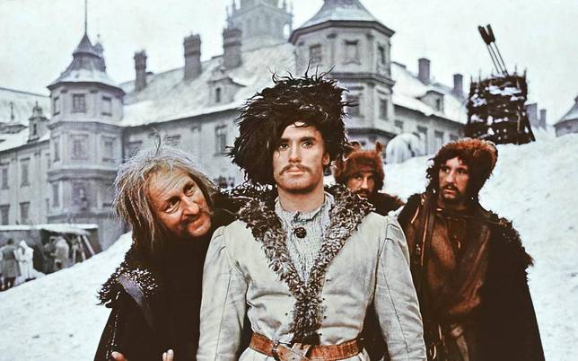
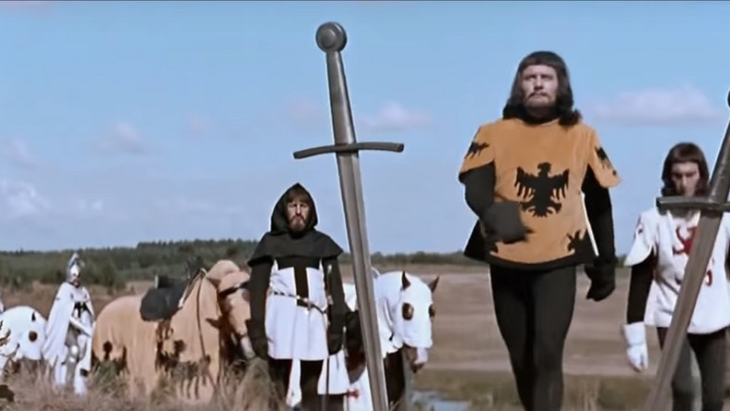
The most famous works
- The Trilogy: "Flood" ("Potop"), "Fire and Sword"
("Ogniem i mieczem"), "Pan Wołodyjowski"
- " In Desert and Wilderness"
( "W pustyni i w puszczy")
- "The Teutonic Knights" ("Krzyżacy")
- "The Lighthouse keeper" ("Latarnik")
Fun fact:
Henryk Sienkiewicz had four sisters and a brother.

Slide 10
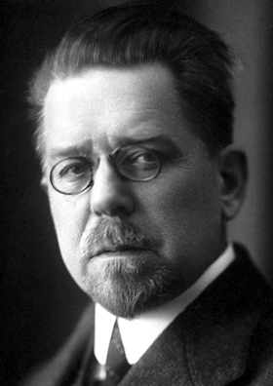
WŁADYSŁAW REYMONT
He was born in 1867 in the village of Kobiele Wielkie and died in 1925 in Warsaw.
He had six siblings.
He was a novelist and reporter.
In 1924 he was awarded the Nobel Prize for Literature.

Slide 11
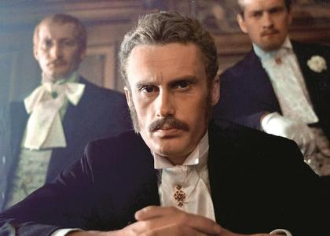
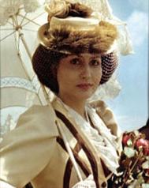
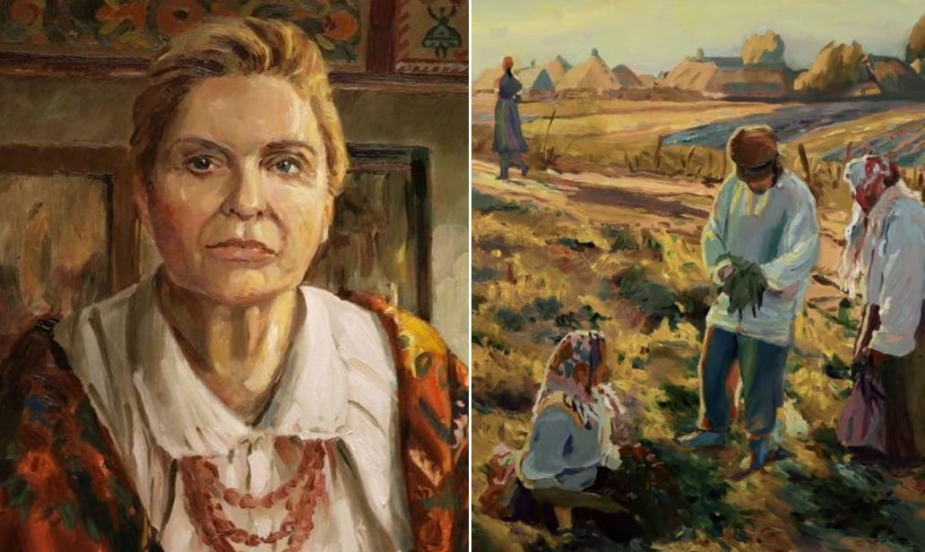
The most famous works
" The Peasants" ("Chłopi")
" The Comedienne" ("Komediantka")
" The Promised Land"
("Ziemia obiecana")
Fun fact:
His parents wanted him to become a priest.

Slide 12
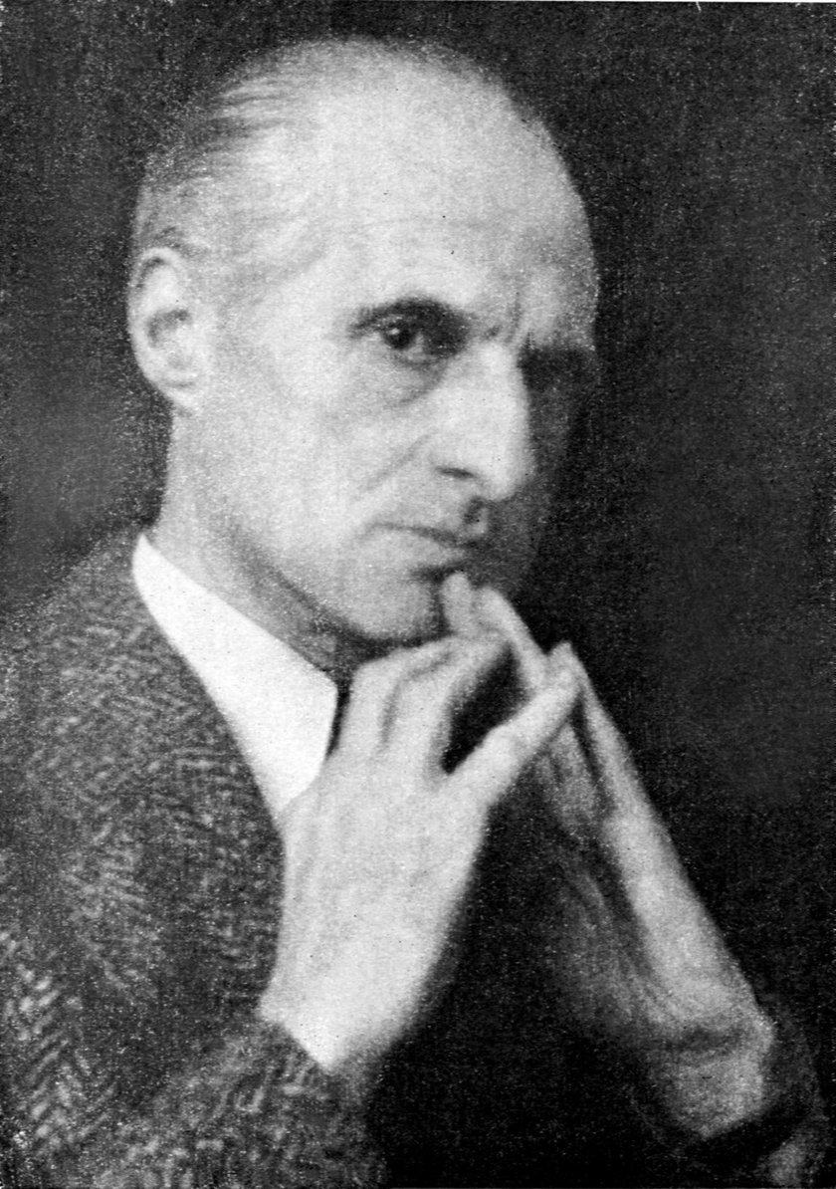
JULIAN TUWIM
He was born in 1894 in Łódź and died in 1953.
To this day, he is the most recognizable member of the poetry group Skamander.
He wrote many poems addressed mainly to younger people.
He was ashamed of his face because he had significant birthmark on his left cheek.

Slide 13
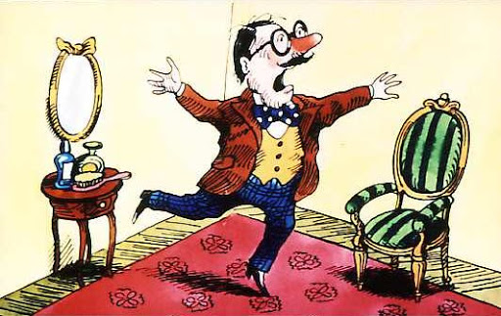
The most famous works
"The Locomotive" ("Lokomotywa")
"Trąbalski the Elephant" ("Słoń Trąbalski")
" Zosia Samosia and Other Poems"
("Zosia Samosia I inne wierszyki"
"Glasses" ("Okulary")
"The Turnip" ("Rzepka")
" Polish Flowers" ("Kwiaty polskie")
Fun fact
Julian Tuwim suffered from fear of open space.

Slide 14
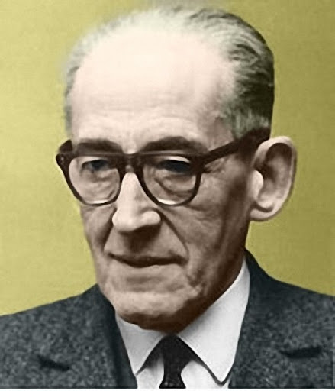
JAN BRZECHWA
He was born in 1898 in Żmerynka and died in 1966 in Warsaw.
Jan Brzechwa, or actually Jan Wiktor Lesman, was an attorney, poet, author of fairy tales and poems for children and satirical texts for adults.
The nickname was Brzechwa
(the feathered part of the arrow) was given to him by his cousin Bolesław Leśman.

Slide 15
The most famous works
" Academy of Mr. Kleks"
("Akademia Pana Kleksa")
"Flax" ("Leń")
"On a stall" ("Na straganie")
"Brzechwa for children" ("Brzechwa dzieciom")
Fun fact:
During Brzechwa's lifetime, not one of his literary volumes was published.

Slide 16
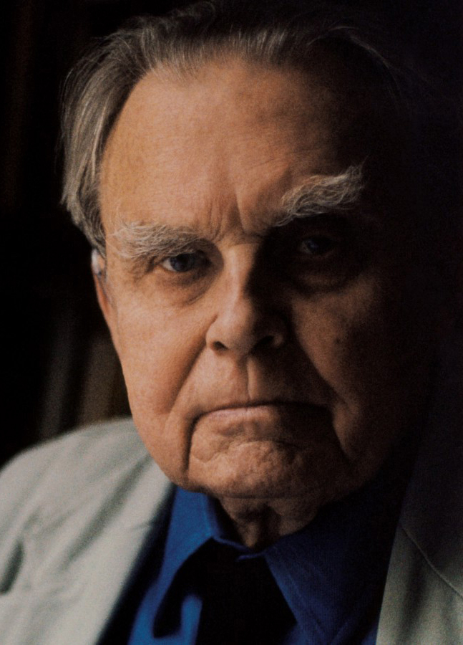
CZESŁAW MIŁOSZ
He was born in 1911 in Szetejna and died in 2004 in Krakow.
He was a prose writer, translator, and one
of the greatest Polish writers.
He was awarded the Nobel Prize for Literature in 1980.
Privately, he was a close friend of Wisława Szymborska.

Slide 17
The most famous works
"Spell" ("Zaklęcie")
"From The Window" ("Z okna")
" Faith" ("Wiara")
"Three Winters" (" Trzy Zimy")
"The Garden of Science"
(" Ogród Nauk")
Fun fact:
In 1960 Czesław Miłosz moved to the United States to work at the University of California in Berkeley and at Harvard.

Slide 18
WISŁAWA SZYMBORSKA
She was born in 1923 and died in 2012.
She was a poet, essayist and winner of the Nobel Prize in Literature,which she received in 1996.
In her private life, she was friends with Czesław Miłosz.

Slide 19
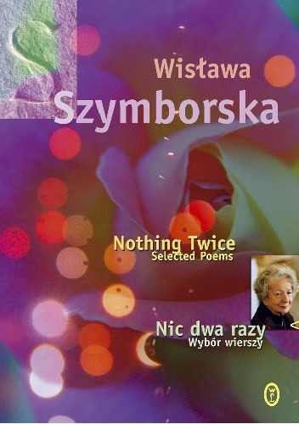
The most famous works
"Nic dwa razy. Nothing Twice"
"Happy Love" ("Miłość szczęśliwa")
" Moment" ("Chwila")
Fun fact:
Wisława Szymborska smoked a lot of cigarettes.

Slide 20
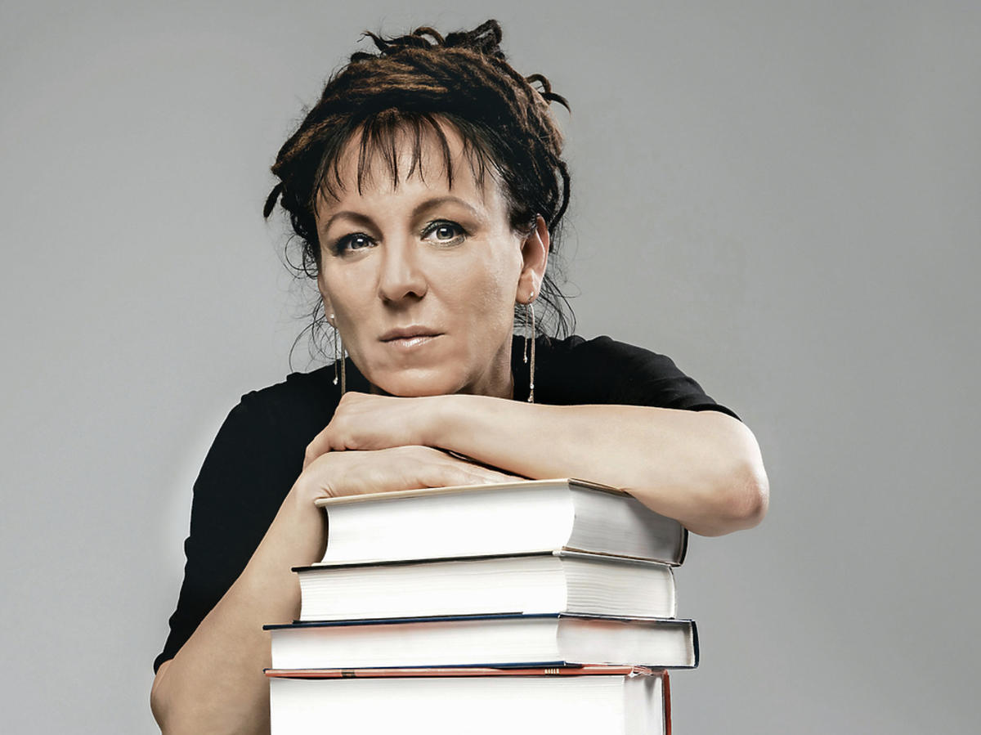
OLGA TOKARCZUK
She was born in 1962. She is a writer, essayist, poet, screenplay writer and winner of the Nobel Prize in Literature, which she received in 2019. She has two sons and a husband.

Slide 21
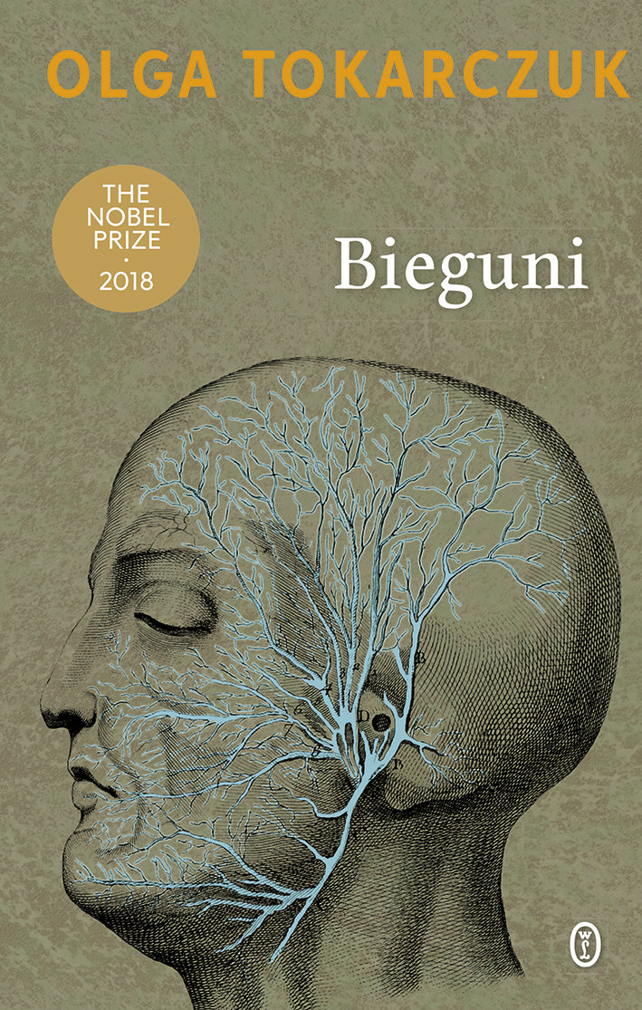
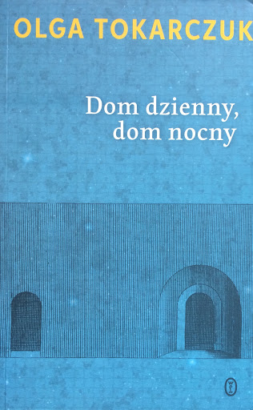
The most famous works
"The Books of Jacob"
("Księgi Jakubowe")
"Poles" ("Bieguni")
"House of Day, House of Night"
("Dom dzienny, dom nocny")
"The Last Stories" ("Ostatnie historie")
Fun fact:
Olga Tokarczuk set up a foundation in her name. She also opened an art cafe in Nowa Ruda: "Dobra Nowina".

Slide 22
Sources
TEXTS:
Wikipedia.org
Culture.pl
Gosc.pl
Kurierhistoryczny.pl
Ciekawostki.online
Fajnepodroze.pl
PICTURES:
Slide 2- polona.pl
Slide 3- kochamjp.pl wikipedia.org wikipedia.org
Slide 4- wikipedia.org
Slide 5- allegro.pl kreatywnypolonista.blogspot.org wikipedia.org
Slide 6- memorizer.pl
Slide 7- klubpdp.pl pinterest.com kanonlektur.pl pinterest.com
Slide 8- wikipedia.org
Slide 9- wyborcza.pl plejada.pl kultura.onet.pl
Slide 10- gminagrabow.pl
Slide 11- twojaksiegarnia.pl allegro.pl odzimek.com
Slide 12- fakt.pl
Slide 13- kafeteria.pl dziecionline.pl przedszkole.sp3.swidnik.pl
Slide 14- databazeknih.cz
Slide 15- empik.com megakonyvek.hu youtube.com
Slide 16- divasofverse.com
Slide 17- interbok.se
Slide 18- szymborska.org
Slide 19- empik.com lubimyczytac.pl swiatksiazki.pl
Slide 20- hit.vn
Slide 21- empik.com empik.com inverso.pl

Slide 23
C
Made by Maciek Dubielowski
Poland

