Slide 1
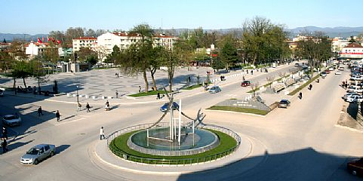
D.U.Z.C.E

Slide 2
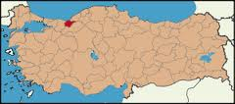
Duzce is the 81st and the last province of Turkey.

Slide 3
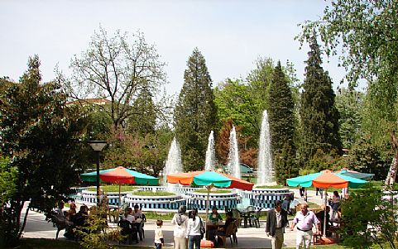
It is located on the north-west of Turkey.

Slide 4
It’s population is 370.000

Slide 5
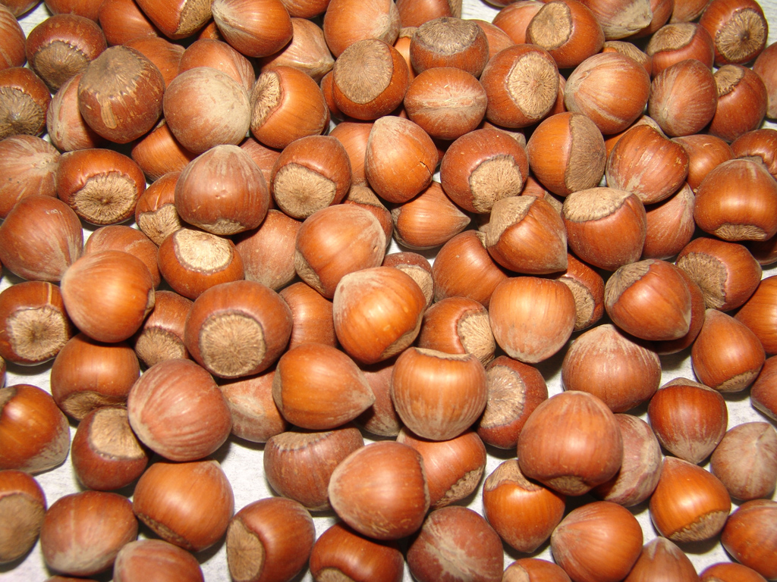
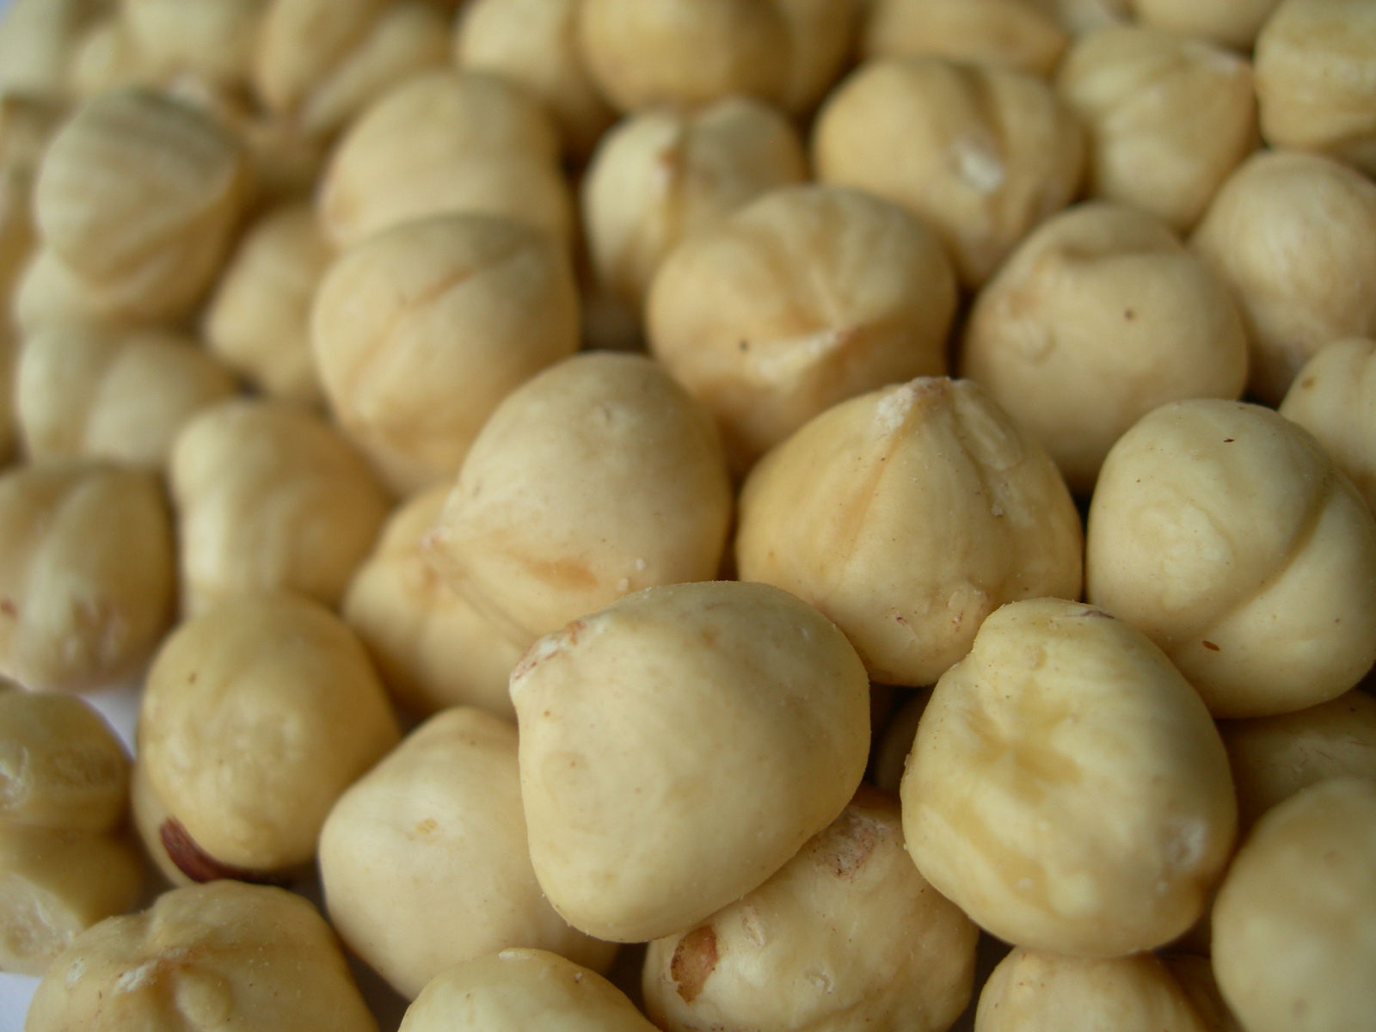
People mostly grow nuts.

Slide 6
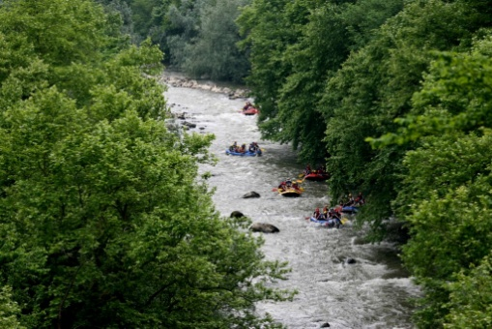
You can go rafting.

Slide 7
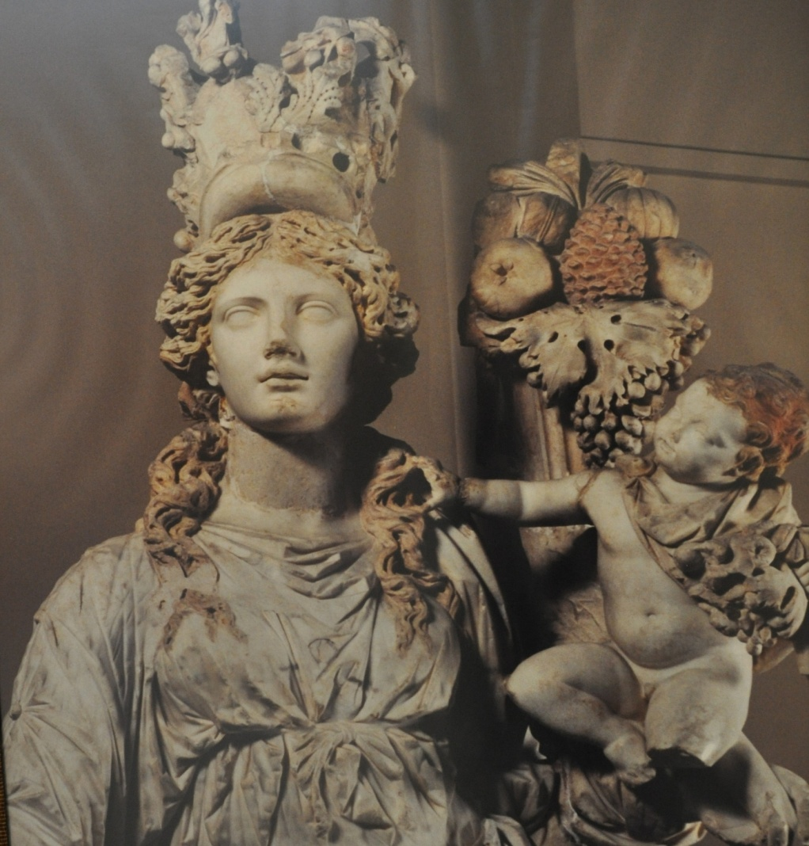
You can visit Konuralp Museum. There are historical objects from the antique era.

Slide 8
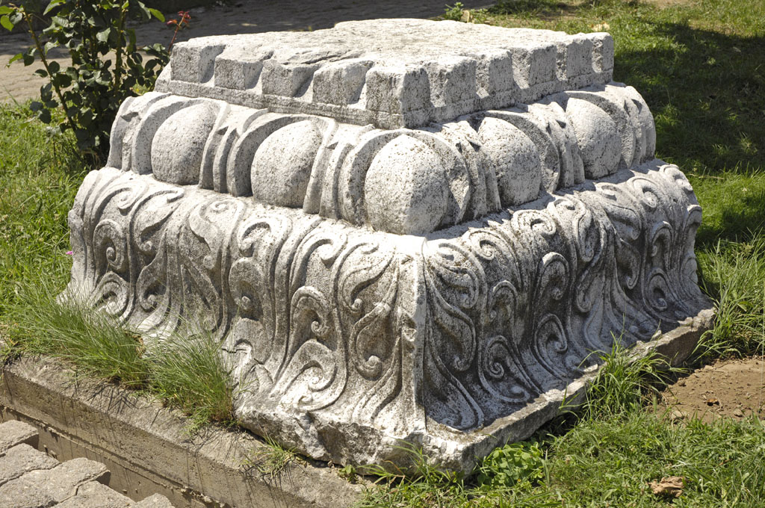
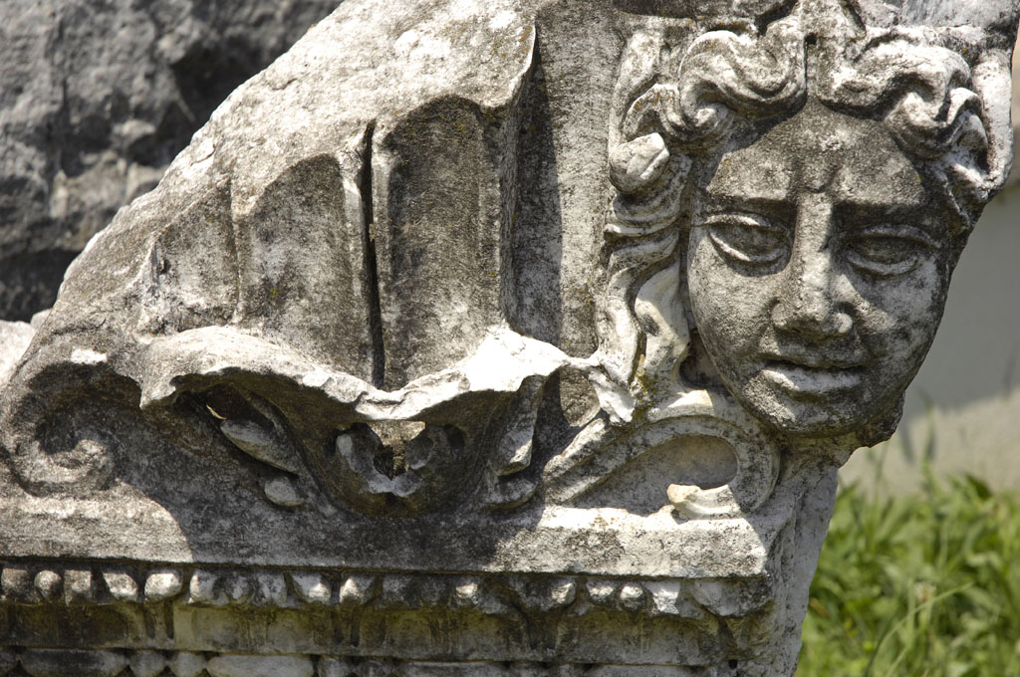

Slide 9
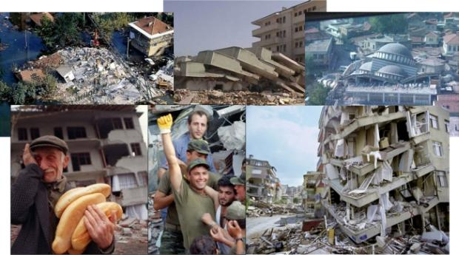
A big earthquake destroyed Duzce in 1999

Slide 10
There is an old castle.You can have picnic there and you can have a beautiful sightseeing.

Slide 11
Duzce is famous for its waterfalls.People go for trekking there.

Slide 13
Fascinating lakes; There are small lakes in the forest.You can have picnic ,ride a horse or go hiking there.

Slide 14
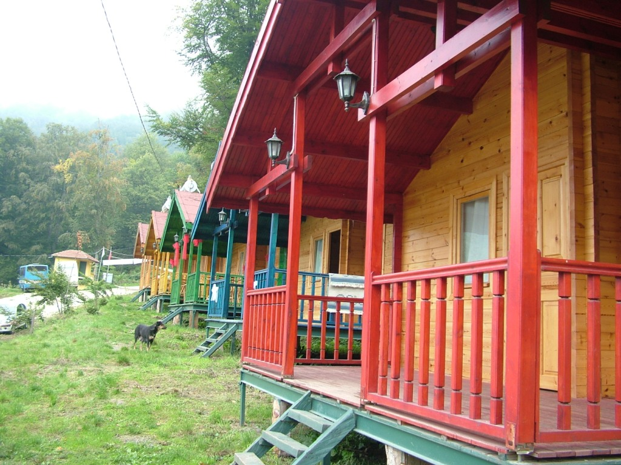
You can stay in the forest.

Slide 15
You can swim in the sea.It’s thirty minutes away from the centre.

Slide 16
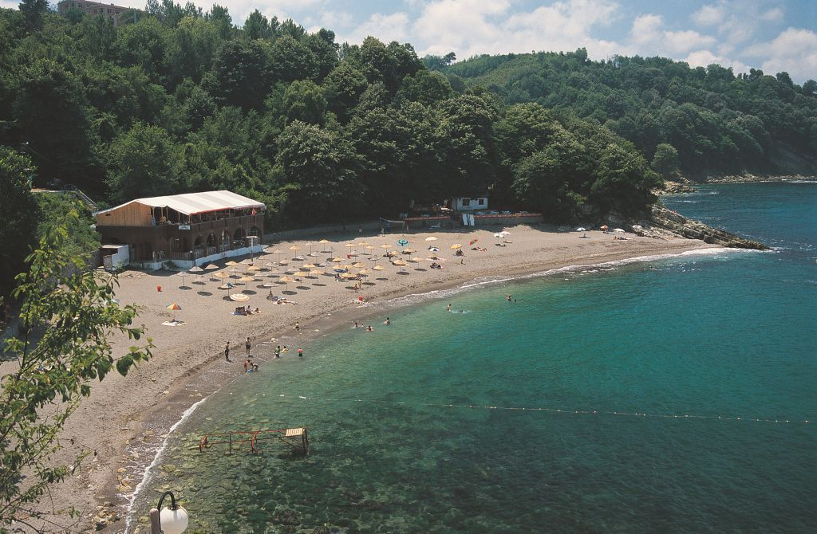

Slide 17
There are a lot of mosques.

Slide 18
There are crowded streets.You can do shopping or have something to eat.

Slide 19
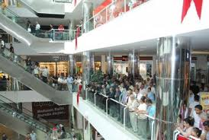
There is a big
shopping mall
in the centre.
You can go into the cinema, eat something or do shopping there.

Slide 20
This is Ataturk’s statue.He was the founder of Turkey.He was a great leader.

Slide 21
Duzce has Efteni lake.It is a paradise for birds.

Slide 23
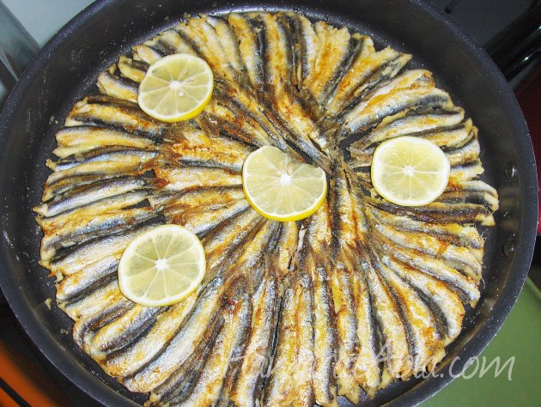
We love eating anchovy and corn bread.

Slide 24
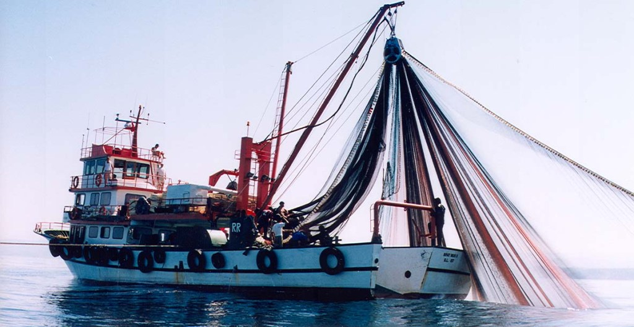
A fishing boat

Slide 25
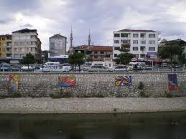
There is a creek in the centre.There are beautiful paintings on its walls.

Slide 26
The Cave

Slide 27
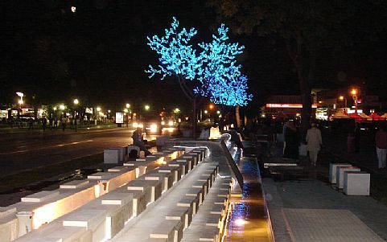
Duzce at night

Slide 28
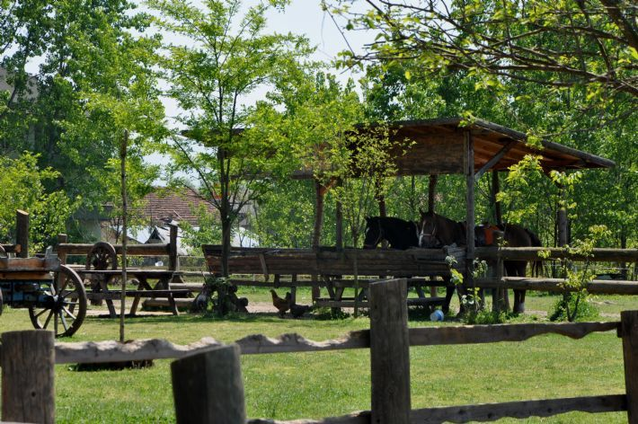
A horse farm

Slide 29
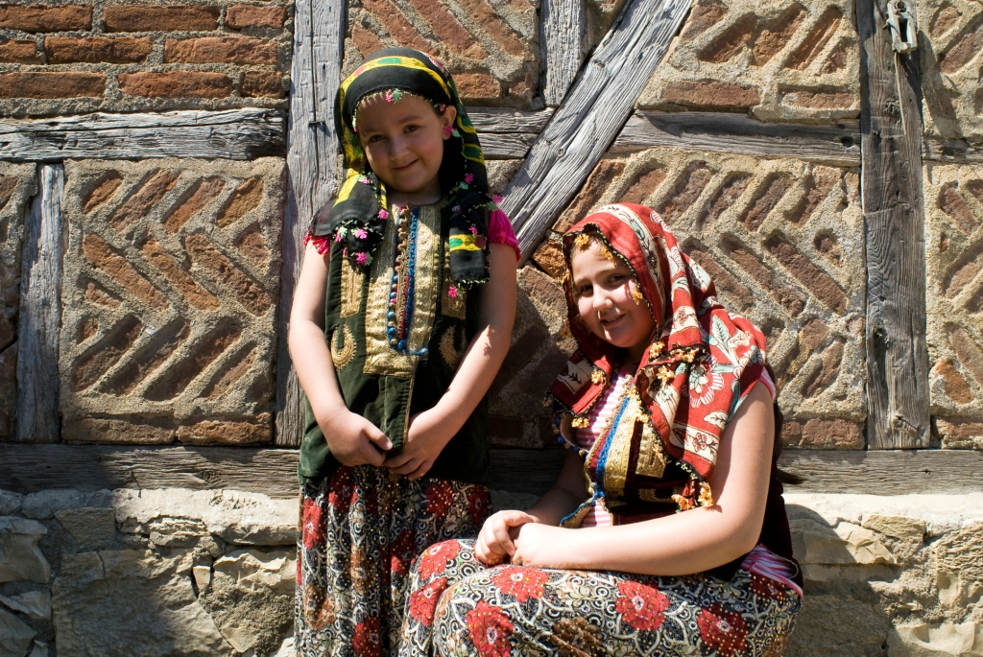
Villagers

Slide 30
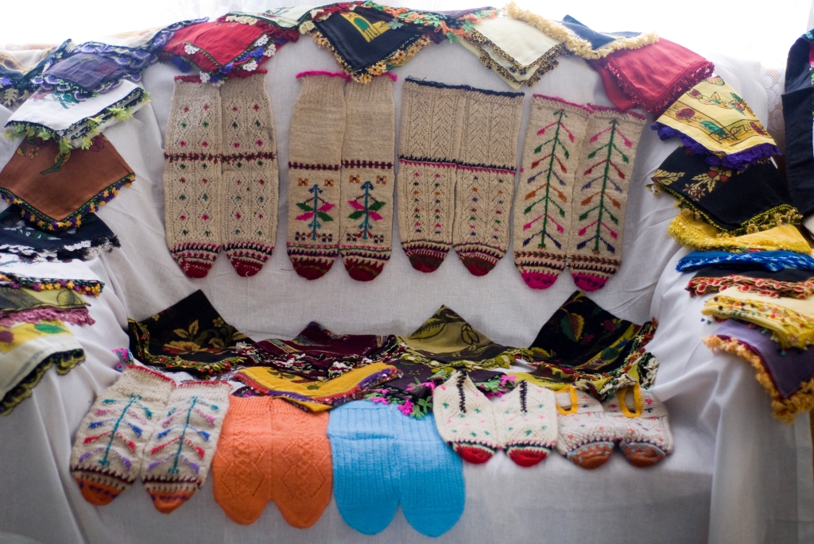
Hand made products of villagers

Slide 31
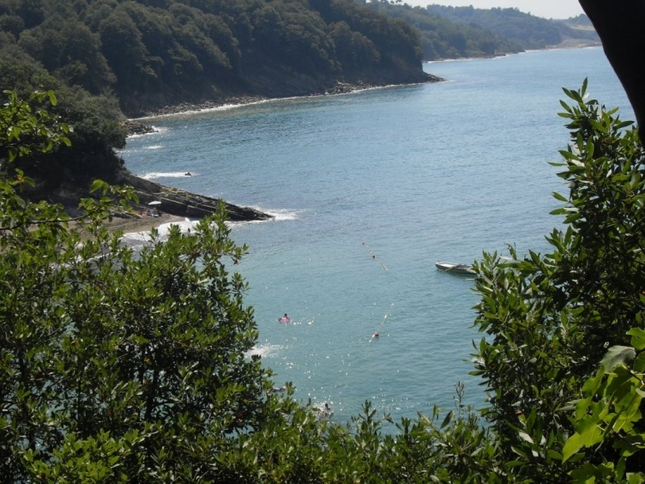

Slide 32
