Slide 1
ATATÜRK SECONDARY SCHOOL
MUSIC HAS NO BARRIERS
Music to All
2019 – 2022
www.musictoall.eu

Slide 2
AŞIK VEYSEL
Veysel Şatıroğlu or by his nickname Âşık Veysel, is a Turkish folk poet. He belongs to the Şatırlı tribe of the Avşar tribe. He was born in 1894 in the village of Sivrialan, in the Şarkışla district of Sivas. Veysel lost his both eyes at the age of seven due to smallpox desease.
www.musictoall.eu

Slide 3
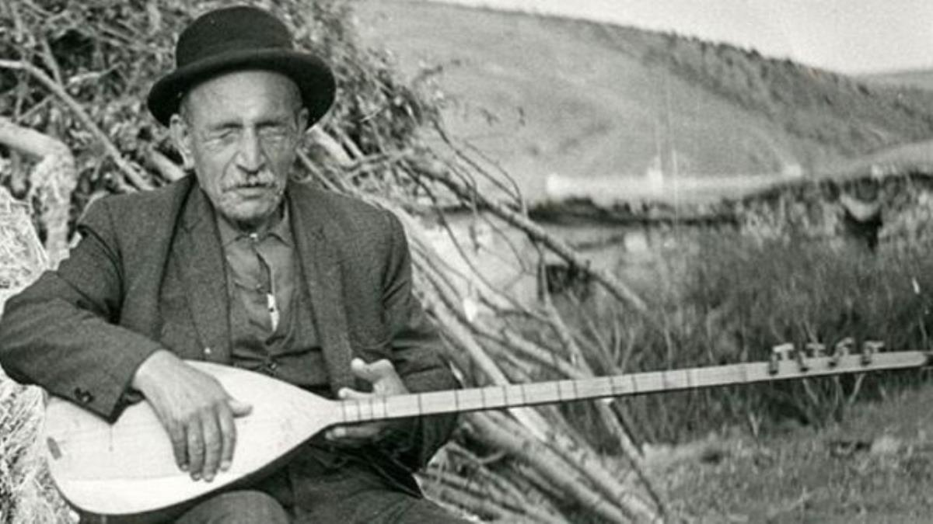
Âşık Veysel first started playing the songs of other poets with the baglama that his father bought for him to linger. His Turkish is simple in his works. He uses language skillfully. Joy of life and sadness, optimism and despair were intertwined in his poems. There are also poems in which he criticizes nature, social events, religion and politics. His poems were collected in his books, Deyişler-Sayings (1944), Sazımdan Sesler-Sounds from my instrument (1950), Dostlar Beni Hatırlasın-Friends, remember me (1970). He passed away in 1973 as a result of lung cancer. After his death, his works were republished under the name of All Poems (1984).
www.musictoall.eu

Slide 4
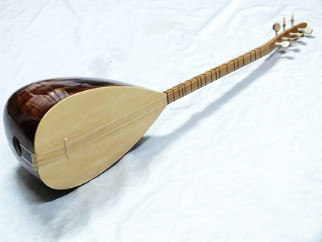
MUSICAL INSTRUMENT HE PLAYED: SAZ-BAGLAMA
It is a stringed instrument consisting of stem, boat and auger parts, starting from Central Asia and spreading to the Balkan geography. According to the regions, it is called by different names such as kopuz, cura, çöğür, dombra and tamburator. It is known as dombra in Central Asia. Today, it has been changed to tambura. Reed types differ according to their size. Reed strings made from animal intestines in ancient times are made of metal strings today. Baglama family is named as small size, medium size and large size.
Saz is an instrument with all melodies and a very effective sound. It has between 17 and 24 frets. The most important feature of the reed is that it is made of trees that do not change shape. It is examined in two ways as short and long stem. It has 7 wires, body and handle.
www.musictoall.eu

Slide 5
www.musictoall.eu

Slide 6
Thank you for your interest
www.musictoall.eu

