Slide 1
ATATÜRK SECONDARY SCHOOL
LEADING FOLK SINGERS
Music to All
2019 – 2022
www.musictoall.eu

Slide 2
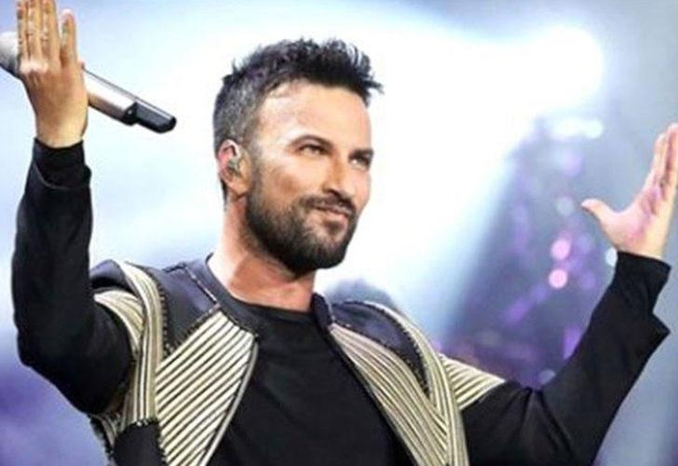
SEZEN AKSU
www.musictoall.eu

Slide 3
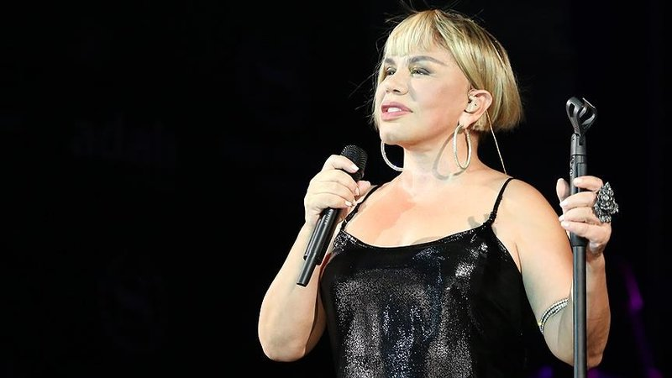
Fatma Sezen Yıldırım, known by her stage name Sezen Aksu, is a Turkish singer, songwriter and composer.Since his debut in the mid-1970s, he became an icon with his songs and steered Turkish pop music. In addition to his singing, she often came to the fore with his songwriter and composer identity, thanks to the songs she wrote and composed for others. She supported many backing vocalists and produced their albums. She helped introduce and influence various names throughout the 1990s and early 2000s.
www.musictoall.eu

Slide 4
Se moved to Istanbul to record records in 1974, and a year later she released her first 45 single "Haydi Şansım" under the name Sezen Seley. In 1977, she released her first studio album, «Allaha ısmarladık». Then dozens of them, including Serçe (1978), Firuze (1982), Sen Ağlama (1984), Git (1986), Sezen Aksu Söylüyor (1989), Gülümse (1991), Deli Kızın Türküsü (1993), Düş Bahçeleri (1996) were released. Among them, Gülümse became one of the best-selling albums of all time in Turkey. Aksu has sold more than 40 million albums worldwide up to now.
www.musictoall.eu

Slide 5
Sezen Aksu has more than 400 poems and compositions up to now. 197 of these poems were published in the Book of Incomplete Poetry. The second of this book was released in November 2016 with the name "Missing Poetry Second Book".
www.musictoall.eu

Slide 6
.
www.musictoall.eu

Slide 7
Thank you for your interest
www.musictoall.eu

