Slide 1
ATATÜRK SECONDARY SCHOOL
LEADING FOLK SINGERS
Music to All
2019 – 2022
www.musictoall.eu

Slide 2
SERTAB ERENER
She started his music education at the Istanbul Municipal Conservatory and continued at the Istanbul State Conservatory. She was a promising soprano. Sertab Erener, who stepped into her professional music career after 6 years of education, grew up listening to Turkish classical music songs sung by her father.In some of his works, he combined Western music and Eastern music, and he benefited from operas and Turkish classical music as well as ethnic elements. She opened to Europe in the early 2000s and offered various works for sale here.
www.musictoall.eu

Slide 3
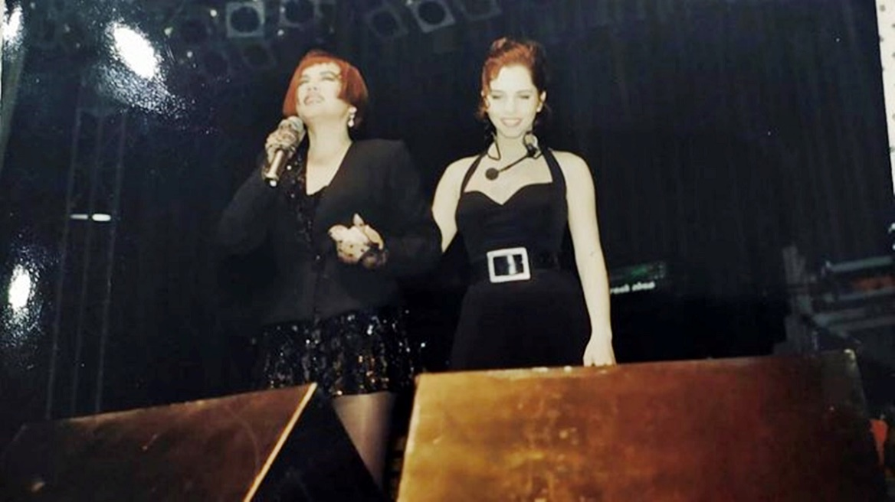
While Sertab Erener was the vocalist of Sezen Aksu, one of her biggest supporters, she released her first album ‘Sakin Ol-Be Calm' in 1992 with the support of Aksu. Produced by Sezen Aksu, the album became the 'best selling album' with 950 thousand official sales.
www.musictoall.eu

Slide 4
He released the album 'Lal-Garnet' in 1994. 'Sertab Gibi' followed 'Lal' in 1996. This album achieved a sales figure of 1.5 million in total. Sertab Erener, who performed a duet with Ricky Martin with 'Private Emotion - Come to Me', released the single 'Aşk-Love' with Greek artist Mando in 2000.
www.musictoall.eu

Slide 5
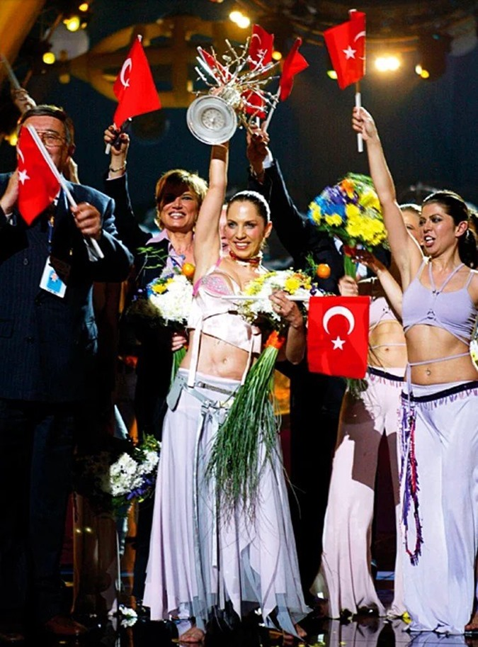
Competing for Turkey in the 48th Eurovision Song Contest held in Riga, the capital of Latvia, on May 24, 2003, Sertab Erener and her team won 167 points with their song 'Every Way That I Can'.
www.musictoall.eu

Slide 6
«Ada Sahilleri» FOLK SONG
www.musictoall.eu

Slide 7
www.musictoall.eu

Slide 8
Thank you for your interest
www.musictoall.eu

