Slide 1
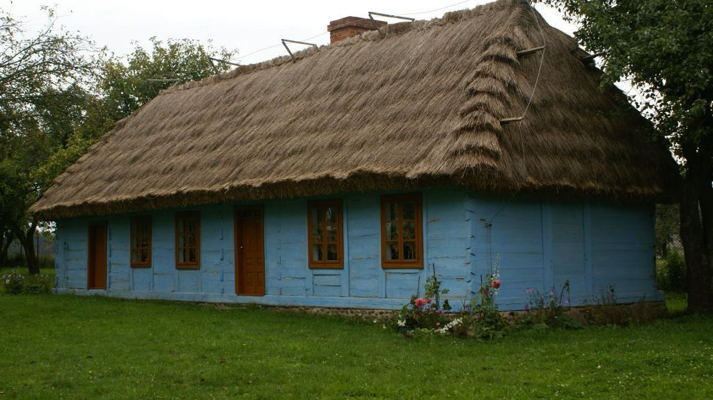
Folklore in Poland
Ewa, Tosia, Gustaw, Kacper

Slide 2
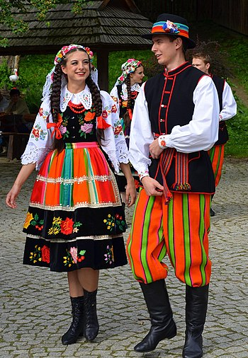
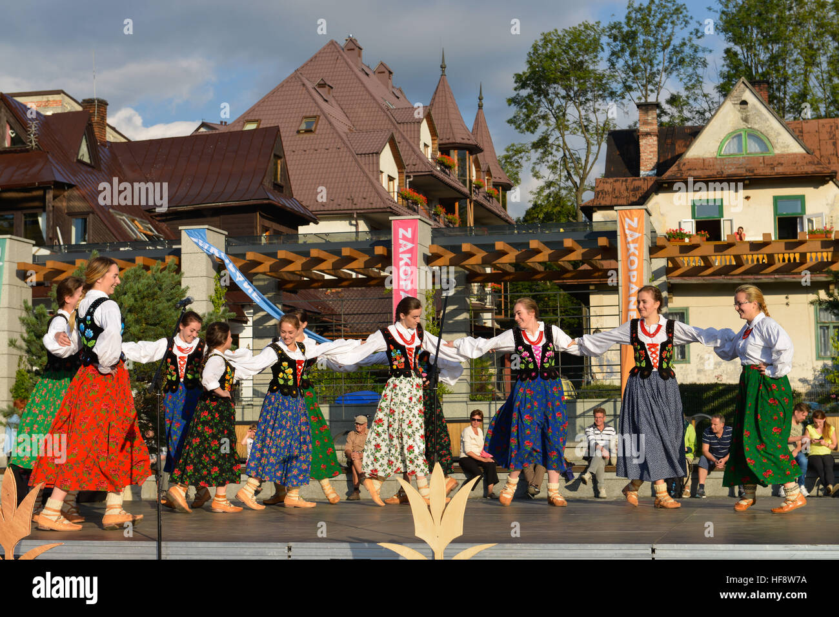
Diversity
We have a lot of folk groups in Poland.
In this presentation we would like to concentrate on 2 most well know groups.
1. Mazovia folklore
2. Mountain folklore

Slide 3
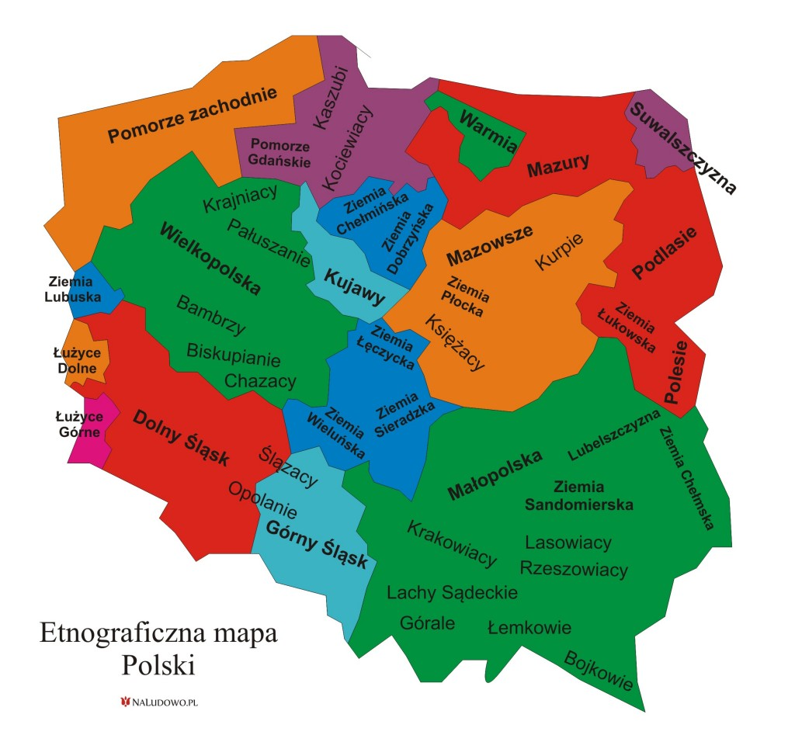
Mazovia Region
Region of Poland settled on the east.
Historical capital of Mazowsze is Płock.
Current capital of Poland Warsaw is laid in Mazowsze.

Slide 4
Mazovian costiums
A characteristic feature of Masovian costumes was simplicity.
Elements of the costiums were made by hand, using the raw materials available in this area - linen and wool.

Slide 5
Mazovian Music
Mazovian music is very nice, we really like it and appreciate it a lot.
Folk instrumental playing in Mazovia was characterized by performance variability (rhythmic and melodic).
Typical Mazovian instruments are: Violin, bagpipe, dulcimer, clarinet and even more.

Slide 6
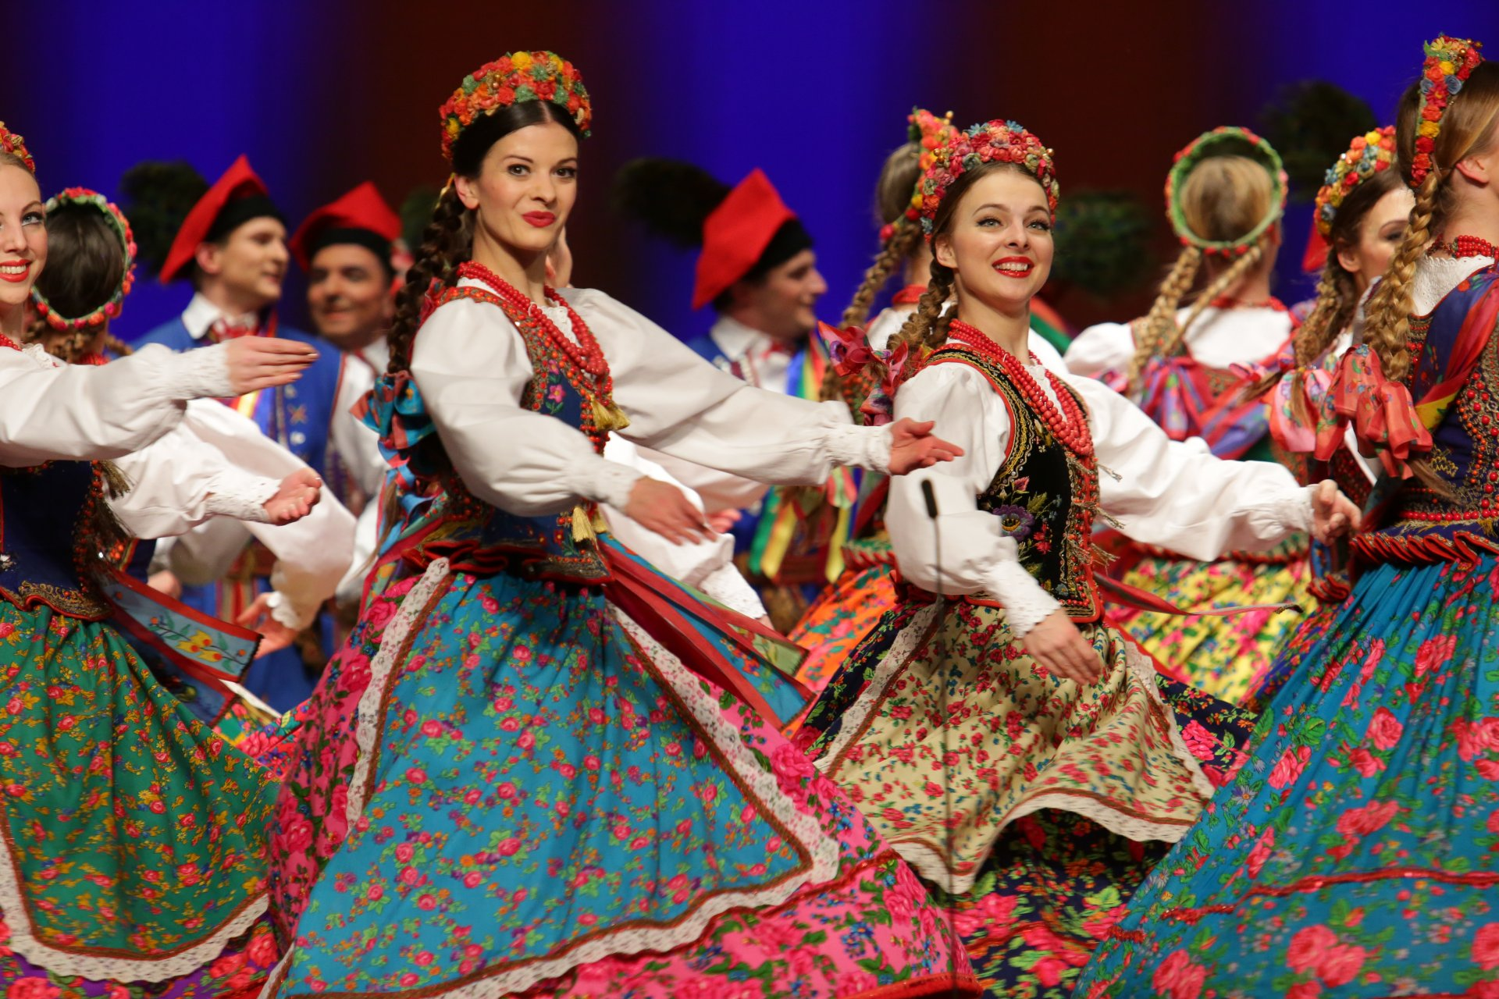
Musical folklore in Mazovia
Looking at the musical folklore of the region of Mazovia (Mazowsze), one can distinguish the following subregions: Kurpie, Mazowsze Płockie, Mazowsze Łowickie, Mazowsze Skierniewickie, Mazowsze Rawskie, and Mazowsze Polne (Południowe). Mazovia's folk instrumentalists did not adhere to one standard of performing as regards melody and rhythm.

Slide 7
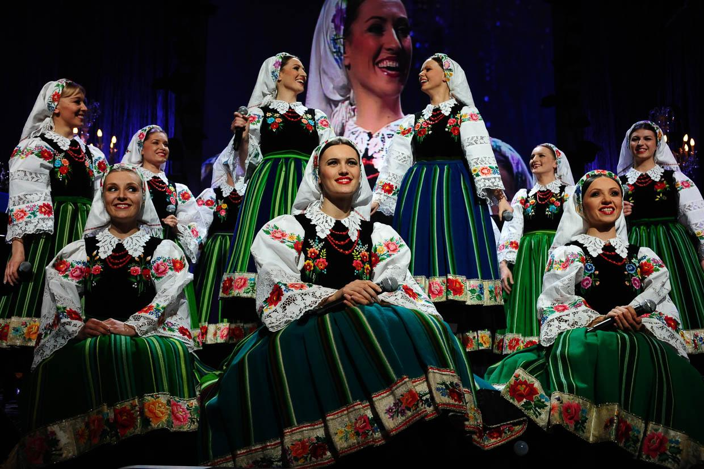
Mazowsze Folk group
"Mazowsze" is one of the largest artistic groups in the world, reaching for the wealth of national dances, songs, songs and customs. The name of the group comes from the central region of Poland - Mazovia, but the repertoire of "Mazowsze" also includes folklore of other regions. The ensemble consists of a ballet, choir and symphony orchestra. The melodies come from 39 ethnographic regions of Poland and from around the world. The band's concerts are always a great artistic spectacle, combining dance, singing and music. It is a coherent presentation of national and folk culture from various regions of Poland. All this makes the band's work recognizable not only in Poland, but also abroad.

Slide 8
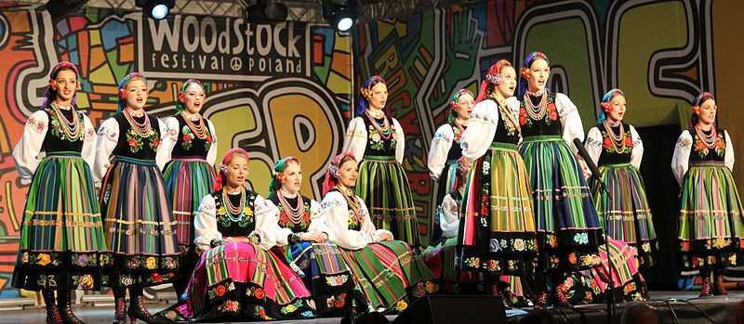
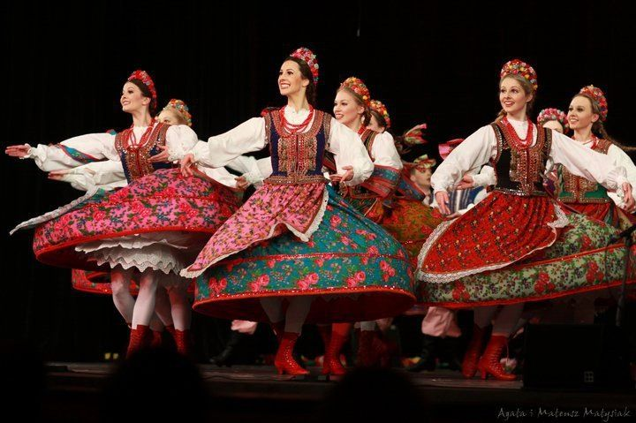
Since 2009, the headquarters of the group is the folklore center "Matecznik Mazowsze". The main element of the facility is a modern entertainment and educational hall, which can accommodate 563 spectators at a time. The team was established on January 2, 1949 by an order of the Minister of Culture, Stefan Dybowski. For 50 years its organizer was the Ministry of Culture and Art, later the Ministry of Culture and National Heritage, and from 1999 this role was taken over by the Mazowieckie Voivodeship Self-Government.

Slide 9
Mountain or Highland Folklore
Mountain region is in the south of Poland
Zakopane is the most well know town
The region is known for its folklore and oscypek

Slide 10
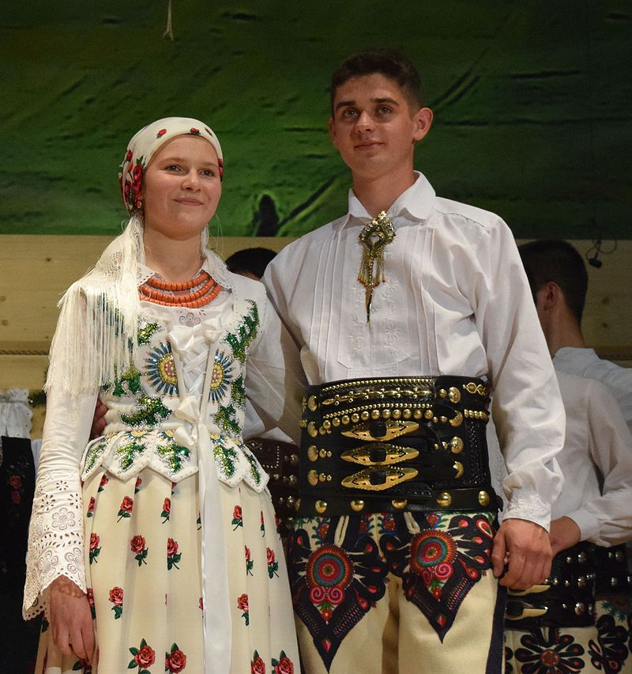
Mountain folk clothes
Unlike other regional groups in Poland, Highlanders from Podhale wear traditional outfit (or its elements) on a daily basis
The most important elements of male attire are: trousers and a coat made of woollen broadcloth, a leather vest, moccasins and a belt, shirt and a black felt hat.
Female attire has been changed through the 19th and 20th century and in mid-19th century consisted of a percale shirt with wide sleeves, a decorated corset made of fabric, a wide percale skirt with floral motif, a muslin apron, boots with high soles, trinkets or coral necklaces around the neck and a muslin (or tybet, or woollen) scarf worn on the head or over the shoulders. Women also wear the same type of shoes as man do.

Slide 11
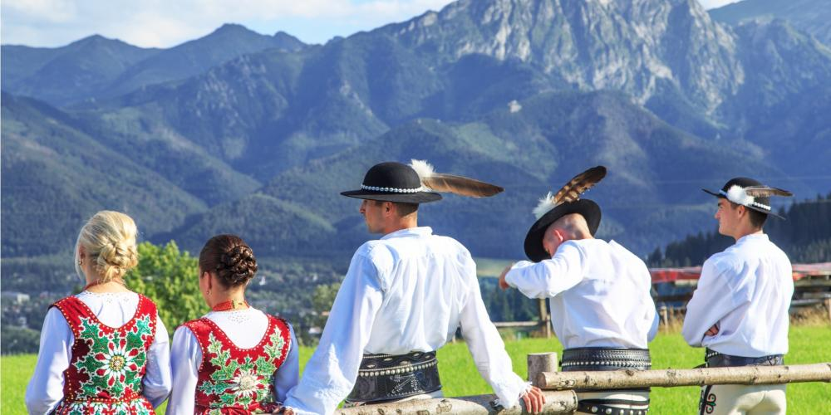
Mountain Folklore
Highland songs and music characteristic of the Carpathian area is a fusion of cultural elements brought in by different ethnic groups that had been settling there over the centuries. In the Polish section the Carpathian area the following groups of highlanders (górale) have developed their own characteristic style.

Slide 12
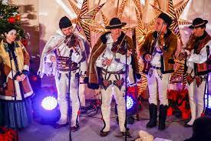
Traditional instrumental bands of Podhale were made up of a violin and small basses still in the mid-19th century, then, between the 1890s and 1930s a second and third violin would be added to the line-up. Sometimes big basses were also used. These days more than three violins are sometimes seen.
Thanks to a robust folk revival movement, some abandoned instruments, such as bagpipes, złóbcoki, trombitas, or pipes are played again, if mainly at festivals or other showcases.
Short passage of Jan Karpiel-Bułecka’s performance.
http://folk.instruments.edu.pl/en/instruments/show/instrument/4746

Slide 13
Thank You For Your Attention!

