Slide 1
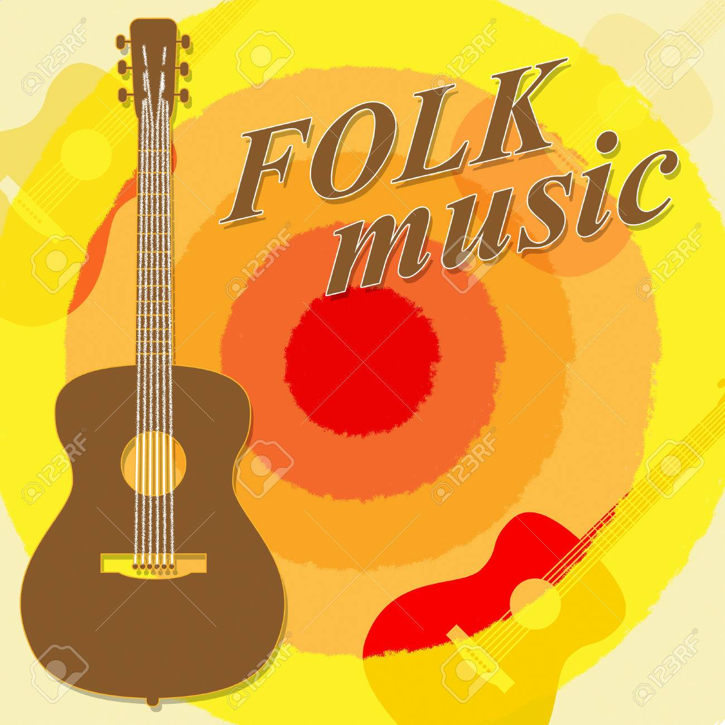
SPANISH FOLK SINGERS

Slide 2
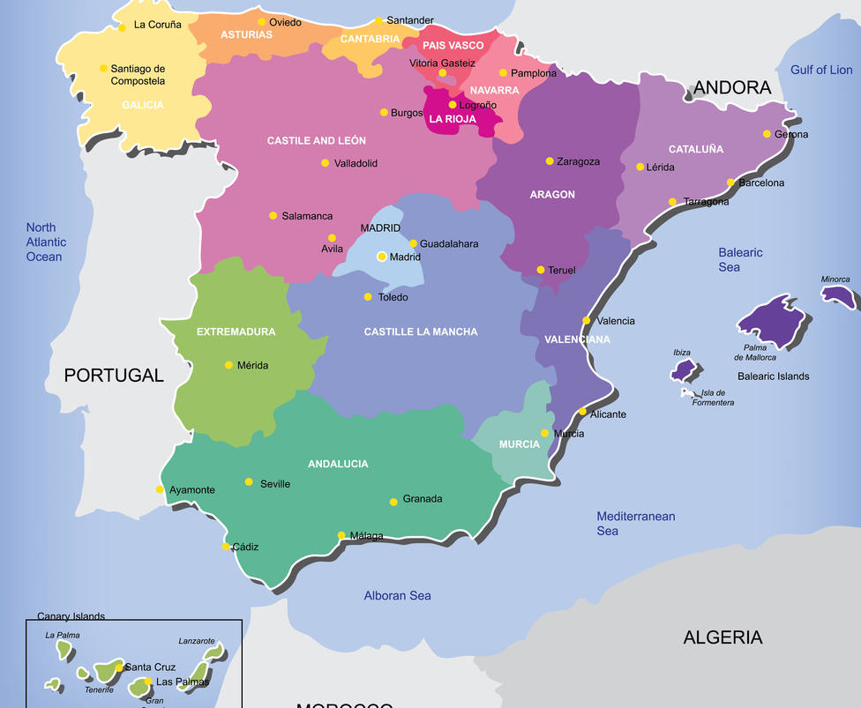
Spain is divided in many autonomous communities.
Each one has got different folk music and traditions.
We have selected one from the north, one from the Centre and another one from the South.

Slide 3
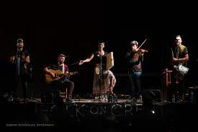
FOLK ON CREST
FOLK ON CREST is a group from the North of Spain.
It is a group formed by five members.
They make modern versions of traditional songs.
They receive the influence of Celtic music, typical of the area where they are from.

Slide 4
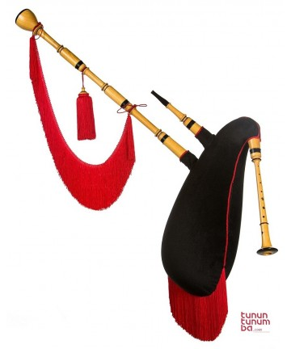
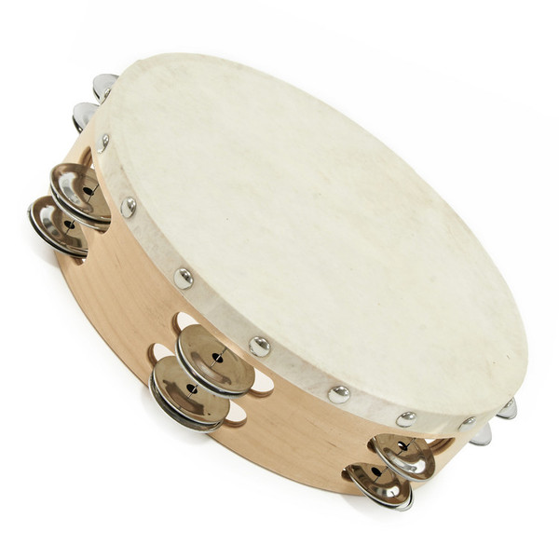
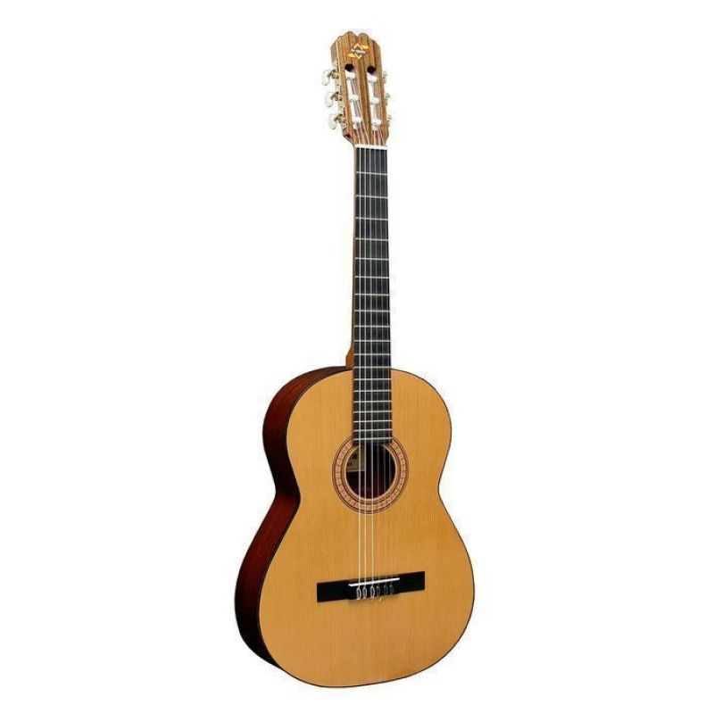
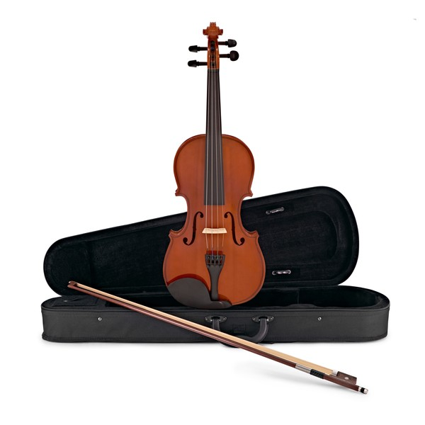
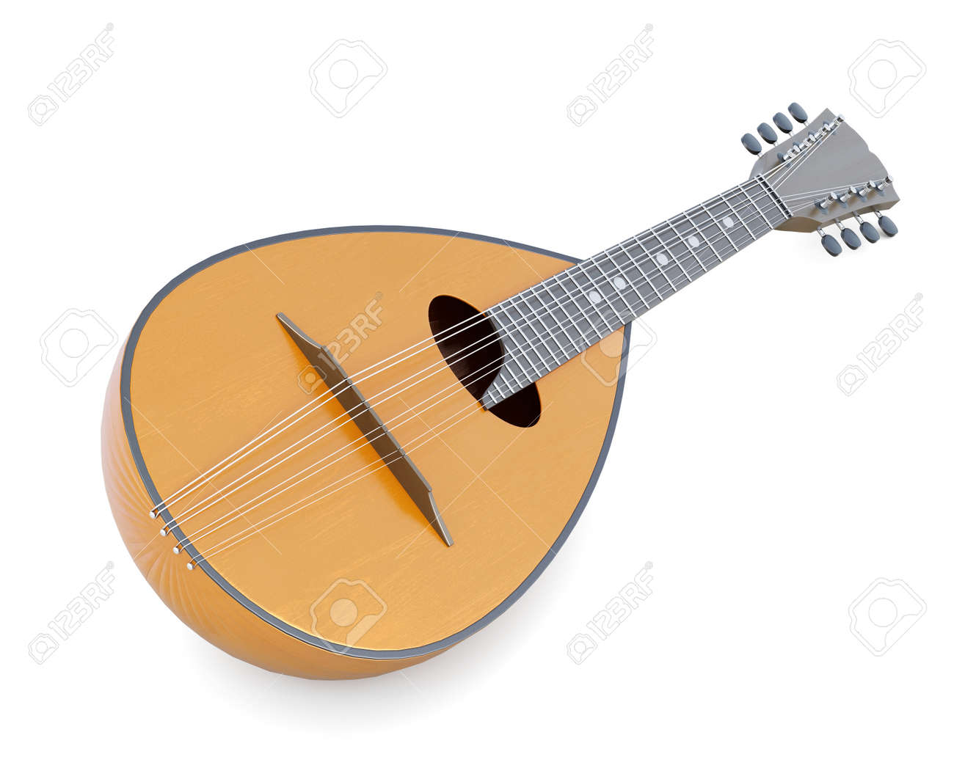
Tambourine
Bagpipe
INSTRUMENTS THEY USE
Acoustic guitar
Violin
Mandolin

Slide 5
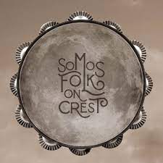
These are the links to some of the most famous popular songs of the group:
https://youtu.be/3Xh6iht33dg
https://youtu.be/JlaA2UVeHT8
https://youtu.be/00oZ0_TF4fU
https://youtu.be/QUN4-l89224
https://youtu.be/aUZUwQB

Slide 6
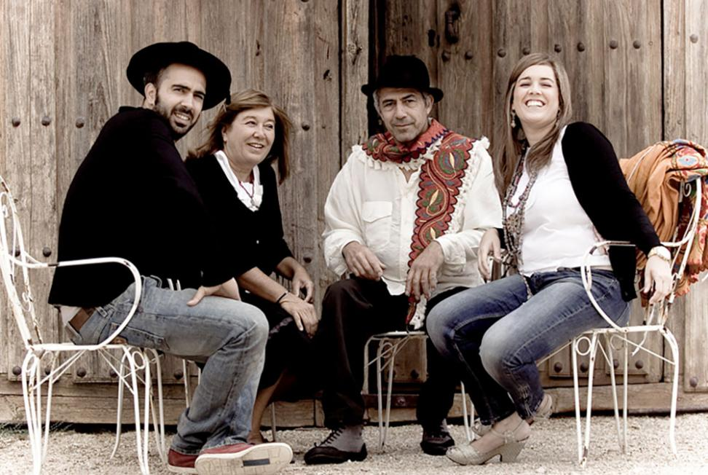
GRUPO MAYALDE
Mayalde is a folk music group from Castille-León, in the centre of Spain. For the last 38 years they have been recuperating typical songs and traditions from that part of the country.
The members of the group are Eusebio, Pilar, and their children Laura and Arturo.

Slide 7
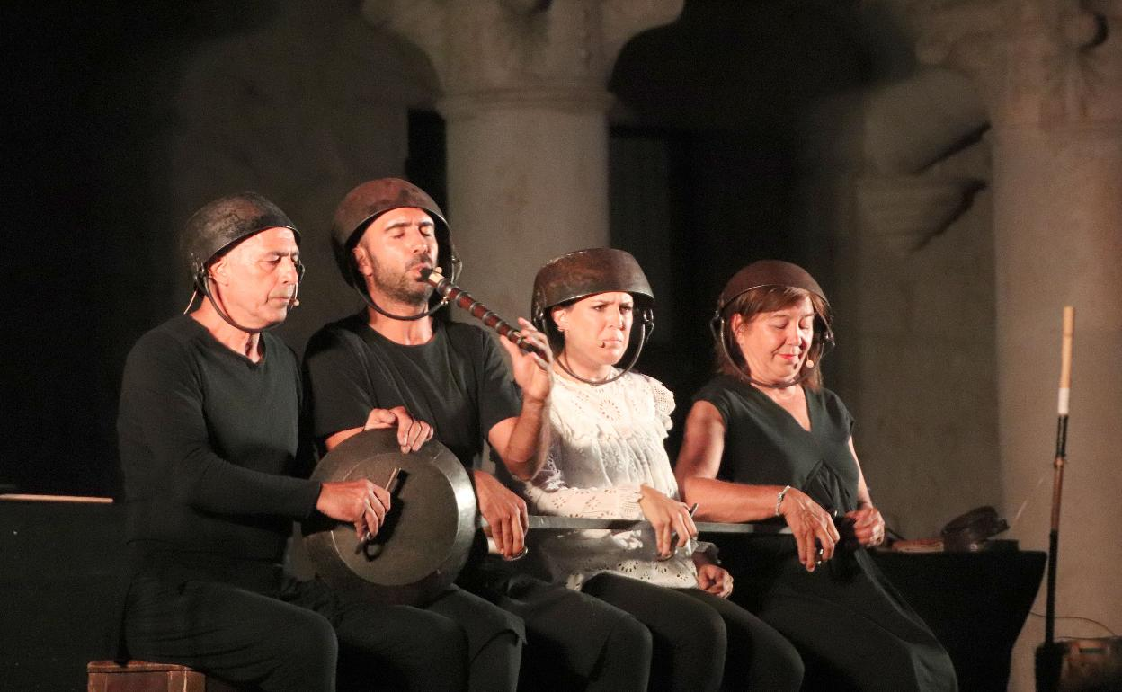
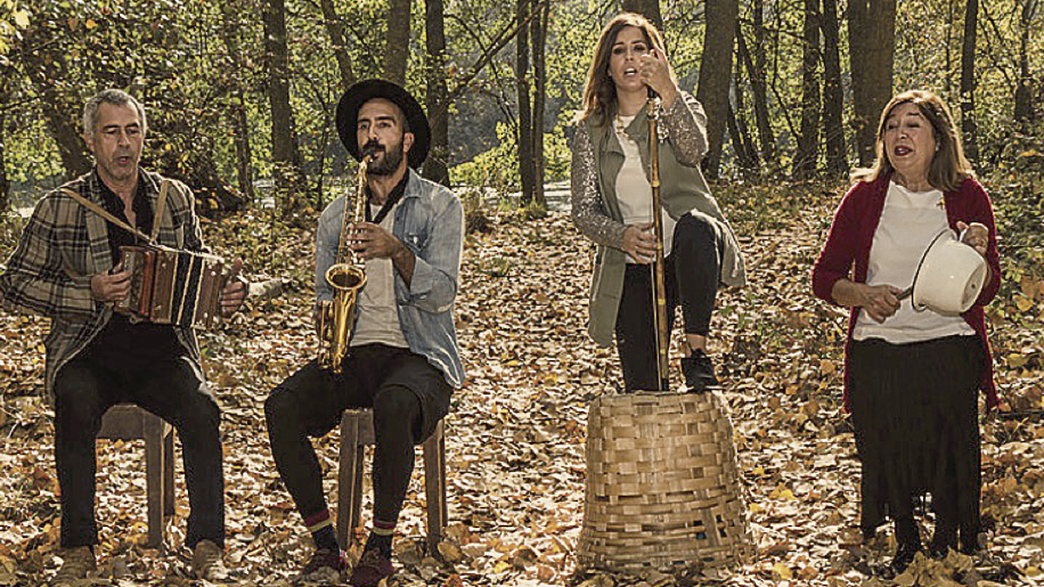
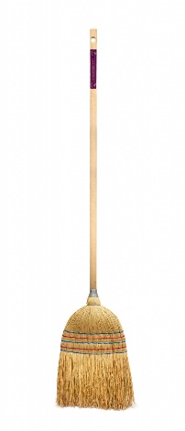
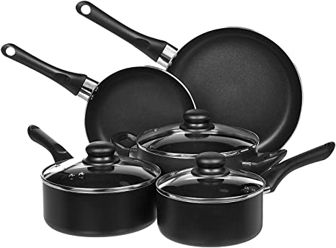
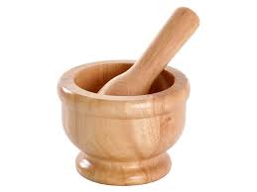
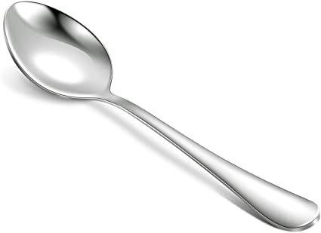
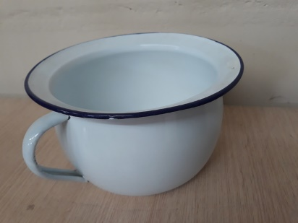
INSTRUMENTS
As instruments they use objects from our daily lives,
such as:
,,,,, glasses, plates, shears, bones, bass drums, accordions, pots, frying pans, watering cans, oil bottles, tops.
Spoons | potties | brooms | pans | mortars

Slide 8
Let’s listen to some examples of their songs
https://youtu.be/OV3qIjoxoj4
https://youtu.be/rDhhVbcdDDg
https://youtu.be/b_NzEZRLpII

Slide 9
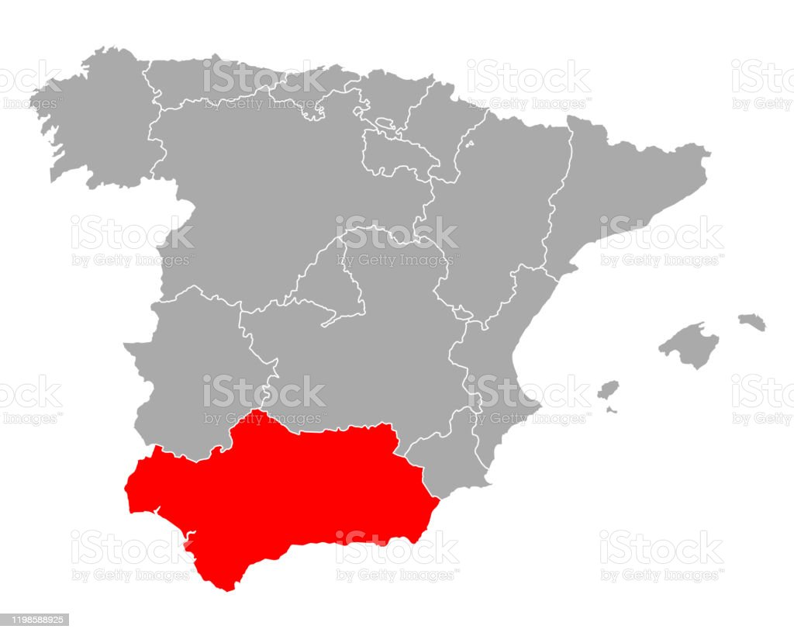
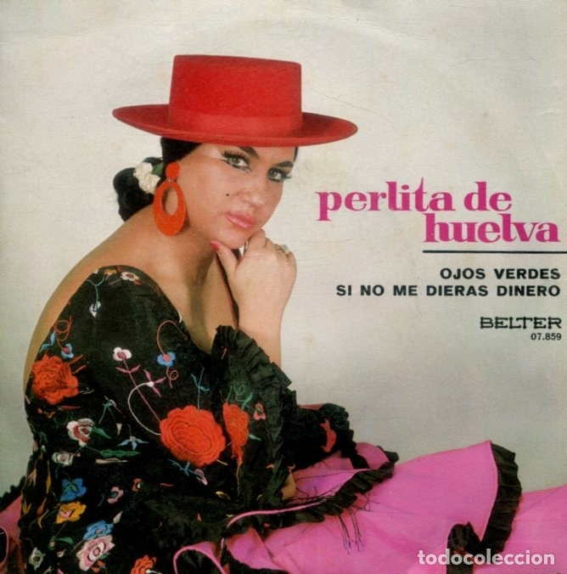
PERLITA DE HUELVA
She was born in Andalucia, in the South of Spain,
She is a famous flamenco singer. She started singing around 1950.
She has published many songs that our grandmothers still sing.

Slide 10
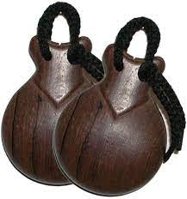
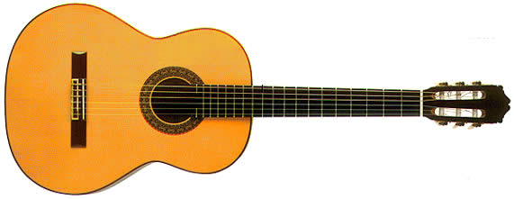
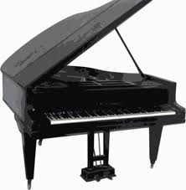
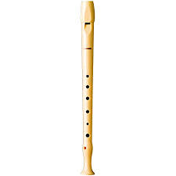
The instruments that you can hear in her songs are: The guitar, piano, flute and castanets.

Slide 11
Now you are going to hear an example of her songs.

