Slide 1
ATATÜRK SECONDARY SCHOOL
LEADING FOLK SINGERS
Music to All
2019 – 2022
www.musictoall.eu

Slide 2
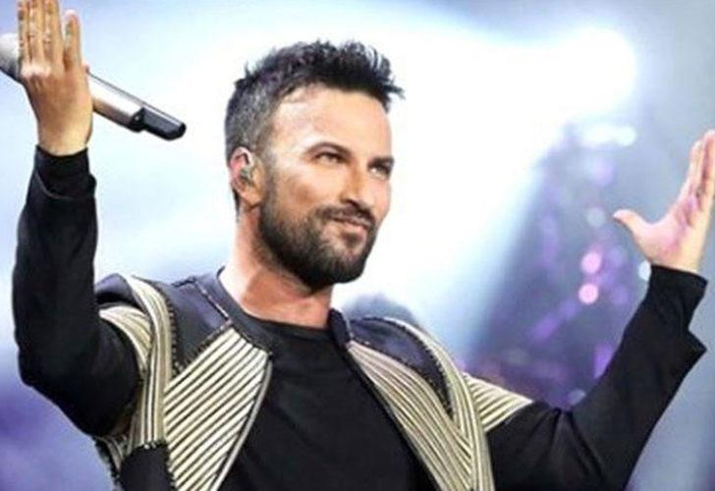
TARKAN
www.musictoall.eu

Slide 3
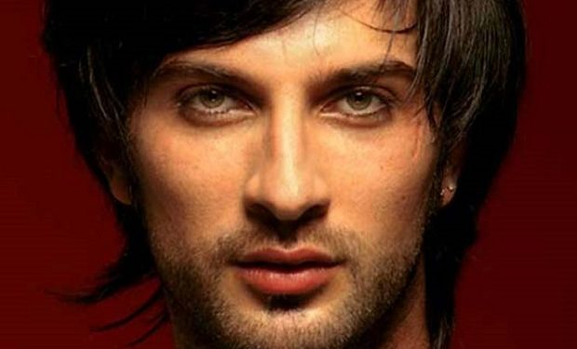
Tarkan Tevetoğlu (born 17 October 1972) is a Turkish singer-songwriter. He became known both in Turkey and in Europe with his continuous chart success and sales success in Turkish pop music since the early 1990s.Tarkan was born and raised in the town of Alzey in the Rhineland-Palatinate state of West Germany. He came to Turkey with his family in 1986 and as a result of his interest in music that started in his childhood, he started his first music education in Karamürsel, where he started his high school life. In the following years, he met Mehmet Söğütoğlu, the owner of the Istanbul Plak company, and signed an album contract with the company.
www.musictoall.eu

Slide 4
Tarkan released his first studio album, Again Sensiz, in the last months of 1992 and debuted with the song "Kıl Oldum" in the album. He achieved commercial success with his second studio album Aacayipsin, released in 1994, and his third studio album, Ölürüm Sana, released in 1998. The single "Şımarık", released from the album Ölürüm Sana, entered the national charts of many countries. He signed with Universal Music Group in 1998. The compilation album Tarkan, released in 1999, won platinum and gold certificates from various countries. He clipped the songs "Kuzu Kuzu", "Hüp" and "Verme" in his fourth studio album Karma, which was released in 2001. He achieved commercial success again with the album Dudu, which was released two years later, and in 2006 he entered some European charts with his first English album, Come Closer. "Bounce" and "Start the Fire" were singles from the album.
www.musictoall.eu

Slide 5
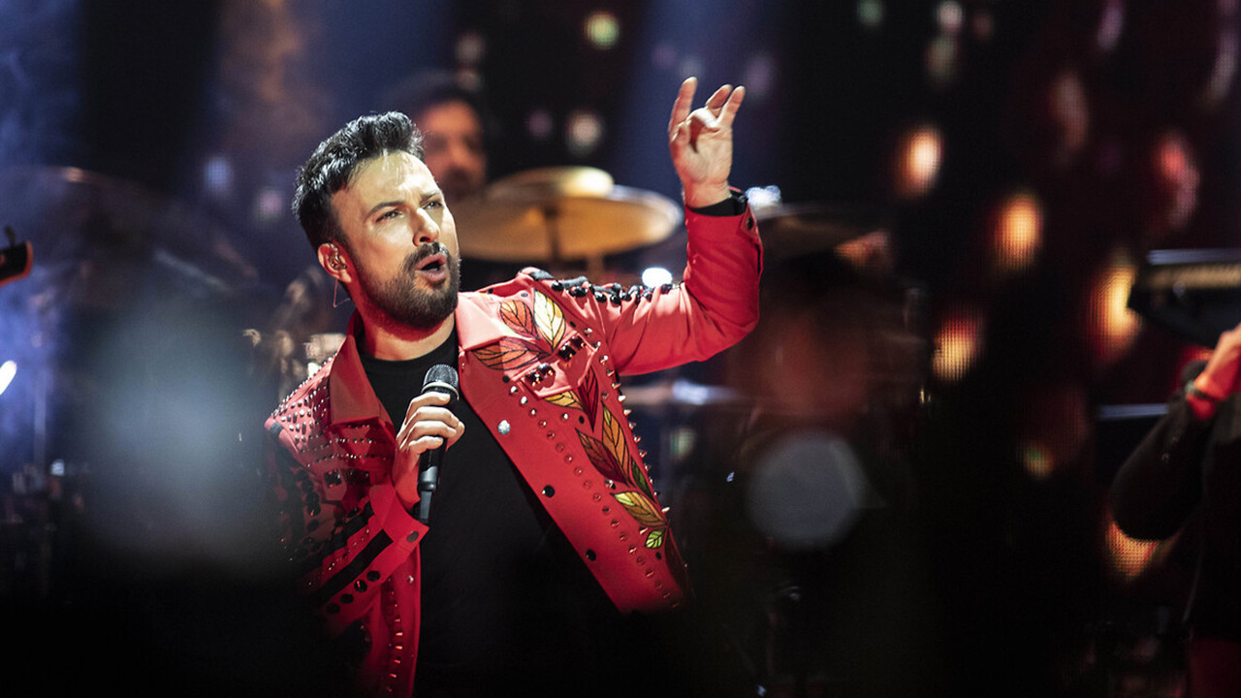
Taking part in various social responsibility projects as well as musical projects, Tarkan is referred to as "Megastar" by the Turkish press, "Prince of Pop" and "Prince of the Bosphorus" by the world press.
www.musictoall.eu

Slide 6
.
www.musictoall.eu

Slide 7
Thank you for your interest
www.musictoall.eu

