Slide 1
ATATÜRK SECONDARY SCHOOL
LEADING FOLK SINGERS
Music to All
2019 – 2022
www.musictoall.eu

Slide 2
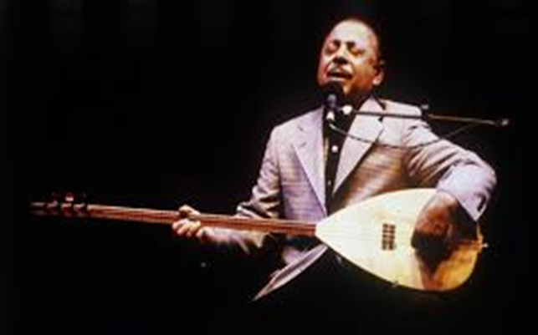
Born in 1938, Neşet Ertaş's father is a saz master like himself. Neşet Ertaş, who has 7 siblings, is the second child of the family. He did not have the chance to study because he traveled to many different places in Anatolia with his family.
www.musictoall.eu

Slide 3
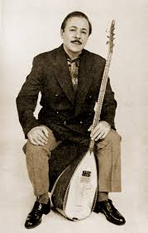
Neşet Ertaş, a saz master, is one of Turkey's most important artists. The famous artist, who came to Istanbul in the 1950s at the age of 14, released his first record here with the song «Neden Garip Garip ötersin Bülbül- Why are you singing poorly, nightingale?".
www.musictoall.eu

Slide 4
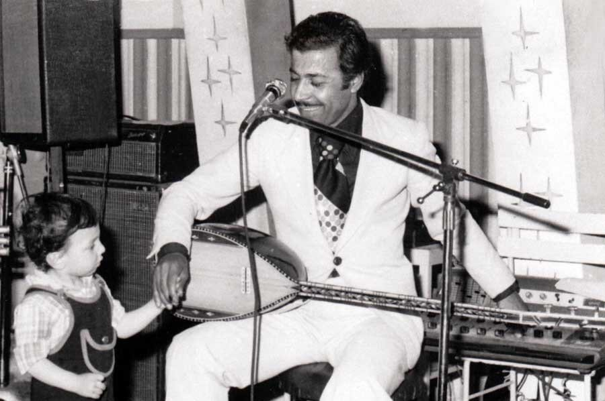
With this album released in 1957, he became one of the most important folk poets of the country. Neşet Ertaş, who was listened to a lot by the public, was also heavily listened to by the Music Society. During his stay in Istanbul, Neşet Ertaş, who made many records and canned cassette works, settled in Ankara after a while and continued his artistic life there.
www.musictoall.eu

Slide 5
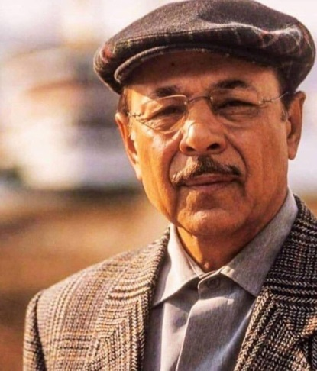
Known as the "Legend of Anatolia" or the "Musician of Abdal", Neşet Ertaş continued his musical life without breaking his style until he passed away.
www.musictoall.eu

Slide 6
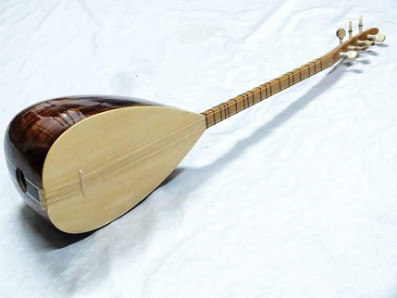
It is a stringed instrument consisting of stem, boat and auger parts, starting from Central Asia and spreading to the Balkan geography. According to the regions, it is called by different names such as kopuz, cura, çöğür, dombra and tamburator. It is known as dombra in Central Asia. Today, it has been changed to tambura. Reed types differ according to their size. Reed strings made from animal intestines in ancient times are made of metal strings today. Baglama family is named as small size, medium size and large size.
Saz is an instrument with all melodies and a very effective sound. It has between 17 and 24 frets. The most important feature of the reed is that it is made of trees that do not change shape. It is examined in two ways as short and long stem. It has 7 wires, body and handle.
www.musictoall.eu

Slide 7
«Kesik Çayır Biçilir mi?» FOLK SONG
www.musictoall.eu

Slide 8
www.musictoall.eu

Slide 9
Thank you for your interest
www.musictoall.eu

