Slide 1
Polish disabled musicians
Ewa, Tosia, Gustaw

Slide 2
Roman Roczeń
Polish blind singer and guitarist. He’s known for performing shanties. He loves sea and he even organized a sailng cruise for other blind people.

Slide 3
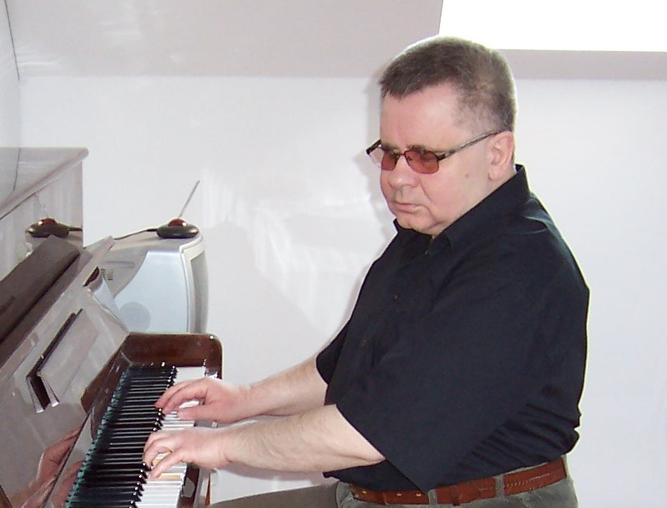
Janusz Skowron
postoperative wound
postoperative wound
Blind jazzman, pianist and composer. He was born on 23.05.1957 in Warsaw and died 27.02.2019 because of an infection of an postoperation wound. He performed in many worldwide famous bands.

Slide 4
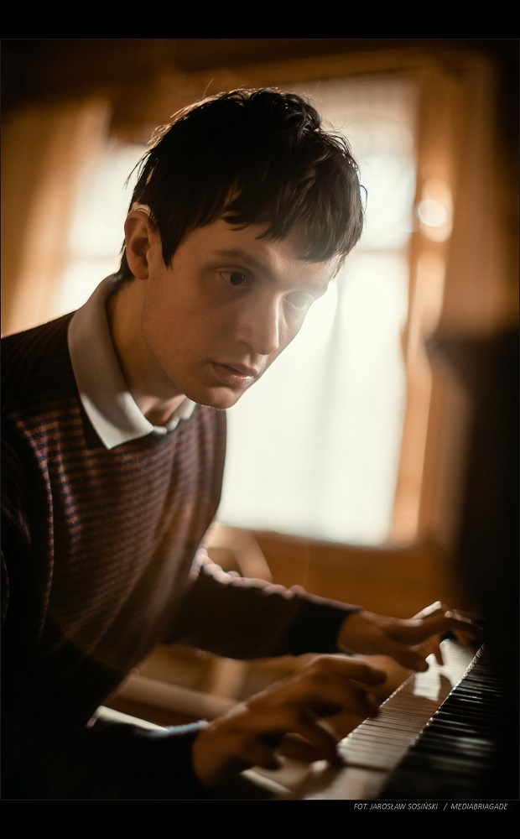
Grzegorz Płonka
Grzegorz Płonka was born deaf so everyone thought that he’s autistic. He heard something for the first time when he was 18. He’s a great pianist, some say that he played Beethovens theme better than Beethoven himself.

Slide 5
Monika Kuszyńska
Polish Singer, vocalist of famous group Varius Manx.
She had a car accident and she is paralyzed since 2006.
She stays on a wheelchair still singing.
She is an ambassador of many charity actions in Poland.
She represented Poland in 2015 the Eurovision competition with a song „In the name of love”

Slide 6
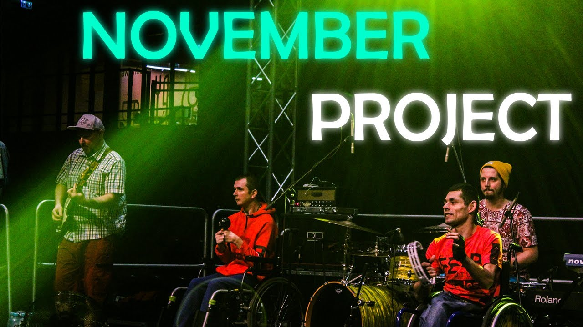
November Project Band
The group consists of twelve people, some of them are disabled.
The band is form Warsaw and their favourite music is Reggae.
In November Project Band they help each other and learn from each other.

Slide 7
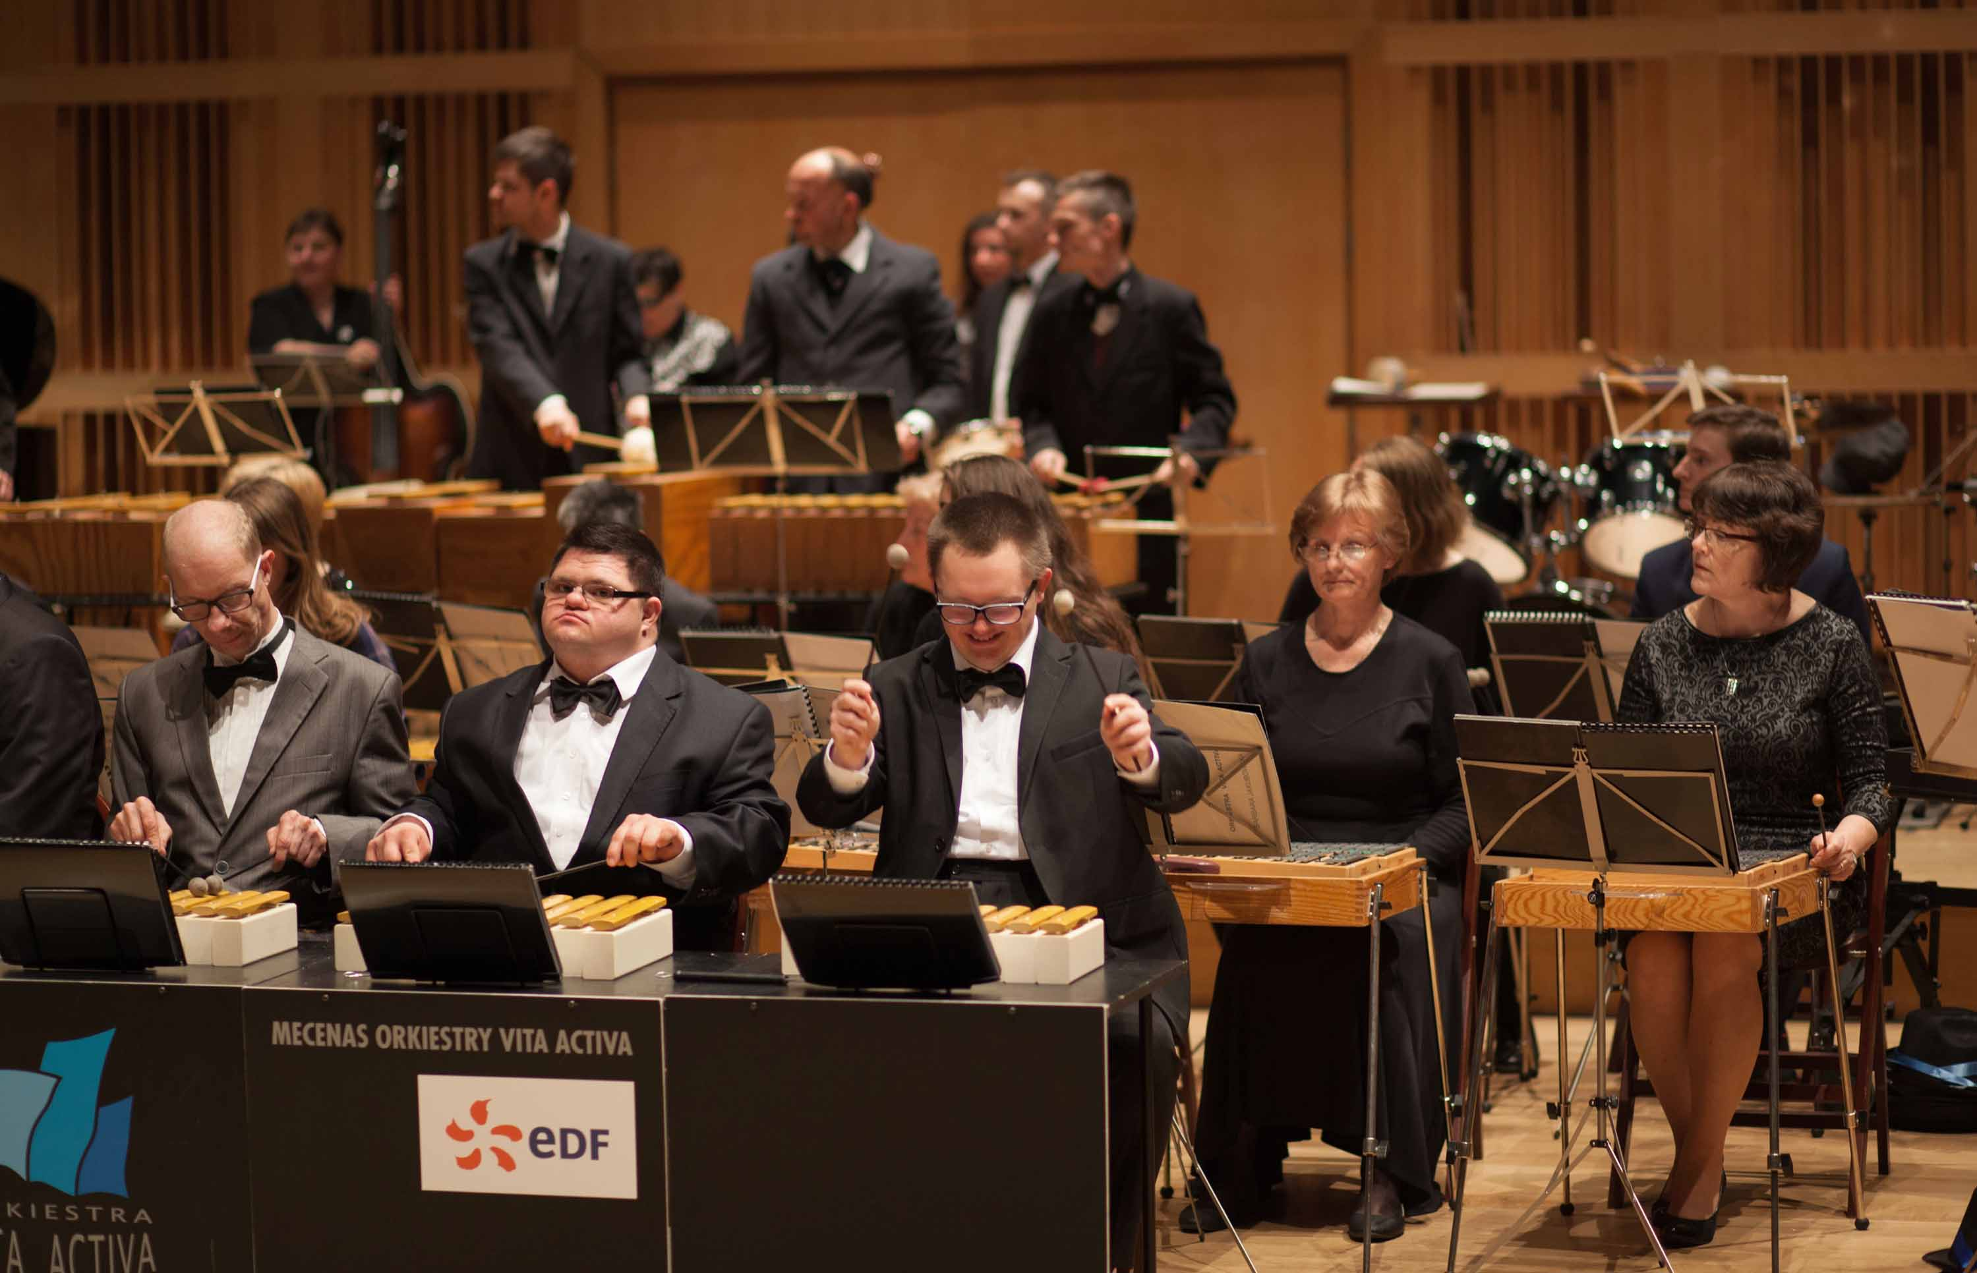
Orchestra Vita Activa
Most of the musicians are people with intellectual disability
They play the xylophones, bells, metalophones.
They had ove 240 concerts in Poland and abroad. They play classical music.

Slide 8
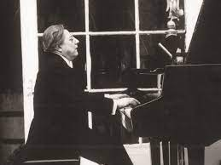
Edwin Kowalik
Polish pianist, composer and publicist.
He lost sight when he was seven years old.
He was the finalist of The Fryderyk Chopin Piano Competition.
His piano career lasted over 40 years.

Slide 9
Thank you for your attention

