Slide 1
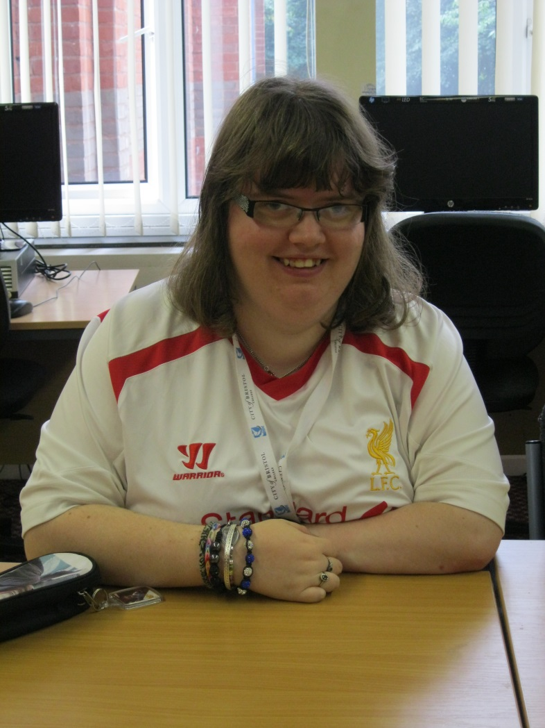
Hello! My name is Becky.
My name is Becky.
I live in a house in Yate.
I come to College every Tuesday and Wednesday.
My hobbies are Karate and football.
I like watching t.v
and dvds and listening to music.

