Slide 1
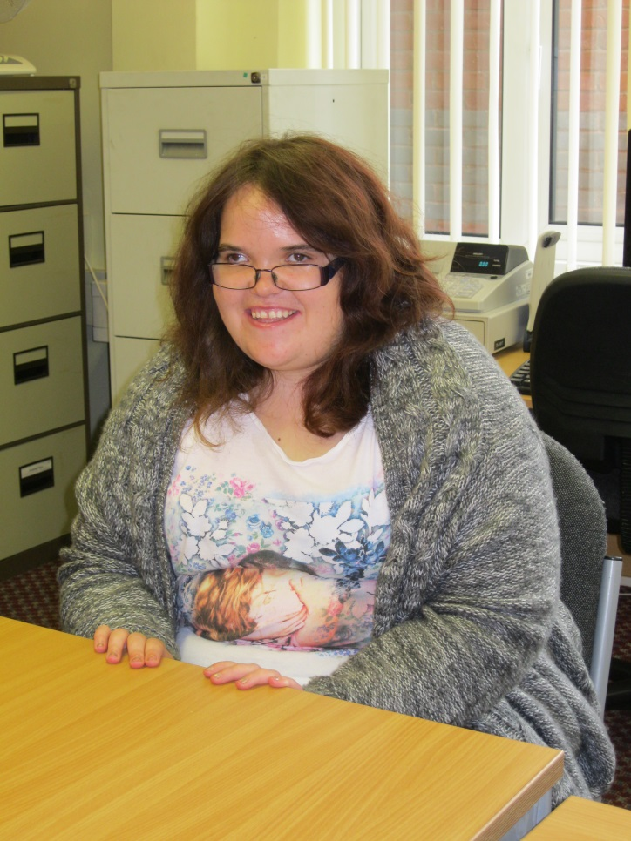
Hello! My name is Amy.
I live in kingswood Bristol.
I come to college every Tuesday and Wednesday to study Art and Citizenship. I have two teachers.
I like watching the Lion King and Finding Nemo.

