Slide 1
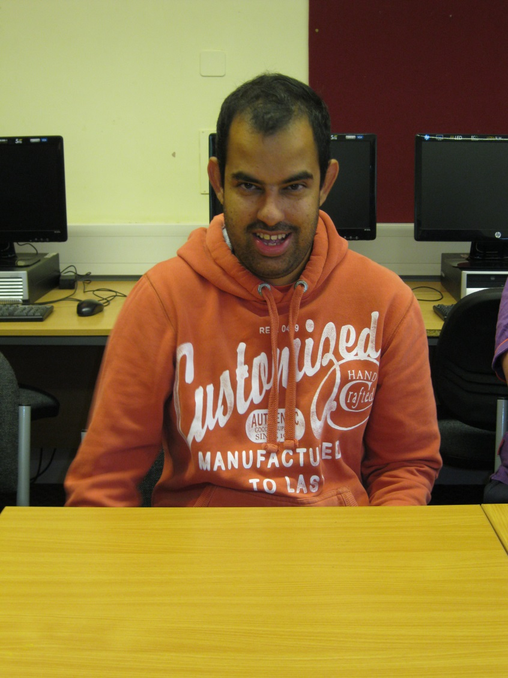
Hello! My name is Akif.
I live in Kingswood, Bristol, with my family. I come to college every Wednesday to learn Citizenship. I have a job as a farm volunteer. My hobbies are cricket, football and TV.

