Slide 1
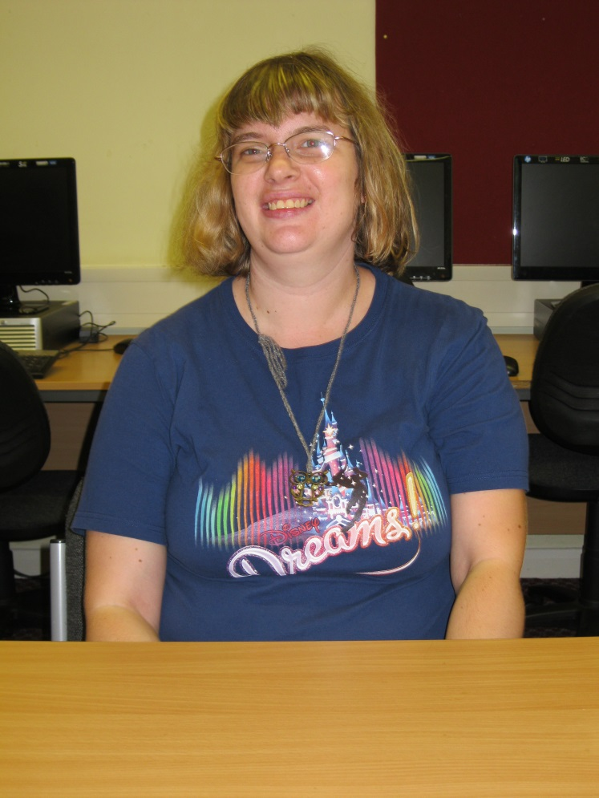
Hello! My name is Sarah.
I live in Fishponds , Bristol with Julie and Katherine and Paula.
I come to college every Wednesday to learn
Citizenship .
I have a Job in The PDSA on a Thursday
My Hobbies are:
To go shopping
Meeting new people
Listening to Music
Watching films
Making Jewellery
Visiting my Partner Jimmy and Support worker Ben next Tuesday evening for tea. Also Zumba lessons at a club called the Hive on Mondays .

