Slide 1
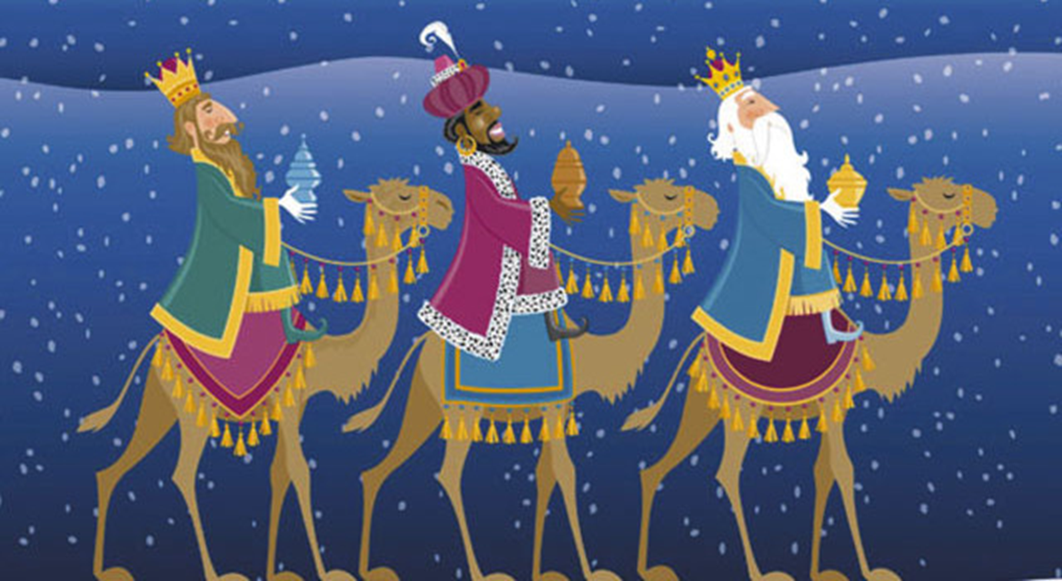
OUR CHRISTMAS
How we spent the Christmas holidays in Spain?

Slide 2
CARMEN
HELLO MY NAME IS CARMEN AND I SPENT MY VACATION VILLAGE BURGONDO (AVILA) AND MADRID.
I EATEN OUT MY NEIGHBOURS AND WE HAVE BEEN PRESENTED WITH MANY GIFT BAGS. I WENT TO RIDE OF THE MAGI VI CALIFORNIA IN A SWEET CHARIOT
PAPA NOEL GAVE ME A LOT OF THINGS AND ALSO THE KINGS

Slide 3
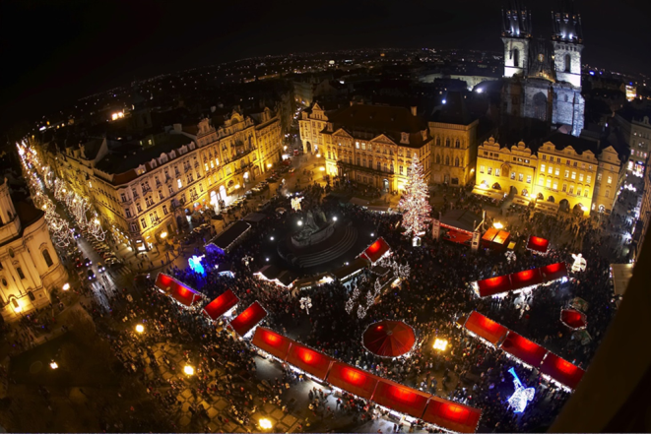
MARGOT
HELLO MY NAME IS THIS CHRISTMAS HE MARGOT AND EATEN STEAKS WITH FRENCH FRIES AND CHICKEN SALAD.
THEN I WENT TO WALK WITH ME MY FATHER TO THE PLAZA MAYOR TO SEE THE BELEN.
I WAS WALKING FOR A GOOD TIME THERE UNTIL VOLVI ME HOME TO EAT CHOCOLATE MARZIPAN AND NOUGAT.
ME THEN WENT HOME TO SEE MY TIO GIFTS THAT WAS BROUGHT ME THE CHILD JESUS. BROUGHT ME SOME HELMETS FOR COMPUTER AND NEW YEAR'S EVE DINNER VOLVI HOME TYPICAL FOOD NOCHEVIEJA.
DOCES THEN WE MEET AT ALL IN THE SALON FOR TAKING THE GRAPES AND CELEBRATE THE ARRIVAL OF A NEW YEAR.
IN THE LAST CHRISTMAS DAY I WENT TO THE ICE RINK TO SKATE.

Slide 4
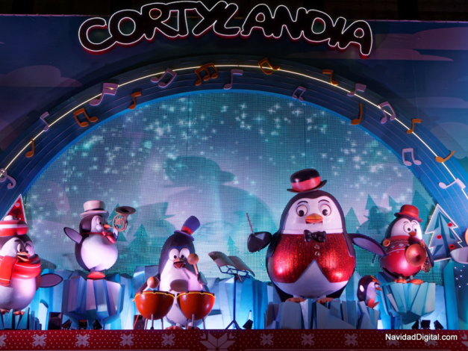
ROBERTO
Hi I'm Bob and this Christmas I've been with my parents and my grandparents.
I have done many things like go to the Puerta del Sol, Plaza Mayor, Cortylandia and Christmas Eve dinner with my parents and my grandparents. Then I went to Mass Gallo is at twelve o'clock.
Santa Claus brought me a mobile and much more ..
WHAT TAKES PLACE IN YOUR COUNTRY IN GRAPES?
I saw the procession of the Magi on the 5th and the next day we woke up and they were the presents under the tree
Whats there RIDE OF KINGS?

Slide 5
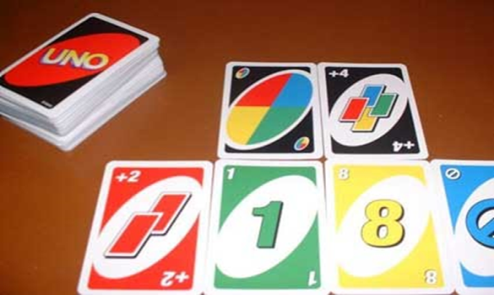
ALMUDENA
HELLO I AM ALMUDENA
I HAVE 18 YEARS. CHRISTMAS HOLIDAYS IN THESE I WAS IN MADRID WITH MY PARENTS
I WAS DURING THE HOLIDAYS WITH MY COUSINS, SALI TO RUN WITH MY PARENTS AND MY BROTHER
I was STUDYING LANGUAGES AND DOING THINGS AT HOME
I LIKE ANIMALS AND MUCH MORE I LIKE IS THE CAT AND THE FOX AND THE HORSE.
MY FAVORITE SPORT IS THE SWIMMING AND TENNIS.
GAME THAT ARE MORE LIKE THE LETTERS OF ONE

Slide 6
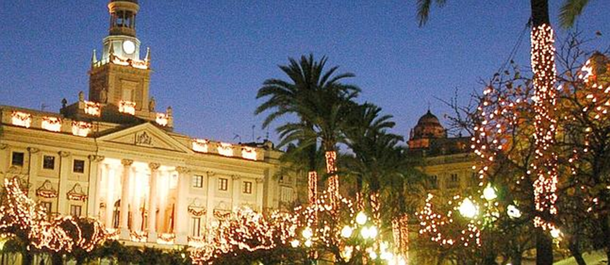
OLGA
I am Olga
This Christmas I've been to Cadiz with my family and all my cousins. I would've had a great time enjoying my family
Papa Noel gave me a bag with fringes which I loved.

Slide 7
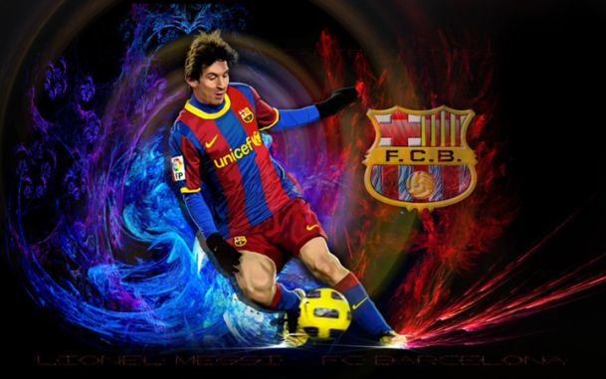
Hassan
Hello I am Hasan and as I am a Muslim I do not celebrate Christmas as party but, yes celebrate the feast of Ramadan to be held this year on June 28, 2015. In addition, we also celebrate the feast of lamb on September 23.
This Christmas I used to play football with my friends and I went to the movies with the Centre where I go in the evenings and have seen animals.

