Slide 1
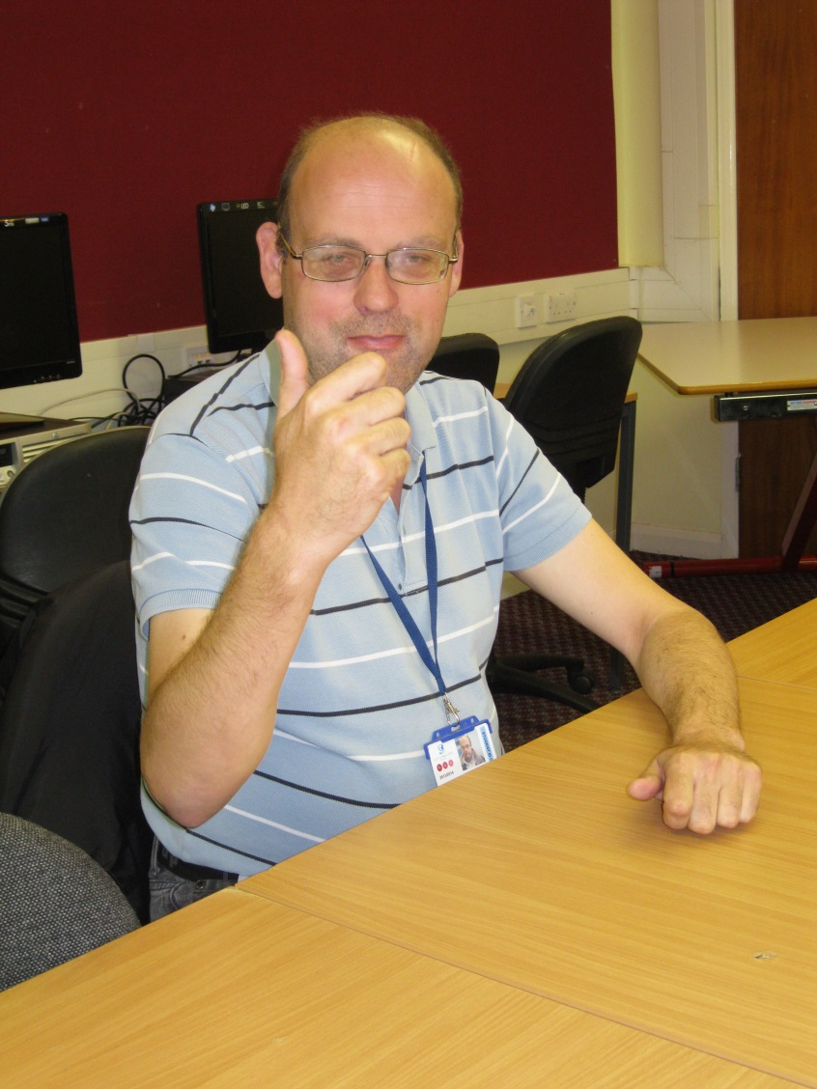
Hello! My name is Dom.
I live in Bristol with friends. I come to college every Wednesday to
learn citizenship.
My hobbies are ice skating and horse riding.

