Slide 1
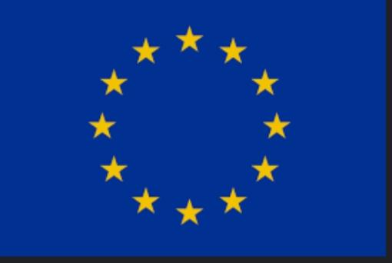
Business and industry

Slide 2
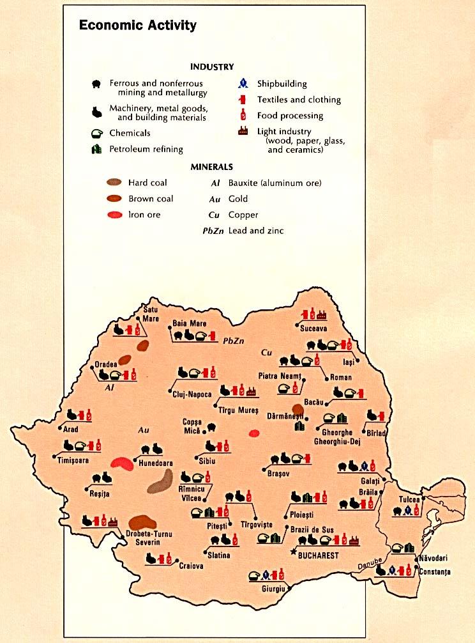
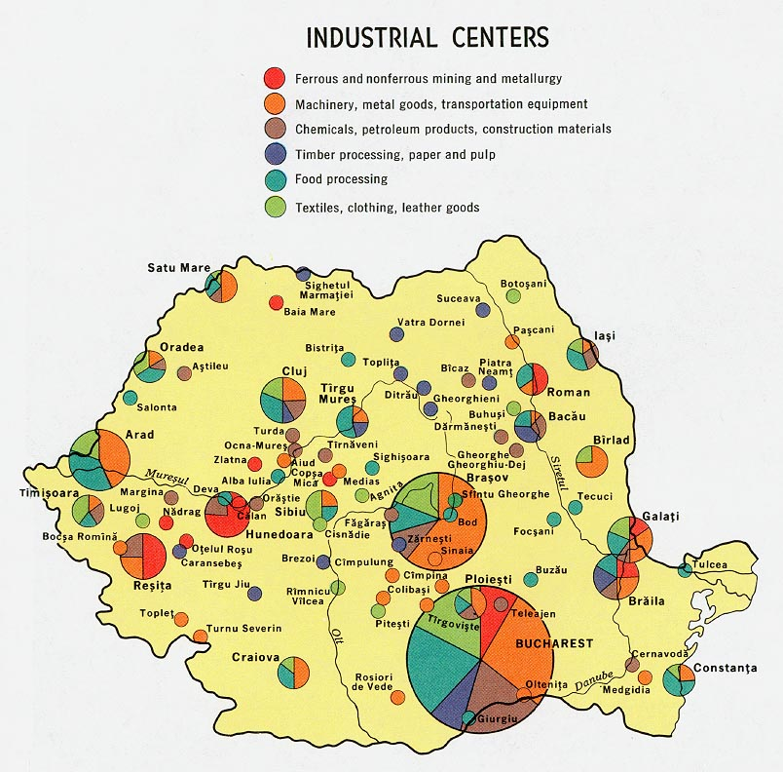
ROMANIA

Slide 3
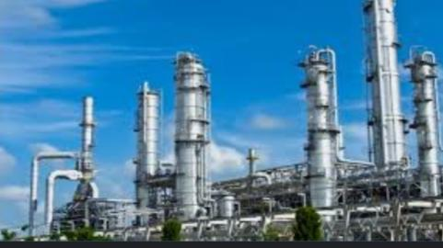
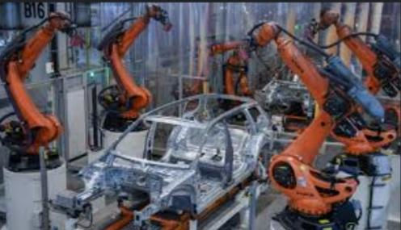
Romania has been successful in developing dynamic telecommunications, aerospace, and weapons sectors. Industry and construction accounted for 32% of gross domestic product (GDP) in 2018, a comparatively large share even without taking into account related services. The sector employed 26.4% of the workforce. With the manufacture of over 600,000 vehicles in 2018, Romania was Europe’s sixth largest producer of automobiles. Dacia is producing more than 1,000,000 cars a year (with 1 factory in Morocco).

Slide 4
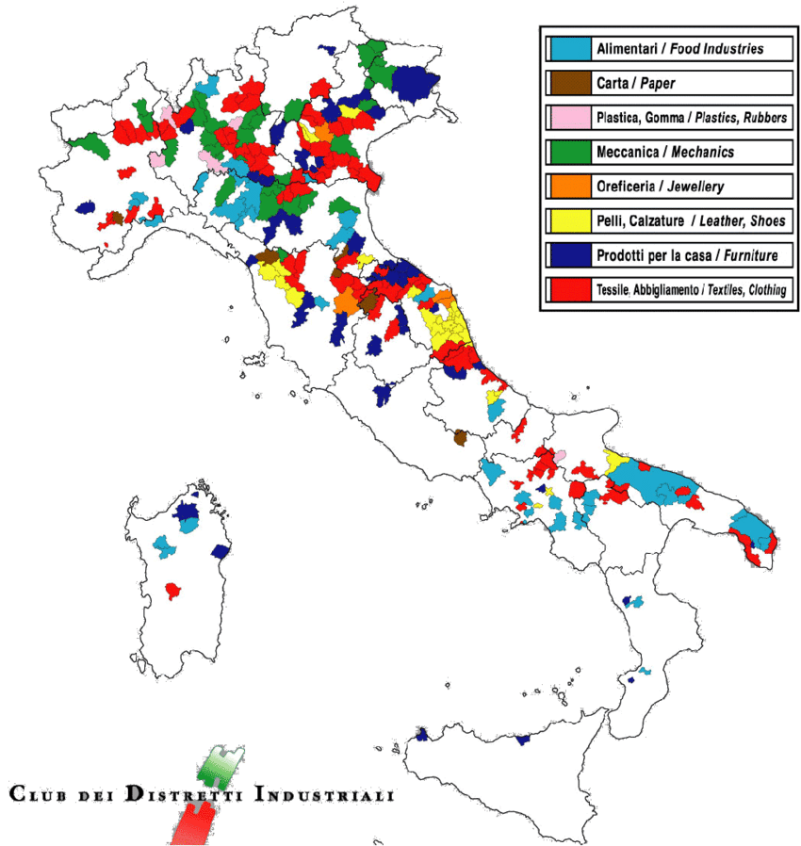
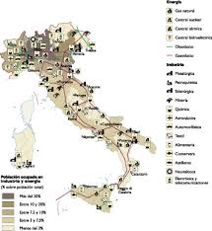
ITALY

Slide 5
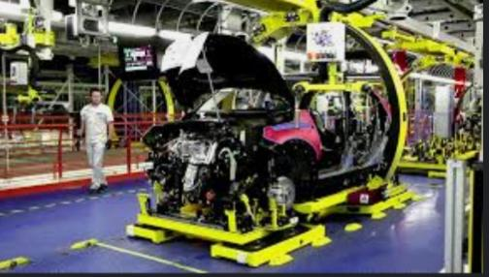
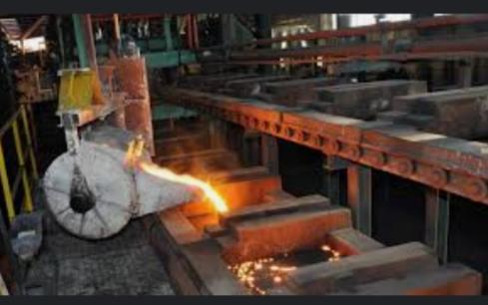
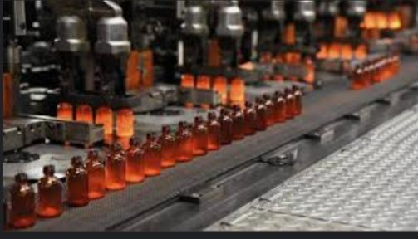
The economy of Italy is the third-largest national economy in the European Union, the eighth-largest by nominal GDP in the world, and the 12th-largest by GDP (PPP). Italy is a founding member of the European Union, the Eurozone, the OECD, the G7 and the G20;[22] it is the tenth-largest exporter in the world, with $632 billion exported in 2019. Its closest trade ties are with the other countries of the European Union, with whom it conducts about 59% of its total trade. The largest trading partners, in order of market share in exports, are Germany (12.5%), France (10.3%), the United States (9%), Spain (5.2%), the United Kingdom (5.2%) and Switzerland (4.6%).

Slide 6
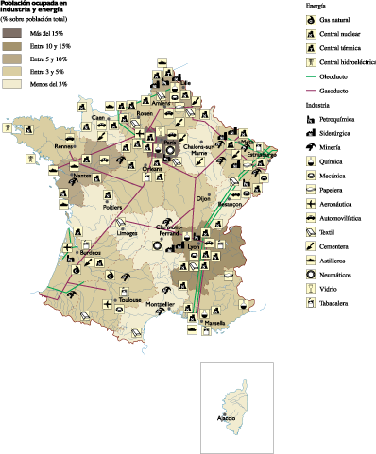
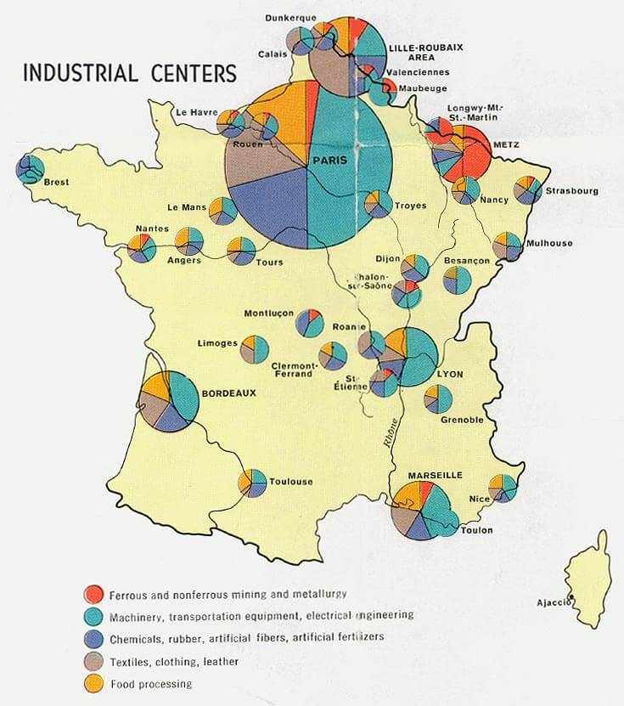
FRANCE

Slide 7
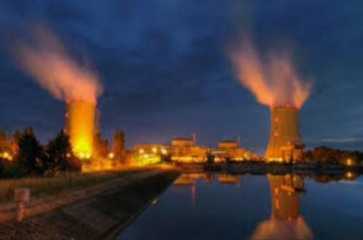
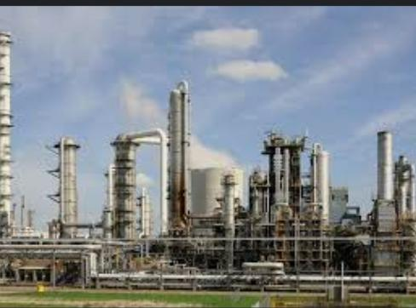
France has a diversified economy, that is dominated by the service sector (which represented in 2017 78.8% of its GDP), whilst the industrial sector accounted for 19.5% of its GDP and the primary sector accounted for the remaining 1.7%. France was in 2020 the largest Foreign Direct Investment recipient in Europe, Europe’s second largest spender in Research and development, ranked among the 10 most innovative countries in the world by the 2020 Bloomberg Innovation Index, as well as the 15th most competitive nation globally, according to the 2019 Global Competitiveness Report (up 2 notches compared to 2018). The fifth-largest trading nation in the world (and second in Europe after Germany), France is also the most visited destination in the world, as well the European Union’s leading agricultural power.

Slide 8
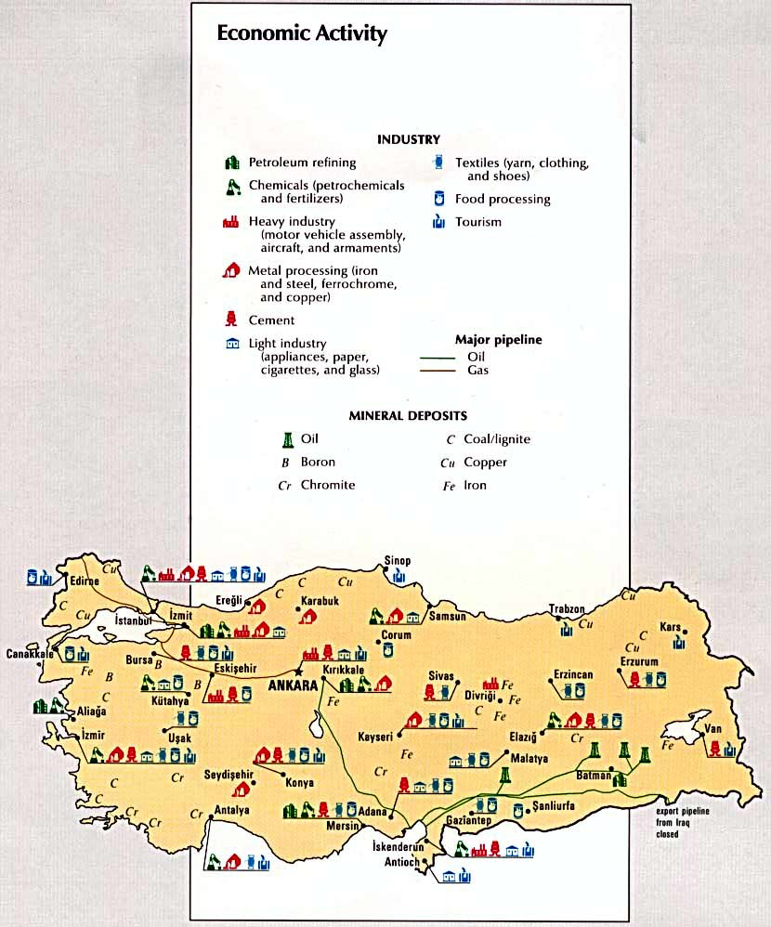
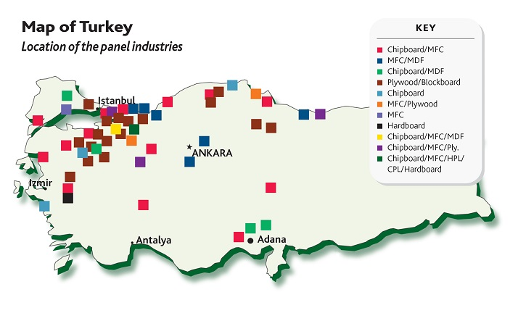
TURKEY

Slide 9
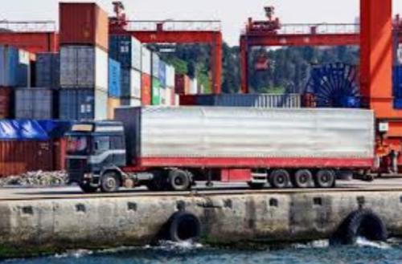
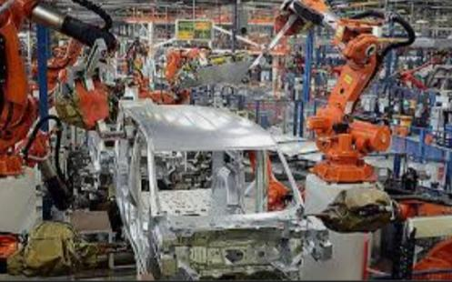
The economy of Turkey is an emerging market economy as defined by the International Monetary Fund.[35] Turkey is among the world’s developed countries according to the CIA World Factbook. Turkey is also defined by economists and political scientists as one of the world’s newly industrialized countries. Turkey has the world’s 17th-largest nominal GDP,[37] and 13th-largest GDP by PPP. The country is among the world’s leading producers of agricultural products; textiles; motor vehicles, transportation equipment; construction materials; consumer electronics and home appliances (see the related chapters below).

Slide 10
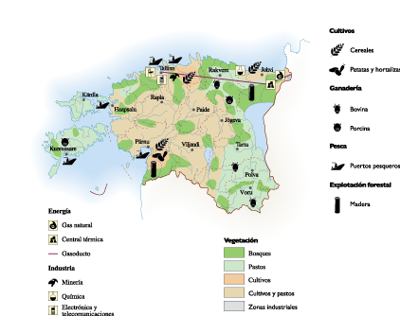
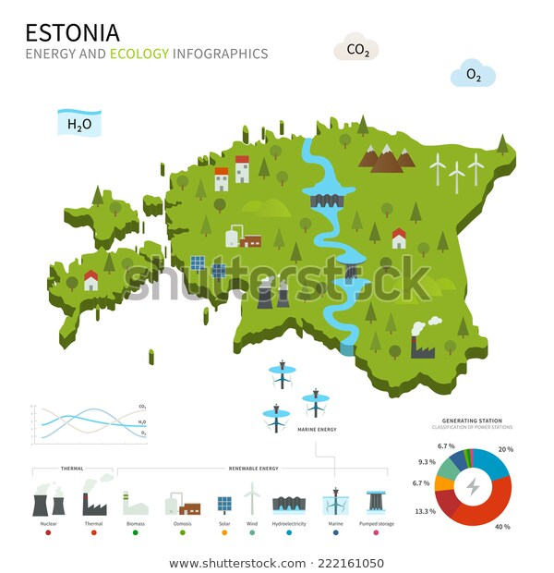
ESTONIA

