Slide 1
ECOLOGICAL STUDIES IN TURKEY AND AROUND AKSARAY
Ecological Studies in Our School, Aksaray and in Turkey
from Aksaray Şehit Pilot Hamza Gümüşsoy Science High School Students.
Elif.ŞPHGFL

Slide 2
ECOLOGY IN OUR SCHOOL
Recycling is very important and a common practice.
We use recycle bins in our school hallways for each type of recyclable wastes such as paper wrappings, plastic bottles and metal cans in order to contribute recycling.

Slide 3
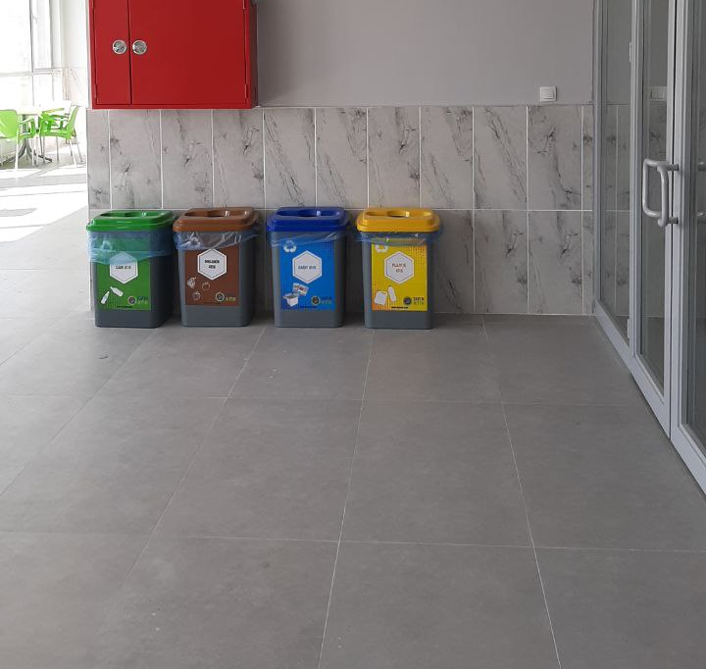

Slide 4
Because of the practices within the scope of recycling projects and recycling studies that have been carried out since 2001. These studies are still being carried out heavily and the gaining form recycling is increasing day by day.

Slide 5
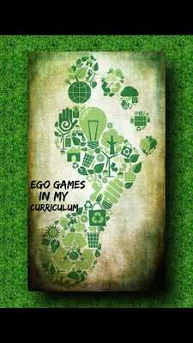
AN E-TWINNING PROJECT: “ECO GAMES IN MY CURRICULUM”
A project called ‘Eco Games in My curriculum’ is being carried out in our school. The aim of this project is to raise awareness about ecology. We create games and online tools about ecology that can be used in all sorts school subjects in our curriculum. By this Project we will discover tools that will integrate virtual learning methods into their curriculum and learn the ecological matters by creating and playing games.

Slide 6
In order to prevent environmental pollution we voluntarily collect the trashes around our school garden once a week after the lunch break.

Slide 7
FORESTATION
In Turkey, on the 11 of November, it has been celebrated as the National Afforestation Day in Turkey since 2019. People are planting many saplings. 11 million trees in 81 provinces were planted in 2019 , in 2020, Turkey's 81 provinces and 922 districts as well as. In our city we plant trees as a school activity with our friends.

Slide 8
“ZERO WASTE” PROJECTS
Zero Waste (Sıfır Atık) Project aims to evaluate waste materials through recycling, to review the factors that cause waste, and to prevent waste. In our school we give importance to zero waste so we join the projects about it.

Slide 9
SUSTAINABLE ENERGY
Sustainable energy meets our today's energy demand without putting them in danger of getting expired or depleted and it can be used over and over again. Sustainable energy is widely encouraged as it does not cause any harm to the environment and is available widely free of cost. So many solar power plant was located in the western and southern parts of Turkey. The electrical energy obtained from the sun is used both in heating, industry and greenhouse cultivation. By this way electrical energy is stored and the remainder is transferred to the regions in need. The month where the most electricity is generated from solar energy is June, while the month where the lowest level of electricity is obtained is December in our country.

Slide 10
STUDIES FOR ENDEMIC SPECIES IN TURKEY
Endemic species are plant and animal species that are unique to a particular geographical region and can be found in nowhere else in the world. In Turkey some researches are being done in order to save endemic species.

Slide 11
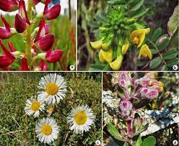
Some endemic species

Slide 12
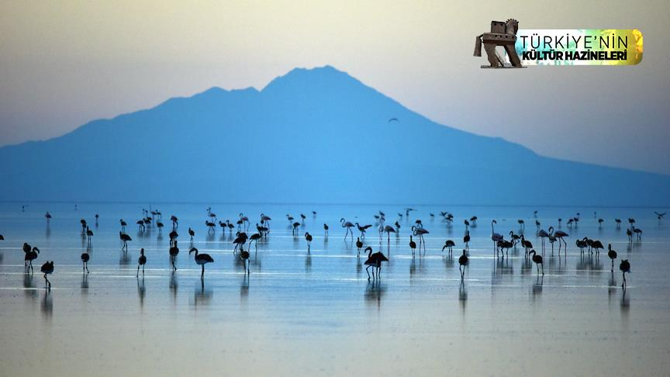
TUZ GÖLÜ (Lake Tuz)
Tuz Gölü (Lake Tuz) is the second largest lake in Turkey with its 1,665 km² surface area and one of the largest hypersaline lakes in the world. It is located in the Central Anatolia.

Slide 13
THANK YOU SO MUCH
ŞPHGFL Students

