Slide 1
Our green actions in the
Lycée Alain
from the MDL and the CVL (but more the MDL) to make our highschool greener and to reduce its footprint

Slide 2
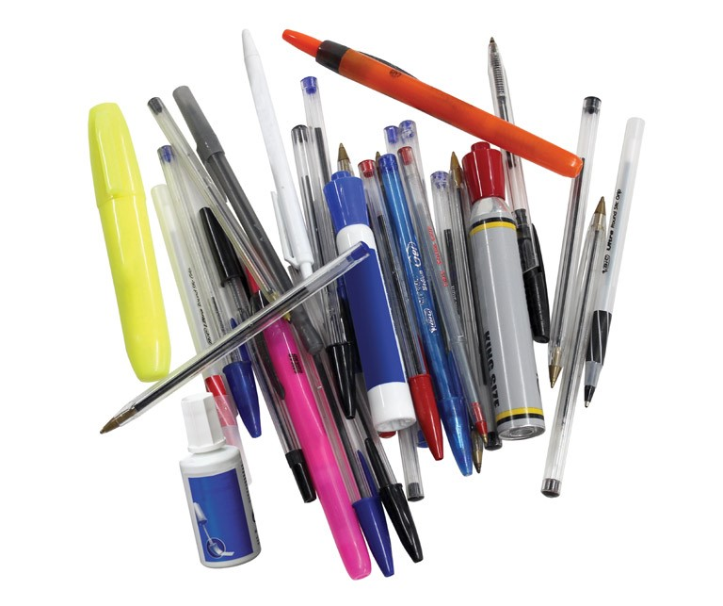
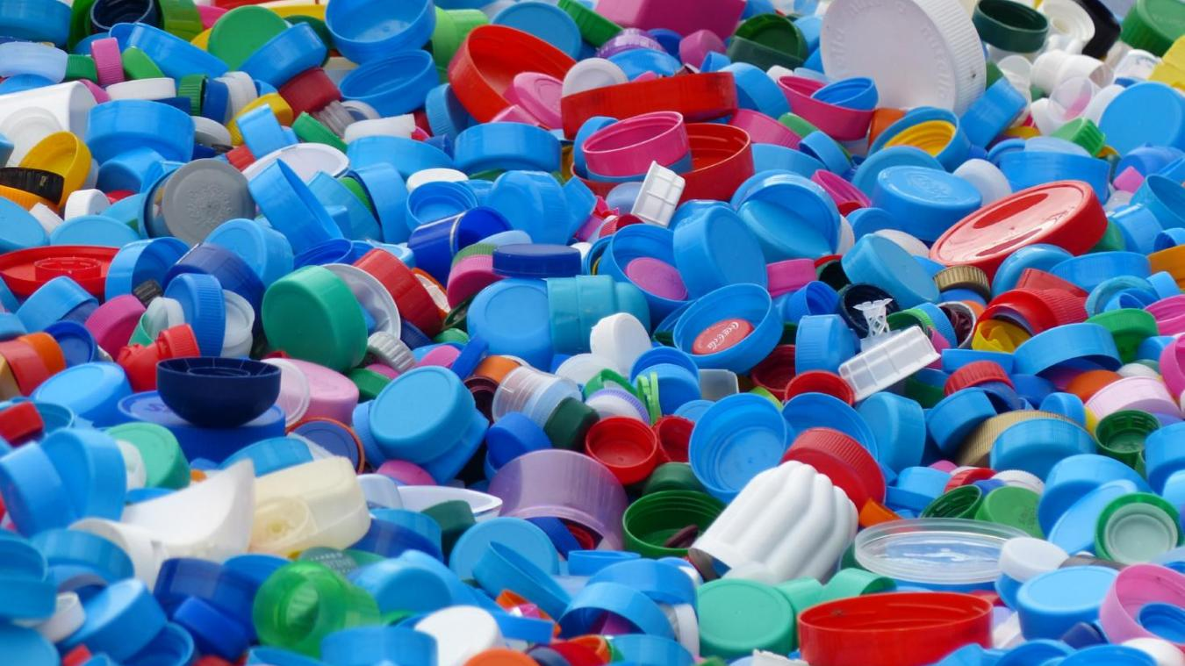
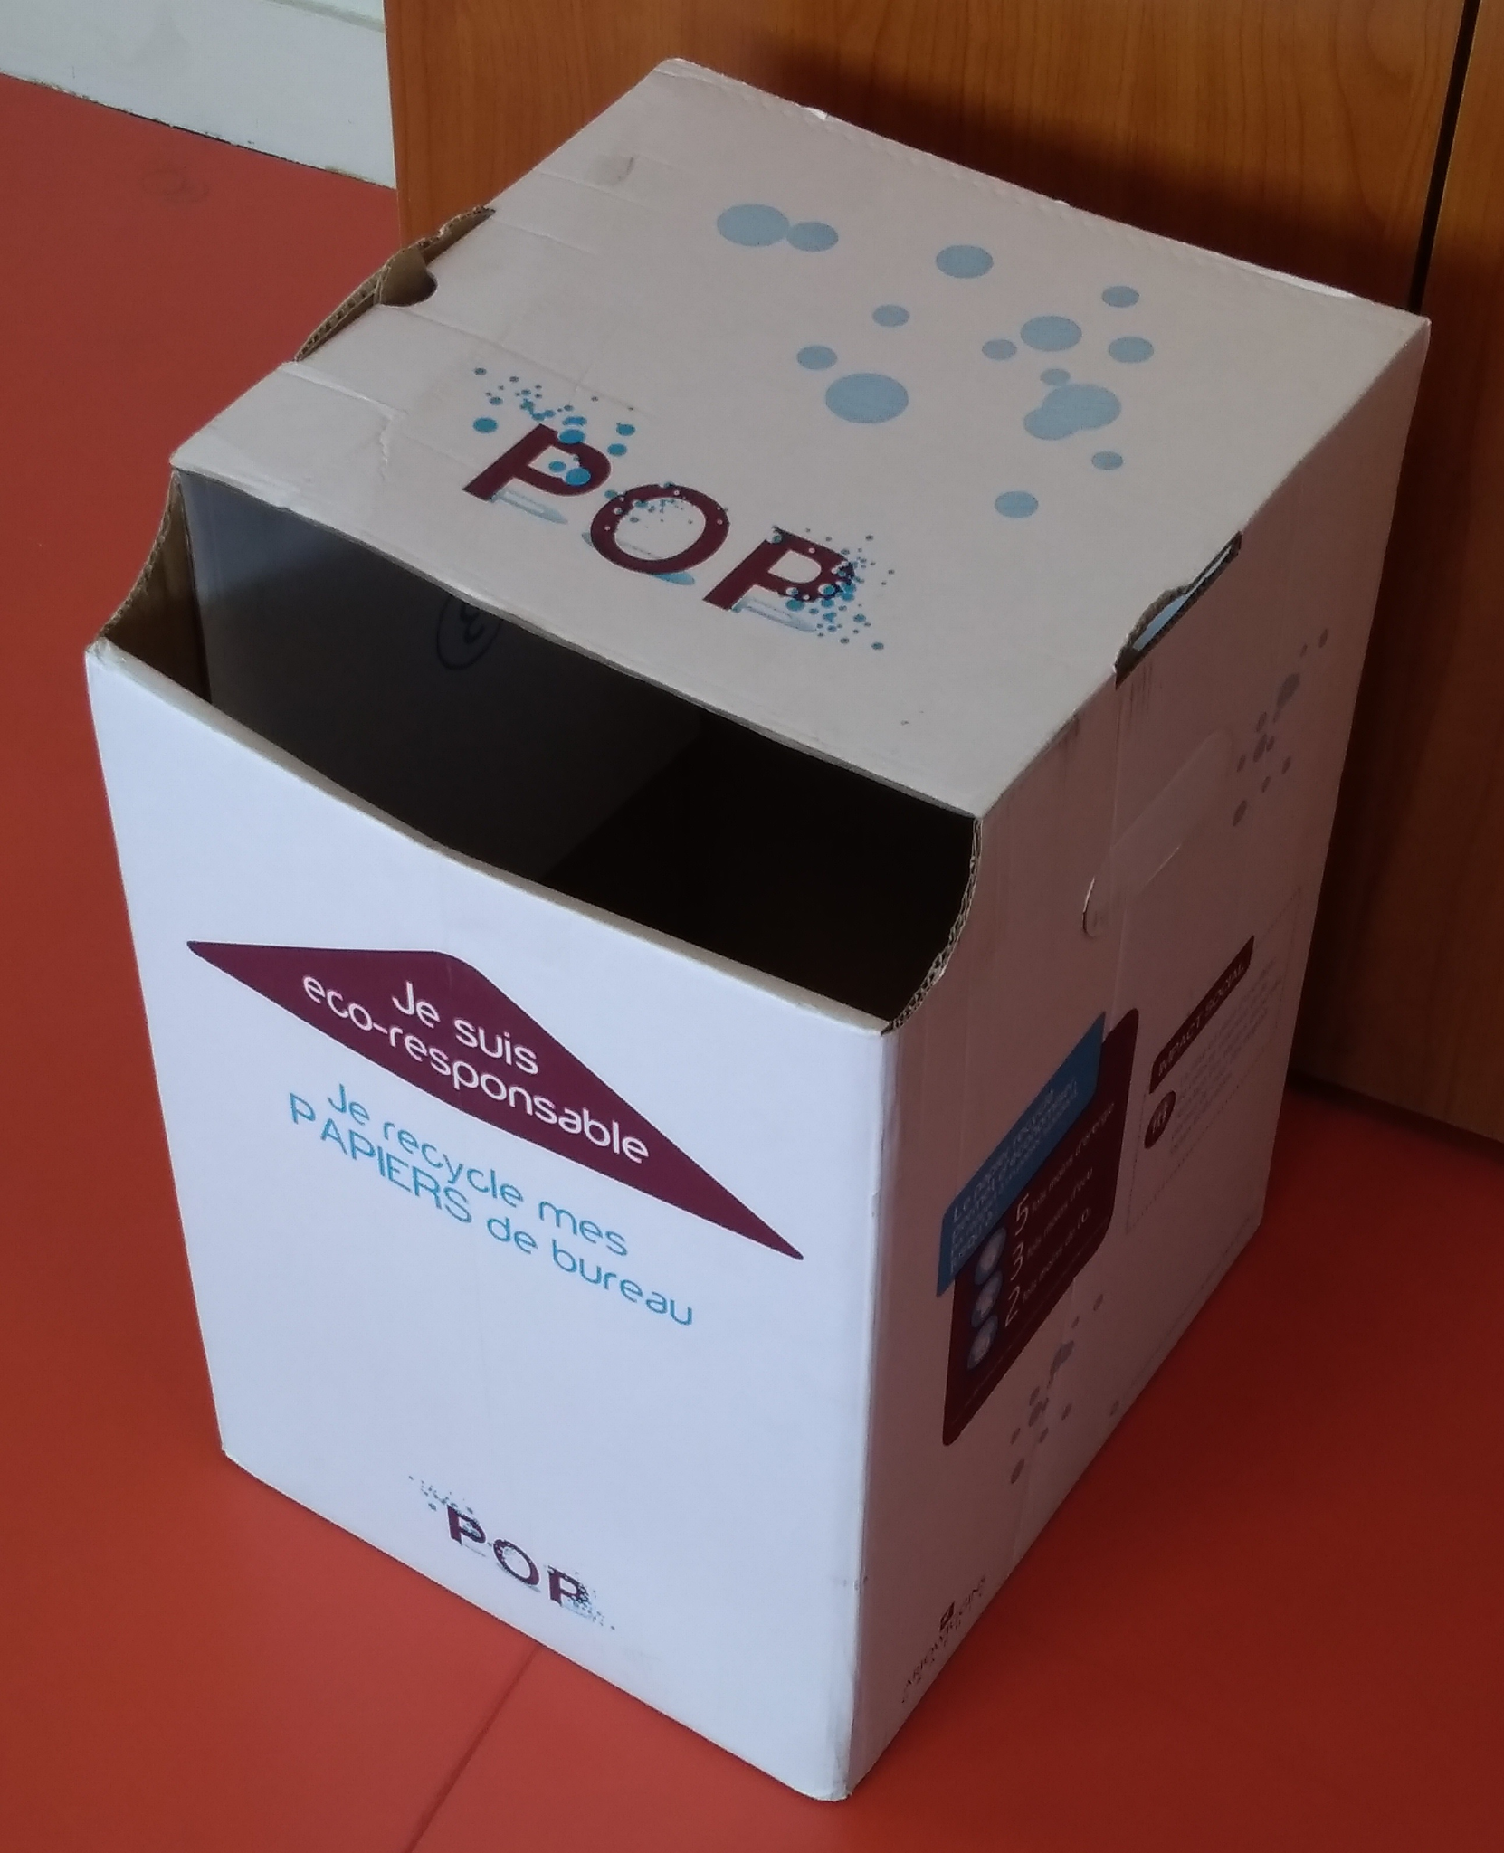
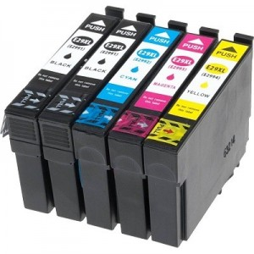
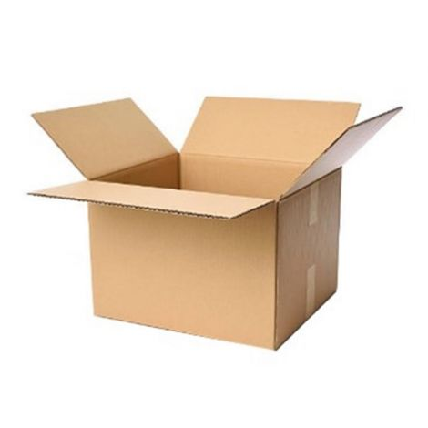
Recycling
paper
caps
pens
printer cartridges
small plastic materials
the cardboard used for the canteen is crushed

Slide 3
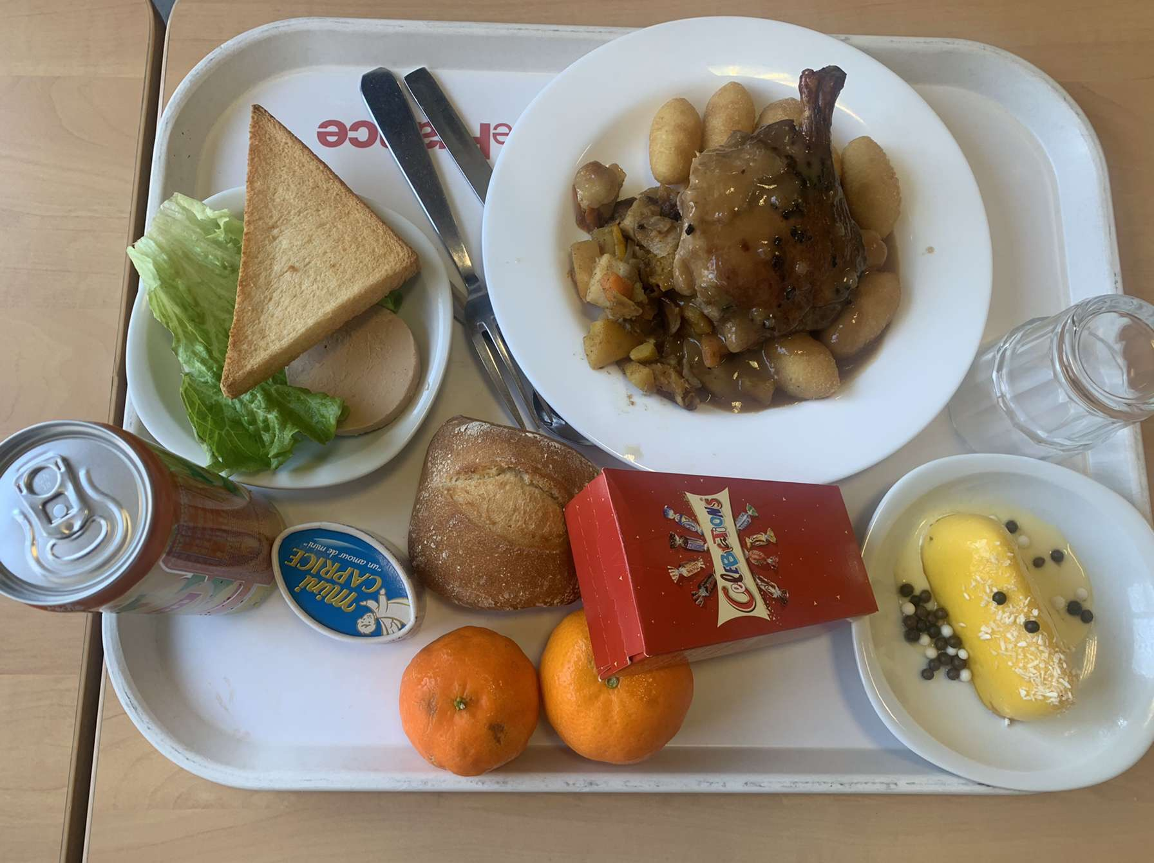
A big step in our highschool : reducing our use of plastic
Remove plastic from our school canteen → no more plastic plates and cutlery
more environmentally friendly

Slide 4
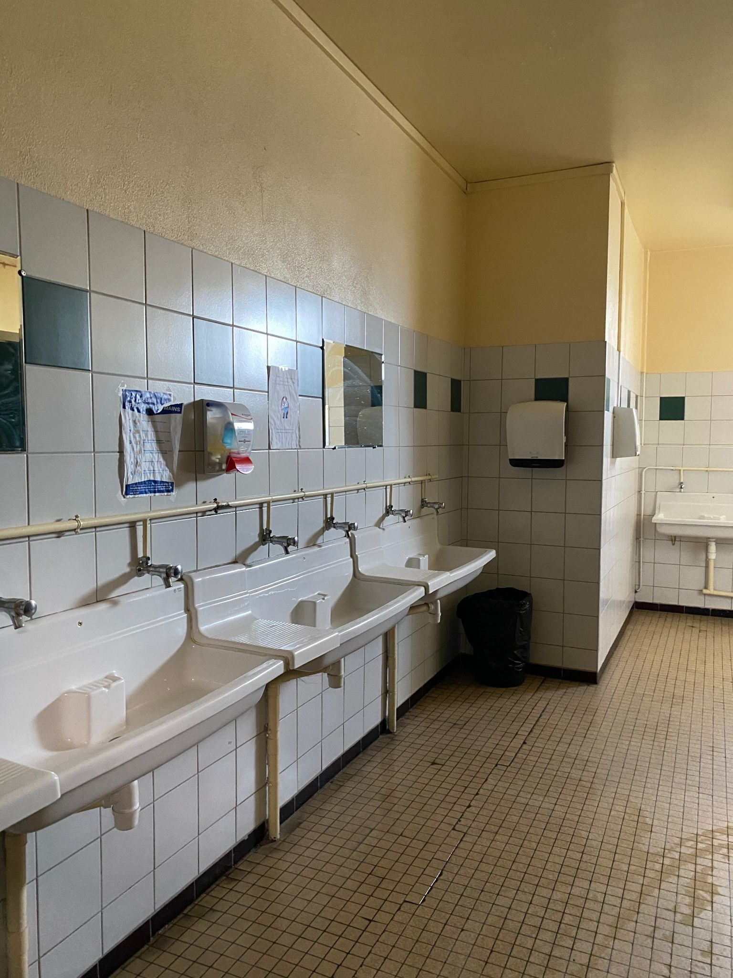
No more waste
Reduction of water flow in the toilets → less water waste

Slide 5
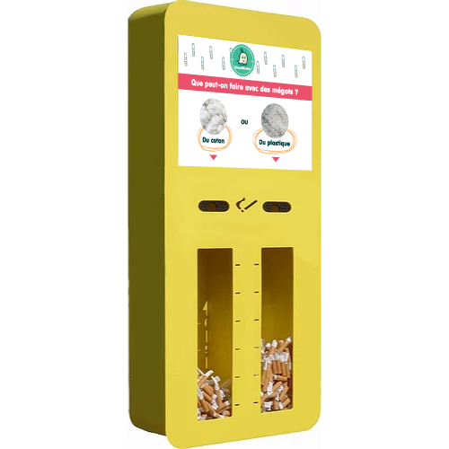
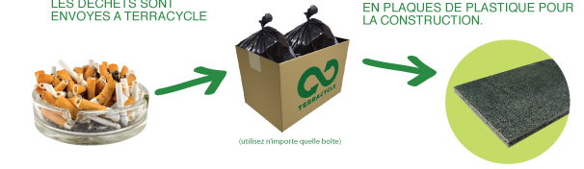
Cigarettes
Recycling and recovery of butts by a specialised company

Slide 6
Learning thanks to the others and acting at our scale
Participation in conferences to discuss ecology in our establishments
Election of eco-delegates
Creation of the sustainable development club → implement concrete actions in the school

Slide 7
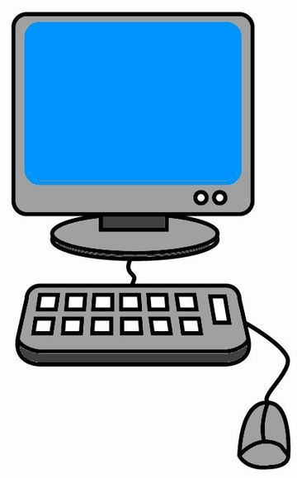
Reducing our digital footprint
Computers automatically turn off from 7 p.m. to 7:30 a.m.
)
)

Slide 8
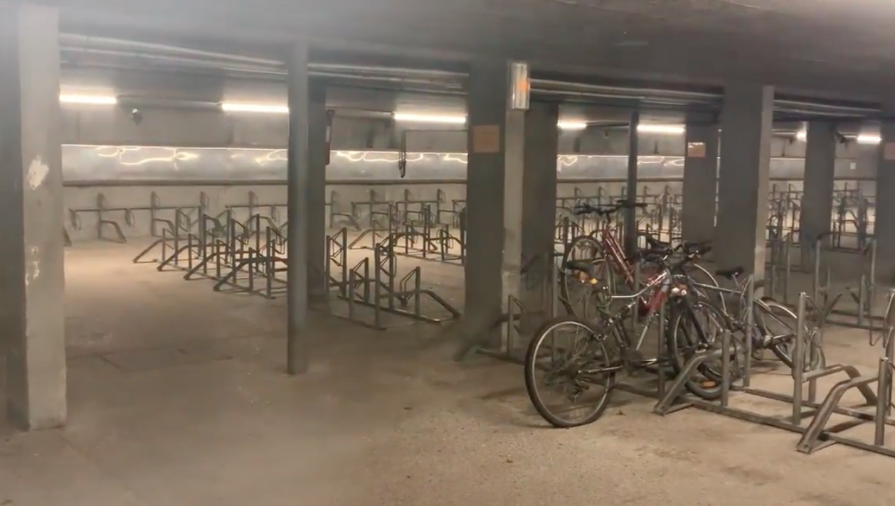
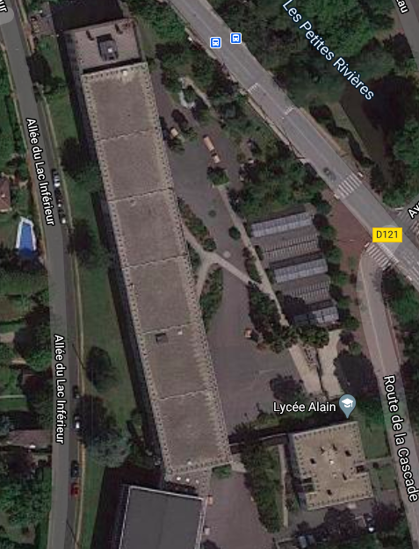
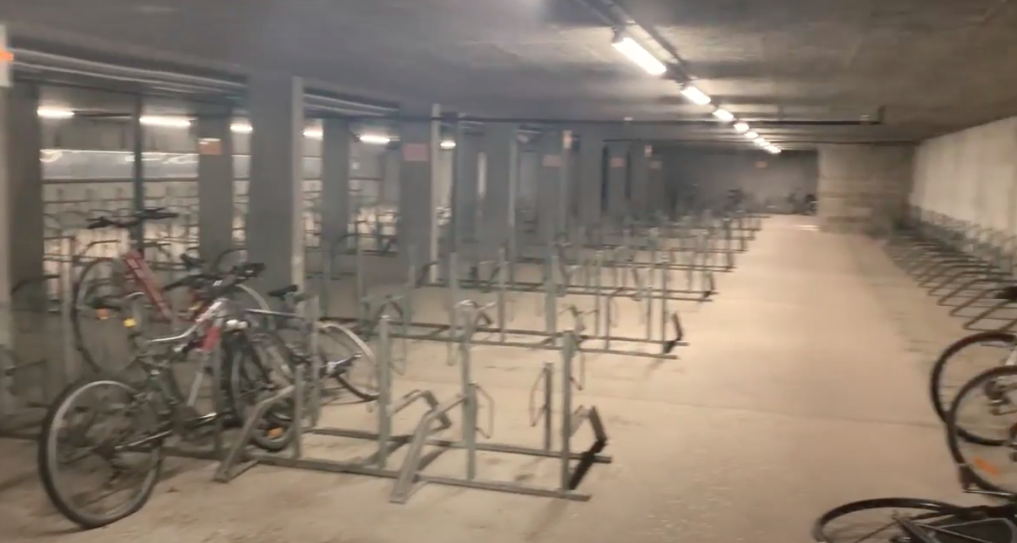
Paying attention to greener transports
train station = 10 min walk
bus
Lycée Alain
Covered bike rack, bike shelter

Slide 9
Thank you for your attention !

