Slide 1
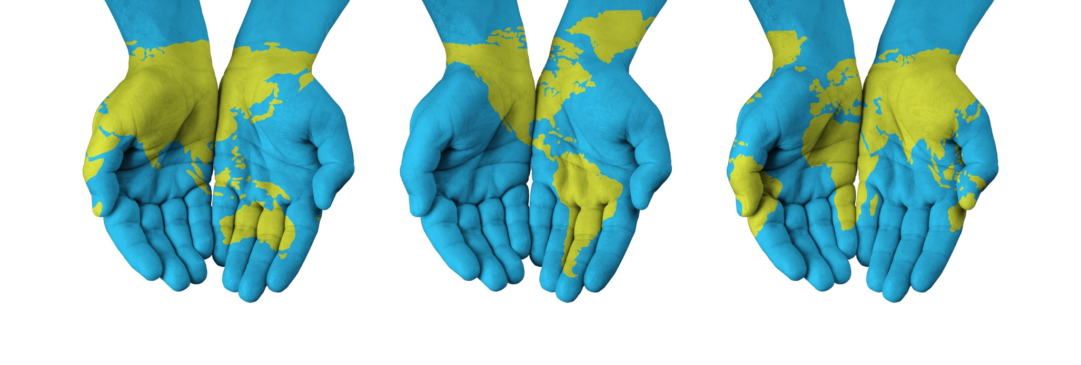
Sustainable-imperative development of the future
We have a planet. How do we manage it so that future generations can live at least as well as we do now?

Slide 2
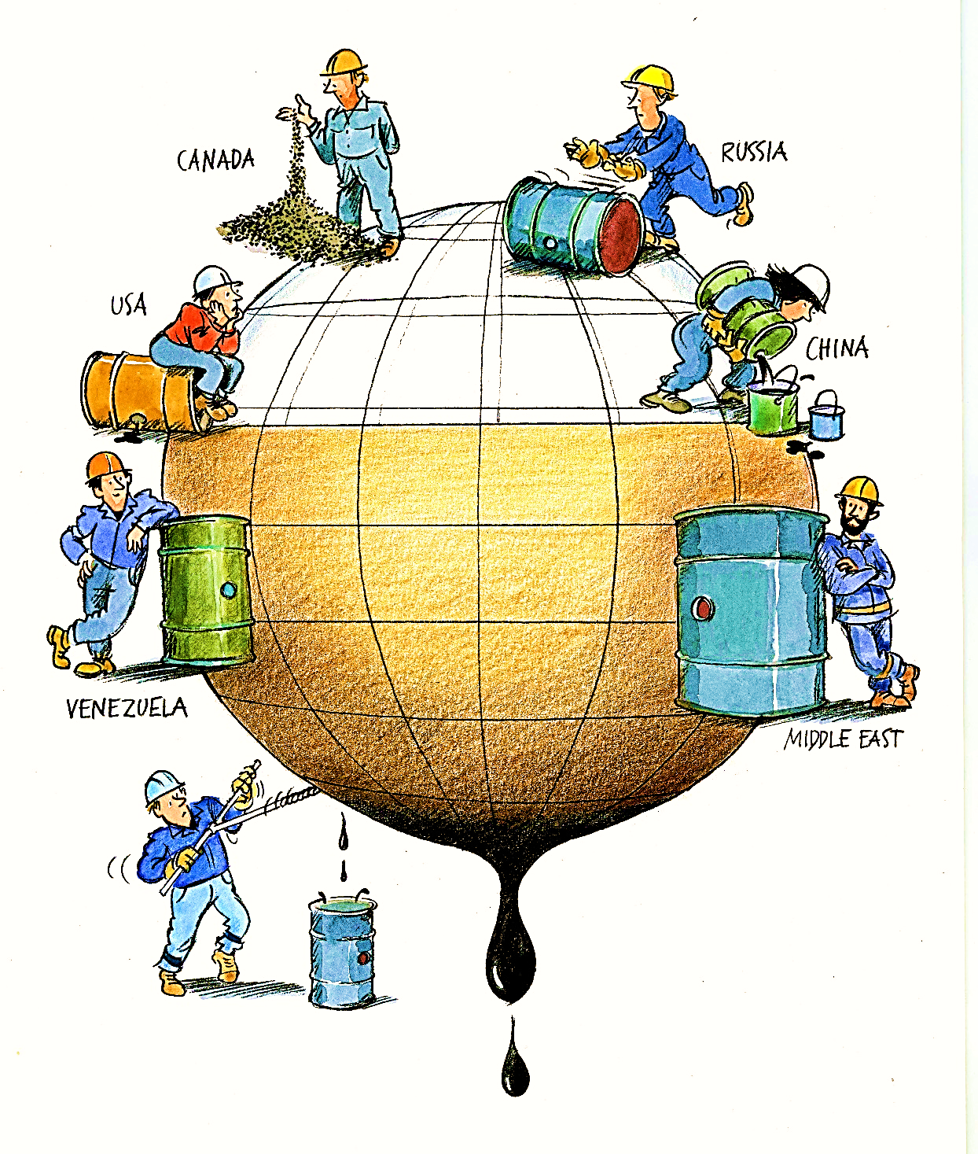
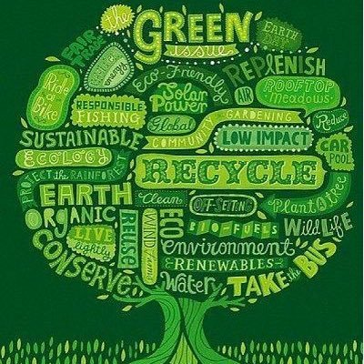

Slide 3
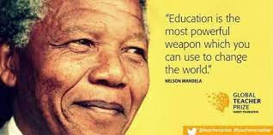
INFORMATION
RESPONSABILITY
INVOLMENT
AWARENESS
ACTION- PARTICIPATION

Slide 4
WHAT DOES THE STUDENT REALLY LEARN?
To protect the forest and the existing green spaces around them
To plant trees
To selectively collect waste - Ecotic, Rorec
To recycle reusable materials
Store waste in specially designed places
To participate in greening actions- Let”s do it ROMANIA!
To keep the soil, water, air clean
Make useful things from recycled materials (Christmas decorations, Easter, bags, march tokens, etc.)
Learn to use water and other resources of the planet rationally

Slide 5
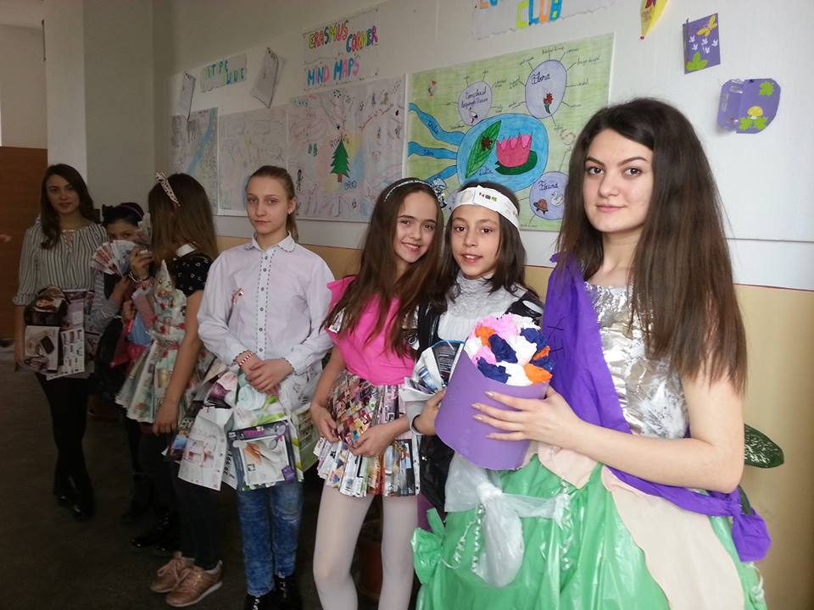
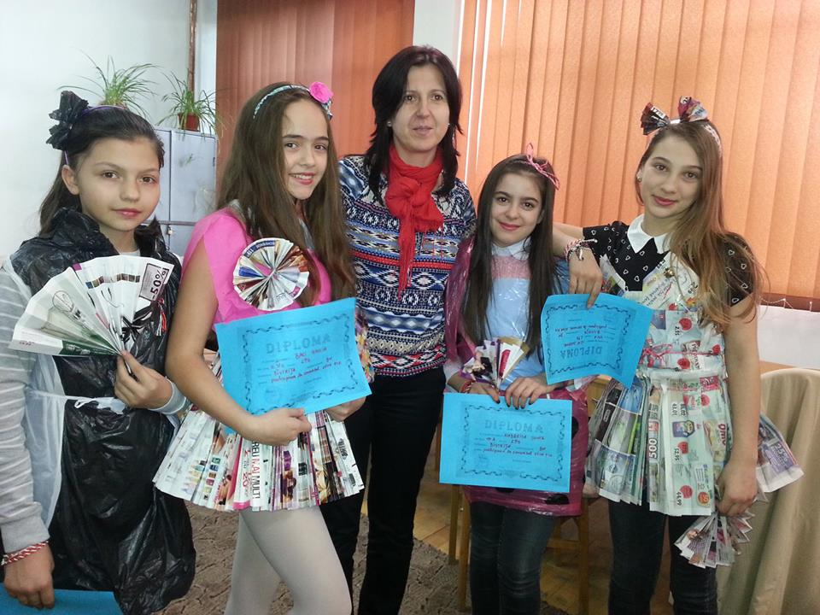
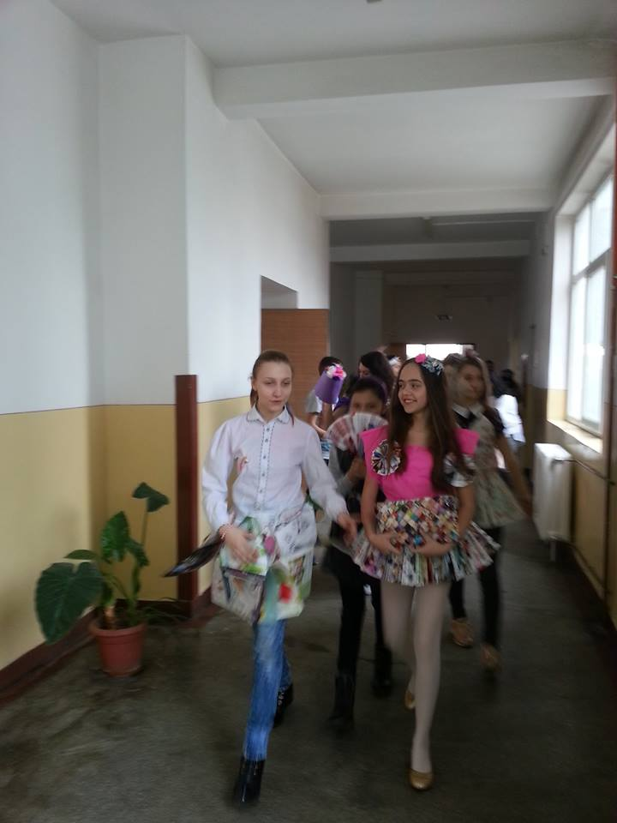
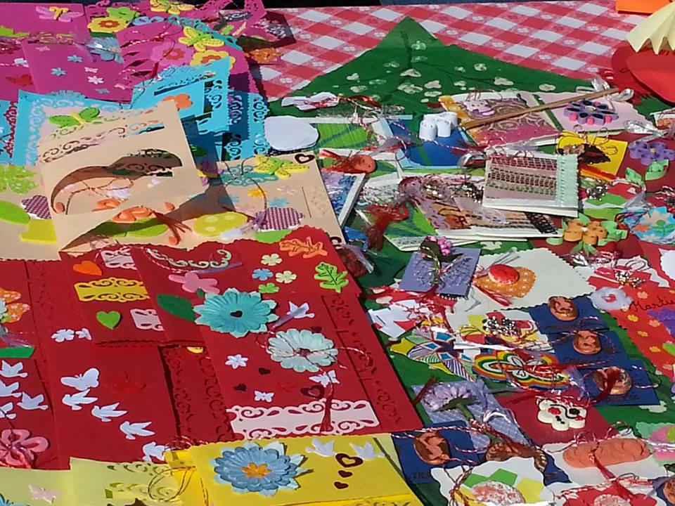
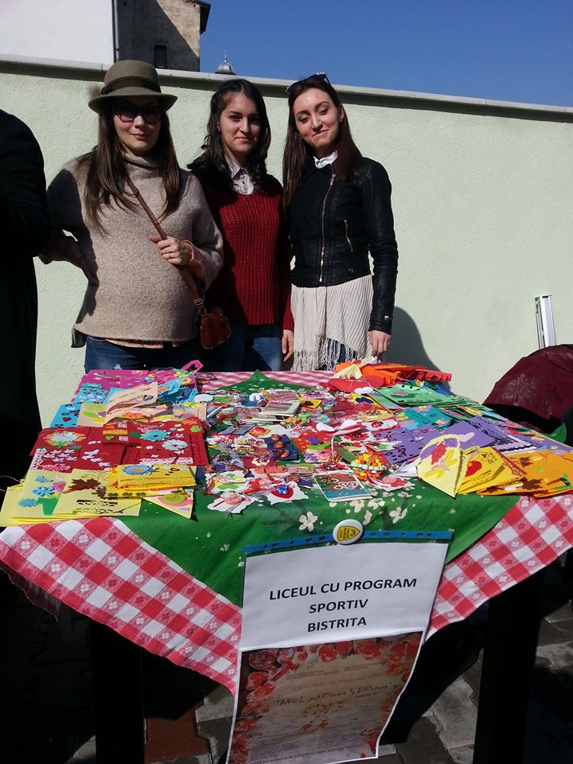

Slide 6
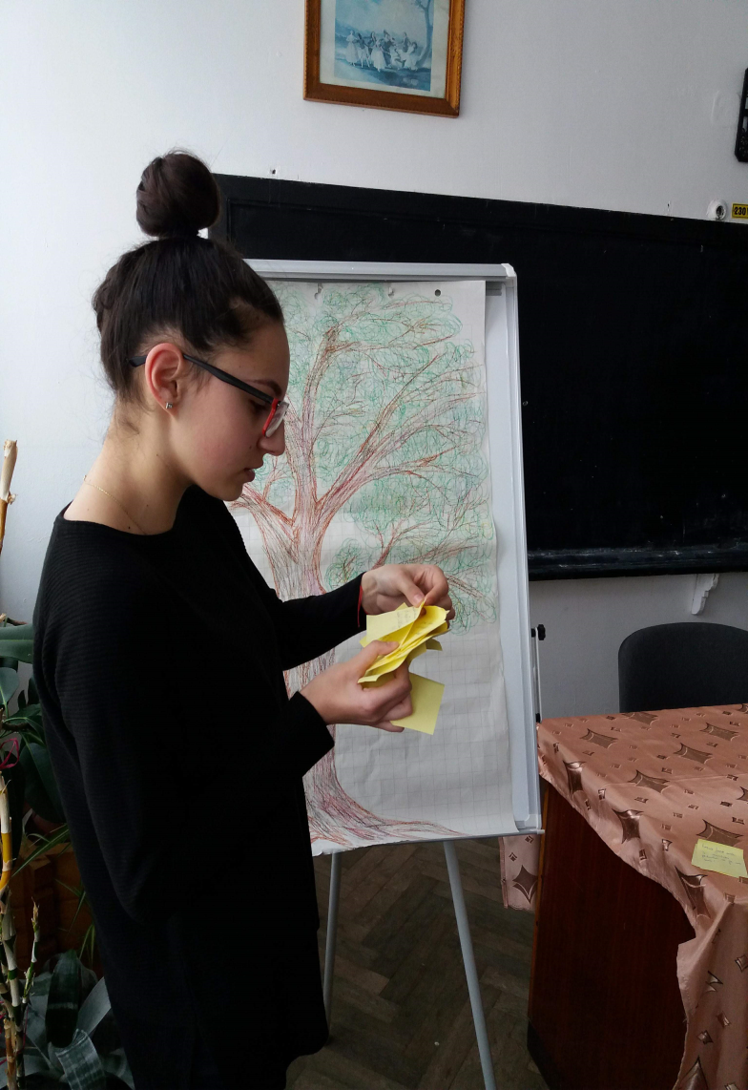
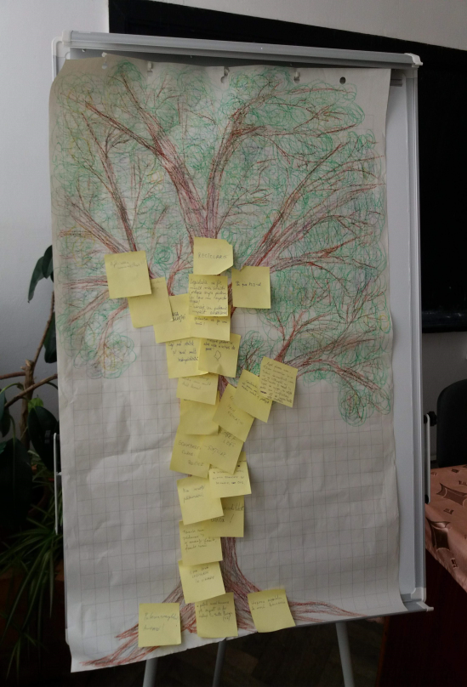

Slide 7
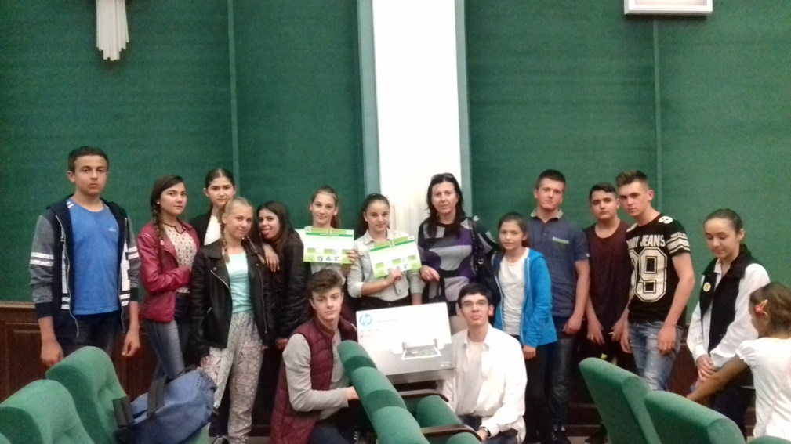
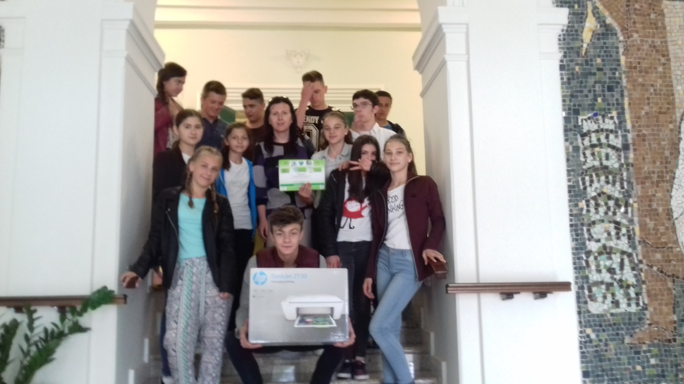
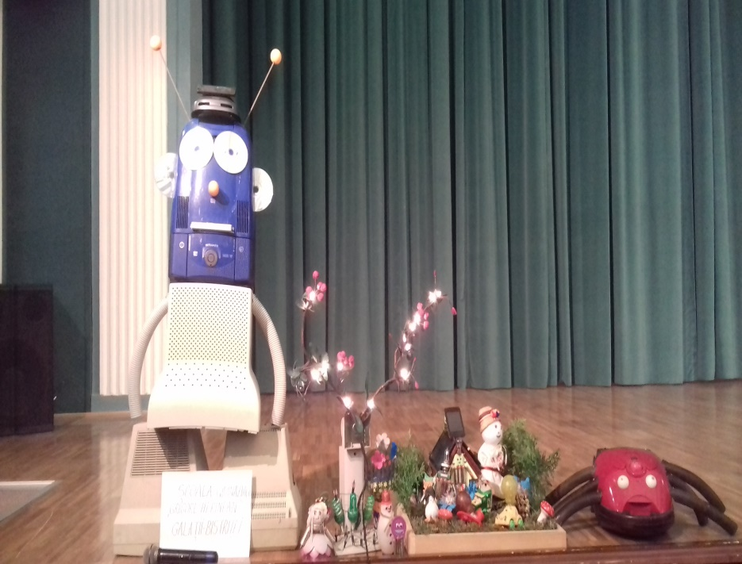

Slide 8
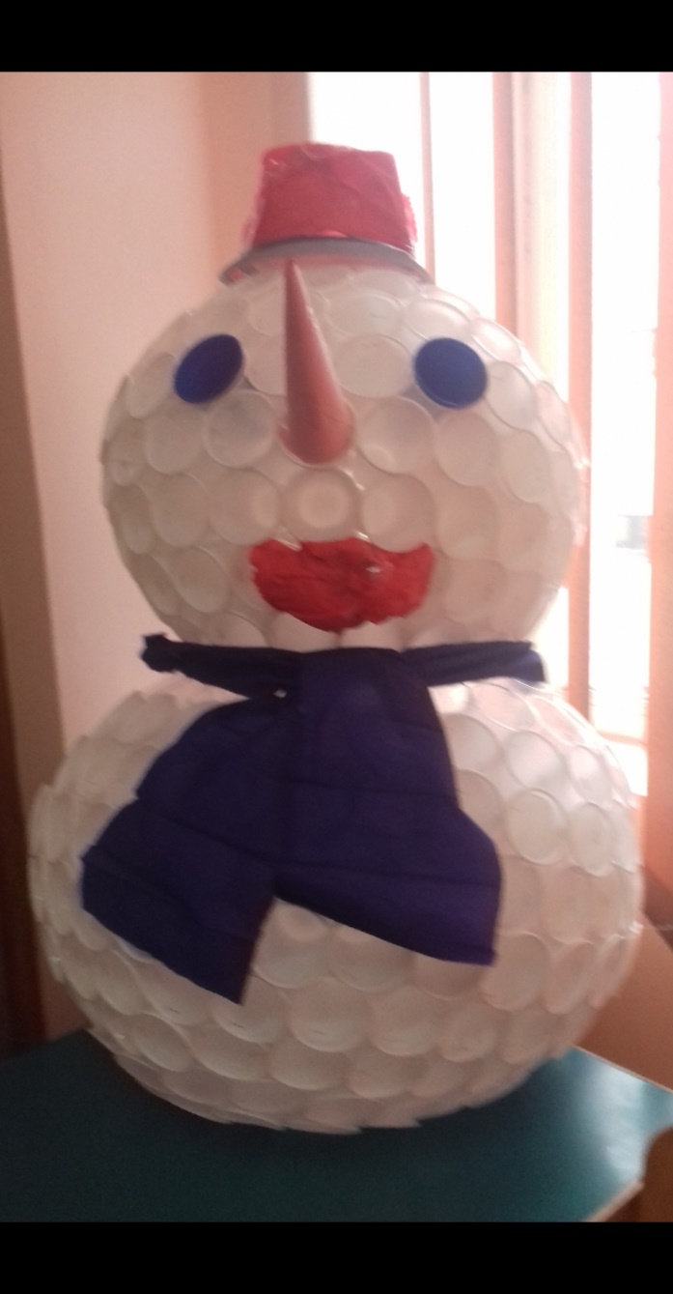
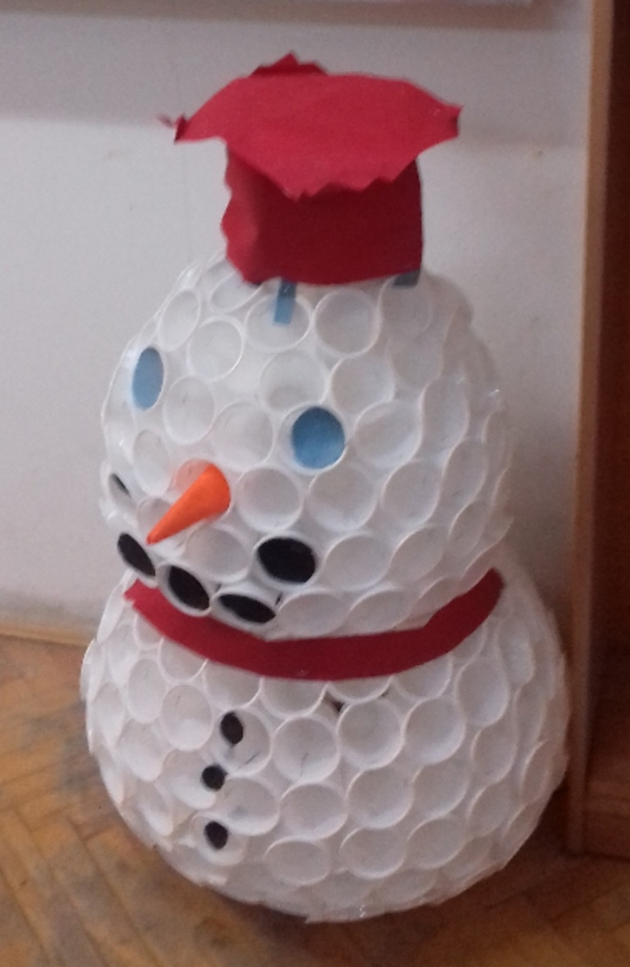
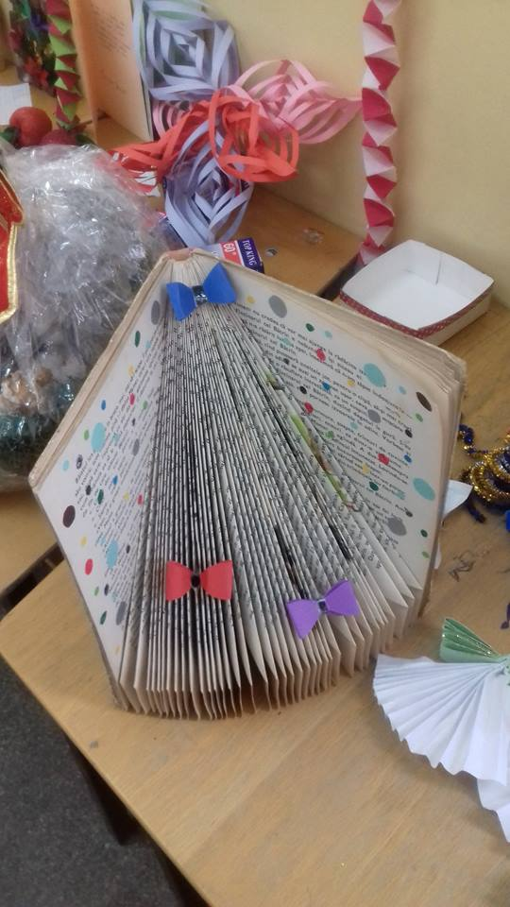
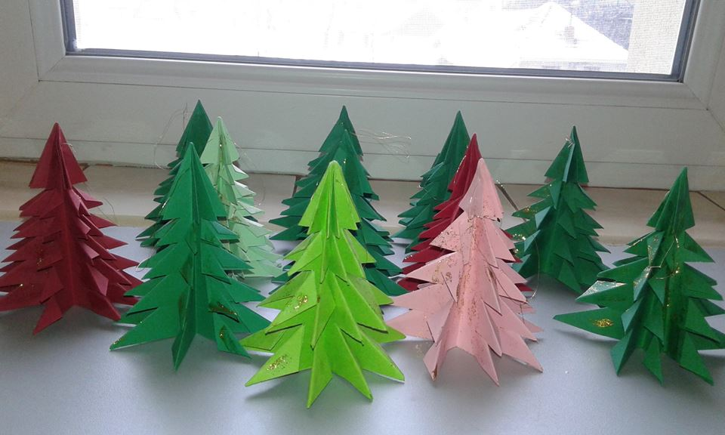

Slide 9
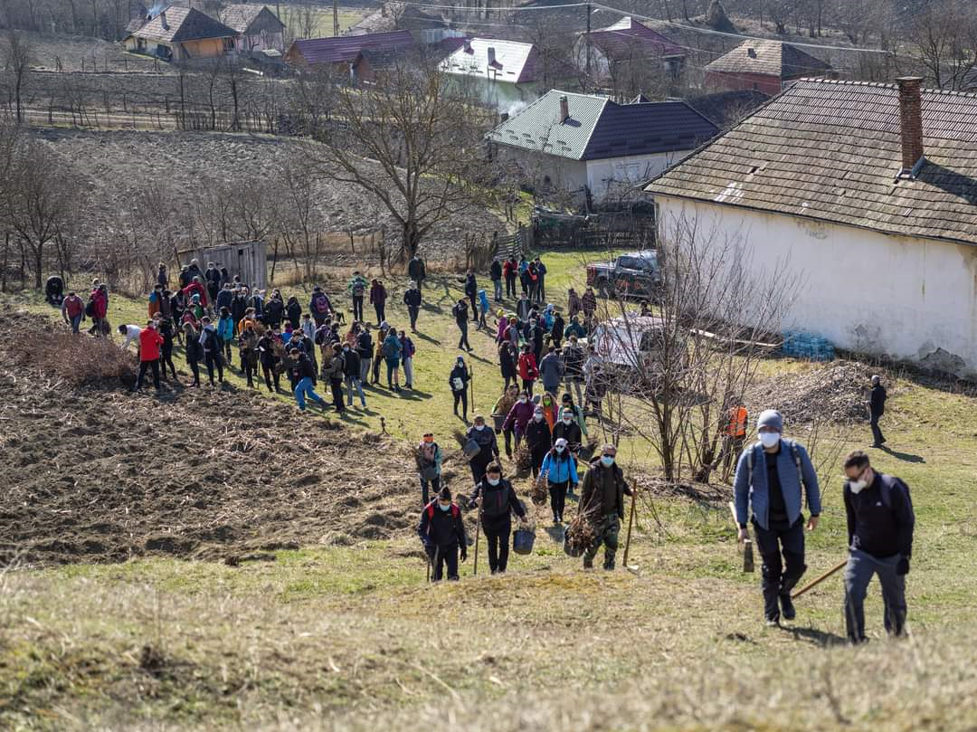
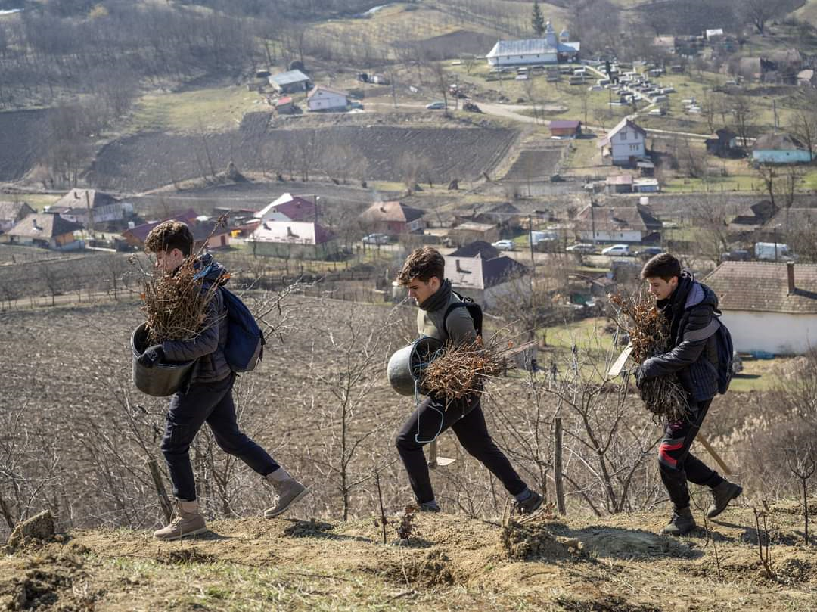
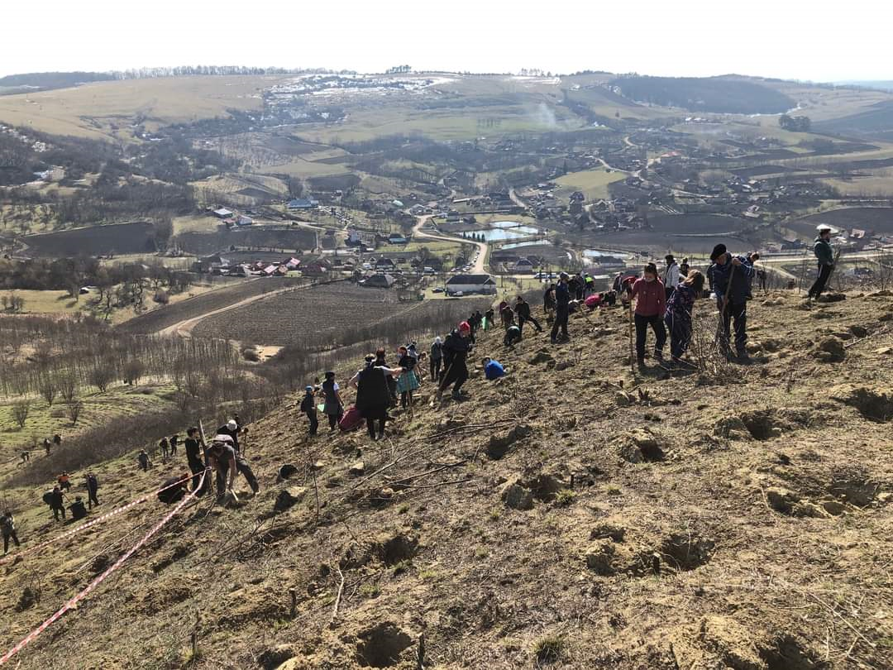
26. 03. 2021 LPS Afforestation

Slide 10
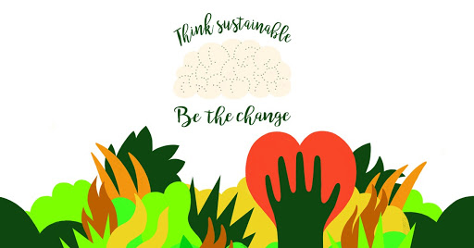
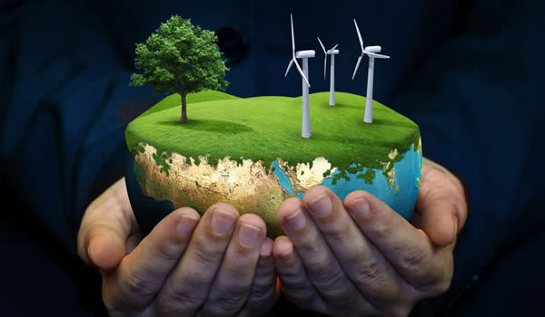
Durabilitatea pleaca de la ideea ca activitatile umanesunt dependente de mediul inconjurator si de resurse.Sanatatea, siguranta sociala si stabilitatea economica asocietatii sunt esentiale in definirea calitatii vietii.Conceptul de dezvoltare durabila a luat nastere acum 30de ani, ca raspuns la aparitia problemelor de mediu si acrizei resurselor naturale, in special a celor legate deenergie.Dezvoltarea durabila a devenit un obiectiv si al UniuniiEuropeane, incepand cu 1997.
Durabilitatea pleaca de la ideea ca activitatile umanesunt dependente de mediul inconjurator si de resurse.Sanatatea, siguranta sociala si stabilitatea economica asocietatii sunt esentiale in definirea calitatii vietii.Conceptul de dezvoltare durabila a luat nastere acum 30de ani, ca raspuns la aparitia problemelor de mediu si acrizei resurselor naturale, in special a celor legate deenergie.Dezvoltarea durabila a devenit un obiectiv si al UniuniiEuropeane, incepand cu 1997.
THANK YOU!

