Slide 1
ZERO WASTE
‘‘We have added value to the future.’’

Slide 3
Purpose Of The Zero Waste Project
Due to the inevitable increase in consumption and waste generation caused by the increasing world population, it is important to recycle the wastes and prevent damage to the environment. This project aims to adopt a waste management philosophy, which includes the prevention of waste, more efficient use of resources, prevention or reduction of waste generation, and ensuring separate collection and recovery of the waste.
«HOTAL Zero Waste Club» tries to fulfill these aims.

Slide 5
«Hacı Ömer Tarman Anatolian High School Zero Waste Club» was founded in 2018 and club members were elected, club management was formed and club action plan and schedule were prepared.

Slide 7
Following to the establishment of the Zero Waste Club, the logo of the club was designed, banners, brochures and posters related with the activities of the club were created by club students to rise awareness on the topic.

Slide 9
Waste bins coloured according to the waste types have been provided and used effectively.

Slide 11
Zero Waste Project Board has been designed by the club members to raise awareness on the issue and to inform the students and the teachers.

Slide 13
An informative workshop about the Zero Waste Project has been conducted for the staff, parents, teachers and students.

Slide 15
Project activities were announced on our school's website.
Our school was equipped with informative documents, posters and pictures drawn by the club members.

Slide 17
Places and units to collect the waste materials of the school (classrooms, laboratories, canteen, teachers room and administrative units, etc.) have been determined and money boxes were prepared to collect money for the activities of the club. Waste material boxes / containers were separated monthly, so the hazardous / non-hazardous wastes were sorted out.

Slide 19
Waste batteries were collected separately from domestic waste and sent to the relevant units.
By contacting the relevant unit of the municipality, it was ensured that the collected wastes were taken regularly by ÇEVNAK Recycling, which is a leading environmental waste management company.
Delivery invoices of these wastes were received and recorded.

Slide 20
For choosing the banners and posters of the club campaign, a contest was organized and announced to the students. Necessary informative letters were placed on the classrooms and floors of the school, and on the Zero Waste Club board.
There will be an Afforestation Day once a year in our school with the support of TEMA which is a Turkish Foundation for Combating Soil Erosion, Reforestation and the Protection of Natural Habitats .

Slide 21
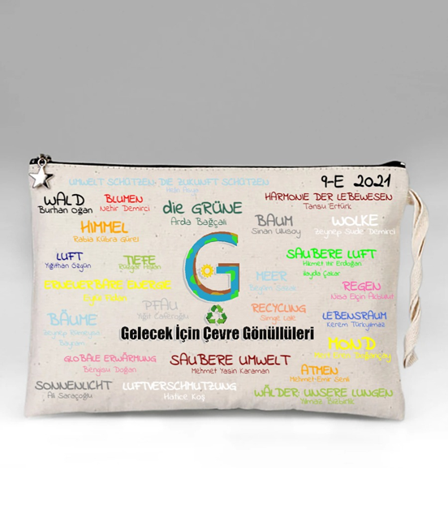
We have prepared zero waste themed t-shirts and bags and we will begin to sell them soon. .

Slide 22
THANKS FOR LISTENING AND READING!
HOTAL PROJECT TEAM

