Slide 1
Technological awareness
eTwinning project
„Youth has the Midas touch”

Slide 2
School: Şehit Pilot Hamza Gumussoy Science High School Coordinating teacher: Nalan Akkoc Student: Elif SPHGFL

Slide 3
School: Şehit Pilot Hamza Gumussoy Science High School Coordinating teacher: Nalan Akkoc Student: Buğra SPHGFL

Slide 4
School: Liceul cu Program Sportiv Bistrița Coordinating teacher: Mihaela Beraru Student: Gabriela LPS

Slide 5
School: Liceul cu Program Sportiv Bistrița Coordinating teacher: Adriana Toderic Students: Mihai LPS & Raul LPS

Slide 6
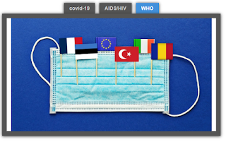
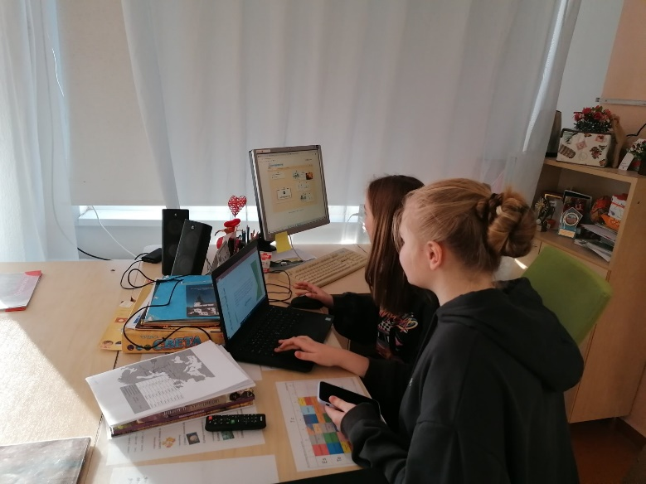
School: Jõhvi Russian Basic School Coordinating teacher: Galina Safronova Students: Enelia.jvp, Ksenia.jvp, Anelia.jvp
Jõhvi Russian Basic School team decided present LearningApps. We used it in this project.
https://learningapps.org/display?v=p0e2chtua21
LearningApps.org is a Web 2.0 application, to support learning and teaching processes with small interactive modules. Those modules can be used directly in learning materials, but also for self studying. The aim is to collect reusable building blocks and make them available to everyone.
It is convenient that in one space you create materials, save them and have the opportunity to get acquainted with a large collection of resources created by other authors. The great thing is that your materials can be edited at any time if necessary, and the work process is quite simple.

Slide 7
School: Colegiul Național Petru Rareș Coordinating teacher: Corina Rus Student: Attila CNPR
The app that our team has chosen is “Prezi”. It’s very easy to use and with it we can create many type of presentation. We can add pictures, videos and a lot of animated content. You can make a lot of interesting and useful things with it. Those presentations you can share with anyone, you can send it to someone, you can save it or you can post it on the website too.

Slide 8
School: Adana Bahtiyar Vahabzade Social Sciences High School Coordinating teacher: Demet Tural Student: Nurcihan ASBL
Adana Bahtiyar Vahabzade Social Sciences High School student Nurcihan ASBL will present “word cloud” which enables students to carry words to the picture in different ways and draw attention and create a different perspective. In the presentation, We will make pictures with words from the Word art site and we will prepare a word cloud.

Slide 9
School: Akif Palalı Anatolian High School Coordinating teacher: Zehra Canbolat Student: Yusuf Apal
Story jumper
As Apal team we decided to present storyjumper.
It is a book creator tool which enables students work as a class collaboratively. Teachers can create classrooms and add other teachers and students in the work process.

Slide 10
School: Colegiul Tehnic de Căi Ferate „Unirea” Pașcani Coordinating teacher: Maria Iosub Student: Mihaela.CTCFU

Slide 11
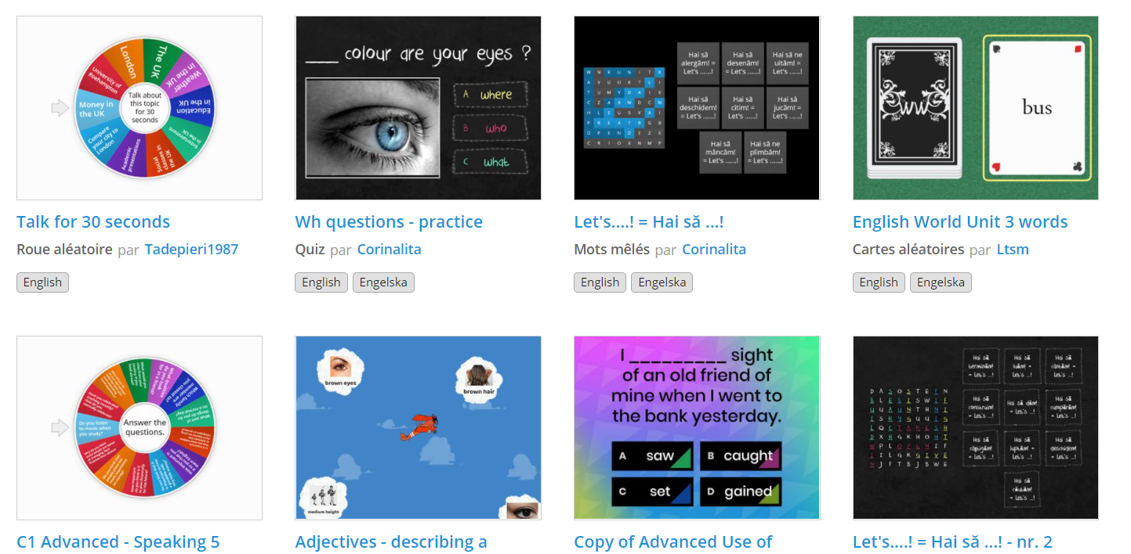
School: Colegiul Tehnic de Căi Ferate „Unirea” Pașcani Coordinating teacher: Alexandra Anicolaesei Student: Gabriel CTCFU

Slide 12
School: Hacı Ömer Tarman Anatolian High School Coordinating teacher: Deniz Akyol Student: Sude.HOTAL

Slide 13
School: Çanakkale Bahçeşehir College Coordinating teacher: Emre INAN Student: Naz BK

Slide 14
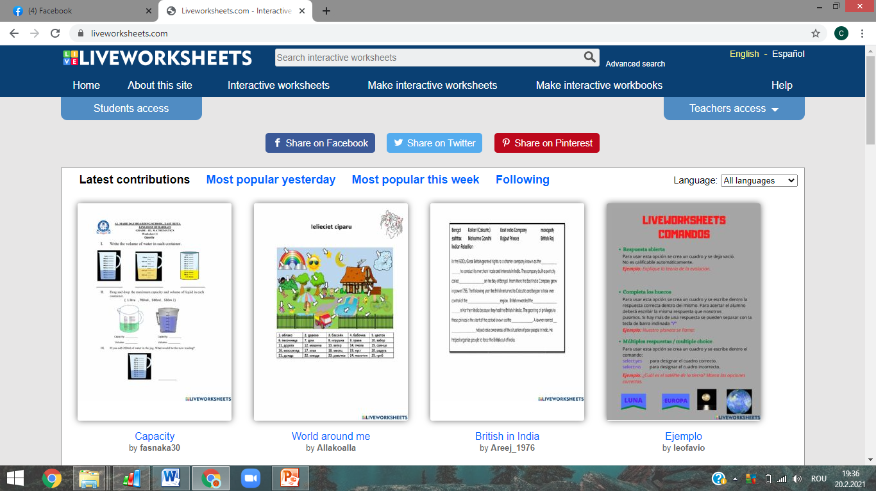
School: Colegiul Tehnic de Căi Ferate „Unirea” Pașcani Coordinating teacher: Maria Iosub Student: Clarisa.CTCFU
Live worksheets is a website, a tool used by most of my teachers, mostly in the period when we went exclusively to online school, as a method to grade and evaluate students individually on their work.

