Slide 1
Live WorkSheets
Blaj Clarisa Ștefania
Colegiul Tehnic de Căi Ferate “Unirea” Pascani, ROMANIA

Slide 2
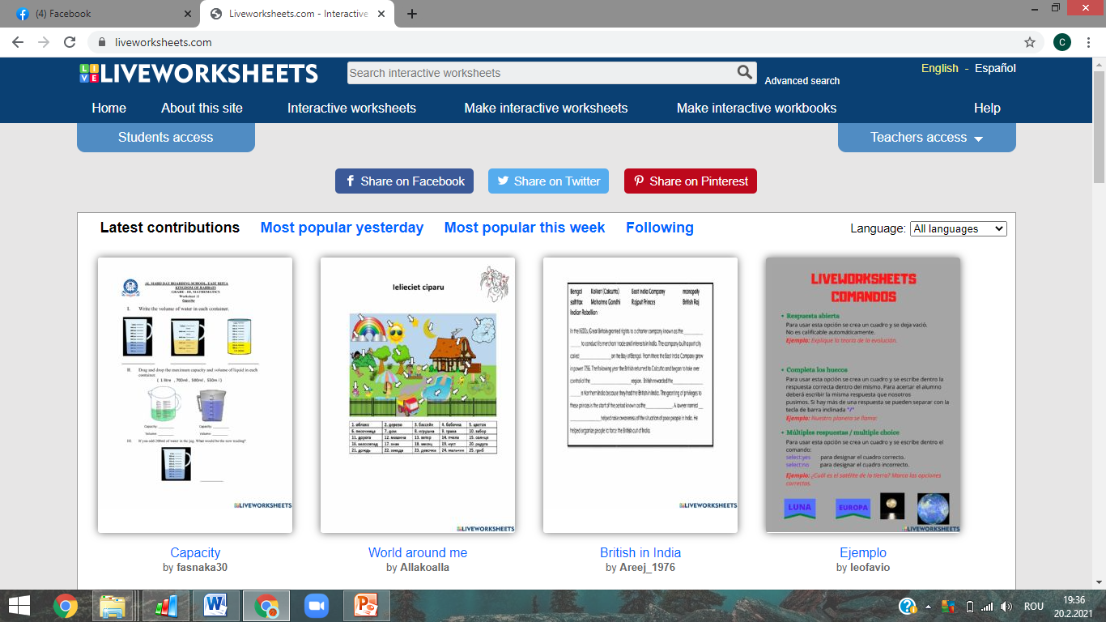
What is Live WorkSheets?
Live worksheets is a website, a tool used by most of my teachers, mostly in the period when we went exclusively to online school, as a method to grade and evaluate students individually on their work.

Slide 3
Who can use Live WorkSheets?
This tool can be used by students and teachers alike, or anyone who may need to get evaluated or evaluate someone based on completing a working sheet.

Slide 4
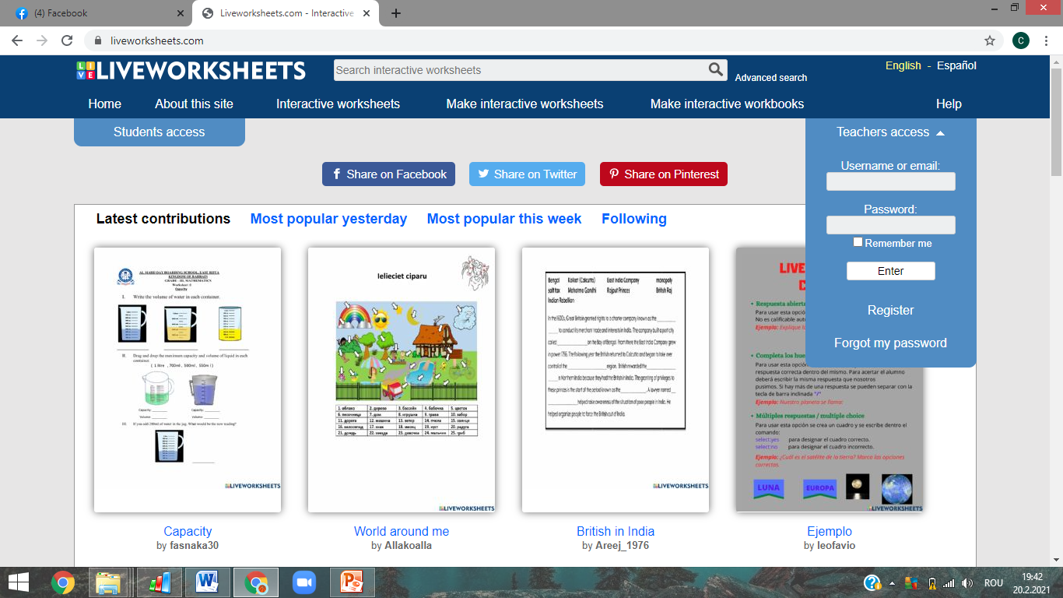
How to use Live WorkSheets?
Live WorkSheets is very easy to use. A piece of cake really!
Firstly, you have to make an account, to register, to sign in, so that you can save and share your live WorkSheets with everyone else on this platform .

Slide 5
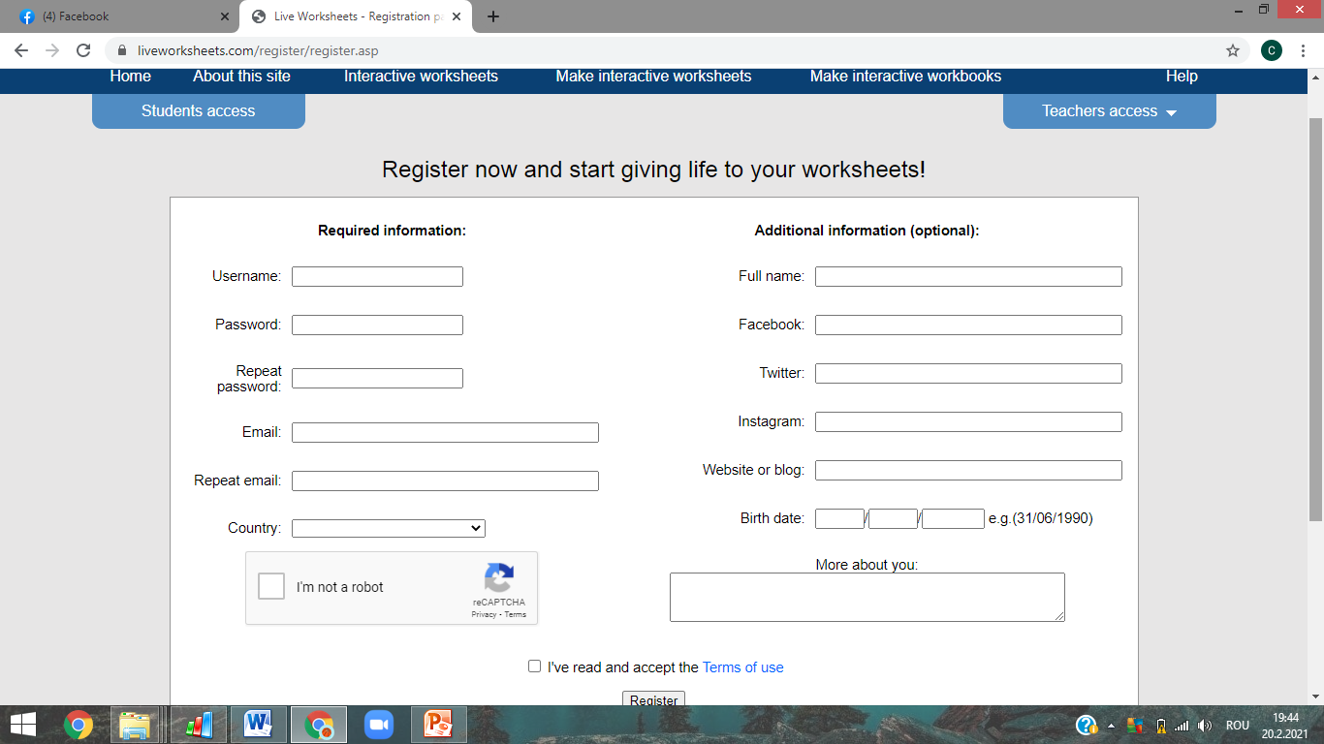
How to use Live WorkSheets?
Students can register on the top left corner of the website, and teachers on the right top corner.

Slide 6
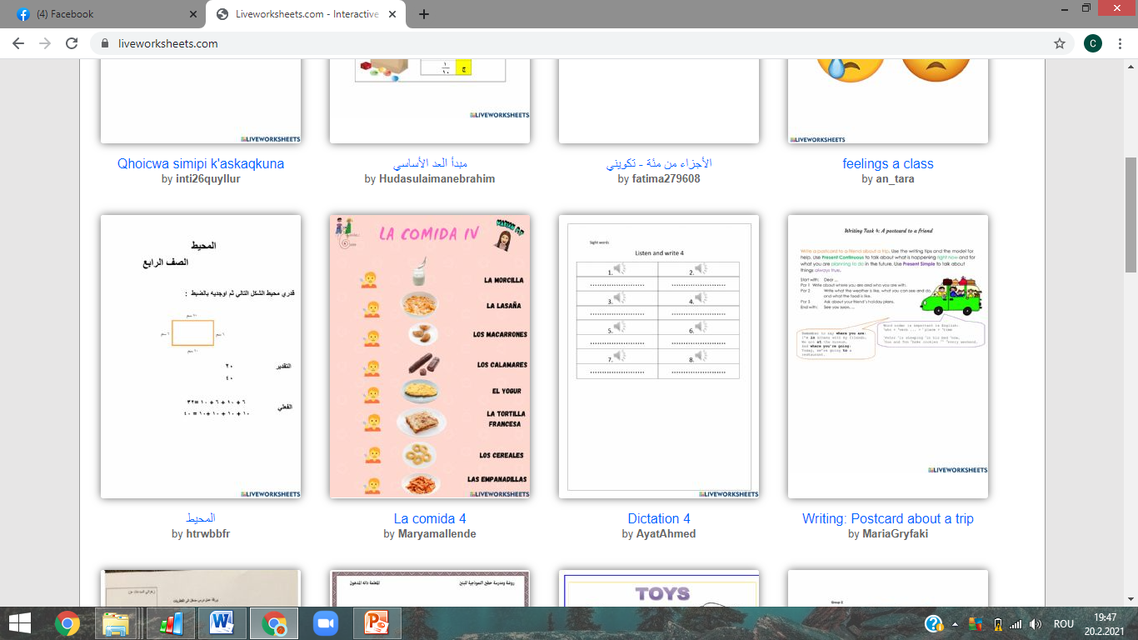
How to use Live WorkSheets?
After you log in, as a teacher, you can upload from your device, the sheet itself, in a jpeg or pdf format, or you can choose from the sheets that are already uploaded.

Slide 7
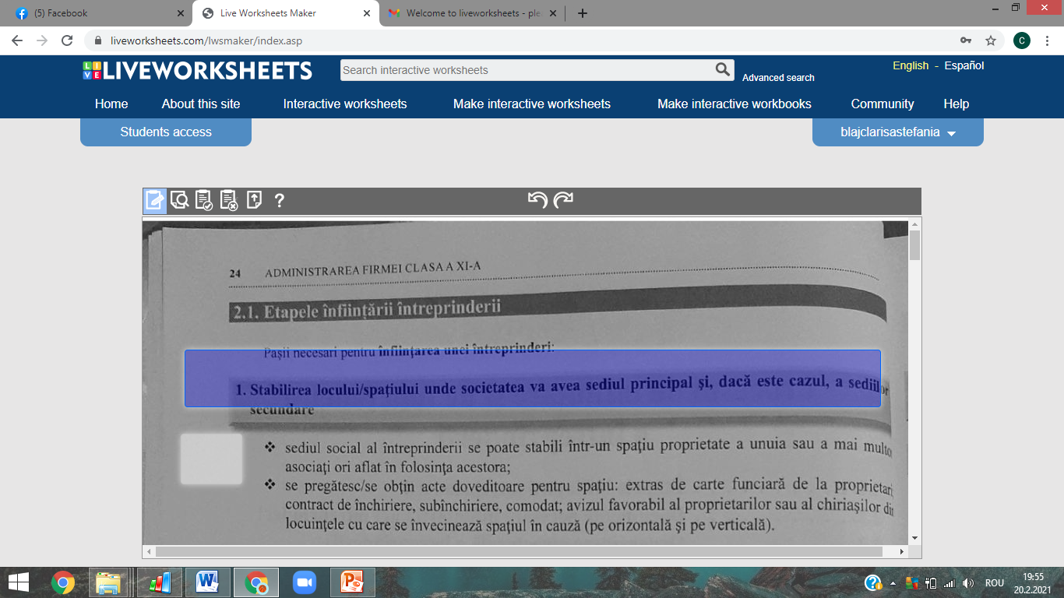
How to use Live WorkSheets?
After you upload your sheet, ypu have to use your mouse, and with the cursor, click and drag the desired space where you want your students to be able to complete with the answers.

Slide 8
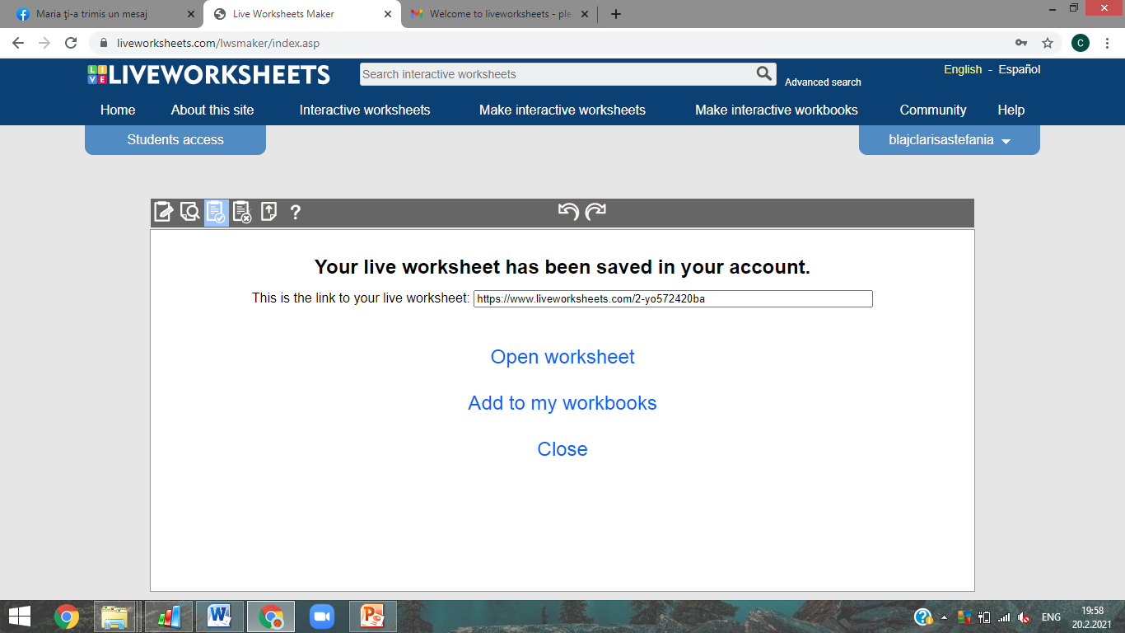
How to use Live WorkSheets?
After you finish adding the spaces in the desired places, you can save the document, and it’s going to get transformed into a link, that the teachers can now share with their students.

Slide 9
How to use WorkSheets?
Now, the students have the Sheet. What happens next? They can complete the spaces you previously choose, with the answers they find that fit. Answers that you placed in the same spaces, before saving the sheet. After completing it, the students can either email the answers directly to the teacher, this way they can evaluate the sheet themselves, or they can control the answers using the ones you already put, and see what grade they got. Pretty easy, is’t it?

Slide 10
Thank you for your time!

