Slide 1
ECOLOGICAL STUDIES IN OUR SCHOOL, AKSARAY AND IN TURKEY
Aksaray Şehit Pilot Hamza Gümüşsoy Science High School

Slide 2
AFFORESTATION
National Afforestation Day in Turkey has been celebrated on every 11 November since 2019, millions of saplings are planted. 11 million trees in 81 provinces were planted in 2019 , in 2020, Turkey's 81 provinces and 922 districts as well as 30 countries participated in this campaign. 83 million saplings were planted.
As a forestation activity we plant trees with our school in Aksaray in order to save natüre.

Slide 3
AN E-TWINNING PROJECT: “ECO GAMES IN MY CURRICULUM”
In this project, we aim to show ecological activities by creating games and online tools about ecology that can be used in all sorts school subjects in our curriculum. The target students are between the ages of 14-19. Throughout this project, our target audiences will discover tools that will integrate virtual learning methods into their curriculum and learn the ecological matters by creating and playing games.

Slide 4
REYCLING
Recycling is reaching serious proportions in recent years in Turkey. Thanks to the practices within the scope of recycling projects and waste recycling studies that have been carried out since 2001, the amount of materials gained has continued to increase every year. In our school we use recycle bins in stead of trashes. These studies are still being carried out with more intense demand.
In our school we collect garbages in the garden voluntarily one day in a week.

Slide 5
SUSTAINABLE ENERGY
In Turkey, many solar power plant was located in the west and South. The electrical energy obtained from the sun is used both in heating, industry and greenhouse cultivation. These solar panels installed on wide plains, electrical energy is stored and the remainder is transferred to the regions in need. The month where the most electricity is generated from solar energy is June, while the month where the lowest level of electricity is obtained is December.

Slide 6
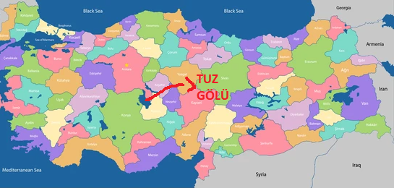
TUZ GÖLÜ (SALT LAKE)
Tuz Gölü is the second largest lake in Turkey with its 1665 km2 surface are and one of the largest hypersaline lakes in the World which means its supersalty
It’s within the borders of these three cities; Ankara(The Capital of Turkey), Konya and Aksaray

Slide 7
TUZ GÖLÜ (SALT LAKE)

Slide 8
SPECIFIC LIVING BEINGS AND THEIR PROTECTION
There are several indigenious plants and animals in Central Anatolia and Salt Lake (Tuz Gölü) Basin. These living beings (Especially endemic plants around Tuz Gölü Basin) have started being protected since they discovered.
I am here to explain these studies based on my researchs, also i will be talking about other stuffs like afforestation, forest ranges and watering. I hope you can enjoy ☺

Slide 9
What does endemic mean?
Endemic species are unique plant and animal species that are found in a particular geographical region and nowhere else in the world.
I am going to introduce you some endemic plants and animals in my city and around it.

Slide 10
A- Turkish Mouflon
Turkish Mouflon or Ovis Orientalis Anatolica is found in Central Anatolia (Mostly in Konya and Aksaray). And it’s common name is Konya Yaban Koyunu (Konya Wild Sheep) through native people.
It’s an endemic animal of course, it’s only found in Turkey. Males weigh between 45-74 kg whereas females weigh around 35-50 kg. Body length varies between 105-140 cm. It is being protected and its population increases year by year.

Slide 11
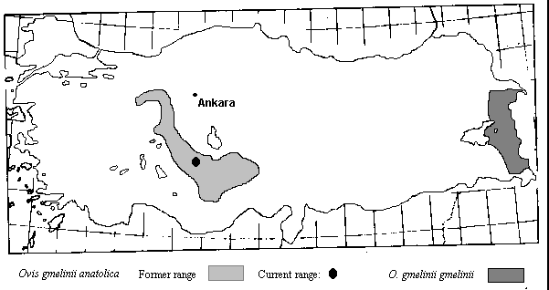
A- Turkish Mouflon

Slide 12
B- Salvia Halophila
It’s a kind of sage but it likes salt so people call them tuzcul adaçayı which basically means salt lover sage. It’s obviously found in near Tuz Gölü Basin but it was endangered in 2010, it has started being protected since that year and in 2016 it became vulnerable meaning it’s not endangered anymore but it is still not enough.
It is bi-coloured (lavender and white) and it can reach 48 inches.

Slide 13
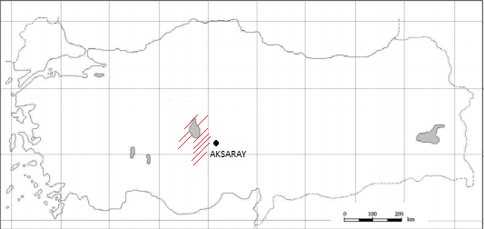
B- Salvia Halophila

Slide 14
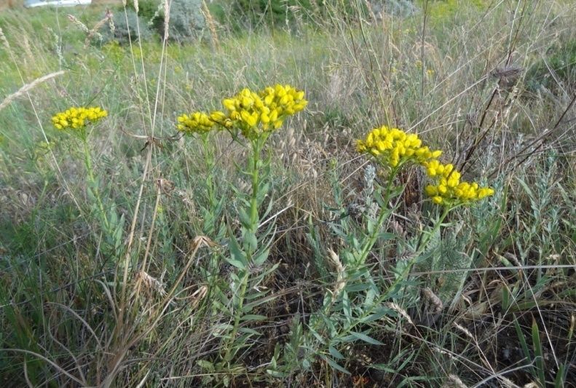
C- Haplophyllum Vulcanium

Slide 15
D- Taraxacum Tuzgoluensis

Slide 16
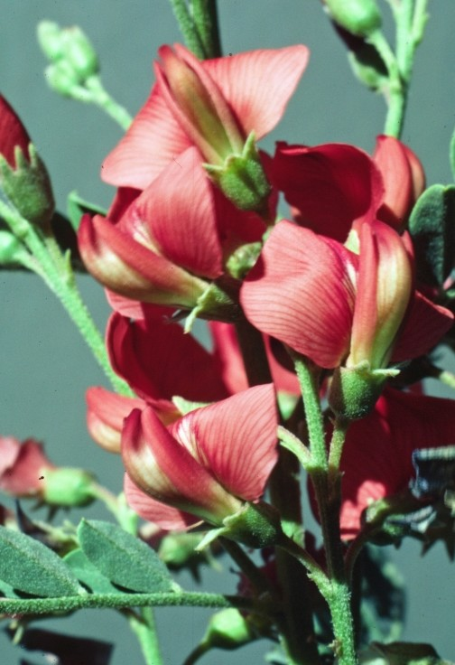
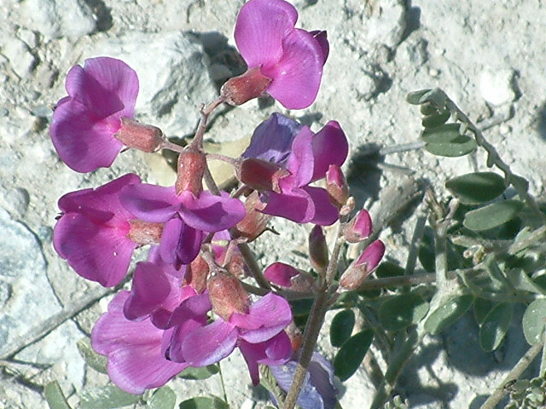
E– Sphaerophysa Kotschyana

Slide 17
THANKS MUCH FOR LISTENING!

