Slide 1
The activities done in Jõhvi Rissian Basic School about environment
Students: Vera.jvp; Emilia.jvp, Ksenija.jvp, Anelia.jvp, Aleksandr.jvp, Sofia.jvp
Teacher:Galina Safronova, Oksana Kutsjak

Slide 2
https://www.kik.ee/en
Project "Let's Get to Know and Preserve Estonian Nature"
Objective of the project:
Generalization of what has been learned in theoretical courses in natural science, to teach to see environmental problems and find solutions, and also to develop students' research skills; to raise awareness of the dependence of man, culture and social environment on natural prerequisites. Thanks to the project, students deepen their knowledge of the laws of the living environment and can use the knowledge gained in solving problems related to everyday life, as well as in describing, explaining and predicting natural phenomena.

Slide 3
Project "Let's Get to Know and Preserve Estonian Nature"
Former Aidu oil shale mine
Every year all students of our school participate in this project. We visit various natural attractions of our native land.
A guide from the Environmental Investment Center Foundation tells a lot of interesting things about natural places, plants and fauna.

Slide 4
Project "Let's Get to Know and Preserve Estonian Nature"

Slide 5
SCHOOL EVENT «ECO MOOD“ FOR ALL CLASSES
The course of the event
Each class prepares two costumes:
1.Suit made of used materials,
2.old thing that might be fashionable now)
And prepares the performance (music, a story about a costume, a fashion show).
After watching the show, a winner is selected.

Slide 6
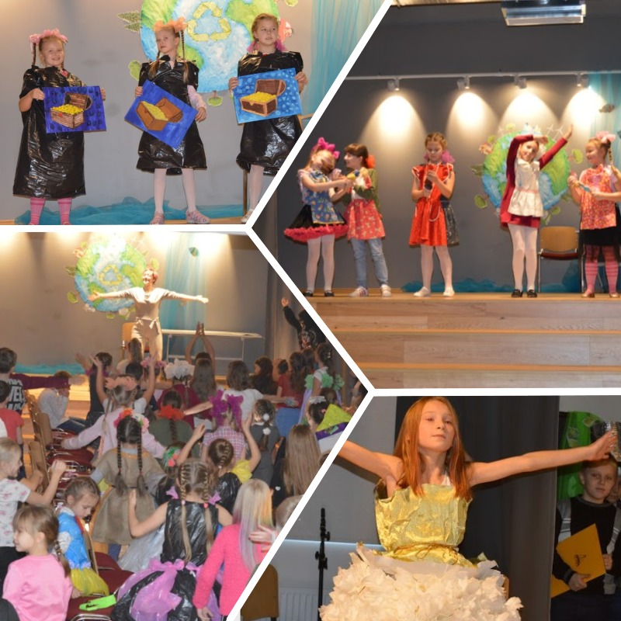

Slide 7
Excursion "The uniqueness of the flora of the garden and park ensemble Toila-Oru"
This excursion is conducted by the students of our school for the children of the entire region, under the guidance of a teacher.
During the excursion, nature lovers can admire the amazing variety of flora of this landscape gardening ensemble.

Slide 8
Excursion "The uniqueness of the flora of the garden and park ensemble Toila-Oru"
Young guides talk about park plants and the fruitful activities of RMK (State Forests and Parks Management Center, sponsored by the European Union Cohesion Fund) in the protection, protection and care of the park's attractions and encourage tourists to love and protect the fabulously beautiful but fragile nature.

Slide 9
Thanks for watching!

