Slide 1
Special Sustainability Points at BVA-School Germany

Slide 2
Fair trade Club
Our fair trade-Club is an activity group for anyone, who is interested in ecology, animal welfare and equality. Their aim is to raise awareness for the fair trade label, like when they are selling fair trade chocolate or they clean a local beach.

Slide 3
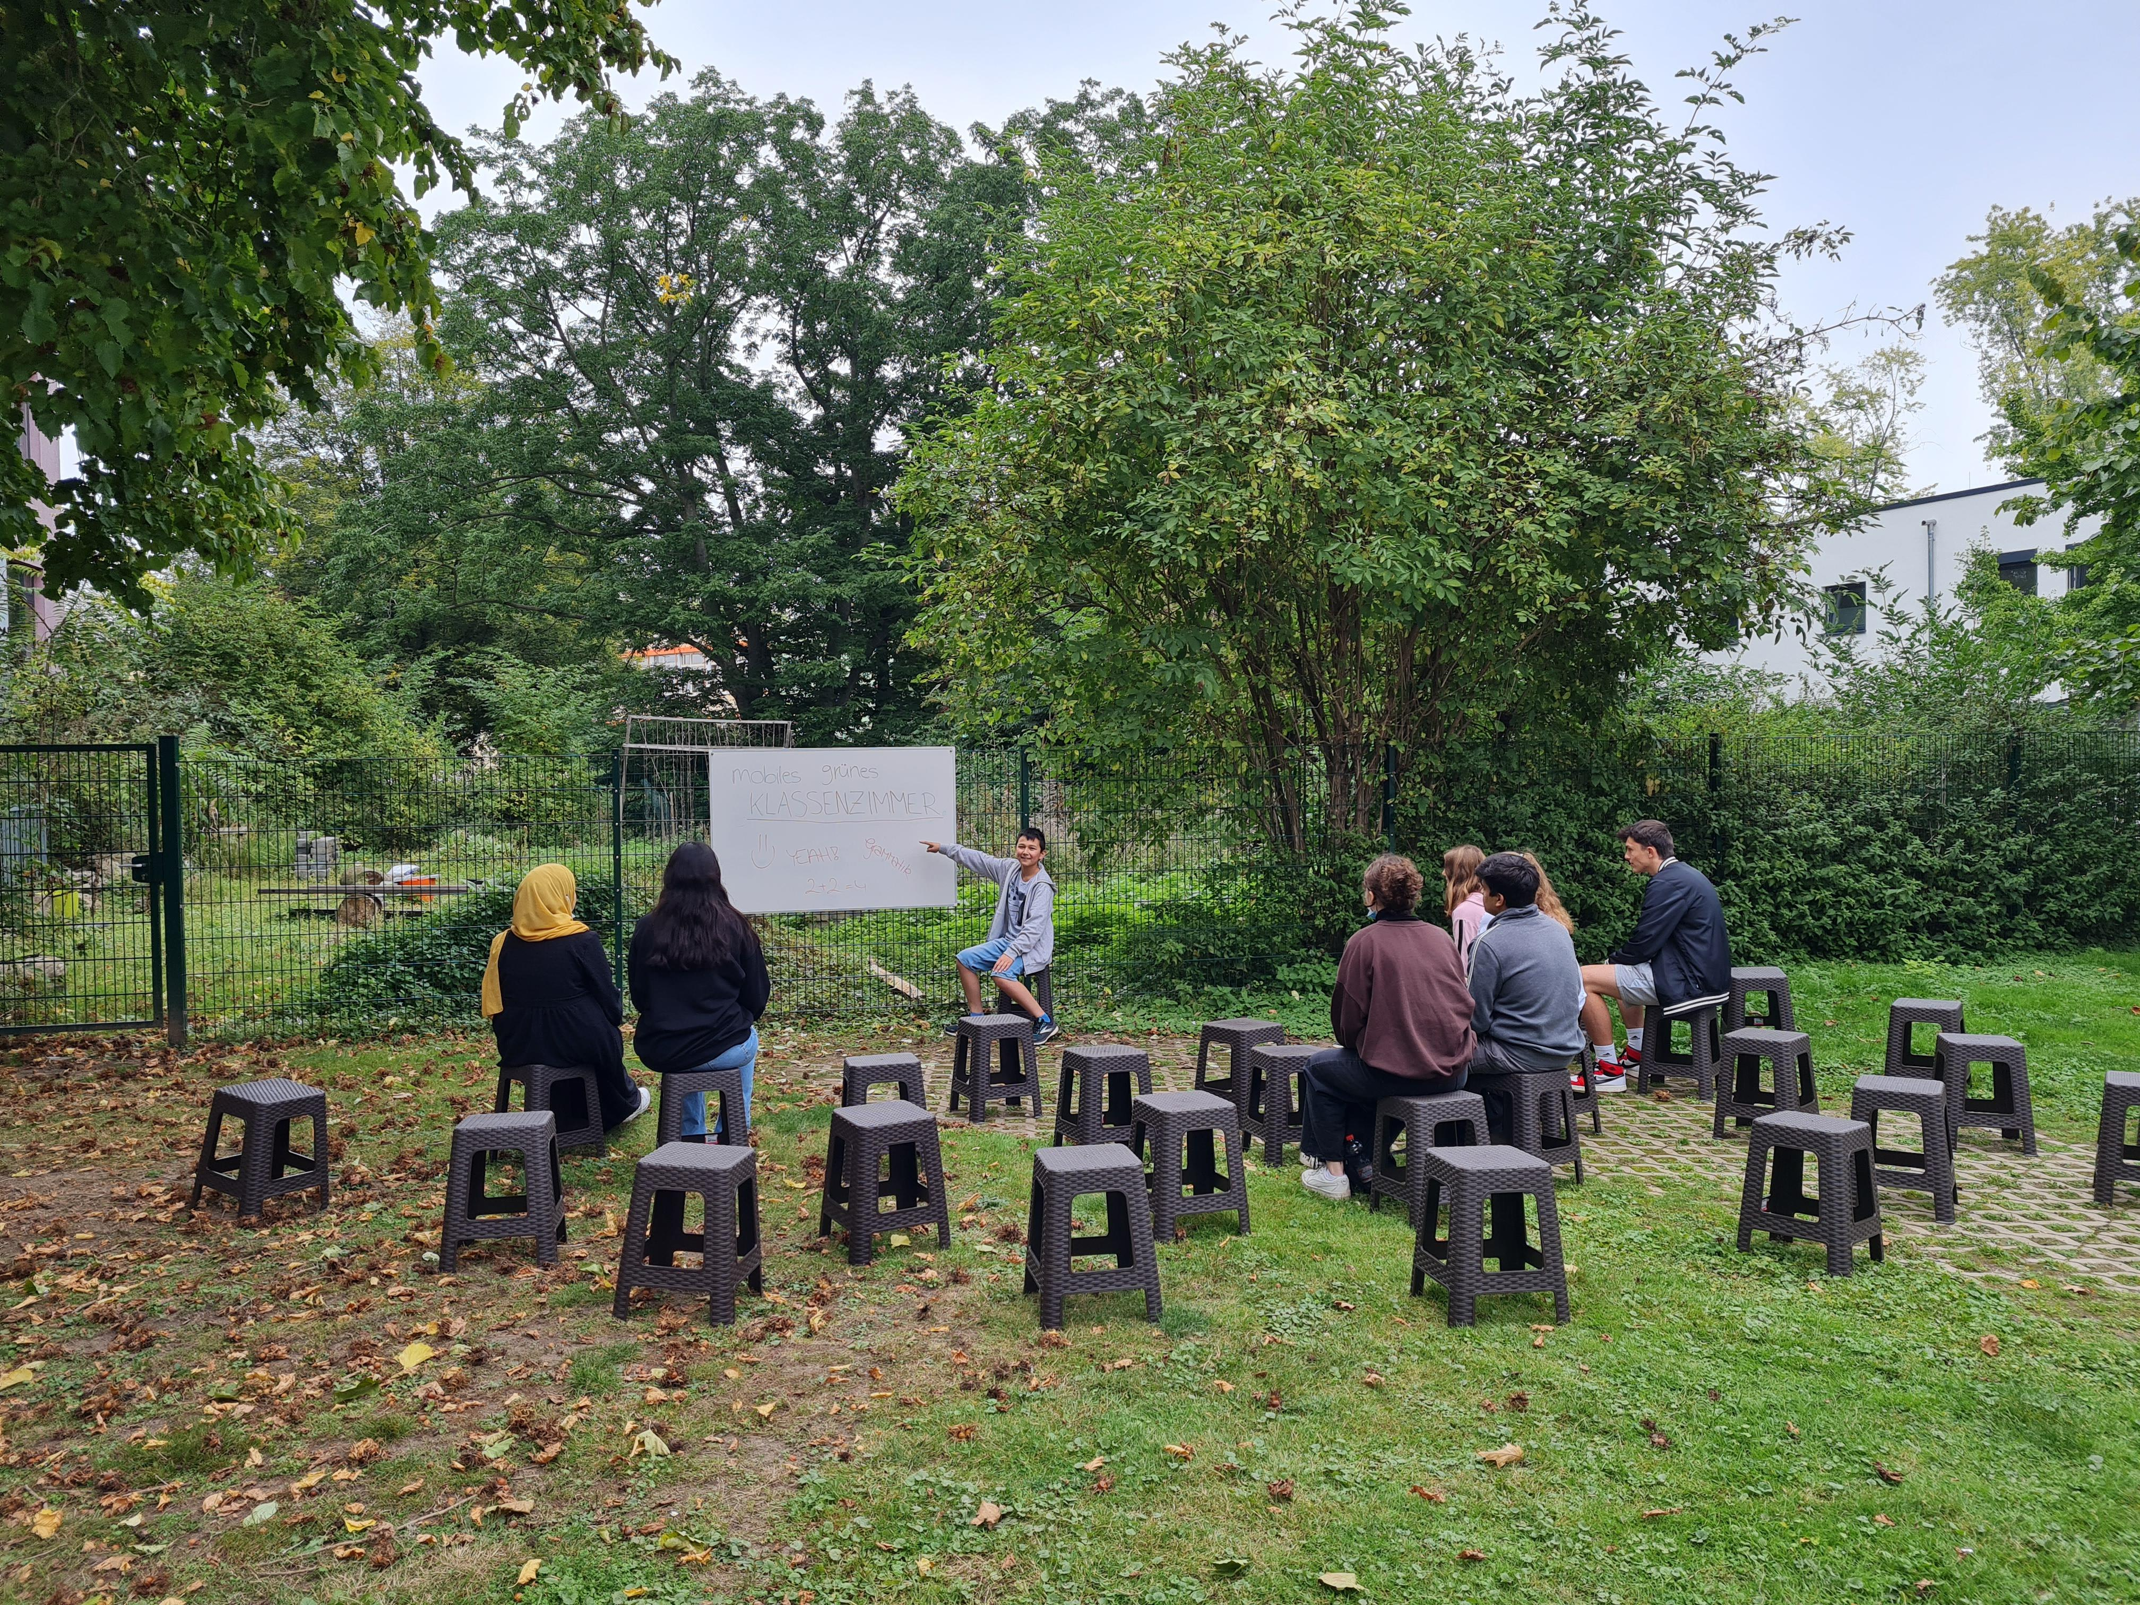
The Mobile Green Classroom
The “Green Classroom (Grünes Klassenzimmer)” is a portable whiteboard with chairs. It can be used and booked like any regular classroom. Especially in hot summer days it can be a big relief to escape from the hot school building to the windy outdoor room.

Slide 4
Sponsored Walk
Every year we walk 6 km to raise money for the children in need. Our sponsored walk means that every student finds “sponsors“ (like their parents, grandparents or friends) who are ready to donate some money for every kilometer to be walked. This event is organised by our Student Council and is an important part of the social aspect of sustainability at our school. 9 000 € were donated to a children´s help organisation in 2021.

Slide 5
School Garden with Pond
At our school, we have a school garden to be used in the Biology classes. Our Erasmus Club has constructed a pond in it with the purpose of creating a new biotope.

