Slide 1
Pyhäselkä school
Erasmus+ survey results

Slide 2
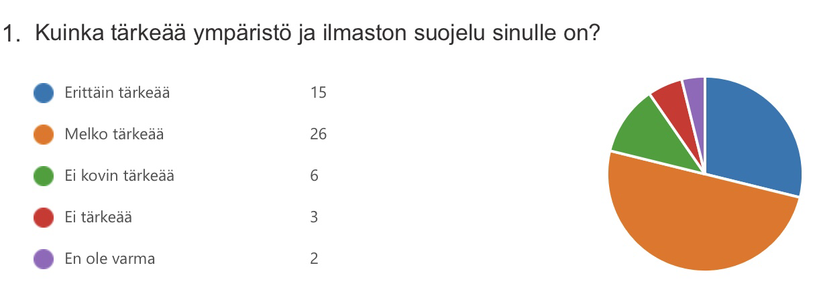
More than three people in four consider environment and climate protection important

Slide 3
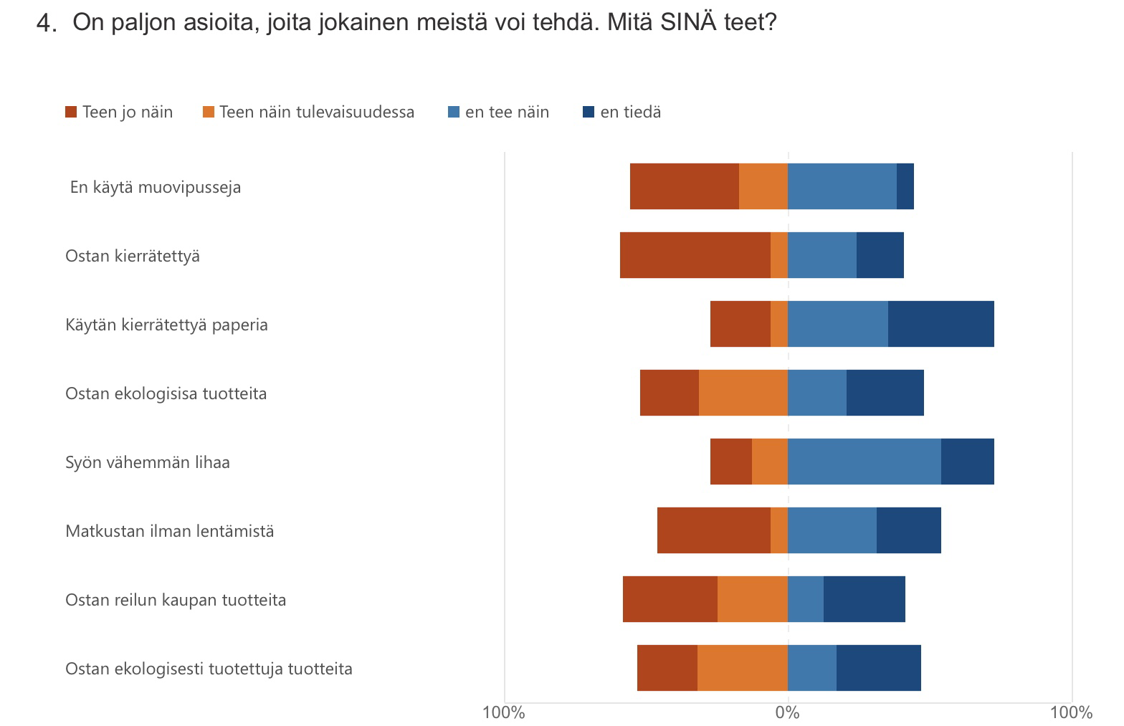
It`s delightful to see that a little over 50 % buy second hand, ecological products and Fair trade.

Slide 4
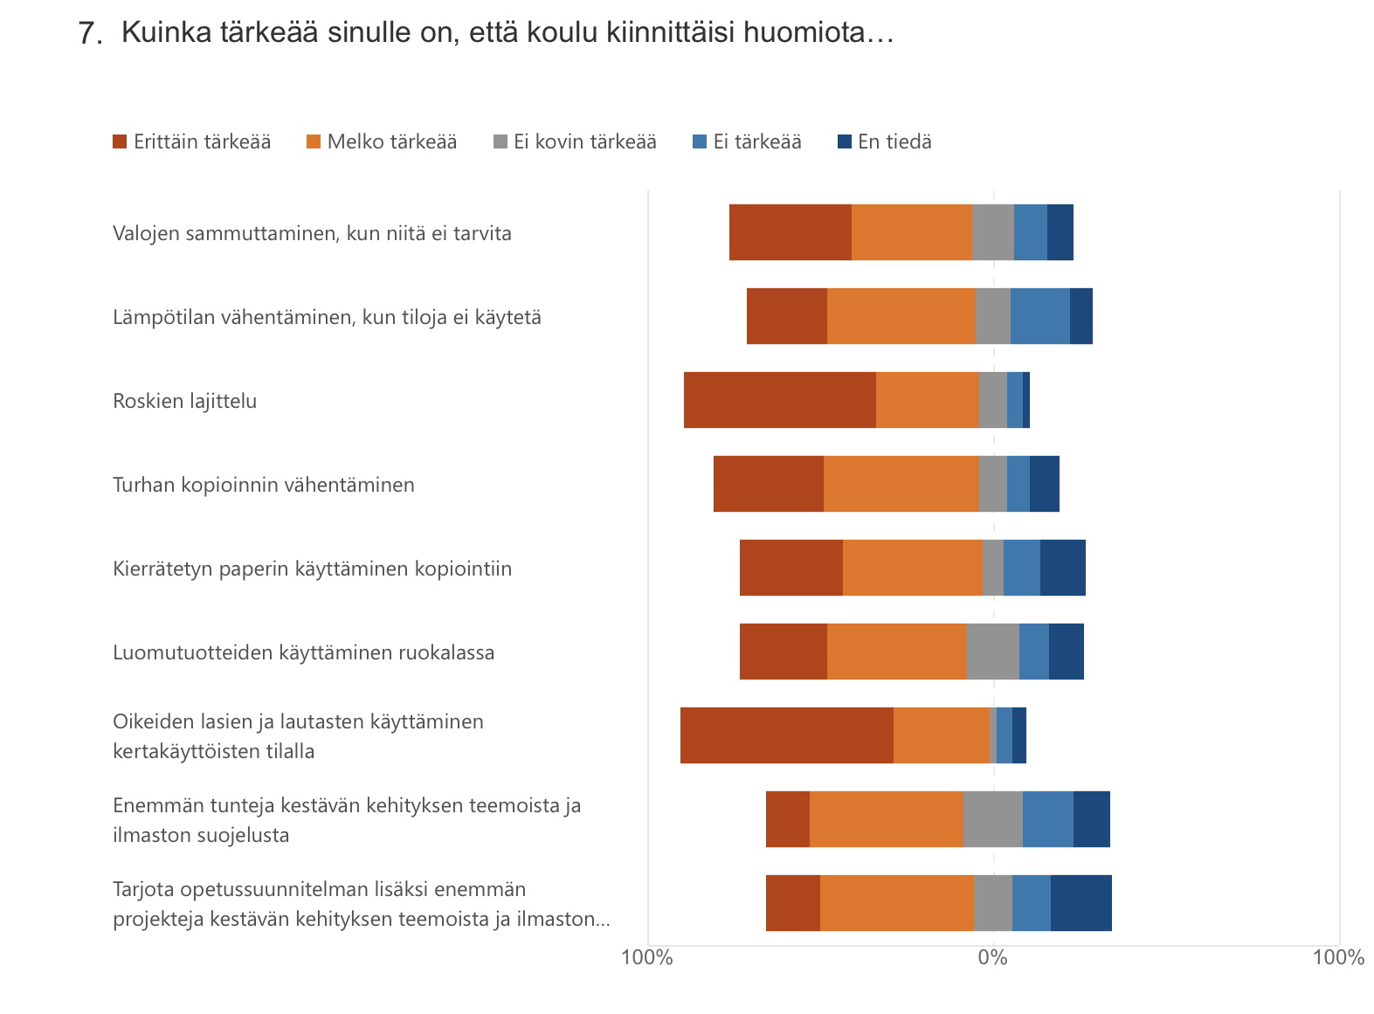
Our school is quite sustainable; we turn the lights off when we leave the calssrooms, air conditioning is turned off at weekends, we use glass and porcelain in the school canteen. All the trash is recycled.

Slide 5
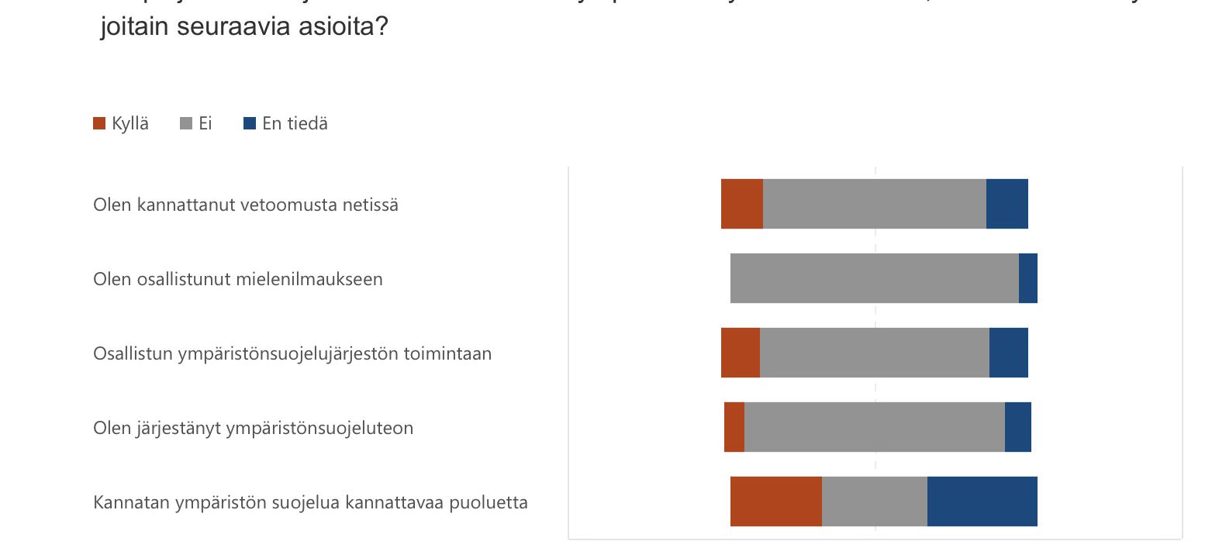
The results show that we consider environmental issues important but it seems that we are a bit lazy to attend demonstrations or even join in activities of environmental organisations.

