Slide 1
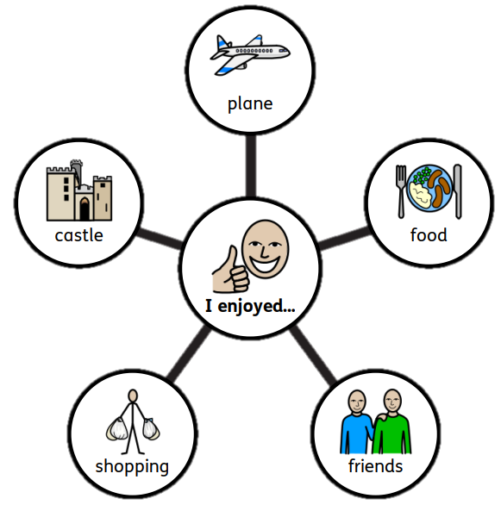
Trip to Barcelona
Robert thought that the aeroplane “was bumpy” but he enjoyed making lots of friends in Barcelona.

Slide 2
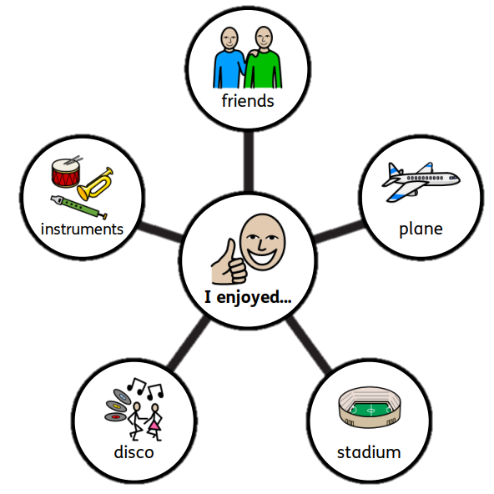
Trip to Barcelona
Andrew said that the trip “was awesome” and that he would like to visit Barcelona again.

