Slide 1
ITT «G. Malafarina»
We Enjoy our school
We listen to each other in our school

Slide 2
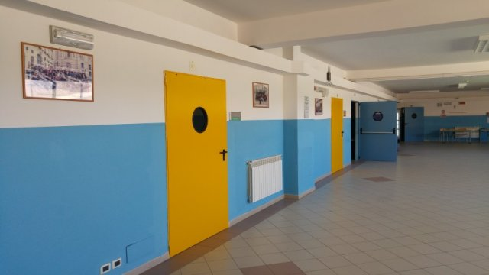
We Enjoy our school
From 5 to 6 hours (no counting 15 minute-break and evening projects), we spend the whole time in class.

Slide 3
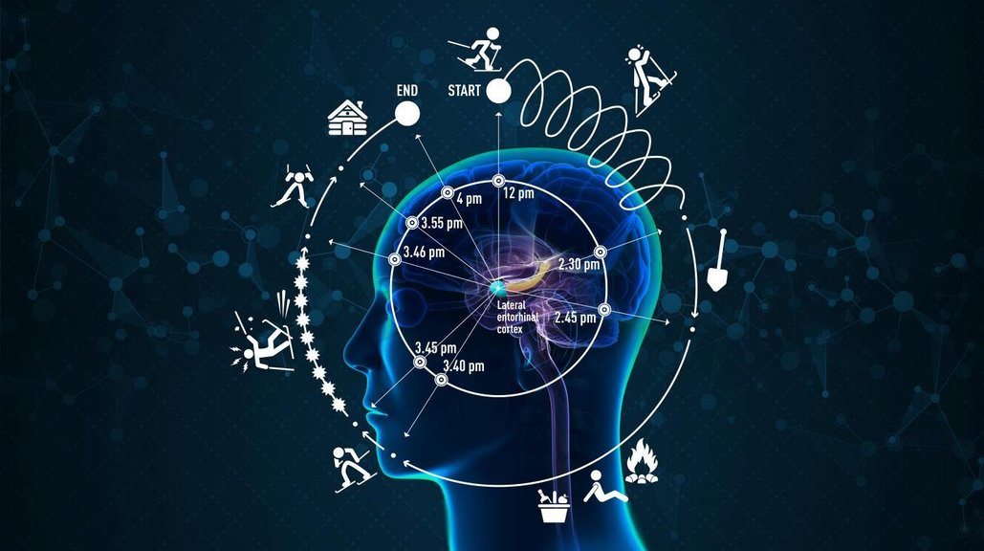
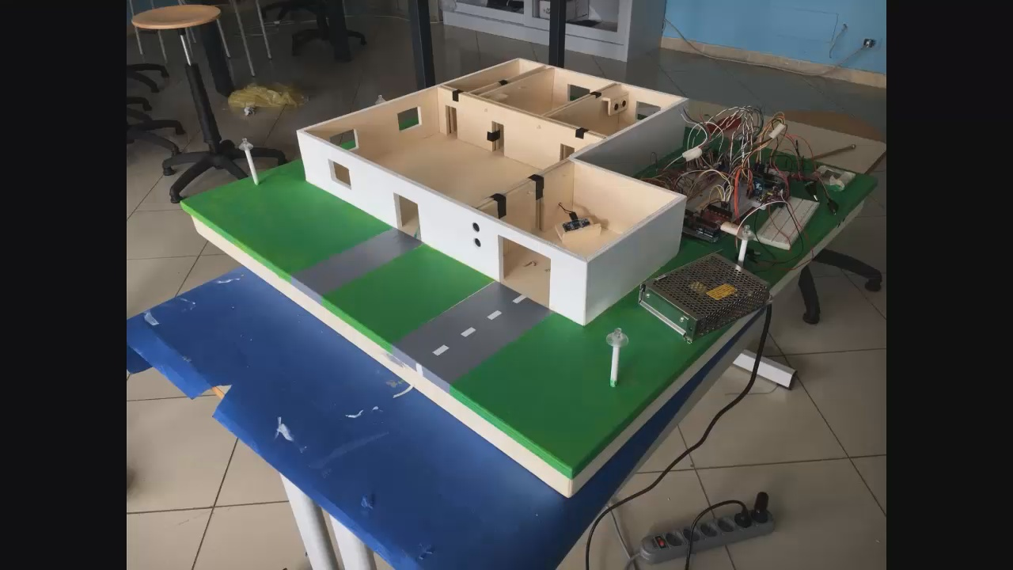
We’re allowed a personal break during the lesson (just a few minutes)
Yet all this, combined with lab’s activity, make the day enjoyable.

Slide 4
What about relationships?
All students have peaceful relationships with each others. School staff promotes social support breaking negative patterns

Slide 5
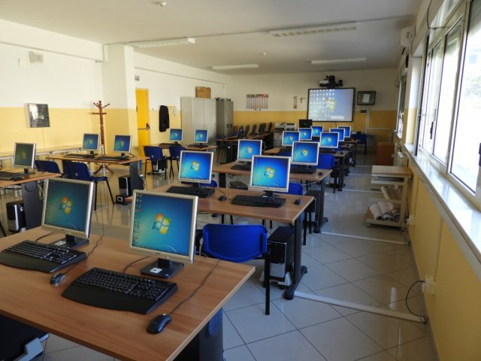
Relationships between teachers and students are satisfying too. Teachers successfully enhance appreciation both for subjects and for moral values. Even the school itself with its warm and comfortable environments infuses positive energy

Slide 6
We listen to each other in our school
Dialogue plays an important role in our school even if sometimes the listener wants to be the speaker too…. We’re not always on the same wavelength but at the end we get a stronger foothold.

Slide 7
Music for interacting
Music is a fundamental channel of communication, since audience forms an integral part of the performance

Slide 8
Does all this mean our school is perfect?
Come on!
Nothing is perfect! Any place can have even a little issue, we’re not exempt from this universal law.
But remember, no matter what the obstacle is, we will find a way to overcome it.

Slide 9
We hope you enjoy it, and thanks for your attention!
Andrea Rosanò, Natale Giaimo, ITT «G. Malafarina»

