Slide 1
Be gentle
Barcelona

Slide 2
Appliying gentle teaching
School’s blog
Ambassador’s power point
Ambassador’s roll up
Ambassador’s interviews
Gentle meeting (all school)
Making our gentle flags
Gentle actions

Slide 3
Our Ambassators
Our students of 6th grade started last year with his ambassator’s role.
They have the experience of last year and they are working really hard to make all school understand and share the gentle values.

Slide 4
Ambassator’s power point
First, they worked pillar by pillar making a wonderfull presentation:
Reviewing this values for them first, and then for the
rest of the school.

Slide 5
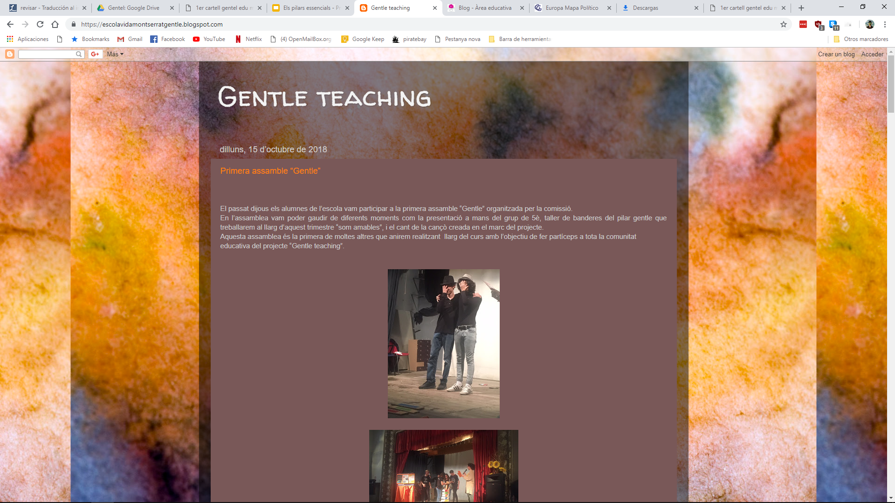
School blog
With the objective of sharing gentle ideas and thoughts, our students are documenting every gentle activity and sharing it online.
https://escolavidamontserratgentle.blogspot.com/

Slide 6
Ambassador’s roll up
Since the start of the course they’ve been working on it, and now here is it!

Slide 7
Ambassator’s recording
Our ambassators wanted to know what people think in our school about what they’re learning.
They interviewed some people in catalan, and later they translated all and made english subtitles!

