Slide 1
Climate Education is a lifelong journey.
“SANDRO PERTINI” SECONDARY SCHOOL (ITALY)
LESSON PLAN :
Teaching Socials Studies through English –
a CLIL approach
UNIT :
Sustainable Development Goals
THEME / TOPIC :
CLIMATE CHANGE : A DAILY FIGHT.
CLIMATE EDUCATION AS A LIFELONG JOURNEY
NOT JUST A DESTINATION
Martinsicuro 20/11/2020

Slide 2
How important is in our daily journey to build and increase awareness on factors causing climate change?
Learn European policies against climate change
–» SDGs-Climate Action

Slide 3
Rationale: This teaching unit consists of 2 lessons, one hour each. While they may be adapted to suit many subject areas, the lessons are geared towards socials studies classrooms. The lessons are about climate change – and encourage students to think about their attitudes towards the environment. These 2 lessons are meant to introduce a cycle of classes on climate change as global threat. Students with Special Education Need*: We chose to expose students to some informational texts Easy-to-Read ands easy to understand since they are also meant to address the participation in the class of Pupils with Special Education Need (disabled pupils, dyslexic pupils and pupils with Bes/Sen). Law 104/92 art. 3, paragraphs 1 and 3 and Law no. 170/2010 (New regulations for specific learning disorders in the educational field).
Title : Climate CHANGE : A DAILY FIGHT.
CLIMATE EDUCATION AS A LIFELONG JOURNEY.

Slide 4
“ALL STUDENTS ARE CREATED EQUALLY (AND DIFFERENTLY)”
*Students with Special Education Needs
COMPENSATORY TOOLS | DISPENSATORY MEASURES
Use of ICTs, tables/schemes | no taking notes or copying tasks
mind maps and online tools | no reading aloud
accessible format (font: Arial/Comic/Verdana 12/14pt) | reduction and adaptation of assigned work
simplified text | spelling mistakes misregarded
digital dictionary and pictures | focus on content
additional time if needed
- Law 104/92
- Law 170/2010

Slide 5
Rationale: Why teach this module? Approaching climate change in the classroom can be overwhelming. How can we introduce students to not only the serious challenges and far-reaching implications of climate change, but also the social, cultural, political, and economic complexities involved in working toward viable solutions? Understanding local challenges and focusing on positive solutions can offer an entry point to deeper learning on climate change, while also encouraging critical and creative thinking on issues that are directly relevant to students’ lives. The lessons pull together the information students have learned in other classes or experiences outside of the classroom, and then leverage these ideas to promote deeper learning. The module is divided into two parts, the first lesson explores the causes and impacts of climate change, while the second is more specifically focused on solutions that involve both mitigating global warming and adapting to the impacts of climate change.
Title : Climate CHANGE : A DAILY FIGHT.
CLIMATE EDUCATION AS A LIFELONG JOURNEY.

Slide 6
CLASS PROFILE
School: Lower Secondary School.
Grade: 5th / 6th
Age: 10/11 years old
Classroom: 20 students including students with Special Education Need. CTP (Customised Teaching Program) according to the lawn 170/2010 and 104/92.
CEFR level: A1 moving to A2 of the Common European Framework
Overview of the class: It has uneven levels of learning (mixed abilities) but the students show liveliness and interest in the subject
Extimated Time: 2 lessons of 1 hours, First Term
Interdisciplinary Teaching: Socials Studies - Social Science – History – Geography - Political Science.

Slide 7
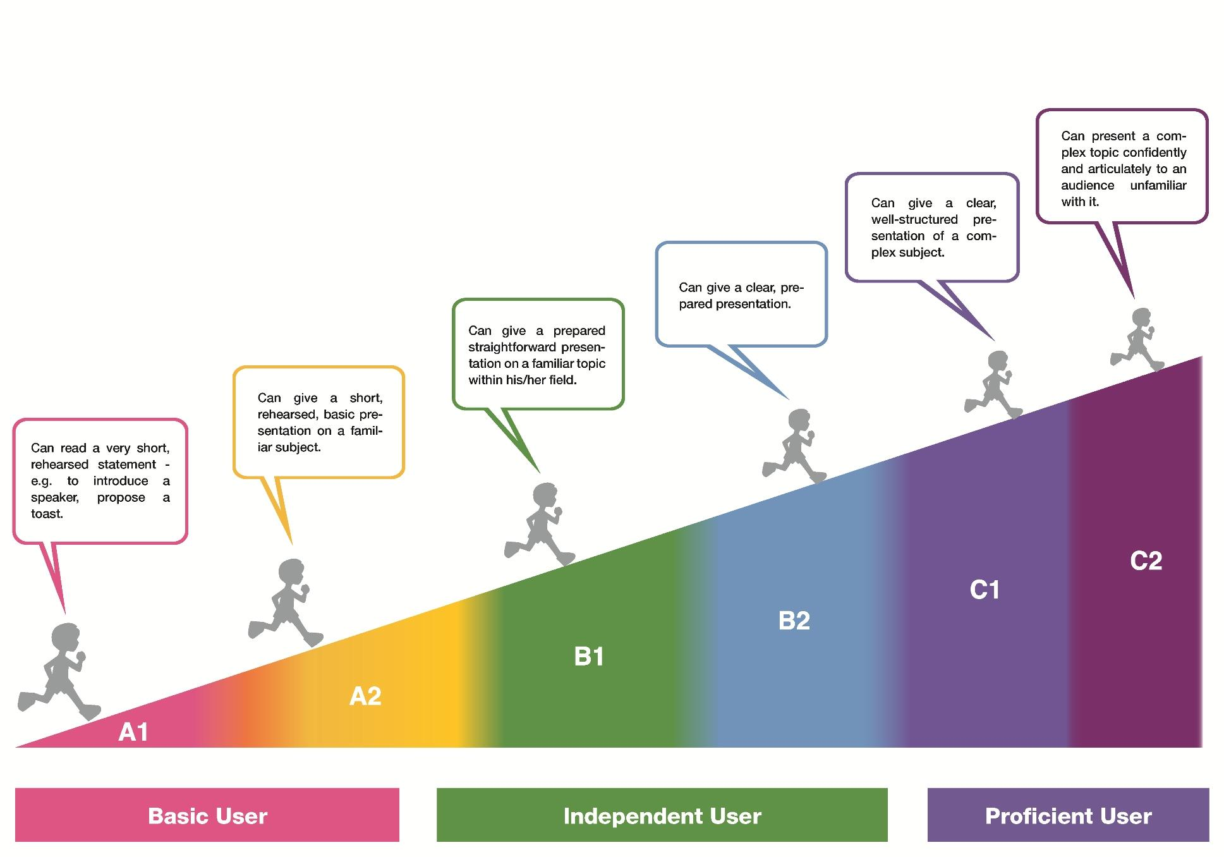
Common European Framework of Reference for Languages (CEFR)

Slide 8
MAIN AIMS
To build and increase awareness on factors causing climate change.
To turn knowledge into meaningful learning.
To produce suggestions and act to mitigate causes and effects of climate change.
To learn European policies against climate change (SDGs-Climate Action)
To give students the possibility to acquire and interpret information.
SUBSIDIARY AIMS
Develop English as a foreign language
To Improve pupils’ digital (web 2.0 tools) skills
To give Ss opportunity to revise specific language terms and to learn new vocabulary.
To encourage critical thinking.
Encourage the use of ICT
RELATIONAL AIMS
To Promote intercultural communication
To promote cooperation through peer and group work
To propose a topic with a communicative and interactive approach

Slide 9
LINGUISTIC and DISCIPLINARY COMPETENCES
Students are able to understand easy texts in standard language and analyze them.
They are already familiar with cooperative learning and are used to reading and listening for gist
PREREQUISITES
METACOGNITIVE CULTURAL COMPETENCES
Students are used to reflect on the language.
Students are used to work in pairs and group.
They are already familiar with cooperative learning and are used to reading and listening for gist.
DIGITAL COMPETENCES
Students are used to surf the internet and to look for information about a given subject.
Students are familiar with technological devices to edit videos (Editor video) and sound tracks (Wavelab)

Slide 10
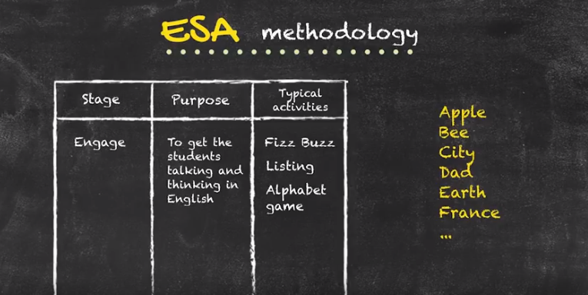
Methodology
«If they can’t learn the way you teach, you teach the way they learn» I. Estrada
Main Methodology:
ESA – it’s a 3 stages methodology.
E=Engage - S=Study - A=Activate
Other Methodologies :
Learner-centred and inductive approach.
Focus on students’ learning styles : the pupil aware of his/her own learning style is able to develop autonomy in the study (Multiple intelligences)
Teacher as facilitator : provides Key competences for lifelong learning (Scaffolding) and is aware of his/her own learning style (pay attention on how we learn to discover how we teach)
A variety of activities to suit Ss’ different learning styles. Techniques include : cooperative learning, skimming, scanning, scaffolding, role-play, suggestopedia method.

Slide 11
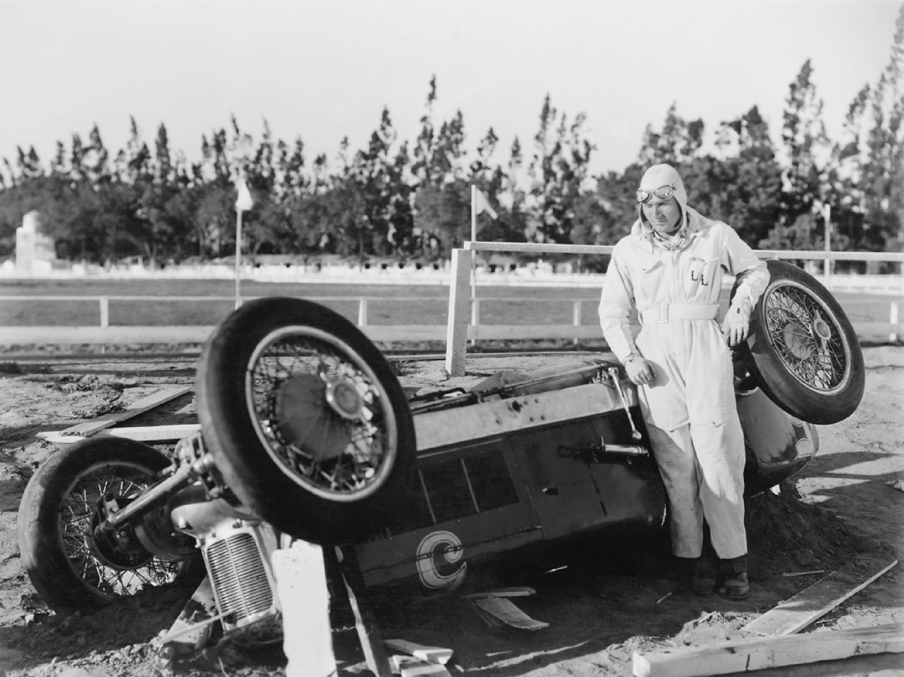
ANTICIPATED PROBLEMS _possible solutions_
Students may have difficulty interacting with the teacher
and the classmates during the class discussion and the speaking activities (emotional filter, fear of losing face).
Teacher's hint: arouse MOTIVATION, create a RELAXED ATMOSPHERE in the classroom, make the TASKS seem ACHIEVABLE, and develop a GOOD RELATIONSHIP with the learners.
Students may have some difficulty with the new vocabulary ( Social Studies Microlanguage )
Teacher’s hint: encourage the students to contextualize the new words in the text and guess the meaning from the context (inductive method: inference)

Slide 12
Warm up : Just to break the ice
Arouse students’ interest and motivation
LESSON 1, PART 1
Engage phase
(ESA methodology)
Visuals and Music:
T. writes some quotations on the board while the Pc is playing the background music (suggestopedia method).
Some questions to activate students’ knowledge:
References to your or students’ experiences
"Do you think music could be useful in language learning? Why?"
- T. writes the Ss’ suggestions on the board.
- T. adds a further reason (a scientific one).
“Music is the art of thinking with sounds” (J. Combarieu)
“After silence, that which comes nearest to expressing the inexpressible is MUSIC” (A. Huxley)
'Music is the best means we have of digesting time.’ (W. H. Auden)
ENGAGE PHASE : get the Ss talking and thinking in English and being interactive

Slide 13
T. shows the students a picture of a human brain
T. Explains :
the brain is divided into LEFT and RIGHT hemispheres (bilateralism)
Both hemispheres play a crucial role in higher mental functions, each hemisphere is specialised in its capabilities.
T. Ask Ss if they know which hemisphere is involved in language acquisition.
left hemisphere is dominant for language acquisition, logic, complex motor behaviour,
right hemisphere is specialised for visual-spatial and other non-linguistic functions (visual imagery, tactile perception, facial identification, appreciation of music non-verbal communication, etc.)
As a consequence, language students usually use just one hemisphere, but songs can involve both hemispheres in the learning process, greatly increasing their potential as students.
Using music to learn a language involves your BRAIN as A WHOLE !
Make students aware of the learning process!

Slide 14
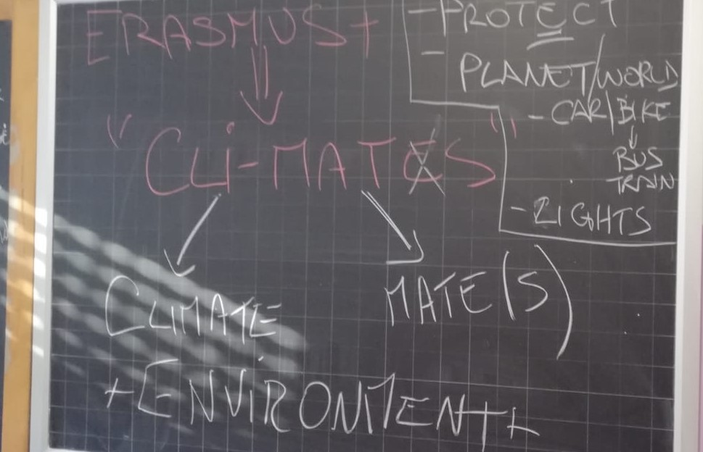
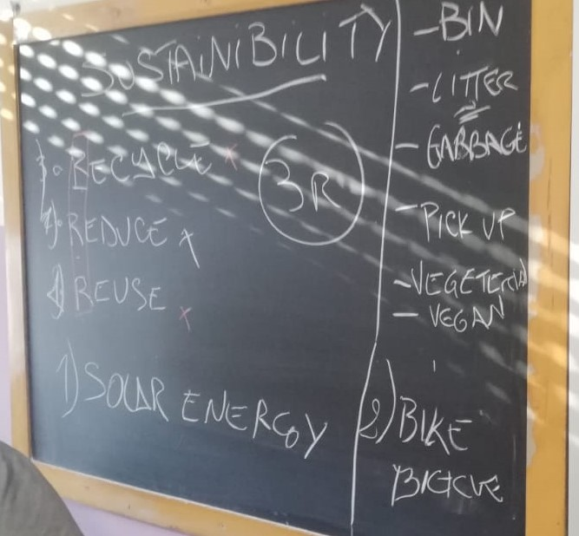
Lead-in Activity :
Introducing the topic with a SONG
Arouse students’ interest and motivation through games activities
Set the context
Activate students’ knowledge about the topic or the situation
LESSON 1, PART 2
Engage phase
(ESA methodology)
Let’s activate our whole brain with some music!
The teacher writes on the blackboard a list of words connected with the main topic and check with the student their meanings.

Slide 15
SONG activity : Specific Vocabulary
Help students to predict what they are going to do/to listen to
Making predictions
Introduce new topic vocabulary
Listening for a specific information
LESSON 1, PART 3
Engage phase
(ESA methodology)
Jack Johnson - The 3 R's
Before listening to the song, they are going to make predictions about what they will find in the lyrics.
This exercise will help them to get deeper into the topic of the lesson
The teachers let the students listen to the song and then together they write the KEY-word on the blackboard
(T. checks all the Ss understand the meaning of the given words)
reduce – reuse - recycle – waste - trash - throw out - bags - clothes – buy - learn to recycle

Slide 16
The 3 R’s (Jack Johnson)
Three it's a magic number
Yes it is, it's a magic number
Because two times three is six
And three times six is eighteen
And the eighteenth letter in the alphabet is r
We've got three r's we're going to talk about today
We've got to learn to
Reduce, reuse, recycle
Reduce, reuse, recycle
Reduce, reuse, recycle
Reduce, reuse, recycle
If you're going to the market to buy some juice You've got to bring your own bags and you learn to reduce your waste And if your brother or your sister's got some cool clothes You could try them on before you buy some more of those Reuse, we've got to learn to reuse And if the first two r's don't work out And if you've got to make some trash Don't throw it out Recycle, we've got to learn to recycle, We've got to learn to. Reduce…

Slide 17
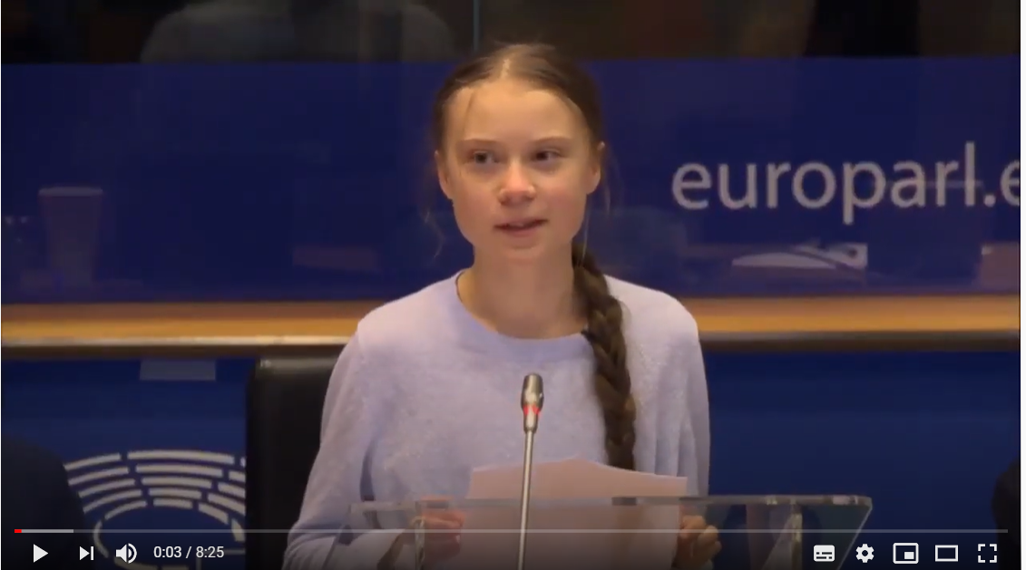
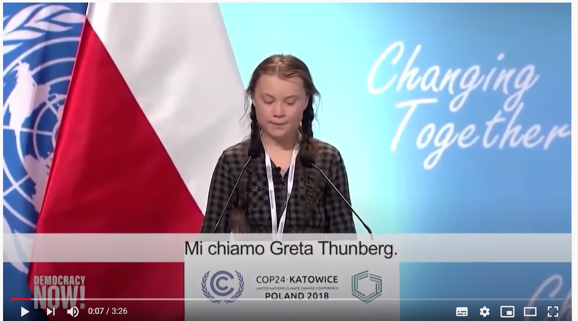
Reading strategies : Skimming and scanning
Presenting videos and texts : watching and reading for skimming / scanning
LESSON 2, PART 1
Study phase
(ESA methodology)
The Goals of the 2030 Agenda for Sustainable Development and the Climate Change
Shows the Ss two videos on the Goals of the 2030 Agenda for Sustainable Development and the climate change.
1° VIDEO: the speech hold by 15-year-old climate activist Greta Thunberg At The U.N. Climate Action Summit.
2° VIDEO: the speech hold by Greta Thunberg at COP24 in Katowice, Poland.
https://www.youtube.com/watch?v=WVAIkovOtKg
https://www.youtube.com/watch?v=oDZWpmYj38U

Slide 18
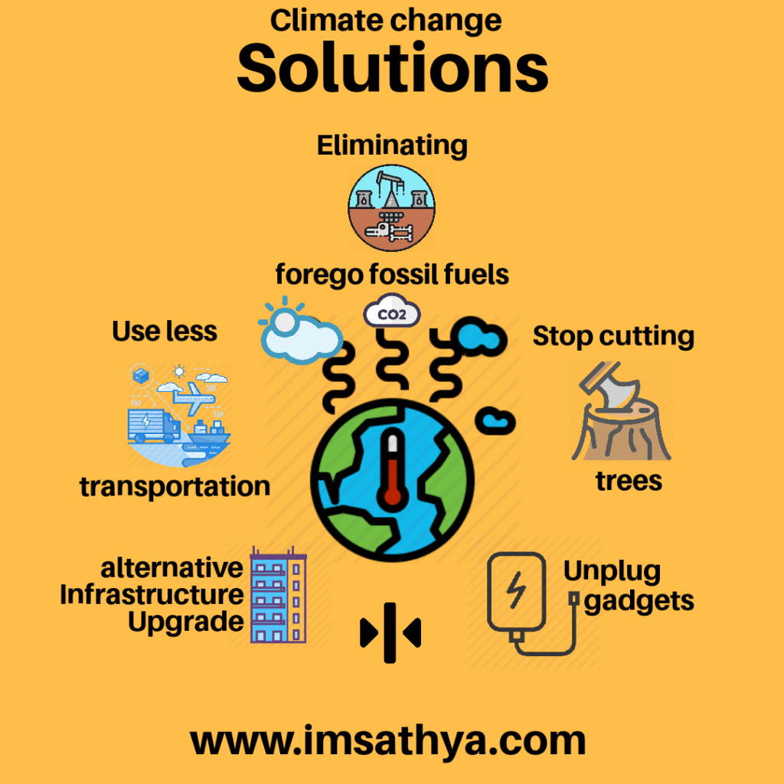
LESSON 2, PART 2
1° phase : videos viewing - Students are already provided the text :
they are going to watch the 2 videos to get the gist, the general idea. (Skimming phase).
2° phase : Analyzing the videos – The T. helps the Ss to analyze in order to find
specific facts about climate change and Sustainable Development (Skimming phase).
3° phase : Interdisciplinary Teaching. Socials Studies – T. reconnects to the previous lessons in Social Studies on Climate and landscape and explains the climate change and environmental degradation.
Activate phase
(ESA methodology)
T. ask Ss to discuss the following questions in pairs: - What is Sustainable Development? What is it about? -Define climate change. How do humans contribute to climate change? - How do you contribute to climate change?
4° phase : Class debate – T. promotes class debate on what is Sustainable Development and what are the implications of climate change regarding the social, cultural, political, and economic complexities involved in working toward viable solutions

Slide 19
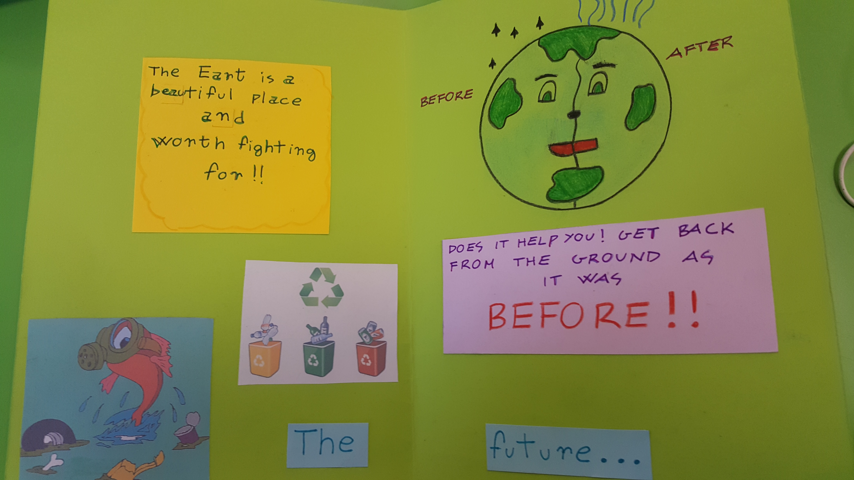
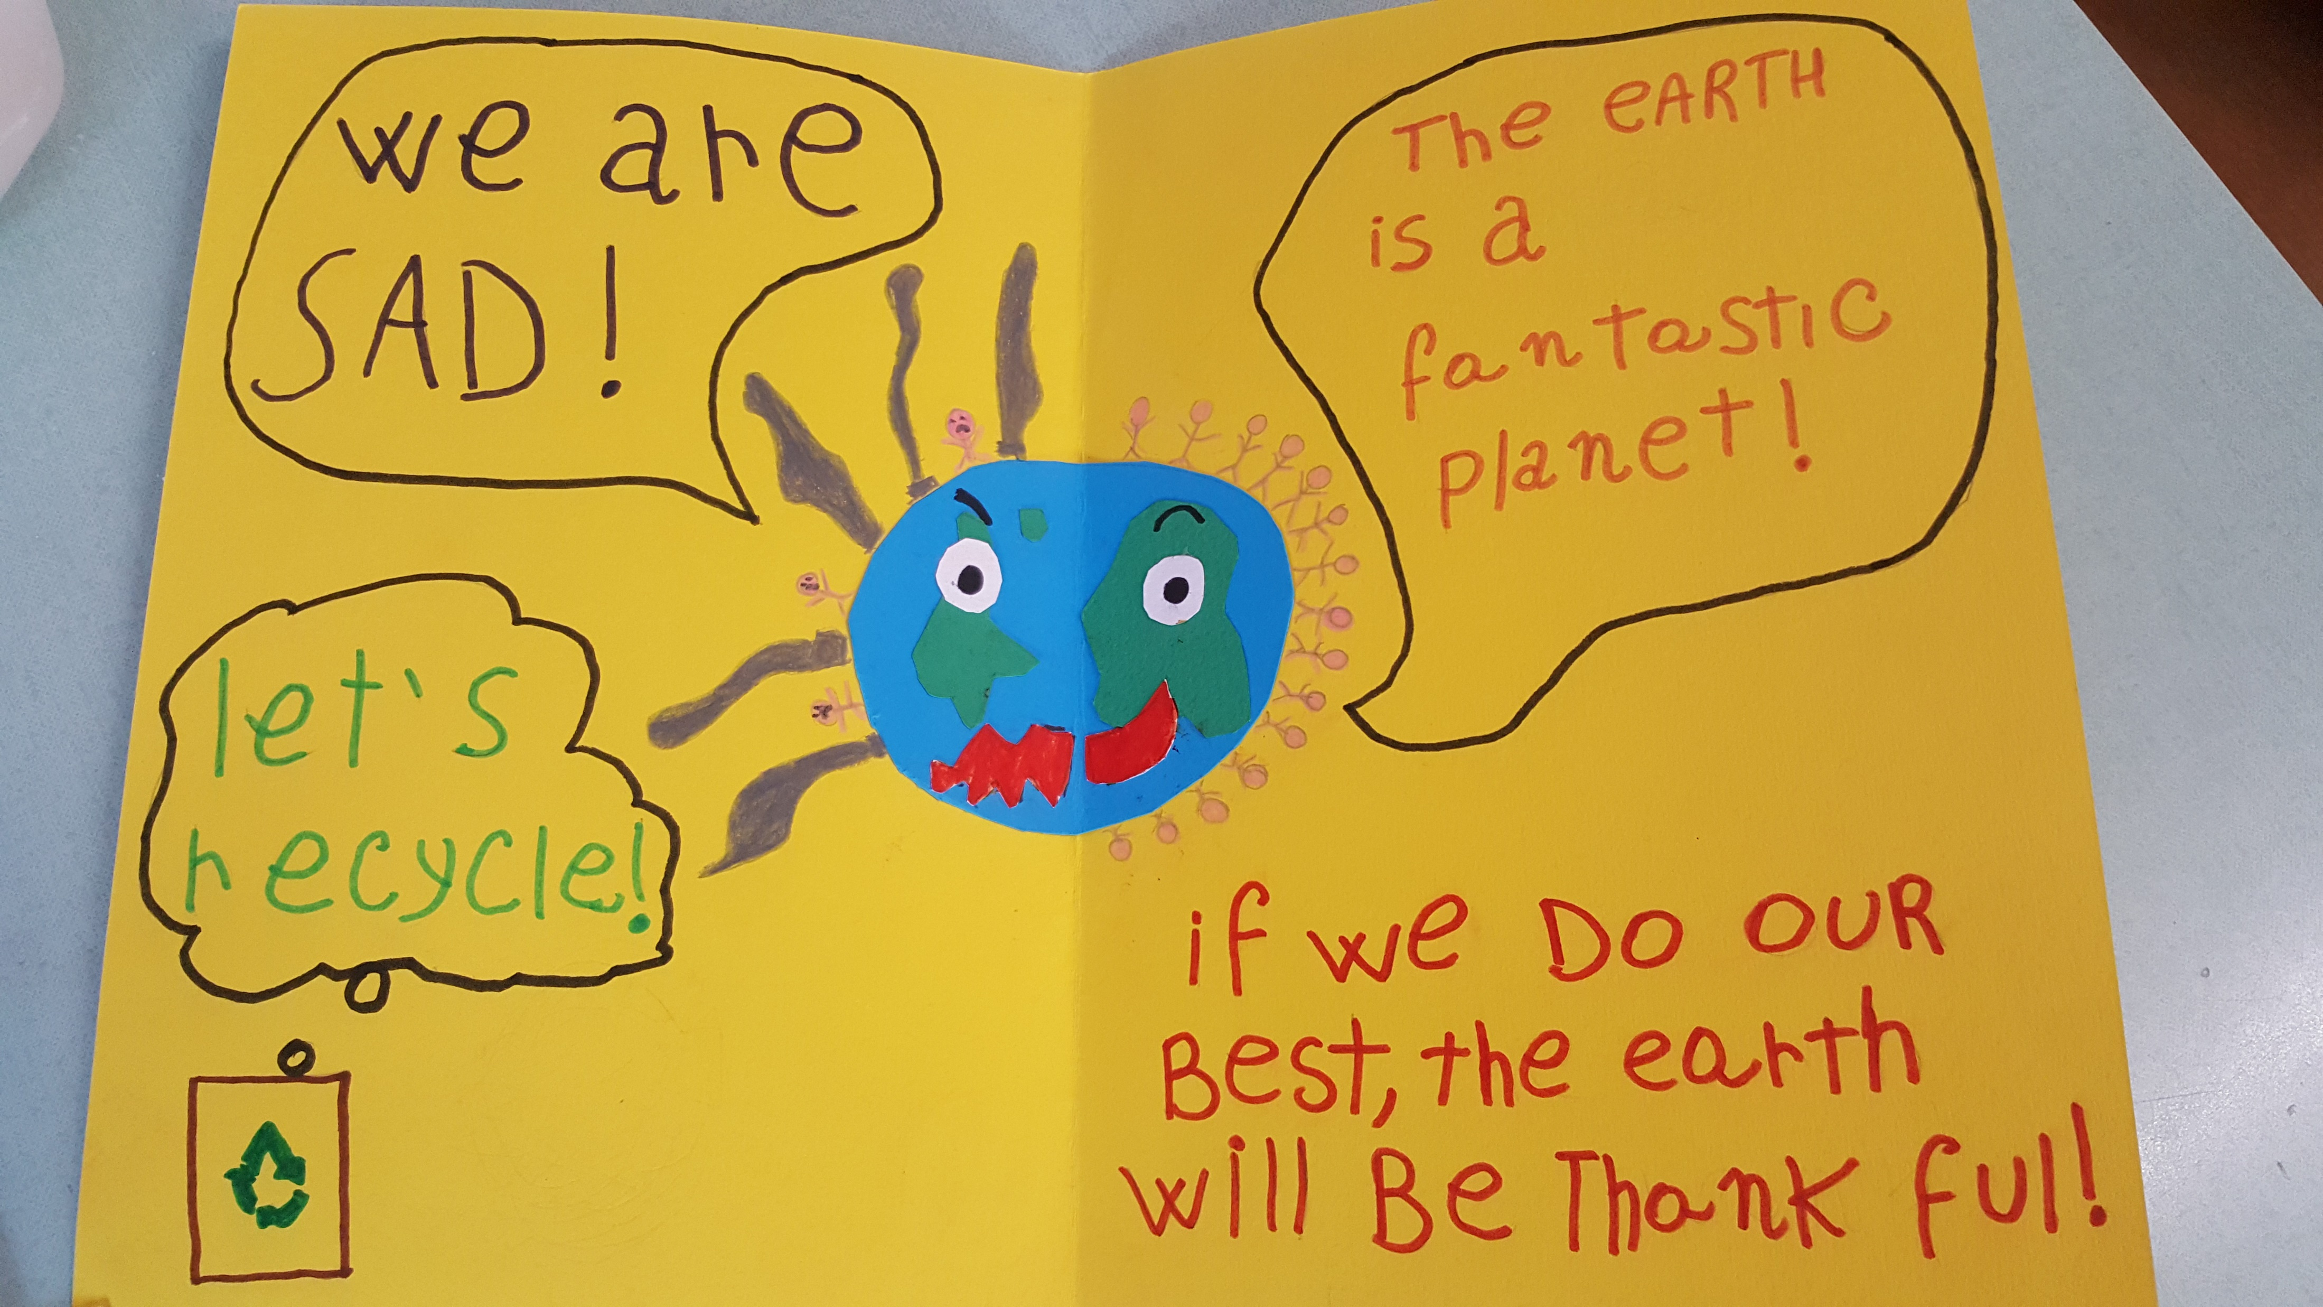
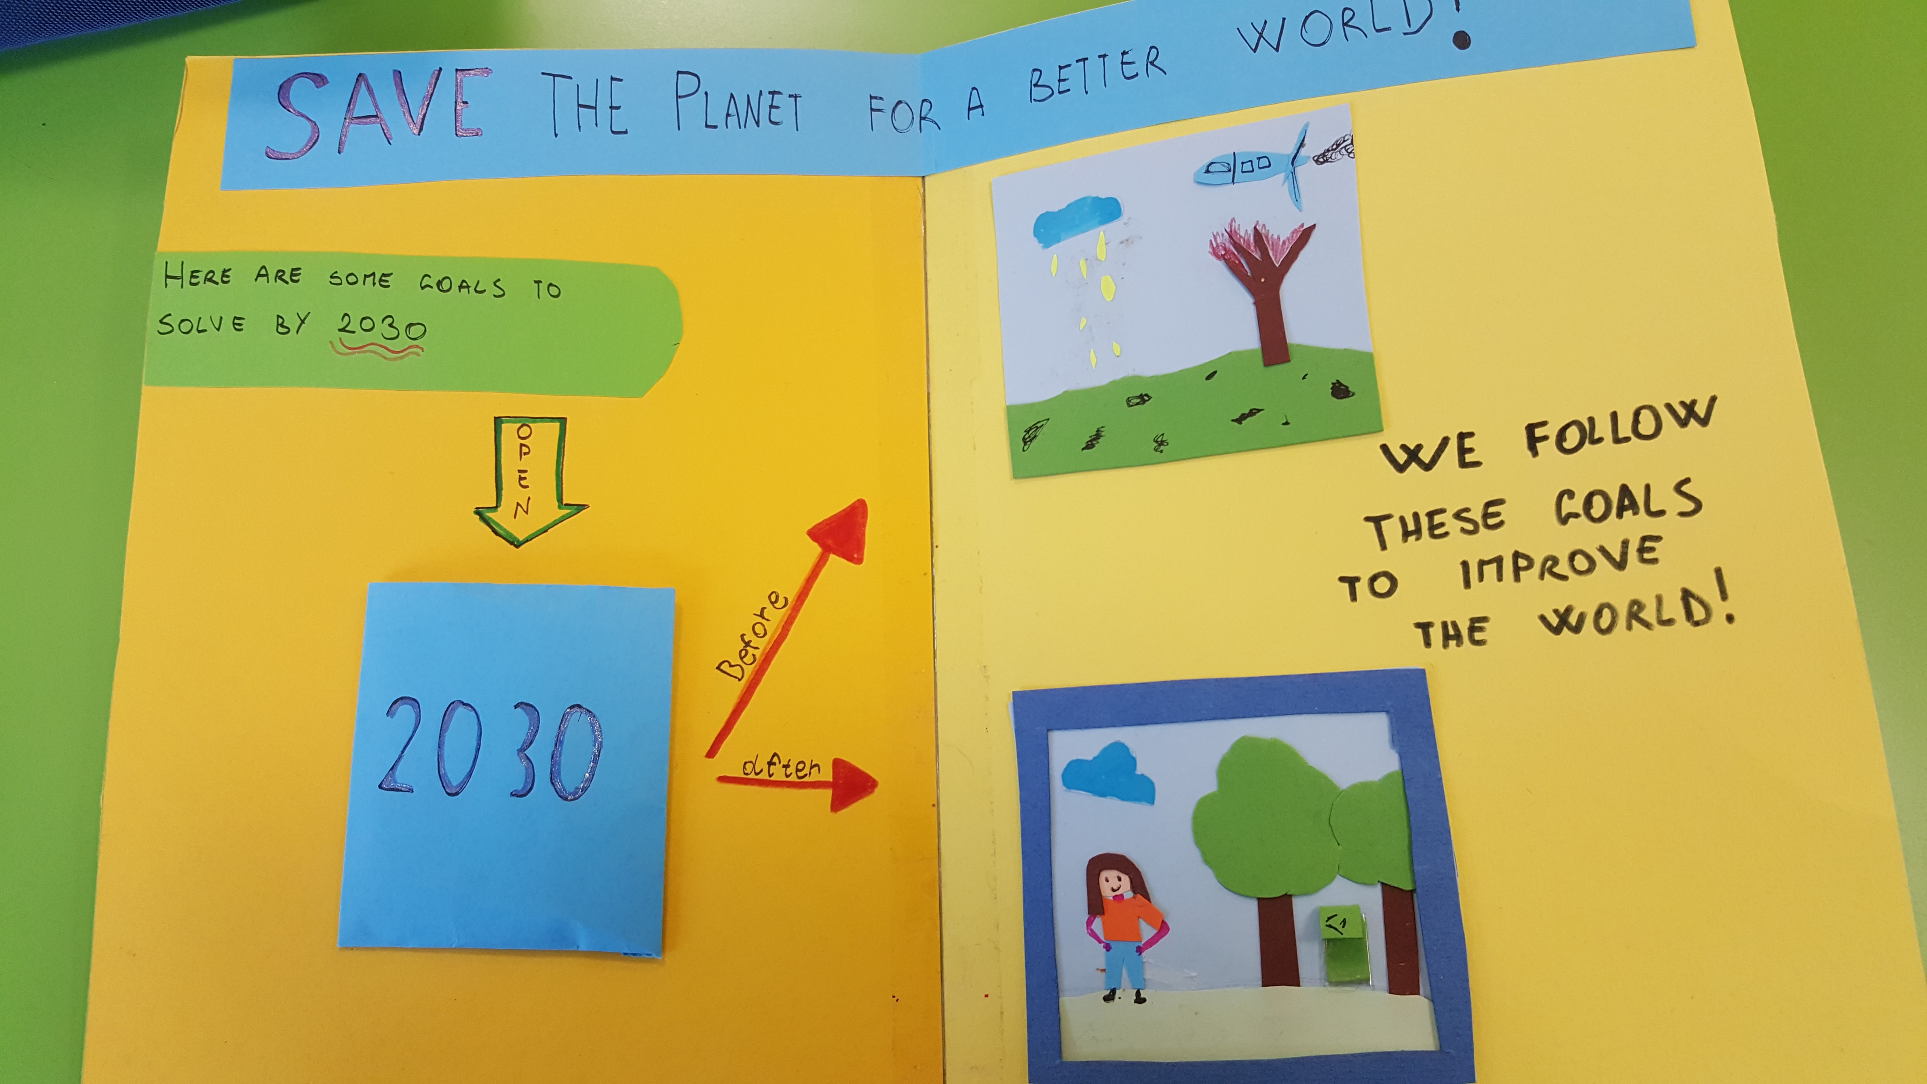
Activate phase
(ESA methodology)
- Homework -
ACTIVATE PHASE. To put the teaching material into a REALISTIC CONTEXT
Students are asked to :
do online research in order to find other ways to fight against climate change.
create flash-cards / lap books / posters illustrating :
- the impacts of climate change
-how we can take actions to reduce the impacts of climate change

Slide 20
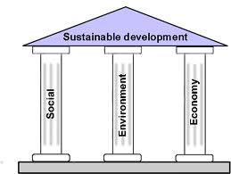
Follow up Activity
Extend the discussion – T. ask students to make a list of things that will be different in 20 years from now due to climate change. Possible topics could be:
- Transport and travel
- Single-use plastics and recycling
- Innovations to tackle climate change
- Migration
- Food
- Agriculture and industry
Conclusion:
it is imperative to to lay the groundwork togethere for a

Slide 21
THANK YOU GUYS,
FOR YOUR ATTENTION AND YOUR COLLABORATION IN THE FIGHT
AGAINST CLIMATE CHANGE

